Slide 1
Steering meeting: 6
2018-12-17

Slide 2
Outline
Project status
Last week's accomplishments
What we planned to do...
What we actually did...
Time report
This week's plan
Identified issues
Questions

Slide 3
Project status
We are on time, we lack updates from Zaid and Matko though.
Not connected Backend with Table

Slide 4
Last week's accomplishments What we planned on doing:
Work on the Design document feedback.
Prepare class presentation.
Started with design and improve it as we go
GIT-lecture
Frontend:
Implement NavBar functionality.
Create the rest of the tables.
Make a component that talks to server and callback all tabs (observer)
Improve timelines
Backend:
Connect with Frontend (tables)
Send data to database

Slide 5
What we actually did...
Design document
Responsible person has been sick. However, it is not a high priority at the moment.

Slide 6
What we actually did...
Class presentation
Class presentation has been done.

Slide 7
What we actually did...
Design
Discussion have been made. No major decisions have been made.

Slide 8
What we actually did...
GIT-lecture
Had a meeting were we tried to get everybody up to date with GIT. Wrote an PDF with some useful commands and hints to facilitate the start.

Slide 9
What we actually did ...
NAVBAR
Connect to other pages with Router
Works now

Slide 10
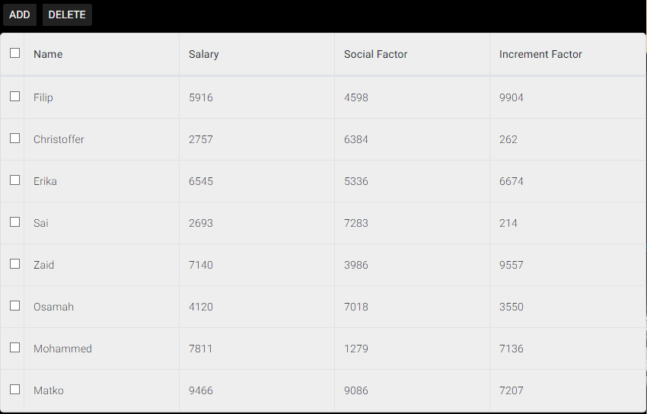
What we actually did...
Frontend: Created the rest of the tables.
- People
- Projects
- Spending
- Remaining
- End Balance

Slide 11
What we actually did...
Frontend: Make a component that talks to server and callback all tabs (observer)

Slide 12
What we actually did...
Frontend: Improve timelines
Refactored the code
Implemented visual warnings if an allocation exceeds a projects end date
Set up events for different interactions with the allocations Lot of time spent on problems (the timeline component is a react abstraction that uses the original component internally, which causes some obstacles).

Slide 13
What we actually did...
Backend: Connect with Frontend (tables)
Not done yet. High priority for next week.

Slide 14
What we actually did...
Backend: Send data to database, and created (Delete, update, insert) operations for database objects.

Slide 15
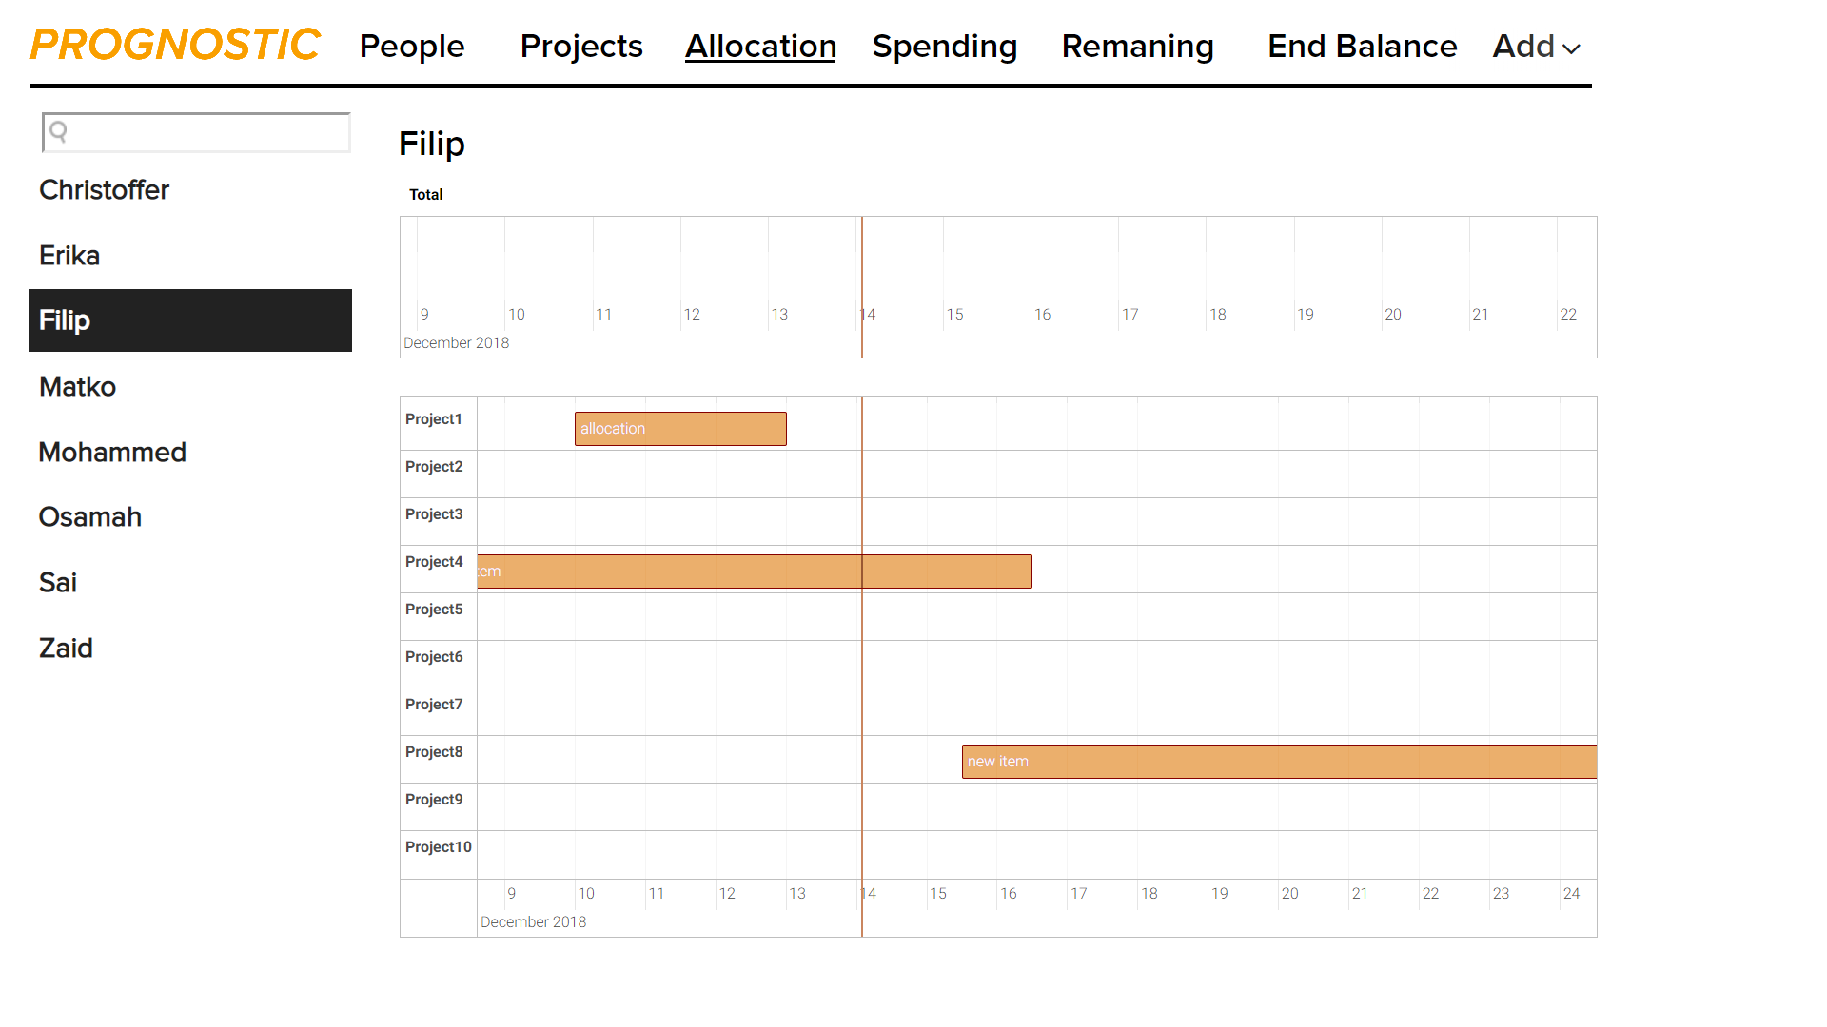

Slide 16
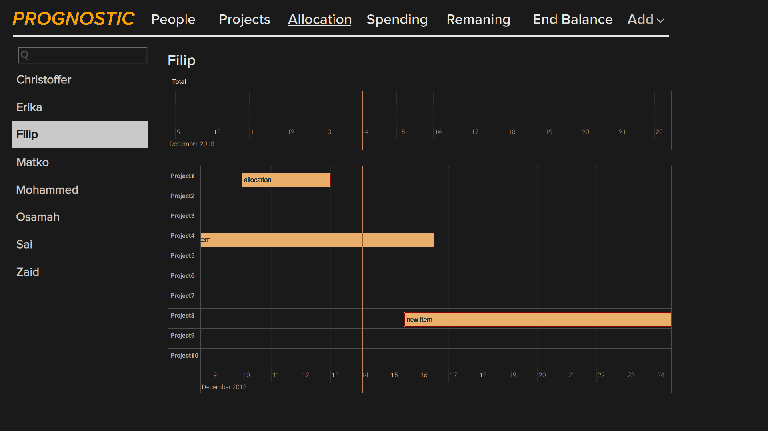

Slide 17
This week's plan
Work on the Design document feedback.​
Structure work for Christmas
Frontend:​
Structure with CSS
Global Save-button
Improve timeline
Fill tables.
Backend:
Connection with frontEnd

Slide 18
Identified issues
Communication is still an issue
Some has done no implementation
Time report, make comments

Slide 19
Name | Hours | TOTAL | What has been done
Filip | 6.5 | 36.5 | Creating the rest of the tables + experimented with their design options. Presentation slides. Design suggestion.
Matko | 2 | 32 | Working on design document. Sick.
Osamah | 10 | 42 | Presentation + run react project + try connect database to react
Zaid |  | 29 | In bed sick
Christoffer | 14 | 62.5 | Refactored code, worked on the timeline, wrote a short pdf about GIT.
Mohammed | 17 | 50.5 | Prepared for presentation, finished the primary query's files, looking for ideas to connect backend to frontend.
Sai | 8 | 40 | Presentation, working with Osamah on fetch and trying to connect database to react
Erika | 10.5 | 56 | Fixed navbar functionality, administrative stuff, learning CSS combined with React and mostly been in bed being sick.
GROUP | 7 | 27 | Meetings, attending design presentation

Slide 20
Questions

