Slide 1
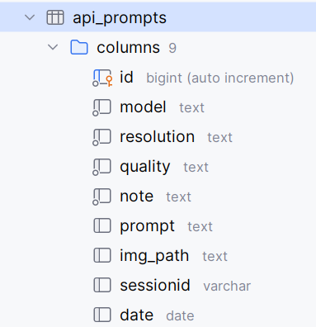
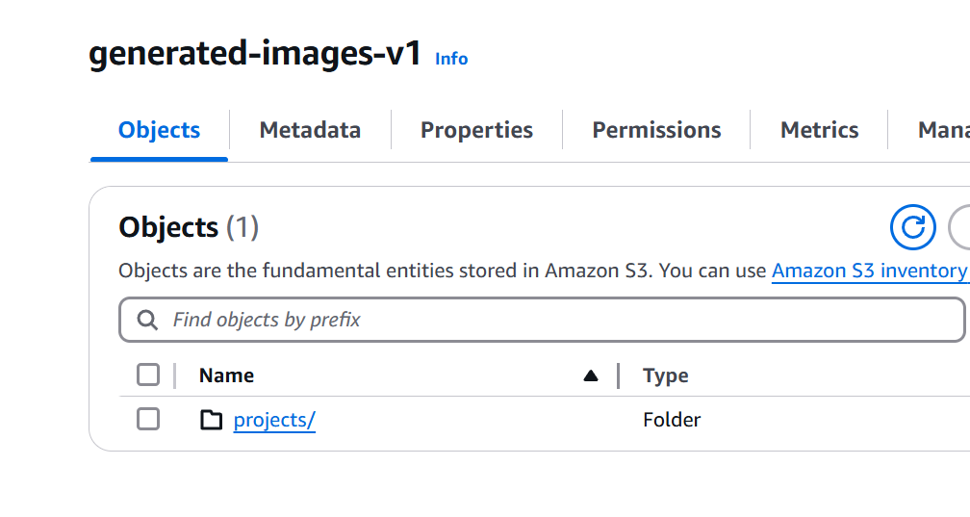
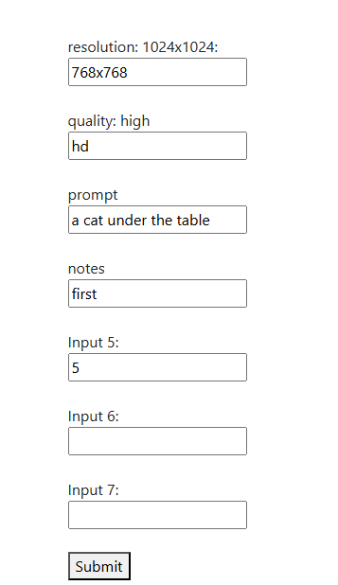
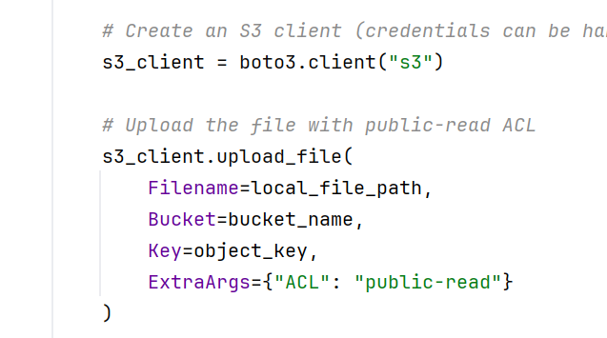
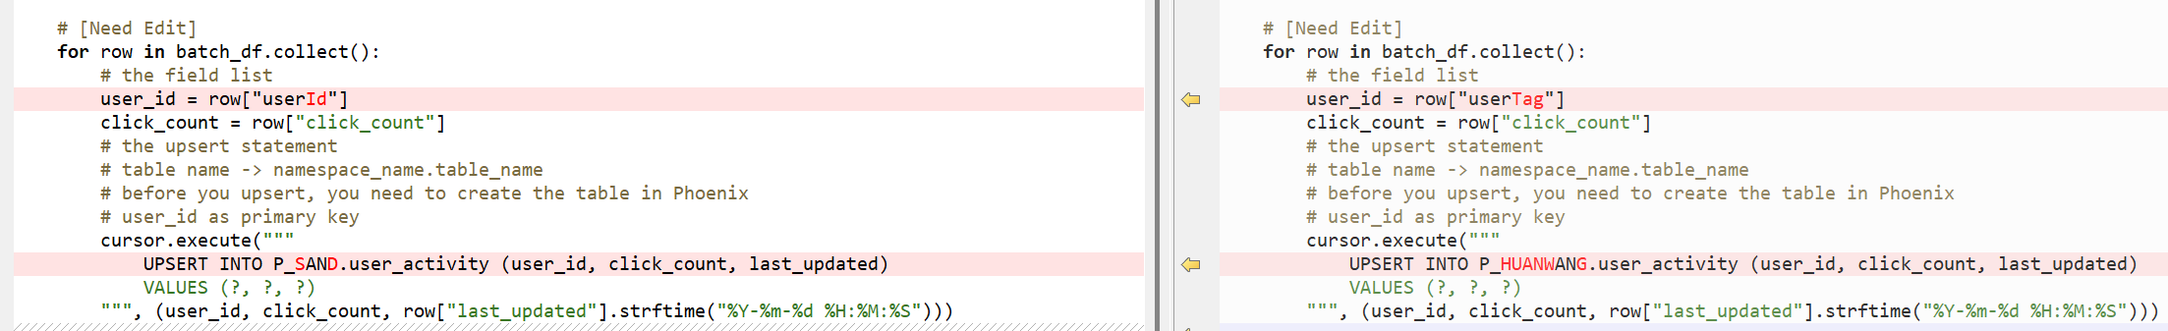
1
4
2
3
5
S1
5

Slide 2
Input the prompt and parameters in webpage, these go to a Db table ‘api_prompts’
Service ‘S1’ filter the table records and parallelly generate images. Because at least 40 seconds will be used for one image and you want to test many prompt by yourself, I think better make it paralle.
S1 upload image to AWS S3 bucket.
S1 update the Db table ‘api_prompts’.
In another webpage, you select two images. The difference of the two prompts will be highlighted.

