Slide 1
1.1 Introduction
1. What is a distributed system?
  A distributed computing system consists of multiple autonomous computers (or processors) that do not share primary memory, but cooperate by sending message over a communication network.
A distributed system is a collection of independent computers that appears to its users as a single coherent system. (P2)

Slide 2
Transparency in a Distributed System
P5
Transparency
Description
Access
Hide differences in data representation and how a resource is accessed
Location
Hide where a resource is located
Migration
Hide that a resource may move to another location
Relocation
Hide that a resource may be moved to another location while in use
Replication
Hide that a resource may be replicated
Concurrency
Hide that a resource may be shared by several competitive users
Failure
Hide the failure and recovery of a resource
Persistence
Hide whether a (software) resource is in memory or on disk
Different forms of transparency in a distributed system.

Slide 3
Comparison between Systems
P41
Item
Distributed OS
Network OS
Middleware-based OS
Multiproc.
Multicomp.
Degree of transparency
Very High
High
Low
High
Same OS on all nodes
Yes
Yes
No
No
Number of copies of OS
1
N
N
N
Basis for communication
Shared memory
Messages
Files
Model specific
Resource management
Global, central
Global, distributed
Per node
Per node
Scalability
No
Moderately
Yes
Varies
Openness
Closed
Closed
Open
Open
A comparison between multiprocessor operating systems, multicomputer operating systems, network operating systems, and middleware based distributed systems.

Slide 4
2.3 Ring
1. Single ring IBM token ring
Access mechanism
There is one token passing around the ring. A node can send a message along the ring only when it holds the token.
Routing algorithm:
  When receiving a message:
Pass to next node, if it is to other
Copy & pass to next if it is to me
Check & discard if I sent

Slide 5
Performance:
D=n-1 APL=n/2
Parallelism: not good
Degree: 2
Scalability: good
Load balance: ok
Routing algorithm: simple
Robustness: bad
2. Double ring

Slide 6
2.4 Tree Structure
1. Complete binary tree
Addressing:
Definition: If a tree has N nodes & the biggest address is N, the tree is a complete binary tree
Not complete tree
1
2
3
i
4
5
2i
2i+1
8
9

Slide 7
2. Performance
Diameter depth = [log₂n] = k
  2k –1, if 2^{k}<n<2+2^{k-1} ;
  D =
  2k, if 2^{k} +2^{k-1} <n<2^{k+1}
Parallel: good
Degree: 1,2,3
Scalability: ok
Load balance: ok
Robustness: low

Slide 8
Routing algorithm:
When node R has a message with destination D, the message is transmitted according to following rules:
1) If D=R then the message is received
2) If D∈leftsubtree(R), it is sent to 2R
3) If D∈rightsubtree(R), it is sent to 2R+1
4) Otherwise send to [R/2]

Slide 9
2.6 Hypercube
000
001
2³
Number of nodes: N = 2^{k}
1. Performance
  D = k = log₂N
  Parallelism: good
010
011
100
101
110
111

Slide 10
Degree = k
Scalability: bad
Load balance: good
Robustness: very good, many paths
Routing algorithm: simple
Features
Node address: k bits
Addressing: only one bit differs
Many paths between any two nodes
Shortest path>1
Path length = number of different bits

Slide 11
0000
0001
1000
1001
0010
0011
1010
1011
0101
1101
0100
1100
0110
0111
1110
1111
2⁴

Slide 12
2. Routing algorithm
When node R has a message with destination D, R passes message to the neighbors whose ith bit = ith bit of D, i is the positions of any 1 in R⊕D
  Question:
  How many shortest paths are there between any two nodes?
k! k = number of 1_{s} in R⊕D

Slide 13
2. Fault tolerance
  Solution for node failure and link broken.
Hardware: add extra link
Software: routing algorithm gives multiple (alternative) paths

Slide 14
1. Addressing
Indicate sending and receiving processes
1) <IP address, port no.>
  ex, <202.119.32.6, 80>
2) Unique name
  ex, www.nju.edu.cn; procedure name( )
P
S
T
Q

Slide 15
2. Methods
1) Synchronous/asynchronous
Comparison
Defects merits
Synchronous wait, no broadcast safe, simple
Asynchronous buffer full,not safe parallelism, broadcast

Slide 16
2) Transient/persistent
Persistent communication:
A message is stored by communication system as long as it takes to deliver it. Neither the sender nor the receiver need to be up.
Ex, email
Transient communication:
No storage facilities are offered, so that the receiver must be prepared to accept the message.
Ex, send, recv in Socket

Slide 17
3) Stream-oriented communication
Two successive messages have a temporal relationship.
Ex, movie, audio stream

Slide 18
2. How does RPC work?
return
node 1 node 2
process Procedure Q(u,buf,v)
{ … { …
Q(i,buf,j) …
… }
}
proc Q
i
i
buf
j
result
?
i
buf
result
buf
j
j
Q
return addr
return addr.
sp
sp
stack
stack

Slide 19
Steps of a Remote Procedure Call
P72
Client procedure calls client stub in normal way
Client stub builds message, calls local OS
Client's OS sends message to remote OS
Remote OS gives message to server stub
Server stub unpacks parameters, calls server
Server does work, returns result to the stub
Server stub packs it in message, calls local OS
Server's OS sends message to client's OS
Client's OS gives message to client stub
Stub unpacks result, returns to client

Slide 20
2) Deal with call by reference
  proc write(in char name, in int buf[], in int len);
  proc read(in char name, out int buf[], in int len);
  Input parameter → deliver the array
  Output parameter → needn’t
RPC:
Addressing: name
Method: synchronous, transient

Slide 21
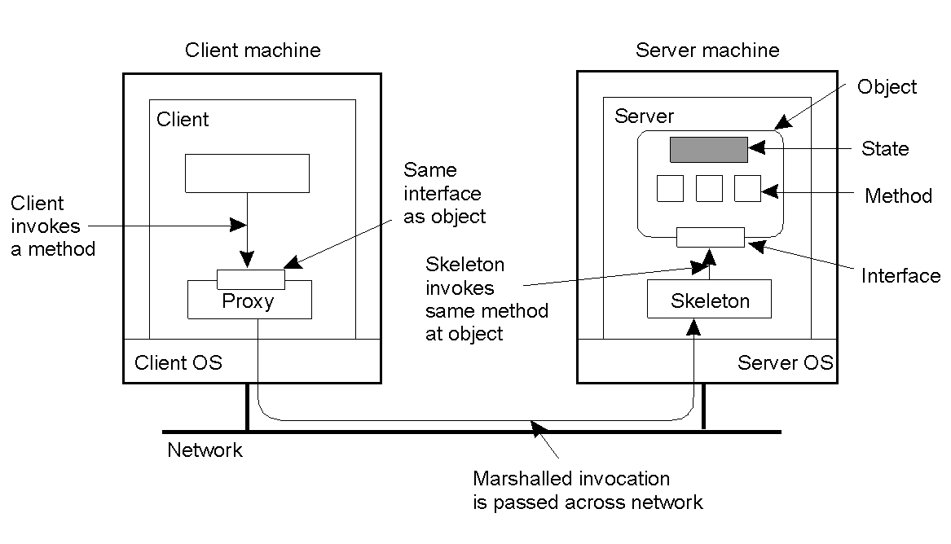
3.3 RMI (or Remote Object Invocation)
P86
Common organization of a remote object with client-side proxy.

Slide 22
1. Distributed object
Compare to RPC:
Same:
  the steps of call is similar
  separating interface from implementation
Difference
  procedure is a segment of program.
  object is a variable of a data type. System provides system-wide object references

Slide 23
remote
2. Object references
Object references are similar to pointer, but not the same. It can be passed between processes on different machines. It can be used as parameters to method invocation
object
object reference

Slide 24
4. Parameter Passing
small
O1
O2
client
m(O1,O2)
reference to local object
O1
reference to remote object
server
m(o,o)
{… … }

Slide 25
When invoking a method with an object reference
as parameter:
that reference is copied and passed as a value parameter only when it refers to a remote object
the referenced object is copied as a whole and passed along with the invocation when the reference refers to a local object
RMI:
Addressing: name
Method: synchronous, transient

Slide 26
3.4 Message-oriented communication
P99
1. About RPC and RMI
advantages: hide communication; message-oriented
disadvantage: synchronous; receiver need to be up
A B email
2. Need for various communication forms
Synchronous/asynchronous
Transient/persistent
100

Slide 27
Persistent communication
A message is stored by communication system as long as it takes to deliver it. Neither the sender nor the receiver need to be up.
Transient communication
A message is stored by communication system long as long as the sending and receiving applications are executing
Various combinations: P103

Slide 28
(a) Persistent asynchronous communication(email)
(b) Persistent synchronous communication
100
(c) Transient asynchronous communication(A B)
(d) Receipt-based transient synchronous communication
(e) Delivery-based transient synchronous communication at message delivery(regular synchronous)
(f) Response-based transient synchronous communication (RPC)

Slide 29
1) Recall socket P105
addressing: IP address, port
forms: synchronous/asynchronous, transient
shortage: low-level, byte-oriented/TCP-IP
2) MPI
designed for parallel applications; offer efficient communication primitives; for high-speed nets.
Addressing
(groupID, processID)
Forms
support most transient communication forms

Slide 30
4. Message-oriented persistent communication
P109
1) Message-queuing model
Addressing: name of destination queue
Method: persistent, asynchronous
2) Basic idea
Application inserts messages in specific queue
the messages are forwarded over a series of communication servers
eventually the messages are delivered to destination

Slide 31
3.5 Stream-oriented communication
P119
1. Requirements
Real life: audio stream (simple stream)
movie (complex stream)
feature: time-dependent information.
temporal relationship between different
data items are fundamental.
Stream media

Slide 32
Requirement for transmission:
  timing for continuous data stream
  synchronization for complex stream
  Ex,
  Samples in audio stream are played at intervals of 1/44100 sec.
  Video and audio sub-streams need synchronize.

Slide 33
2. Streams and QOS
P123
How express time-dependent requirements? QOS
QOS requirements contain:
bandwidth volume
delay timeliness
jitter
transmission rates
Partridge approach: use flow specification

Slide 34
Specifying QoS
P124
Characteristics of the Input
Service Required
maximum data unit size (bytes)
Token bucket rate (bytes/sec)
Token bucket size (bytes)
Maximum transmission rate (bytes/sec)
Loss sensitivity (bytes)
Loss interval (μsec)
Burst loss sensitivity (data units)
Minimum delay noticed (μsec)
Maximum delay variation (μsec)
Quality of guarantee
A flow specification --->
Audio stream : high/medium/low quality

Slide 35
RSVP
Receiver-initiated QOS protocol.
store
flow specification
flow specification
request
with parameter
S
request
with parameter
D

Slide 36
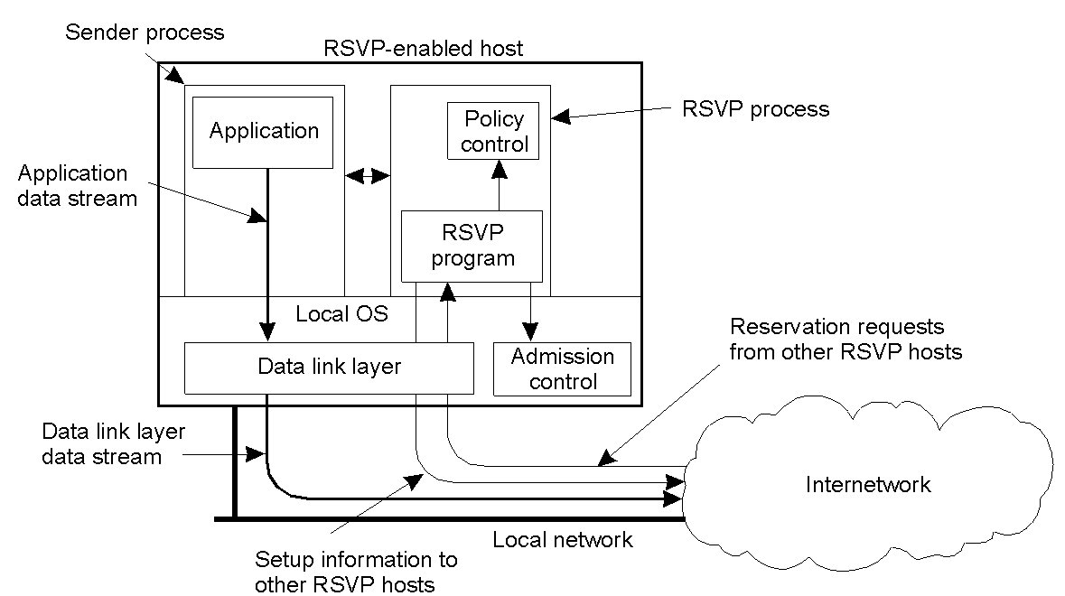
Setting Up a Stream
P126
The basic organization of RSVP for resource reservation in a distributed system.

Slide 37
Admission control module:
check whether enough resources are available
Police control module:
check whether the receiver has permission to make the reservation. Differentiated services may pay different money

Slide 38
Admission control module:
check whether enough resources are available
Police control module:
check whether the receiver has permission to make the reservation. Differentiated services may pay different money

Slide 39
4. Stream Synchronization
Meaning
Maintain temporal relation between streams which may be continuous or discrete data stream.
Essence
Synchronize at the level of data units.
What is a data unit?
a single audio stream a series of samples
a video stream a series of frames

Slide 40
Data unit
Ex1, synchronization for stereo audio stream takes place every 1/44100 sec
a data unit = a sample
Ex2, what about synchronization between an audio stream and a video stream?
video frame 30Hz
audio sample 44100Hz
sample/frame 44100/30=1470
an audio data unit = 1470 samples
1/30 sec

Slide 41
Synchronization mechanism
A process executes read (write) operations on several simple streams, ensuring timing and synchronization.
Ex, alternating between reading an image and reading a block of audio samples every 33ms
video stream
audio stream
sender
receiver

Slide 42
Does sender send two separate streams or a complex stream?
A complex stream.
Where synchronization should take place, sending or receiving side?
Sender: multiplex different streams into a single stream containing all data units, including those for synchronization(timestamp)
Receiver: demultiplexes the stream, using the timestamps of each packet

Slide 43
4.1 Introduction
1. Introduction
1) Concepts
Sequential programming: statements are executed statement by statement
Parallel programming: one statement is executed by many processors (SIMD)
Concurrent programming: a program is composed of several processes and time-shared executed

Slide 44
Distributed programming: a distributed program consists of a number of sequential processes which resides and execute at communication.
2) Language
Two kinds of distributed programming language:
Extend existing sequential language by adding new functions for communication, parallelism (distribution) and non-determinacy
Design new distributed programming language
3) Two ways to get a parallel and distributed program:

Slide 45
Use distributed programming language to write a parallel and distributed program
Existing sequential program
  parallel and distributed program
2. Example
Solve simultaneous algebraic equations AX=B by relaxation, write AX - B = 0
Parallel compiler

Slide 46
3. Distributed system and distributed computing
There is no master in distributed system.
There may be a coordinator in distributed computing, the coordinator can be put at any node in the system
CSP
(Communicating Sequential Processes)
CSP is a theoretical model which was very influential

Slide 47
4.2 CSP
(Communicating Sequential Processes)
CSP is a theoretical model which was very influential
1. Parallelism
1) Process
name :: variables;
commands;
2) Parallel command
[ process || process || … … || process ]
Example
[ Phil(i:0..4) :: PHI || table :: TAB ]

Slide 48
2. Process communication
1) Input command <process name>?<variable>
2) Output command <process name>!<expression>
Input and output commands are synchronous
Example:
P:: Q::
… ...
Q ! 16 P ? t

Slide 49
3. Non determinacy
1) Alternative command
[ B1 S1 B2 S2 … … Bi Si ]
2) Repetitive command
*[ B1 S1 B2 S2 … … Bi Si ]
<alternative command>::= [<guarded command>{ <guarded command>}]
<repetitive command>::= *[<guarded command> <guarded command>}]
<guarded command>::=<guard> <command list> <guard>::=<Boolean exp.>;{<Boolean exp.>; …<input command>}

Slide 50
Example 1:
[x>=y m:=x y>=x m:=y];
Example 2:
i:=0;
*[ i<n ; prime(i) print(i); i=i+1
i<n ; not prime(i) i=i+1 ];
; = and

Slide 51
An alternative command fails when all guards fail, otherwise an arbitrary one with successfully executable guard is selected and executed.
A repetitive command specifies as many iterations as possible of its constituent alternative command.
It terminates when all guards fail.

Slide 52
4.3 MPI
4.3.1 Introduction
1. Two kinds of applications for distributed systems
Resource sharing (distributed application)
Parallel computation
2. Two kinds of tools
CORBA
MPI
3. What is MPI?

Slide 53
MPI is acronym for Message Passing Interface. It is a message passing library specification.
MPI specification
MPI program in C
#include “mpi.h”
C statement;
… …
MPI_Init(…);
… …
C statement;
MPI_Send(……)
… …
MPI_Send(……);
MPI_Recv(……);
… …
… …
125 functions;
6 basic functions

Slide 54
5.1 Threads in distributed systems
1. Thread: a process may have multiple threads of controlling sharing one address space, but running in quasi-parallel
addr.space
...
thread
process

Slide 55
Features:
share same address space
different threads in a process are not quite as independent as different processes
    Process is to machine
    Thread is to process
Threads
may share a processor(CPU);
may have own processor
Blocking system call won’t block the entire process

Slide 56
5.2 Code migration
P158
Applet, agent
Why migrate code?
performance: load balance
parallelism: send agents to search for information in the Web
flexibility: download applet

Slide 57
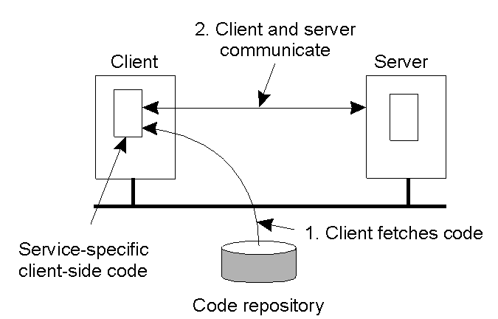
Reasons for Migrating Code
P160
The principle of dynamically configuring a client to communicate to a server. The client first fetches the necessary software, and then invokes the server.

Slide 58
What are difficulties?
different machine ? What form, when?
local resources ?
1. Models for code migration P160
framework: a process consists of
code segment
resource segment
execution segment
program
references to external resources:
file, printer, other processes, port
current execution state: private
data, stack, program counter

Slide 59
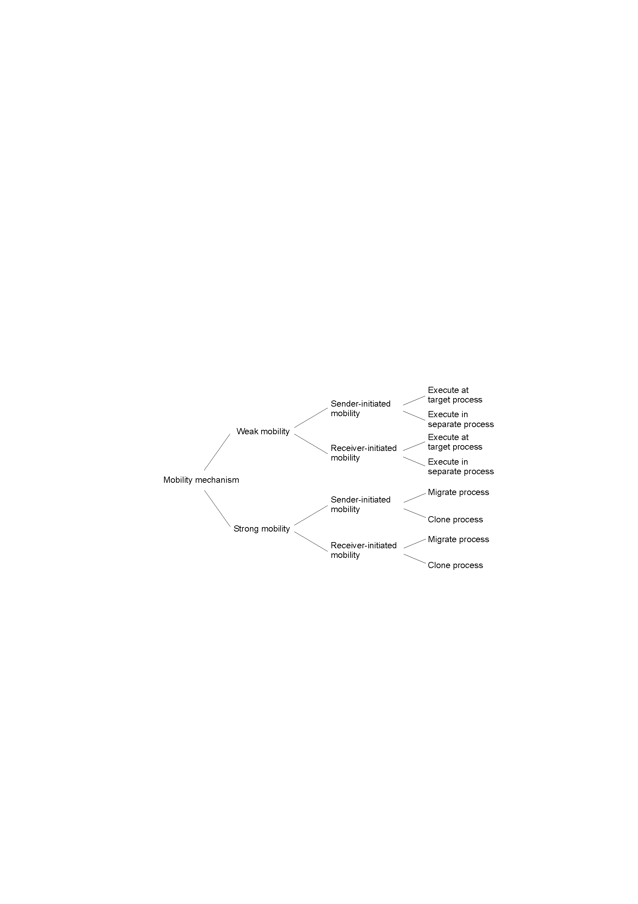
Models for Code Migration
P162
Alternatives for code migration.

Slide 60
For different applications
spawn only code
applet only code, receiver-initiated
agent or process load balance, I’m too busy
process load balance, I’m idle
2. Migration and local resources
Programs usually use various resources, such as
file, database, URL
printer, TCP ports, library, …

Slide 61
Three types of process-to-resources binding.
  Binding by identifier:
process refers a resource by its identifier. URL..
  Binding by value:
only need value. Dictionary, library...
  Binding by type:
only need a resource of a specific type. Printer,..
Three types of resources-to-machine binding.
Unattached, fastened, fixed

Slide 62
P164
How change the reference to these resources when migrating code?
Depend on whether the resource can be moved along with the code.
Establish a global reference (GR)
move the resource (MV)
copy the value of the resource (CP)
rebind process to locally available resource (RB)

Slide 63
What do we need for migration?
Runtime system for migration
Migration stack
  migration stack is its own copy of the program stack, but in a machine-independent way.
  It is updated when a subroutine is called, or return from a subroutine

Slide 64
marshal all global program-specific data forming part of execution segment
marshaled data are transferred to destination, along with the migration stack

Slide 65
Destination node performs
load the code segment
marshaled data are unmarshaled (global data)
a runtime stack is constructed by unmarshaling the migration stack
execution is resumed by entering the subroutine

Slide 66
3. Modifying compiler
generate code to update the migration stack
generate labels in the caller’s code, instead of return address (machine-independent)
need a runtime system
About implementation
use a preprocessor to insert the necessary code

Slide 67
1. Introduction
What is a software agent?
An agent is a process that acts autonomously on behalf of a person or organization.
A mobile agent is an agent that is not bound to the system where it begins execution. It has the unique ability to transport itself from one system in a network to another.
  From：General Magic Inc
  P173

Slide 68
Properties
Property
Common to all agents?
Description
Autonomous
Yes
Can act on its own
Reactive
Yes
Responds timely to changes in its environment
Proactive
Yes
Initiates actions that affects its environment
Communicative
Yes
Can exchange information with users and other agents
Continuous
No
Has a relatively long lifespan
Mobile
No
Can migrate from one site to another
Adaptive
No
Capable of learning
Some important properties by which different types of agents can be distinguished.

Slide 69
3. Agent Technology
P175
It is better to have a general-purpose platform to
support for developing agent system
An agent platform should provides:
create and delete agents
locate agents
inter-agent communication
move agent?

Slide 70
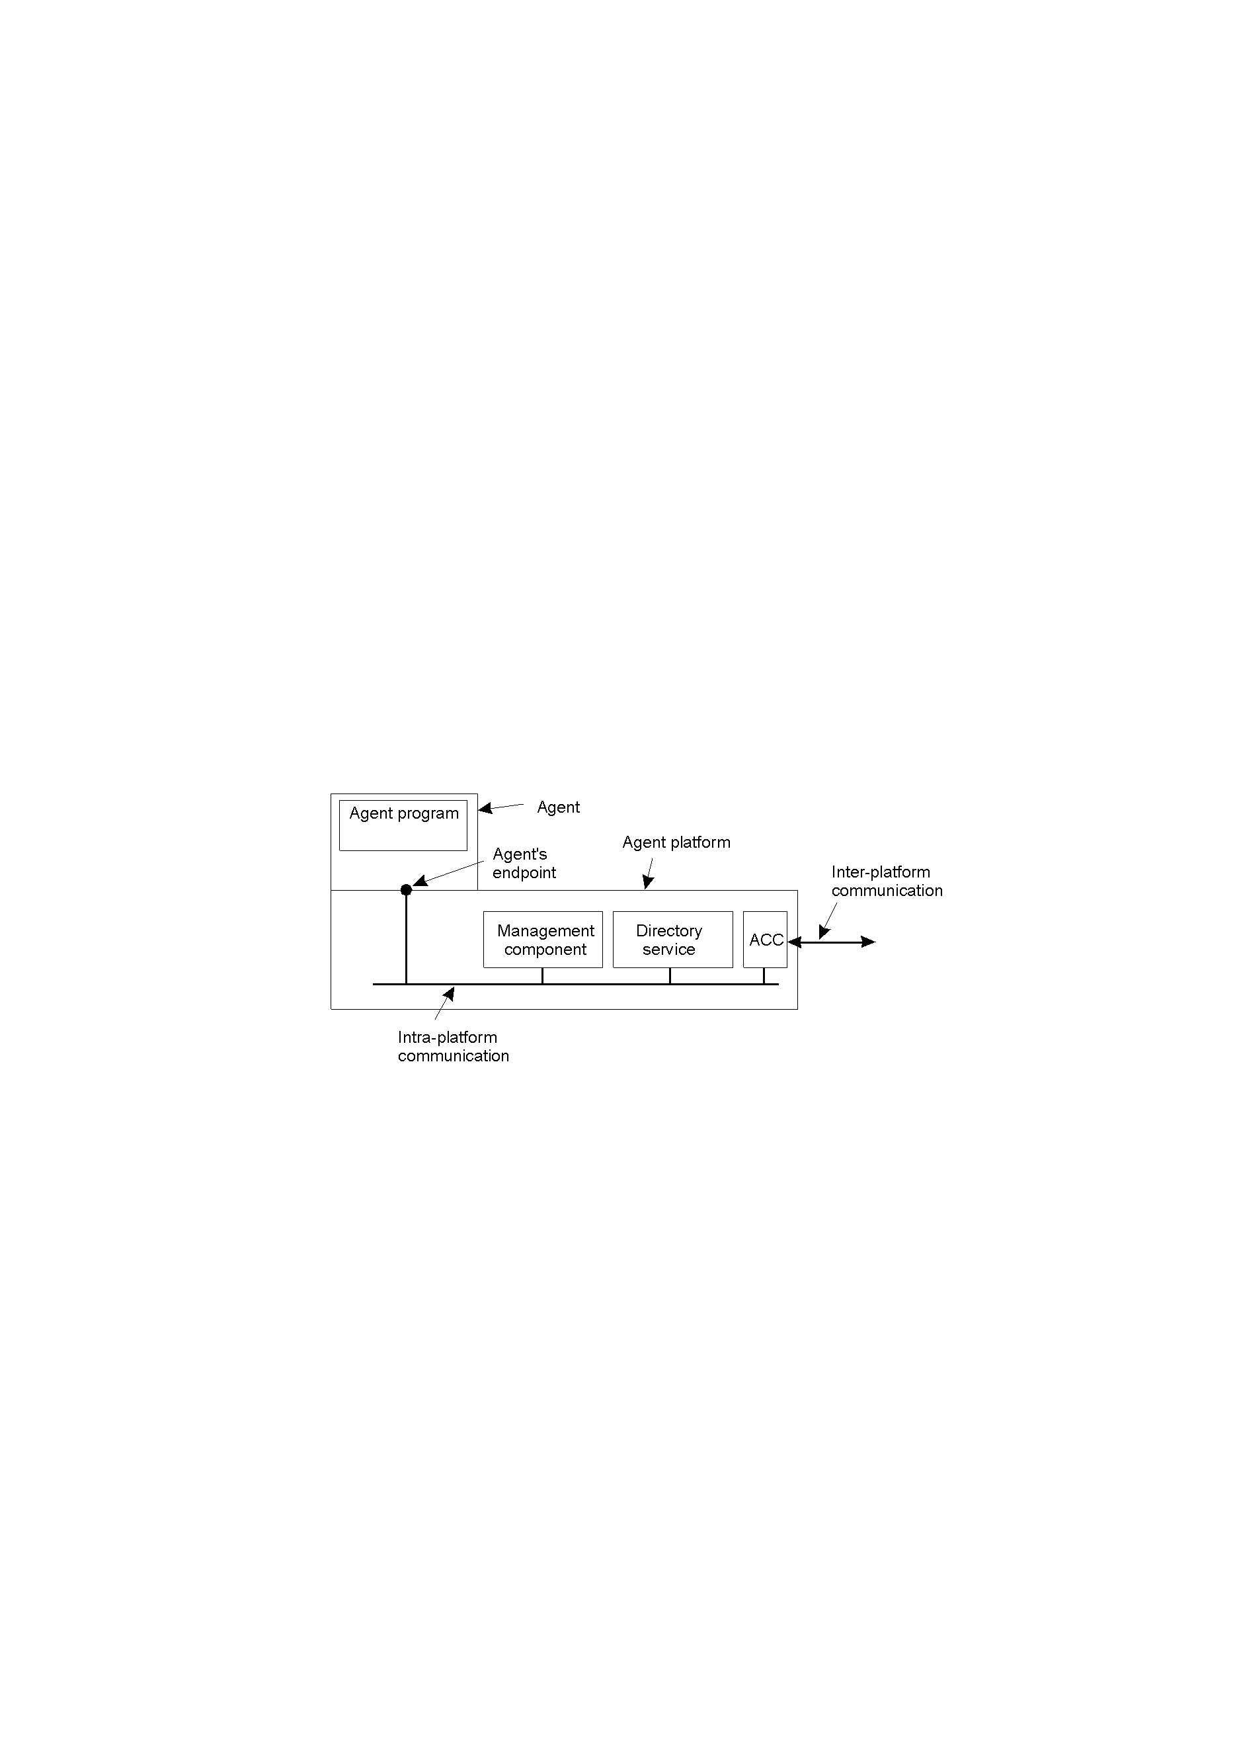
The general model of an agent platform (adapted from [fipa98-mgt]).

Slide 71
4. Agent Communication Languages
Message types
the kind of information that agents communicate
is quite different from what we discussed before.
Message form
Purpose etc. Content

Slide 72
Agent Communication Languages
Message purpose
Description
Message Content
INFORM
Inform that a given proposition is true
Proposition
QUERY-IF
Query whether a given proposition is true
Proposition
QUERY-REF
Query for a give object
Expression
CFP
Ask for a proposal
Proposal specifics
PROPOSE
Provide a proposal
Proposal
ACCEPT-PROPOSAL
Tell that a given proposal is accepted
Proposal ID
REJECT-PROPOSAL
Tell that a given proposal is rejected
Proposal ID
REQUEST
Request that an action be performed
Action specification
SUBSCRIBE
Subscribe to an information source
Reference to source
Examples of different message types in the FIPA ACL [fipa98-acl], giving the purpose of a message, along with the description of the actual message content.

Slide 73
ACL does not prescribe the format and language in which the message content is expressed. As long as the agents have a common understanding how to interpret the data.
Example

Slide 74
Field
Value
Purpose
INFORM
Sender
max@http://fanclub-beatrix.royalty-spotters.nl:7239
Receiver
elke@iiop://royalty-watcher.uk:5623
Language
Prolog
Ontology
genealogy
Content
female(beatrix),parent(beatrix,juliana,bernhard)
A simple example of a FIPA ACL message sent between two agents using Prolog to express genealogy information.

Slide 75
6.1 Naming entities
1. Three kinds of name
human-friendly name: f1, cs.nju.edu.cn
address: name of an access point, entity’s address
202.119.32.6
identifier: a name has properties:
  an identifier refers to at most one entity
  each entity is referred to by at most one identifier
  an identifier is never reused
  Ethernet address?

Slide 76
Names are used to identify and refer to entities.
address is not well suited for referring an entity 202.119.32.6 --- FTP server may be moved;
An entity can offer more than one access points.
human-friendly name may refer to several identities
f1, Tom
2. Name spaces
Names are organized into name space which can be represented as a labeled, directed graph.

Slide 77
3. Name resolution
A path name ---> information stored in the node.
entity
Name resolution:
the process of traversing the naming graph by looking up the components of a path name, one at a time.
N:<label-1, label-2, …, label-n>

Slide 78
Leaf node
represent named entity
store information (address or state) on the entity
directory node
represent a collection of entities
store a directory table of (edge label, node identifier).
path name
N:<label-1, label-2, …, label-n> ..
no:<home,steen,mbox>

Slide 79
4. Name service in large distributed system
Name service (DNS)
allows users to add, remove, and look up names.
It is implemented by name servers
A large-scale name space (naming graph) is implemented by distributing its nodes across multiple name servers and organized hierarchically
Distribution of a name space across multiple name servers affects the implementation of name resolution

Slide 80
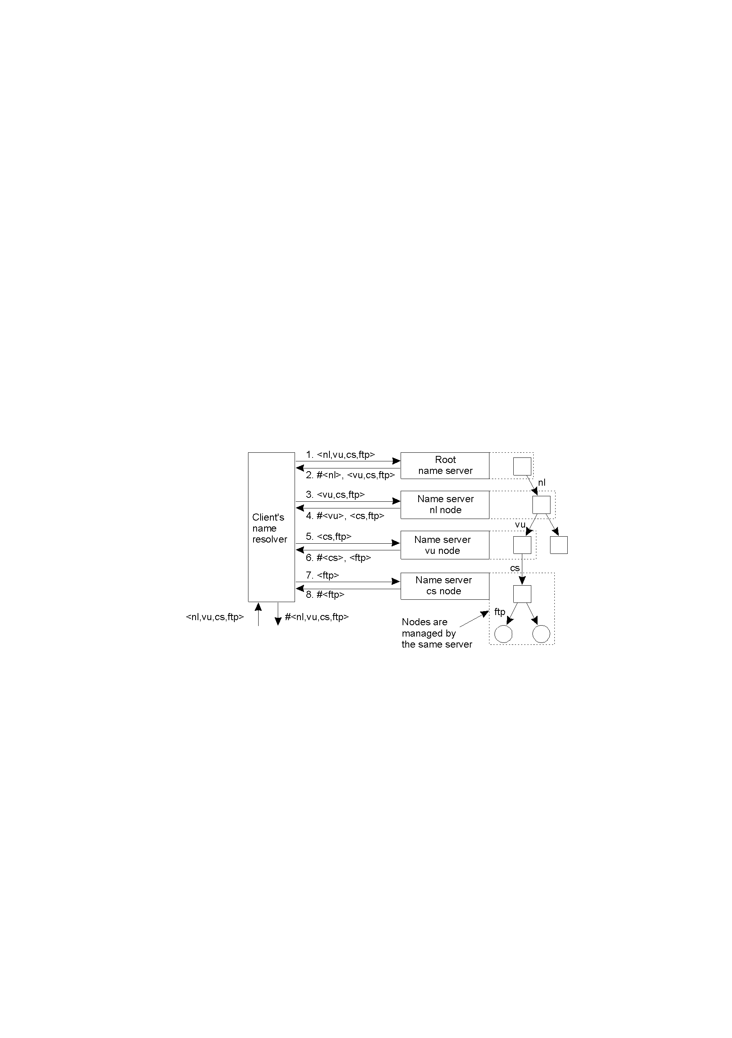
The principle of iterative name resolution.

Slide 81
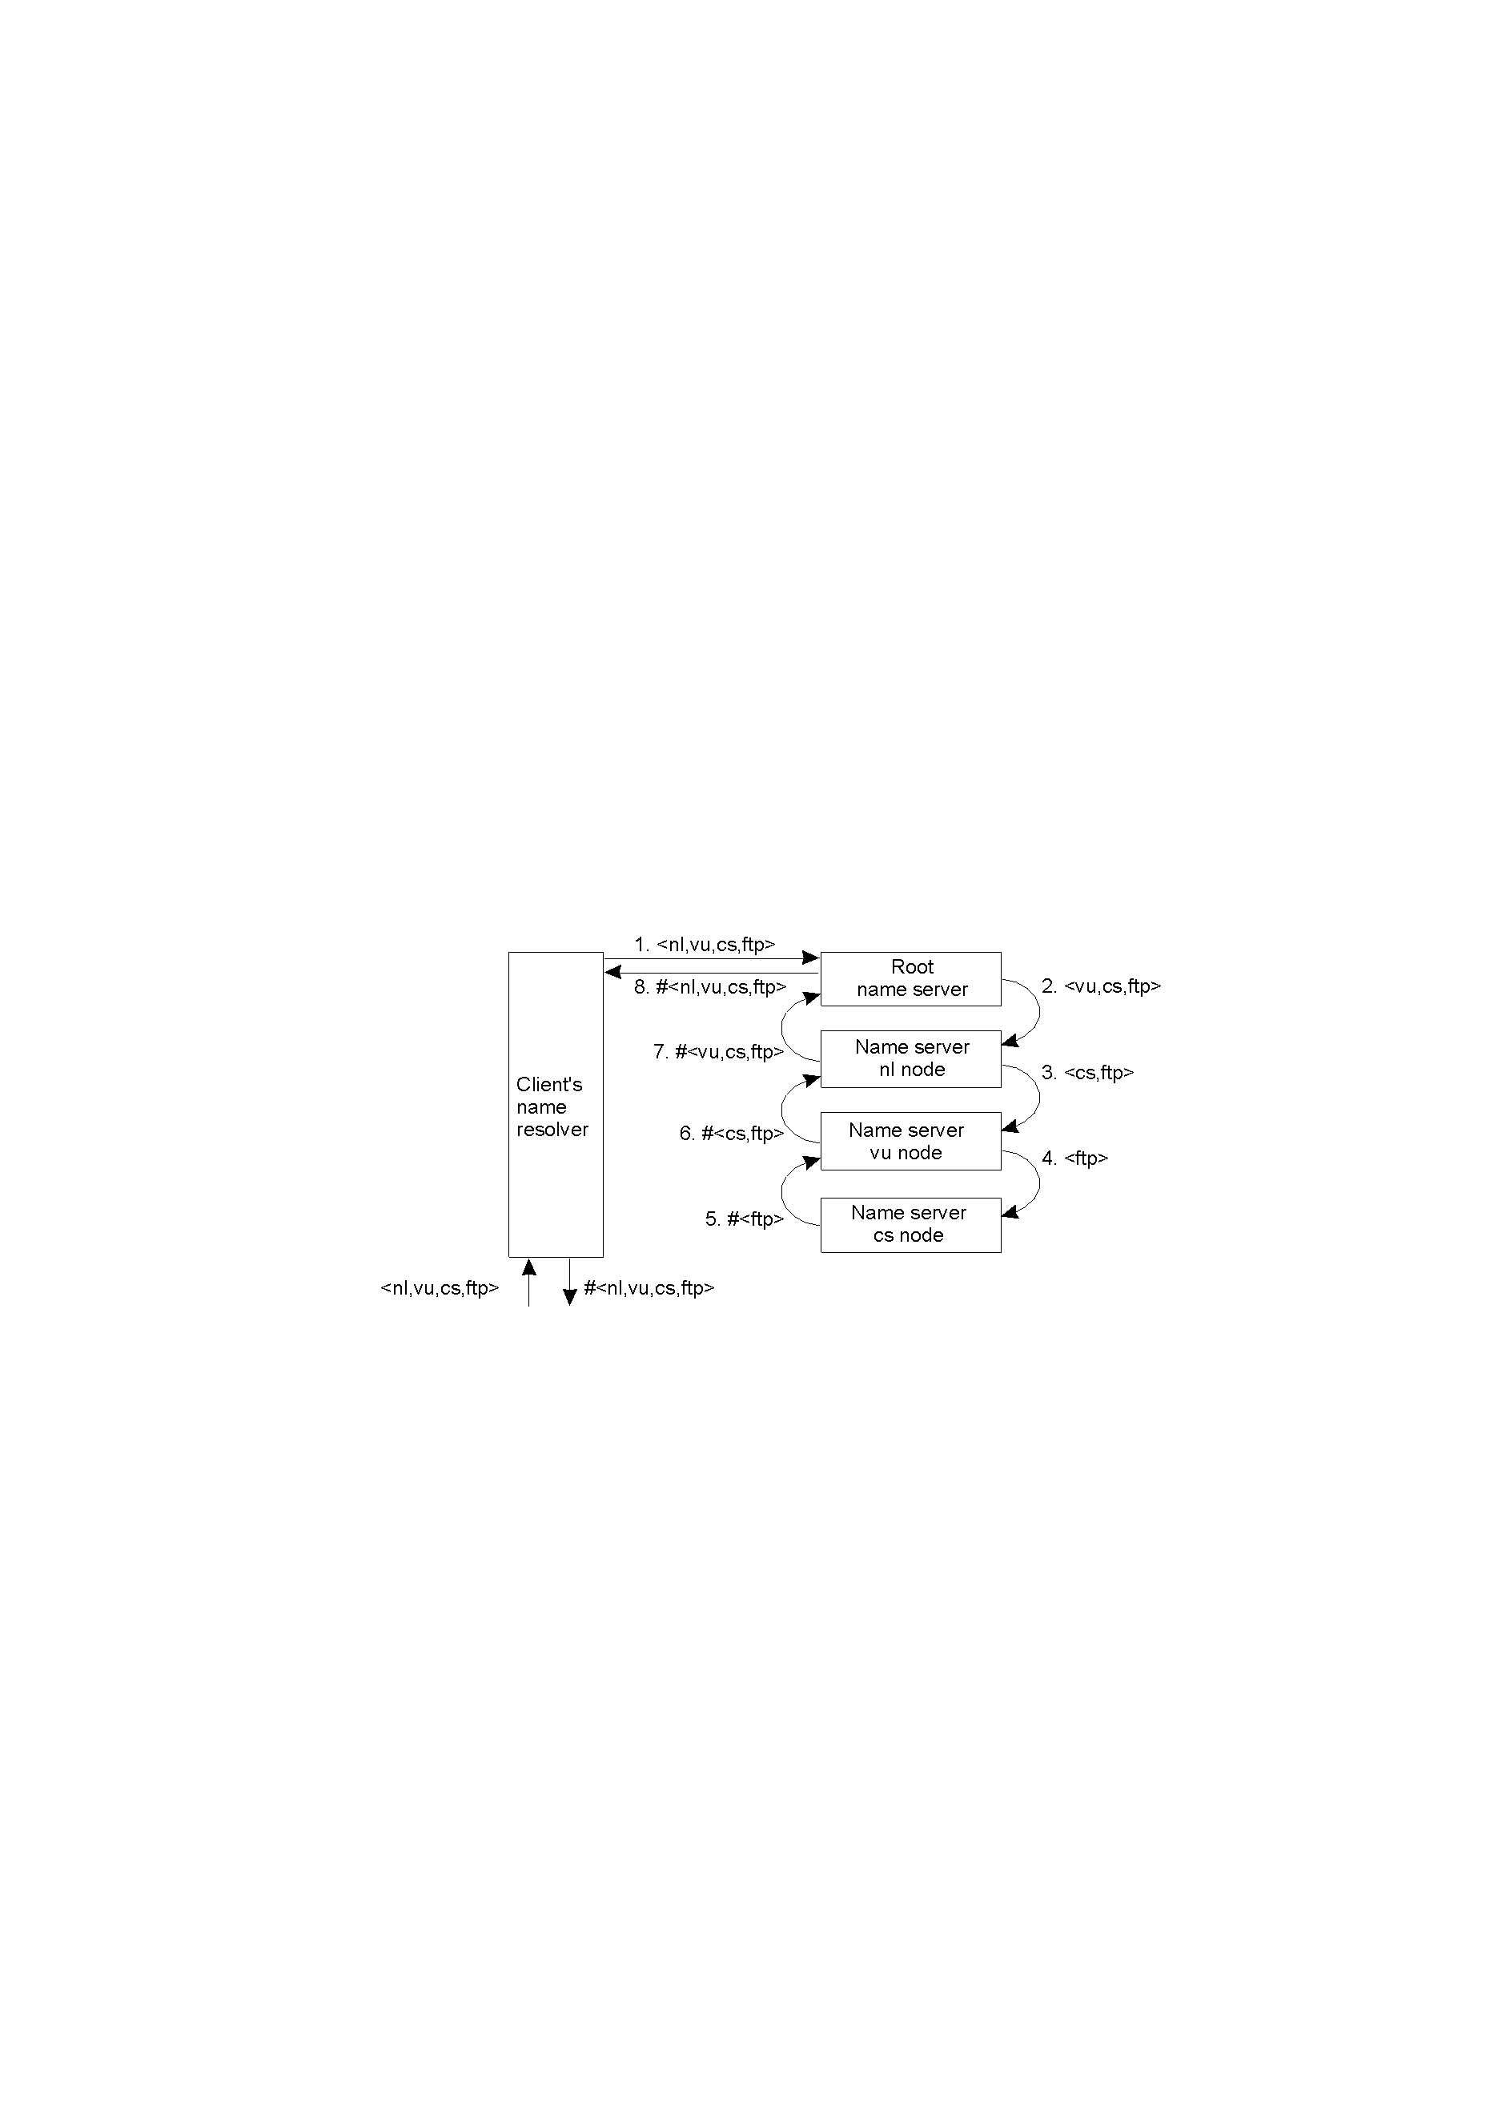
The principle of recursive name resolution. ?

Slide 82
6.2 Locating mobile entities
1. Feature of mobile entities
a mobile entity has multiple addresses
when mobile host moves
a mobile entity may have several names
for example,
“ftp.cs.vu.nl” moves into a different domain
Use address or name to locate these entities?
may change
location-dependent
What about mobile phone?

Slide 83
Solution
Use location-independent identifier to locate mobile entities.
Traditional naming services maintain a direct mapping between name and address of entity. Each time a name or an address changes, the mapping needs to change as well
home address C
ftp.cs.vu.nl is used as identifier S

Slide 84
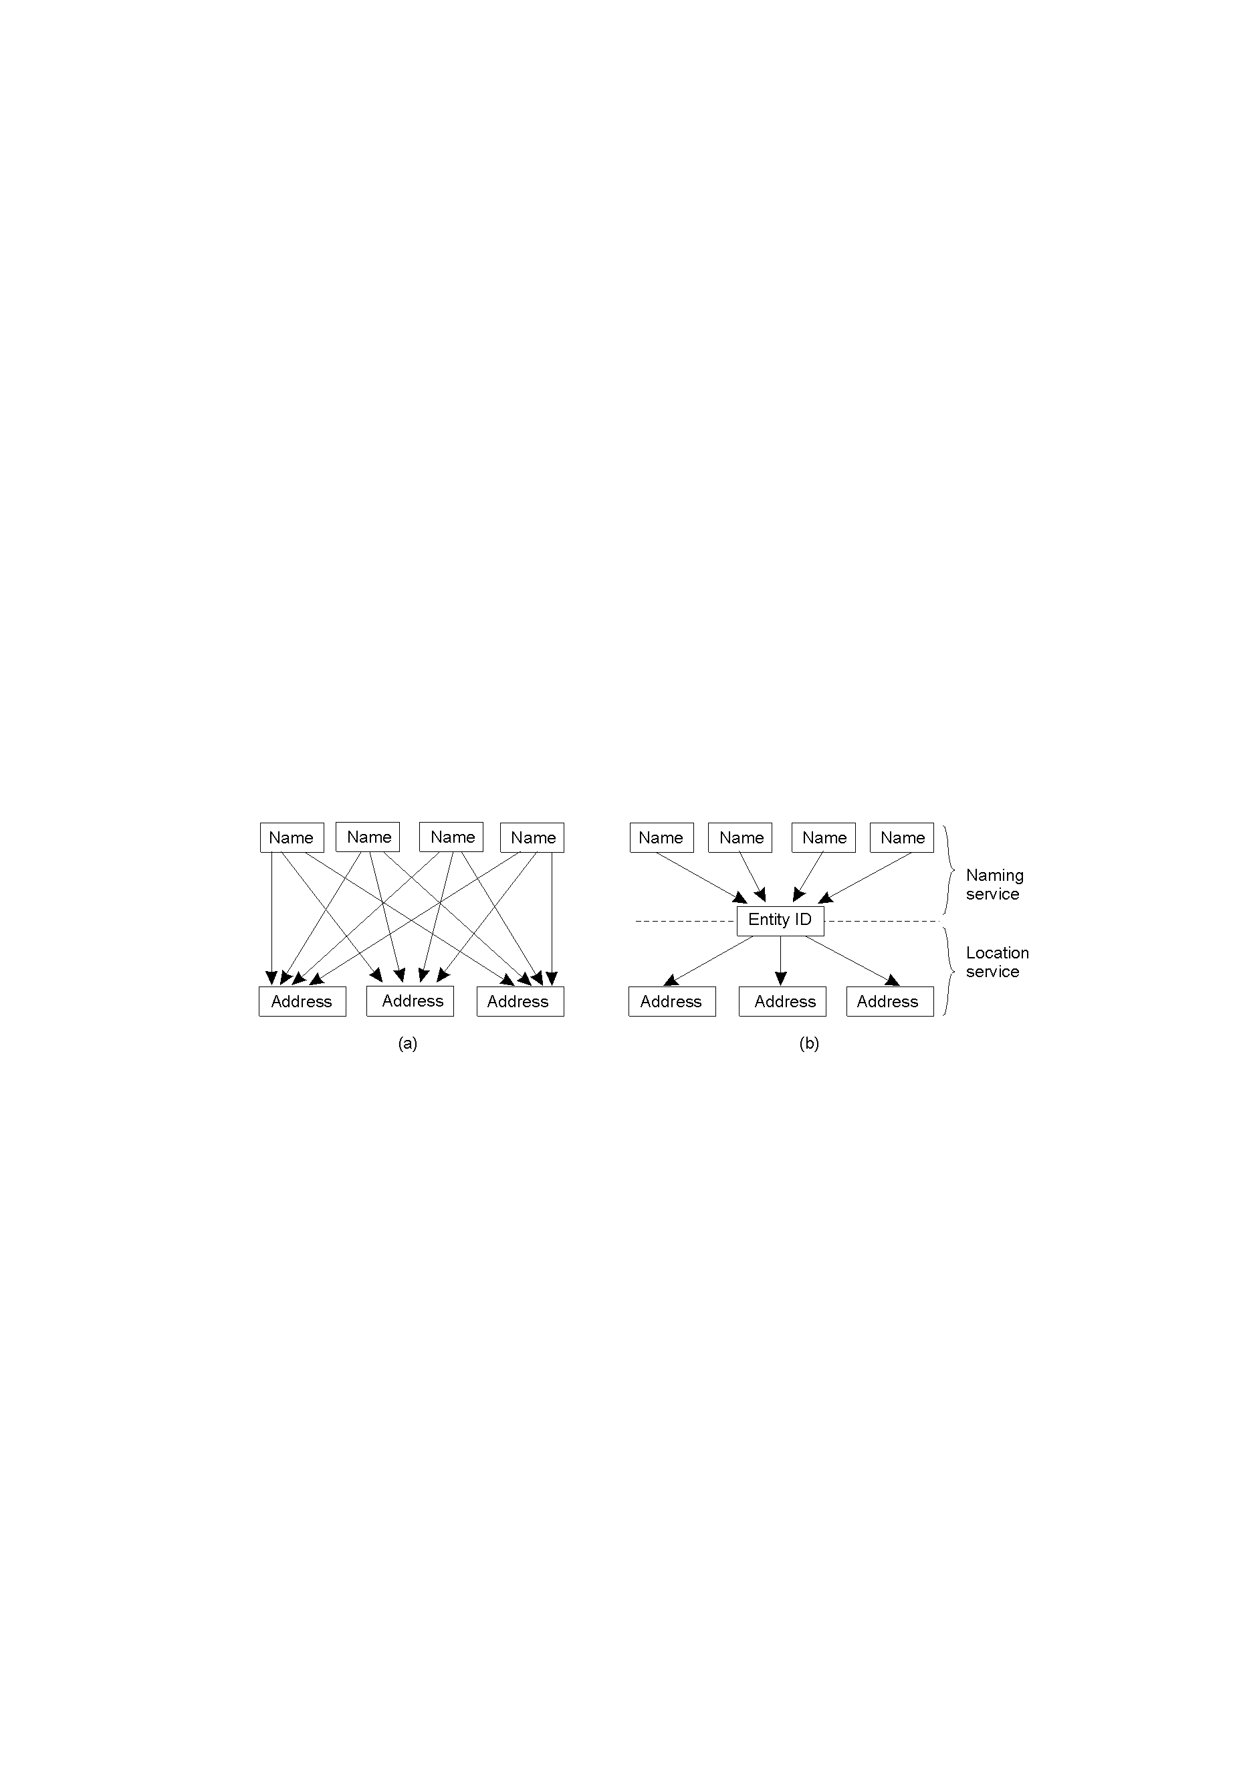
(a) Direct, single level mapping between names and addresses.
(b) Two-level mapping using identities.

Slide 85
Naming service
the identifier can be stored locally for next time
Location service
name
naming service
identifier
identifier
location service
current address of
the entity

Slide 86
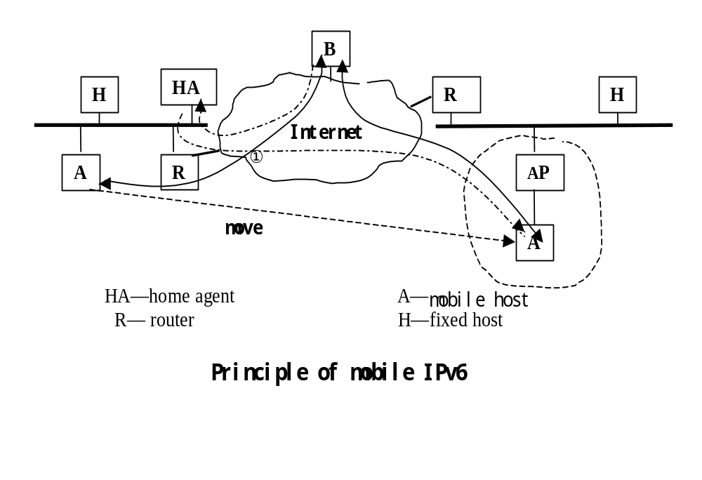
2. How locate mobile entities?
1) Home-based approaches

Slide 87
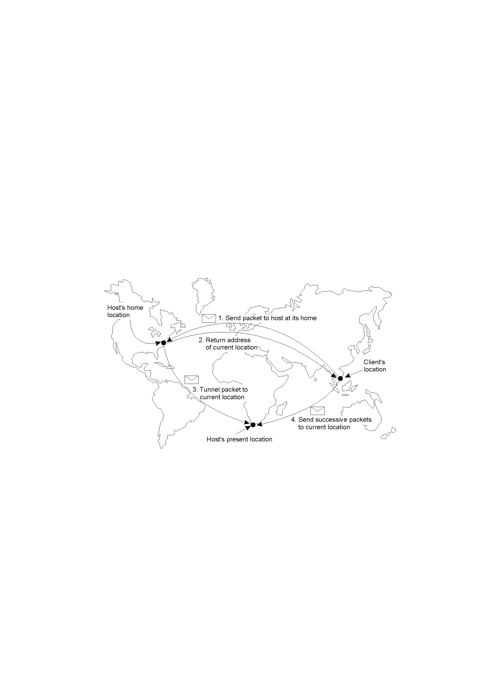

Slide 88
What is used to refer to the mobile host?
Home address --- location-independent identifier
Location service is not naming service
2) Broadcasting and multicasting
Locating an mobile entity in LAN can use broadcasting and multicasting if all entities have their own identifier

Slide 89
G
Where is identifier E
A
B
C
Here is my address
D
E
K
H

Slide 90
3) Forwarding pointer
location A location B location C
entity
When an entity move from A to B, it leaves behind a reference to its new location at B
entity
entity
entity

Slide 91
With respect to distributed objects, when an object
move from address space A to B, it leaves behind a
proxy in A and install a skeleton that refers to it in B.
A
B
A
B

Slide 92
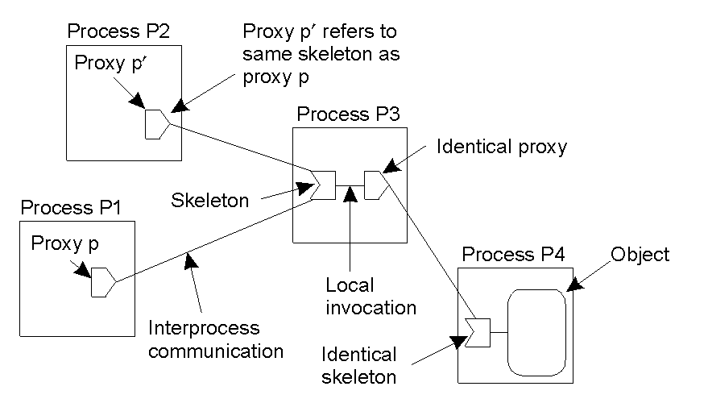
Copy to
Move to
The principle of forwarding pointers using (proxy, skeleton) pairs.

Slide 93
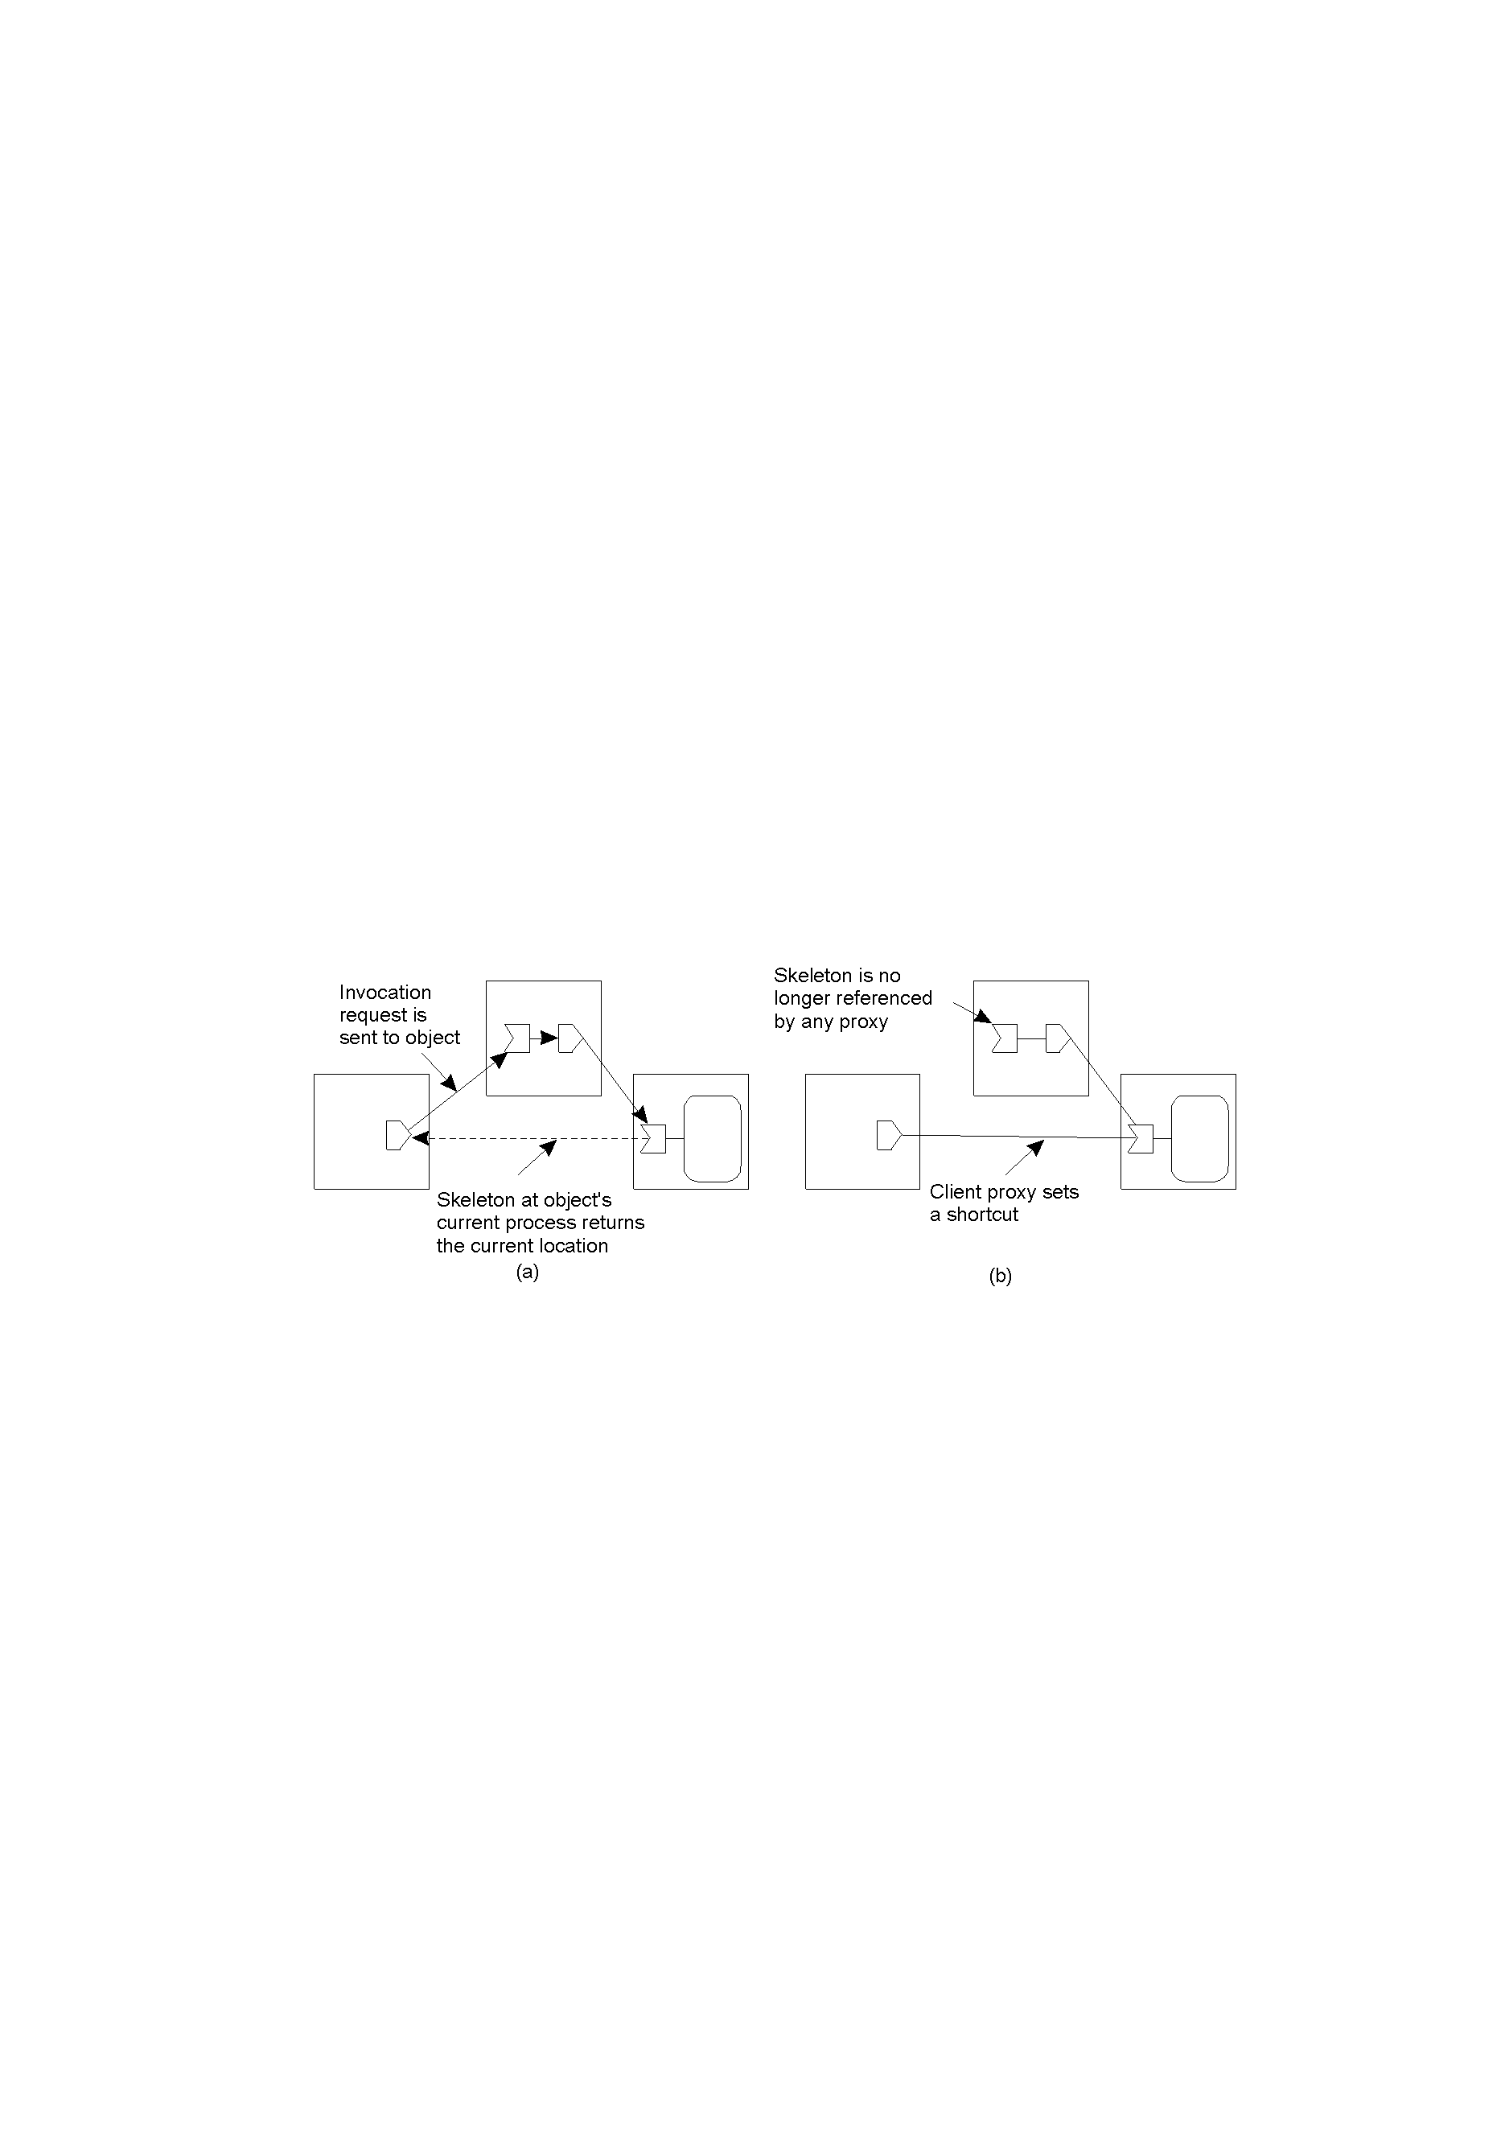
Redirecting a forwarding pointer, by storing a shortcut in a proxy.

Slide 94
4) Hierarchical approaches
It is used in Globe location service.
A network is divided into a collection of domains.
There is a single top-domain that spans the entire network
each domain can be subdivided into multiple smaller subdomains
leaf domain is lowest-level one

Slide 95
D2
D1
D3
D11
D21
D12
D24
D13

Slide 96
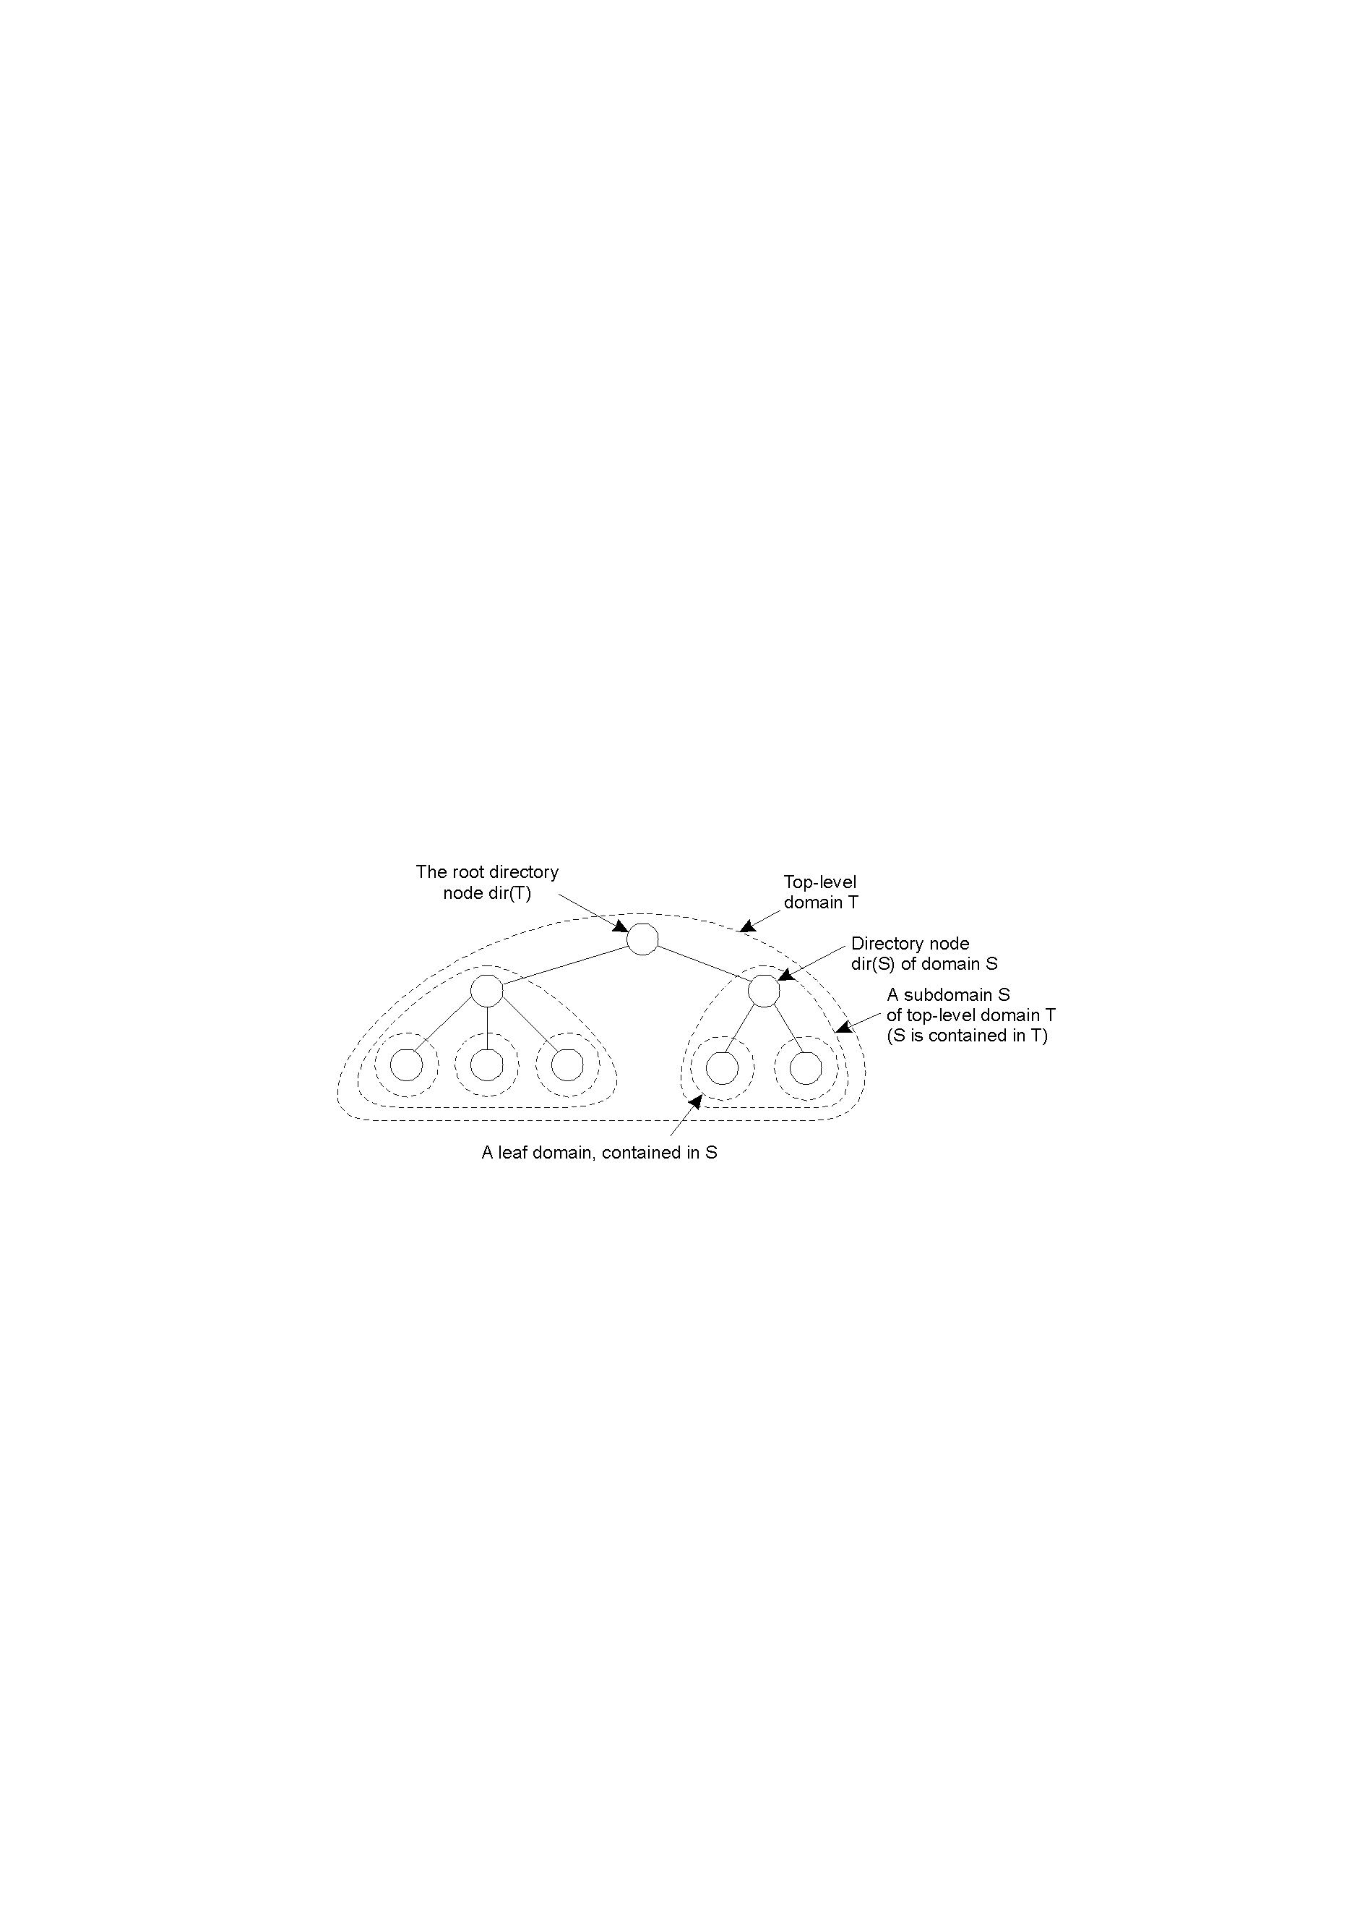
Hierarchical organization of a location service into domains, each having an associated directory node.

Slide 97
Directory node:
each domain D has a directory node dir(D) that stores location records for all entities in D
Location record:
For leaf domain, the location record for entity E contains E’s current address in the domain;
For higher-level domain D’, the location record for entity E contains a pointer to directory node of next lower-level domain that has E
root directory node knows about all entities

Slide 98
6.3 Removing unreferenced entities
P225
1. Introduction
Unused memory:
program is responsible for releasing it
garbage collection
sd=socket( , , ); close(sd)
unreleased memory or slices
This section concentrates on garbage collecting
distributed objects (remote objects).

Slide 99
A
B
Recall:
A reference to a remote object is implemented as a (proxy, skeleton) pair.
a remote reference can be passed to another process
an object itself can hold a remote reference to another object
obj

Slide 100
2. Programs remove unreferenced entity
fd=open( , , ) sd=socket( , , )
In concurrent server, each new thread that is created inherits a copy of all open sockets (files) from the thread that created it.
The mechanism used for socket inheritance is reference count.

Slide 101
1) Simple reference counting
P227
An entity simply counts the number of outstanding references to it (create, copy, remove reference)
when the counter drops zero, the entity can be removed
In distributed system,
Where to keep the counter for object?
proxy, skeleton, object
Communication may cause problem:

Slide 102
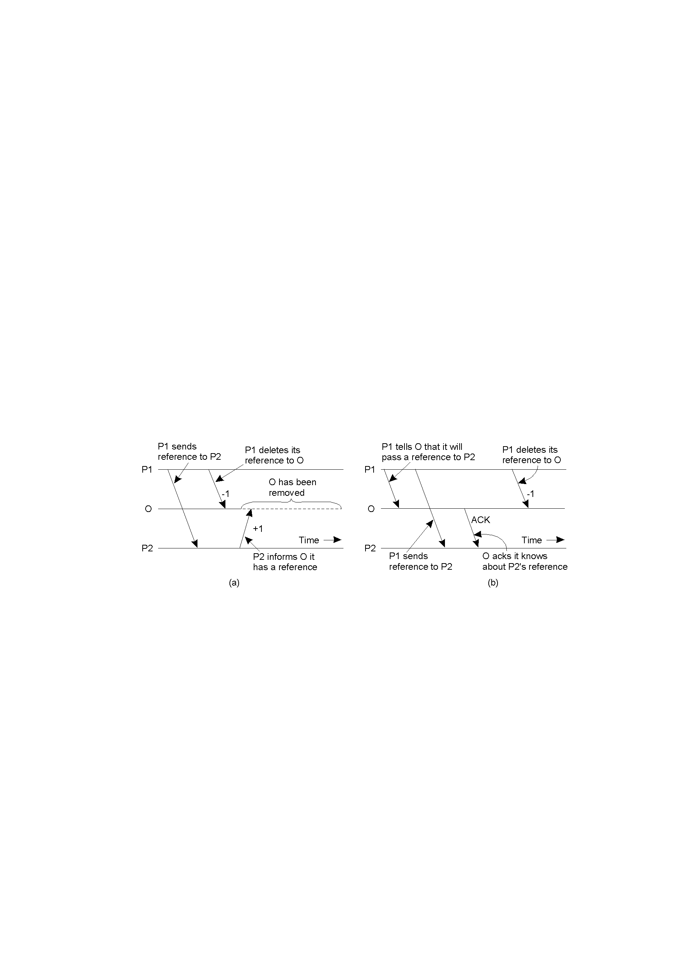
(a) Copying a reference to another process and incrementing the counter too late
(b) A solution.

Slide 103
2) reference listing
P231
Skeleton maintains a list of processes referring to it. (when a process creates, passes, removes an reference, it send a message to the skeleton)
when the list becomes empty, the entity can be removed
Java RMI uses the method
reference listing is more robust than reference counting

Slide 104
3. Identifying unreachable entities
For various reasons, it is possible for a distributed system to have unreferenced entities.
Difficult: it is often unknown whether a reference to an entity is stored somewhere in distributed system.
To detect unreferenced objects, we need trace all entities in a distributed system.
From where?

Slide 105
Root set: a distinguished subset of objects which need not be referenced themselves.
An object in root set represents a user’ main program, a system-wide service,...

Slide 106
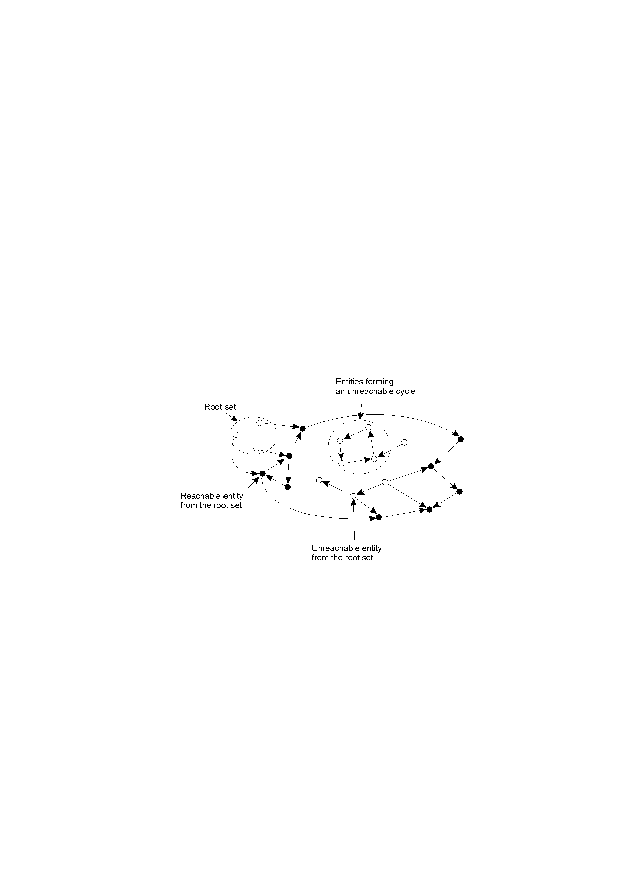

Slide 107
1) Mark-and sweep collector
Mark phase:
entities are traced by following chains of references originating from entities in the root set. Reachable entities are marked.
Sweep phrase:
examine memory to locate entities that have not been marked. Such entities are removed
A local garbage collector is started at each process, with all the collectors running in parallel.

Slide 108
2) Tracing in groups
For scalability,
collect all garbage within a group (a collection of processes)
deal with a large group that encompasses a number of cleaned subgroups
Algorithm to collect garbage within a group

Slide 109
Initial marking, only skeletons are marked. A skeleton is marked black if it can be reached from a proxy outside the group or from a root object. Otherwise it is marked white
intraprocess propagation of marks from skeletons to proxies
interprocess propagation of marks from skeletons to proxies
stabilization by repetition of the previous steps.
garbage reclamation

Slide 110
1. Ways to manage resources
Centralized files etc,
distributed centralized
distributed

Slide 111
Advantage Disadvantage
Centralized simple overhead, not robust
Dis.centralized overhead low search algorithm
Distributed necessary overhead
one kind of resource a physical resource
Centralized 1 manager 1
Dis.centralized k 1
Distributed m k

Slide 112
2. Characteristics
For one kind of resource
OS Distributed System
  1 manager k managers
May cause deadlock and starvation

Slide 113
How do k managers control one physical resource?
1. Centralized algorithm
One manager is elected as a coordinator. Whenever a process wants a resource, it sends a request to the coordinator.
P265

Slide 114
u1
u2
u1 using
u3
0
1
2
0
1
2
R
R
R
ok
u2
C
u3
C
0
1
2
release
ok
u3
C

Slide 115
Whenever a process wants a resource, it sends a request to the coordinator.
granted if no one uses resource;
put into queue otherwise.
When the process doesn’t want to use resource, it sends release message to the coordinator who takes the first item off the queue and sends that process a grant message.
* Easy to use * not robust
* 3 messages per use * bottleneck
* No starvation
It is

Slide 116
2. Token ring algorithm
P269
When a ring is initiated, manager 0 is given a token. Then the token circulates around the ring. The token holder can use the resource.
* Simple * not robust
* No starvation * token is lost
* 1 to n messages per use

Slide 117
0
4
1
2
0
3
4
1
3
2

Slide 118
3. Distributed algorithm
P266
1) Idea:
get permissions from all others.
suppose they have a global clock

Slide 119
1
0
0
8
8
ok
ok
ok
ok
9
9
1
2
1
2
ok
1
2
0
8
8
9
10
9
1
2
2
10

Slide 120
Question
P242
How determine times of applications?
use clock (clocks)
  a global clock it is impossible
  their own clocks clock synchronization
order events in distributed system

Slide 121
2) Key and condition
P242
Key:
Key is how determine the order of several processes.
Condition:
There is a total ordering of all events in a distributed system. That is, for any pair of events, it must be unambiguous which one happens first.

Slide 122
3) Timestamp algorithm
P267
Applicant broadcasts a request message with a time stamp
When receiving a request message with time stamp T_{s}, a reply is sent back immediately if
  it is neither a resource holder nor an applicant
  it is an applicant and T_{s} < T_{r}
  T_{r} is the time stamp in its request message

Slide 123
When using resource or T_{r} < T_{s}, reply is delayed and the request is queued
When releasing the resource, all delayed replies are sent to all members in its queue
After receiving all replies, the applicant becomes the holder, and it can use the resource.
* No starvation * 2(n-1) messages
* Necessary * not robust
return

Slide 124
Algorithm | Message per entry/exit | Delay before entry (in message times) | problems
Centralized | 3 | 2 | Coordinator crash
Distributed | 2(n-1) | 2(n-1) | Crash of any process
Token ring | 1 to ∞ | 0 to n-1 | Lost token,process crash
A comparison of three mutual exclusion algorithms.

Slide 125
4. Logical clocks (about time stamp)
Lamport defined
1) Concepts
Happens before
is a relation between two events which satisfies the following conditions:

Slide 126
(1) If a and b are events of a process, and a happens before b, then a b
(2) If a is an event of sending a message and b is an event of receiving the message, then a b
(3) If a b and b c, then a c (transitive law)
If a b and b a , then a and b are said to be concurrent events

Slide 127
Logical clock:
Question: How determine T_{r} , T_{s} ?
A logical clock is a function which satisfies the
following conditions:
1
a
u
1
2
b
v
3
w
4
5
c
c(a)=1 c(b)=c(a)+1 c(v)=1+max(c(u),c(b))

Slide 128
(1) for an event e, the function c(e) has a positive value
(2) if a b then c(a) < c(b)
A logical clock may be defined as follows:
(1) for an event e_{j} , that is not a receiving event,
1 if e_{j} is the first event
c(e_{j-1}) +1 if e_{j-1} is just before e_{j}
(2) for a receiving event e_{j} ,
c(e_{j}) = 1+ max(c(e_{j-1}), c(e_{s}))
where e_{s} is the sending event
c(e_{j})=

Slide 129
P1 P2 P3
1 a
u 1
i 1
2 b
apply with 2
v 3
j 3
apply with 4
w 4
k 4
x 5
p2
using
using

Slide 130
Ahead of another concept
a b iff c(a) < c(b) or
c(a) = c(b) and i < j
a is an event of process i
b is an event of process j.
Or iff c(a)*N + i < c(b)*N + j
where N is the number of processes
(0 <i, j <=N)

Slide 131
Let N = 10 c(a) = 2 c(b) = 3
i = 8 j = 1
a b
Properties:
(1) if a b then b a
(2) if a b then a b
(3) if a b, b c then a c

Slide 132
P1 P2
1 a
u 1
v 2
2 b
w 3
3 c
x 4
5 d
y 5
c x
c(c) < c(x)
c x

Slide 133
Ricard algorithm
Applicant broadcasts a request message with a time stamp
When receiving a request message with time stamp T_{S}, a reply is sent back immediately if
  it is neither a resource holder nor an applicant
  it is an applicant and E_{S} E_{R}
  E_{S} is the apply event with T_{S}
  E_{R} is its apply event with T_{R}

Slide 134
When using resource or E_{R} E_{S} , reply is delayed and the request is queued
When releasing the resource, all delayed replies are sent to all members in its queue
After receiving all replies, the applicant becomes the holder, and it can use the resource.

Slide 135
Example: Totally-ordered multicast
P254
All messages are delivered in the same order to each receiver.
when a message with sender’s current timestamp is multicast, it is also sent to the sender
when a process receives a message, it is put into a local queue, ordered according to its timestamp. The receiver multicasts an ACK
a process can deal with the message only when that message is at the head of the queue and has been acknowledged by each other process

Slide 136
0
1
2
0
8
8
9
10
9
1
2
0
1
2
0
1
2
10

Slide 137
5. Vector timestamps
P256
Linear timestamps can’t distinguish clock ticks caused by local event and ones caused by message exchange between processes
1 a
(1,0,0)
u 1
(0,1,0)
i 1
(0,0,1)
2 b
(2,0,0)
v 3
(2,2,0)
j 3
(2,0,2)
w 4
(2,3,0)
k 4
(2,0,3)
5 c
(3,3,0)
x 5
l 5
(2,3,4)
using
using
return

Slide 138
1) Vector timestamps
P257
Each process P_{i} maintains a vector V_{i} with the
following properties:
V_{i}[i] is the number of events that have occurred at P_{i} so far
if V_{i}[j] = k then P_{i} knows that k events have occurred at P_{j}
is maintained by piggybacking vector along with message that is sent

Slide 139
when process P_{j} receives message m with timestamp vt, it adjusts its own vector by setting each entry V_{j}[k] to max{V_{j}[k], vt[k]}
2) Application --- Causal message deliver
Electronic bulletin board:
When a process P_{i} posts an article, it multicasts that article as a message a with timestamp vt(a) set to V_{i}
later P_{j} posts a reaction to the article by multicasting a message r with timestamp vt(r) set to V_{j}

Slide 140
a r vt(a)[j] < vt(r)[j]
How can system ensure that applications receive
message a first, then message r?
System must implement causal message deliver.
(1,0,0)
a
(1,1,0)
a
(1,0,1)
r
r
(2,2,0)
(1,2,0)
(1,2,2)
a r
P_{i}
P_{j}
P_{k}

Slide 141
To guarantee causal message delivery, we adjust vector timestamps as follows:
V_{i}[i] is incremented only when process P_{i} sends a message. (receiving a message won’t increment V_{i}[i])
P_{k} hasn’t seen what P_{j} has seen
(0,0,0)
(0,0,0)
(0,0,0)
(1,0,0)
a
(1,0,0)
(1,1,0)
r
(1,1,0)
r
a
(1,1,0)
(1,0,0)
(1,1,0)
P_{i}
P_{j}
P_{k}

Slide 142
P258
Suppose P_{k} receives message r from P_{j}, r is
delivered only if the following conditions are met:
vt(r)[j] = V_{k} [j]+1
vt(r)[i] ≤ V_{k} [i] for all i≠j

Slide 143
7.4 Global state
1. Definition
Global state of a distributed system
local state of each process + messages that are currently in transit
Distributed snapshot
a consistent global state recorded at a particular time
Cut
graphic representation of a global state

Slide 144
2. Algorithm for recording global state
Chandy and Lamport proposed.
Initiating process(any one), say P, records its own local state. Then, it sends a marker along each of its outgoing channels, telling the receivers to participate
when a process Q receives a marker,
  if Q hasn’t saved its local state, it first records its local state and also sends a marker along each of its outgoing channels.

Slide 145
  If Q had already recorded its state, the received marker indicates that Q should record the state of the channel, i.e. messages received during <last time Q recorded its state, Q received the marker>
a process finishes its part of the algorithm when it has received a marker along each of its incoming channels. At that point, it sends its local state and the state of each incoming channel to the initiator.

Slide 146
7.5 Election Algorithm
Many distributed algorithms require a coordinator.
1. Bully algorithm
1) Assume
  each process has a unique number and know others
  initially system designates the process with highest process number as coordinator
2) When initiate an election?
When a process notices that the coordinator is no longer responding, it initiates an election

Slide 147
2
4
6
?
7
3
1
8
5
4
?
Ask process 7 ?

Slide 148
3) Bully algorithm (let P initiate)
P sends an Election message to all processes with higher numbers
If no one responds, P wins the the election and becomes coordinator, announces the result
If one of the higher-ups answers, it takes over. P’s job is done
If a process that was previously down comes back up, it holds an election
Questions:
Is the algorithm centralized or distributed?

Slide 149
2
4
6
?
7
3
1
8
5
2
4
6
7
3
1
8
5

Slide 150
Why does not node 4 only send Election message to node 7?
If node 7 fails too, node 4 will wail for a while. Then node 6, ...
2
4
6
7
3
1
8
5

Slide 151
What is the result if processes 4 and 5 find that the coordinator crashes simultaneously?
Is the algorithm robust?
2
4
6
?
7
3
1
?
8
5

Slide 152
2. Ring algorithm
When any process notices that the coordinator is not functioning, it builds an ELECTION message containing its own process number and sends the message to its successor.
Each successor adds its own process number to the list of the message. ?
When the message get back to the process, it choose the highest one.

Slide 153
10
0
4
10
1
3
9
2
9
0
8
10
4
9
1
use...
release
3
10
8
2
10
9
use

Slide 154
3. Concepts
A distributed database(DDB) is a logical database which consists of several interconnected physical databases.
From user’ point of views, it is an integrated database.
From designer, it is several interconnected databases.
  Homogeneous DDB Unify*
  Heterogeneous DDB LSZ

Slide 155
8.2 Design of DDB
How distribute? How partition?
How replicate?
1. Data fragmentation
1) Horizontal fragmentation
S_{no} s_{name} sex age dept
980001 Zhang lin male 21 CS
… … … … CS
… … … … CS
980100 … … … Math
… … … … Math
s2
s1
student

Slide 156
R=U r_{i}
2) Vertical fragmentation
R=r₁∝ r₂ … ∝ r_{k}
i=1
s_{no} s_{name} tid
age sex dept tid
s1
s2

Slide 157
2. Data replication
Each copy of relation or fragmentation can be stored in different sites.
Ex. s1, s2, s3 can be replicated at Dean’s office
3. Principle of design
Depend on application.
Fragmentation and distribution -- naturally
Replication -- for reliable and favor for read
student DB
banking DB
DNS DB

Slide 158
1. Several kinds of DDBMS
Typical DDBMS
if a user read/write a relation which is fragmented and distributed, the DDBMS will ensure that the operation will be executed on the entire relation.
C/S model DDBMS
The system allows:
  remote or local query
  local(or remote) update DNS(Banking system)
Customized DDBMS

Slide 159
2. DNS DDB and its C/S model DDBMS
1) DNS server hierarchy
DNS server are arranged in a hierarchy that matches the naming hierarchy
2) DNS DDB
DNSDDB(domain_name, IP_address, type, …)
resolve(DNS_server, IP_address, …)
3) Features
only do remote or local query
update DDB locally

