Slide 1
Classifying ECG Data
A particular kind of medical time-series data

Slide 2
Structure of the talk
Explanation of ECG data
Goal of classifying ECG data
Data Exploration
Classification techniques
Challenges faced

Slide 3
What is ECG data?
ECG stands for ‘Electrocardiograph’
Used to track strength and direction of electrical signals through the heart, which correlates with healthy/diseased heart states
Up to 12 channels (i.e. 12 ‘views of the heart’), called ‘leads’.

Slide 4
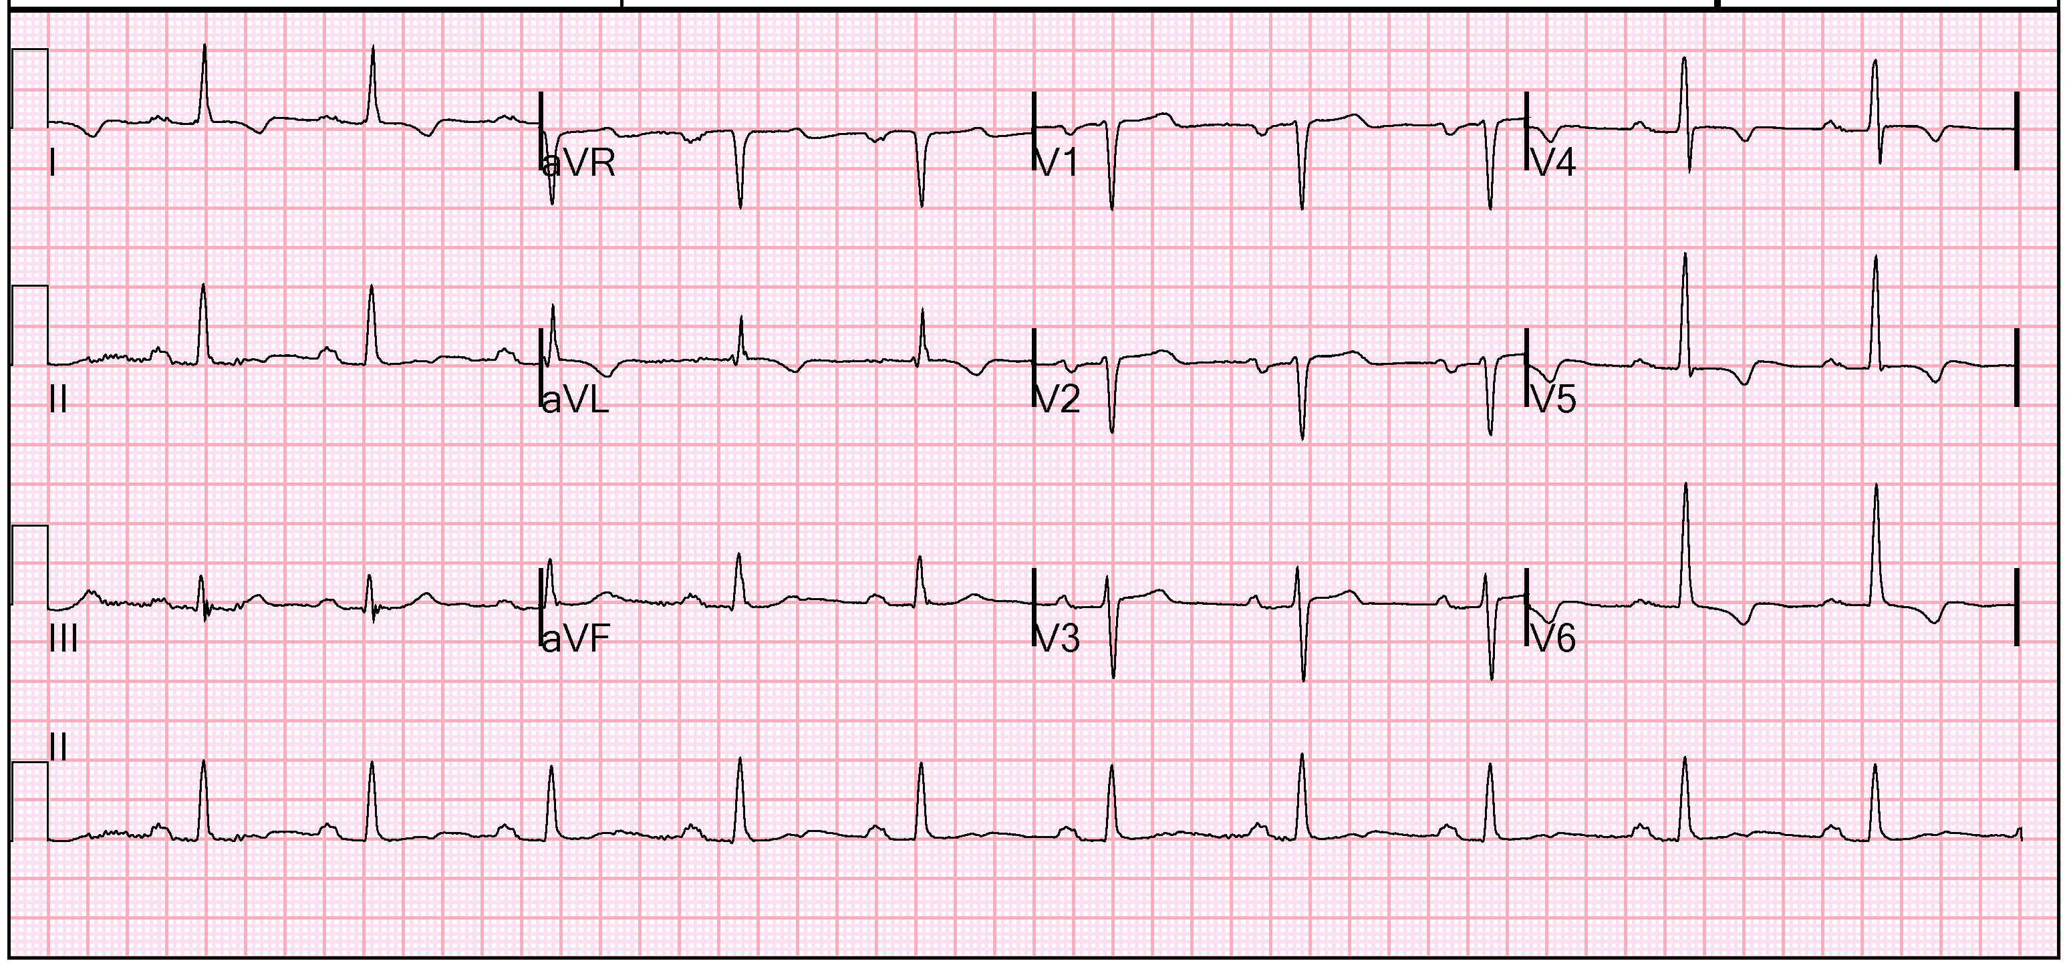
How does an ECG look like?

Slide 5
How does the heart send electrical signals?

Slide 6
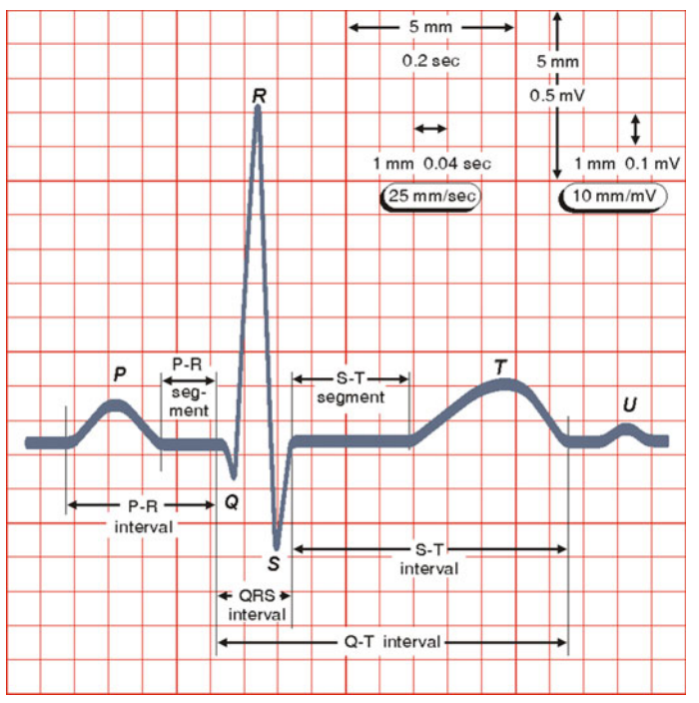
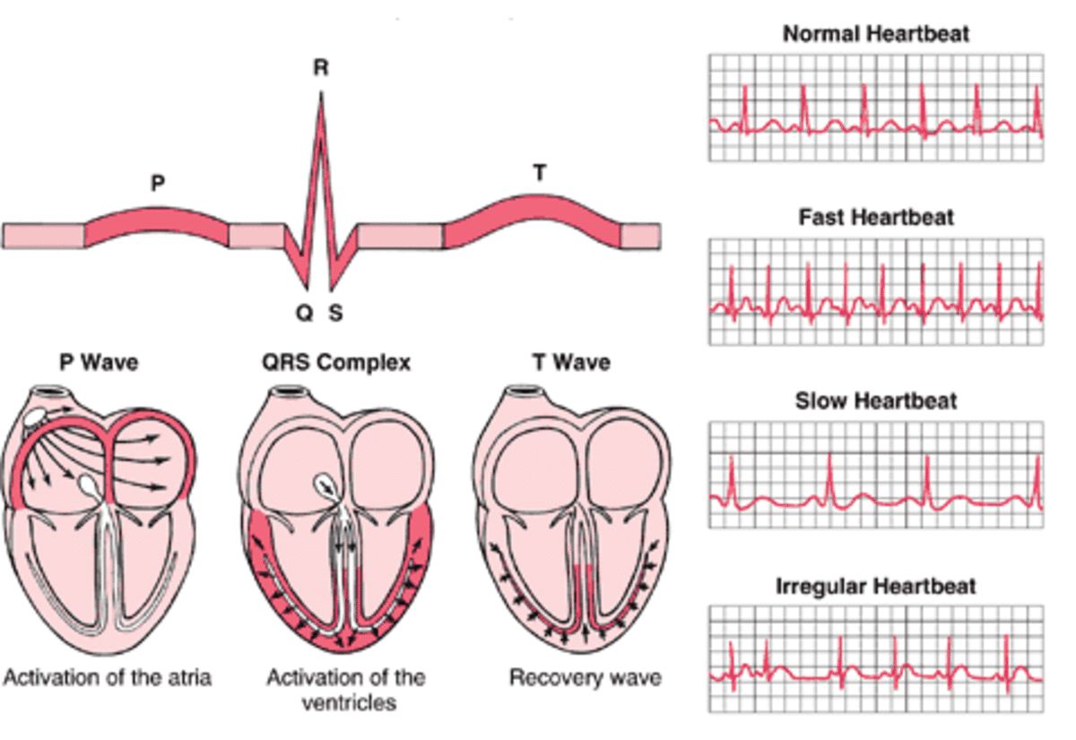
How does a standard wave look like?

Slide 7
Structure of the talk
Explanation of ECG data
Goal of classifying ECG data
Data Exploration
Classification techniques
Challenges faced

Slide 8
Problem Statement
Problem: ECG interpretation takes years of training and mistakes can be made as doctors work long hours
Goal of this project: Automatic classification of ECGs into 1 of 6 classes, 1 healthy class and 5 diseased classes

Slide 9
The PTB-XL Dataset
Database | Number of patients | Number of recordings | Number of leads (channels) | Duration of each recording (seconds)
PTB-XL | 18885 | 21837 | 12 | 10
6 Super-classes to classify into, NORM for Normal, and 5 other classes representing diseased classes.
Clinicians used a sampling frequency of 500Hz, saved in WaveForm DataBase (WFDB) format. The dataset includes a downsampled version of the waveform data at a sampling frequency of 100Hz. This project uses the 100Hz version
The ECG recordings were obtained in a hospital or clinical setting over nearly 7 years between October 1989 and June 1996. Devices from Schiller AG were used.

Slide 10
Structure of the talk
Explanation of ECG data
Goal of classifying ECG data
Data Exploration
Classification techniques
Challenges faced

Slide 11
Time domain, Frequency domain, Time-Frequency domain
ECG is normally analysed in time-domain
…But we can convert from time domain to frequency domain with a method called fast-fourier transform
…and we can convert from time-domain to time-frequency domain with short-time fourier transform

Slide 12
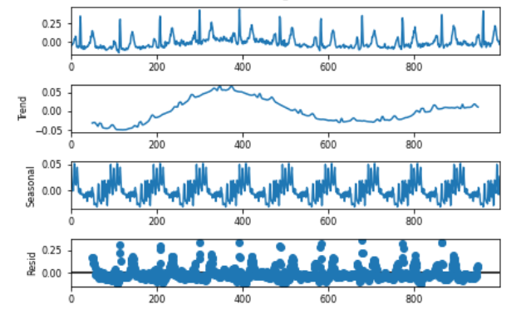
Stationarity of Signal (Time domain)

Slide 13
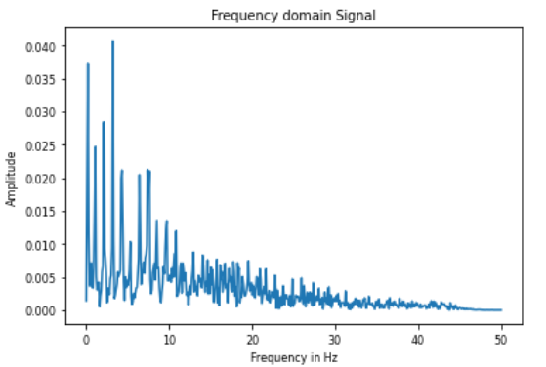
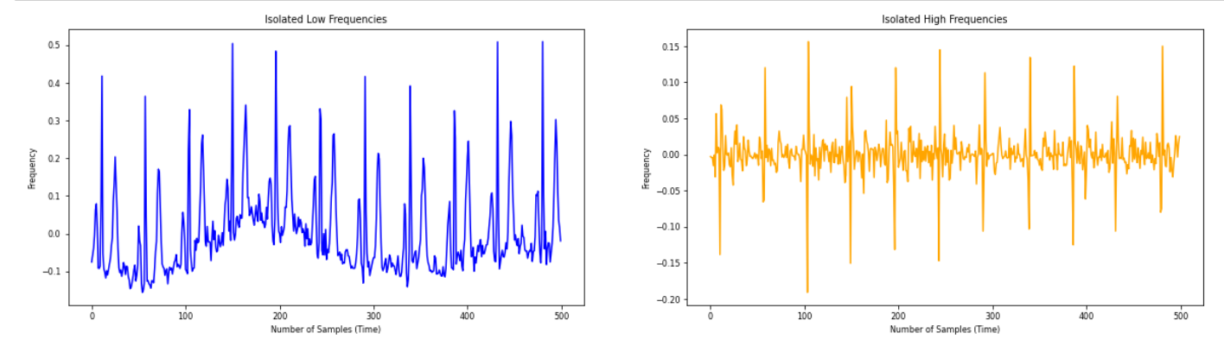
Frequency strengths (Frequency domain)

Slide 14
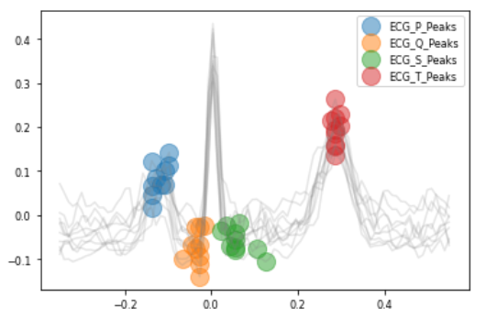
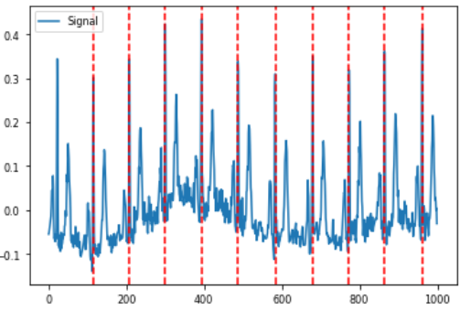
P, Q, S, T peaks and R peaks

Slide 15
Structure of the talk
Explanation of ECG data
Goal of classifying ECG data
Data Exploration
Classification techniques
Challenges faced

Slide 16
Ensemble Method, Neural Network
Logistic Regression
Cascading Classifier (Random Forest and Fully Connected Neural Network)
MTEX-CNN Neural Network

Slide 17
Feature engineering for Cascading Classifier
Statistical features: Kurtosis and Skew
Features about power and frequency: Fast-Fourier Transformed, Short-time Fourier transformed signal
Amplitude features: Max, Min, and Avg height of the peaks in the wave
…All summed up to give one number per channel per ECG signal

Slide 18
Logistic Regression and Cascading Classifier results
Logistic Regression: 60.50% accuracy
Cascading Classifier (Random Forest and Deep Neural Network): 60.76%!
Problems:
Linear combination procedure was unknown. Simple summing and scaling
This project aimed to use as much information from the leads as possible to simulate the data available for doctors

Slide 19
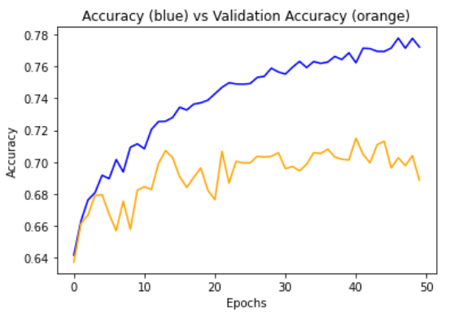
MTEX-CNN
Accuracy: 68.65%
*Raw data fed into the MTEX-CNN network!
Class | Precision | Recall | F1-score | Support
0 | 0.70 | 0.57 | 0.63 | 398
1 | 0.22 | 0.05 | 0.09 | 73
2 | 0.62 | 0.12 | 0.20 | 256
3 [NORM] | 0.69 | 0.95 | 0.80 | 913
4 | 0.88 | 0.35 | 0.50 | 40
5 | 0.70 | 0.71 | 0.70 | 523

Slide 20
Future Improvements
MTEX-CNN is meant to be explainable, but couldn’t implement explainable layer
Can use techniques to reduce the number of unimportant features

