Slide 1
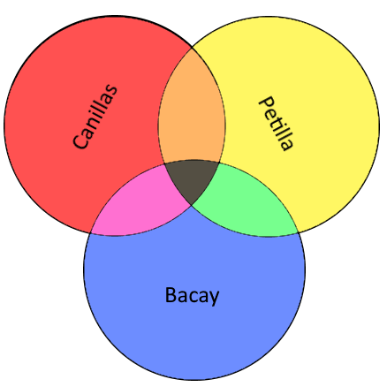
Communication Process Topic Outline
A. Participants
1. Senders
2. Receivers
B. Messages
1. Meanings
2. Symbols
a. Verbal symbols (words)
b. Nonverbal (behaviors)
c. Visual Images
3. Encoding and decoding
a. Encoding
b. Decoding
4. Form (Organization)
C. Context
1. Physical Context
a. Factors of Physical Context
i. Location
ii. Environmental conditions
iii. Distance between participants
vi. Time
b. Communication in Technologically Mediated spaces
i. synchronous technologies
ii. asynchronous technologies
2. Social Context
3. Historical Context
4. Psychological Context
5. Cultural Context
a. Values
b. Beliefs
c. Orientations
d. Underlying assumptions
e. Rituals in society
D. Channels
1. Face to Face Communication
2. Technologically Mediated Communication
E. Interference
1. Physical
2. Psychological
a. Internal Noise
b. Semantic Noise
F. Feedback
1. Face-to-face Communication
2. Online Interactions

Slide 2
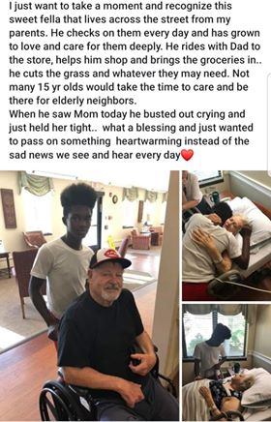
Social Media Post Interpretation
“spreading positivity”
“the boy is innately helpful or indebted”
"heart warming"
“love the elderly"
“bond between different ages and ethnicity”
“see beyond the physical”
“special connection/bond"
“family isn't just by blood“
“you can make someone's life better just by being with or spending time with them”

Slide 3
Video Analysis
“most disliked video on YouTube by YouTube”
“Received a lot of backlash”
“envisioned to take a look back to the trends that defined 2018”
"didn't include most of the popular events and dramas because it's not advertiser friendly"
"YouTube, not its content creators, control Rewind.“
"Neglected events that mattered."
"The voice of the viewers were silenced by the magnate corporate.“
"failed to include the most prominent channels"
"Unnecessary introduction through outdated quips and memes."
"YouTube not keeping up with trends.“
"Had emphasis on irrelevant events and news."
"family friendly" and "SJW"
https://www.youtube.com/watch?v=YbJOTdZBX1g

