Slide 1
Handoffs, Recommendations, and Evidence
Quantum Cognition for Human-AI Decision Teaming
Nathan Yang
M3S1
Notes:
This meeting assumes that students have watched the module videos. Use the session for application and assessment progress.
Preparation: Watch the Module 3 videos. Read the Meridian and Juno examples and complete the short interference notebook. Bring an idea for your individual Discussion 3.
Assessment connection: M3A1_Discussion_3, M3A2_Audit_Practice, M4A1_Project_Part_2.
Workshop output: An individual Discussion 3 draft and a proposed managerial outcome to discuss with your audit team.

Slide 2
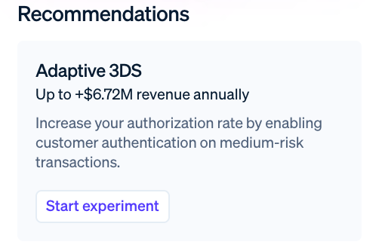
An Interface Suggests the Next Action
An extra identity check changes the payment process.
What does the reviewer see before choosing?
Stripe public interface demonstration, captured November 2026.
Notes:
Activity time: 5 minutes.
Stripe’s public product page illustrates review suggestions and an option to start an authentication experiment. Adaptive 3DS refers to an additional identity check for a payment. The displayed revenue number is part of a company demonstration, not a measured result for our case. Ask students where a recommendation, risk assessment, or interim answer enters the decision process. Compare a direct decision with a decision after an explicit assessment while holding the underlying facts fixed. Manual review is described at https://docs.stripe.com/radar/transaction-reviews.
Preparation: Watch the Module 3 videos. Read the Meridian and Juno examples and complete the short interference notebook. Bring an idea for your individual Discussion 3.
Assessment connection: M3A1_Discussion_3, M3A2_Audit_Practice, M4A1_Project_Part_2.
Workshop output: An individual Discussion 3 draft and a proposed managerial outcome to discuss with your audit team.
Sources (accessed November 11, 2026):
https://stripe.com/radar/transaction-fraud
Image description: The focused view of the official Stripe demo displays an Adaptive 3DS recommendation with a Start experiment control. 3DS adds customer authentication. Its revenue number is demo content.

Slide 3
Meridian’s Illustrative Console Choice
Assessed: 0.63 × (9/11) + 0.41 × (2/11) = 0.59.
Direct: 0.69. Fictional case with imposed rates.
Notes:
Activity time: 15 minutes.
Meridian is fictional and these rates are illustrative. Ask students to calculate the weighted rate and identify what comparison is challenged by .69. Source: Nathan Yang, Case: The Intermediate Step; adapted to distinguish the fixed-rate benchmark from process-dependent alternatives.
Preparation: Watch the Module 3 videos. Read the Meridian and Juno examples and complete the short interference notebook. Bring an idea for your individual Discussion 3.
Assessment connection: M3A1_Discussion_3, M3A2_Audit_Practice, M4A1_Project_Part_2.
Workshop output: An individual Discussion 3 draft and a proposed managerial outcome to discuss with your audit team.
Displayed values are imposed teaching examples. Full data and prompts are in the matching session guide.

Slide 4
The Meaning of the Difference
Compute direct minus assessed.
State why 0.69 lies outside the fixed-rate bracket.
Name a process that could change conditional rates.
Notes:
Activity time: 15 minutes.
The difference is .10 and the bracket is [.41,.63]. The weighted identity holds within assessed records. Carrying its rates to the direct procedure is the additional assumption. Ask groups to propose an informative comparison rather than assert that every classical explanation has failed.
Preparation: Watch the Module 3 videos. Read the Meridian and Juno examples and complete the short interference notebook. Bring an idea for your individual Discussion 3.
Assessment connection: M3A1_Discussion_3, M3A2_Audit_Practice, M4A1_Project_Part_2.
Workshop output: An individual Discussion 3 draft and a proposed managerial outcome to discuss with your audit team.

Slide 5
Equal Block Rates, Different Errors
Imposed outcomes: 30 fraudulent and 70 legitimate attempts in each procedure.
Which outcomes matter beyond the block rate?
Notes:
Activity time: 15 minutes.
Both procedures block 40 of 100 attempts. A blocks 25 fraudulent and 15 legitimate payments; B blocks 10 fraudulent and 30 legitimate payments. Fraud not blocked is therefore 5 versus 20. These are imposed workshop counts with known ground truth, separate from Meridian’s decision rates. A block rate alone does not measure accuracy or welfare. Students specify a managerial outcome and the validation evidence needed for their own setting.
Preparation: Watch the Module 3 videos. Read the Meridian and Juno examples and complete the short interference notebook. Bring an idea for your individual Discussion 3.
Assessment connection: M3A1_Discussion_3, M3A2_Audit_Practice, M4A1_Project_Part_2.
Workshop output: An individual Discussion 3 draft and a proposed managerial outcome to discuss with your audit team.

Slide 6
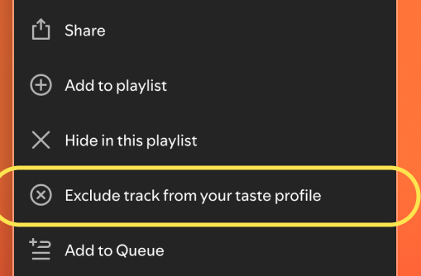
Listening and the Taste Profile
A play can serve a temporary purpose.
What outcome would show that recommendations improved?
Spotify track-exclusion announcement, October 2025.
Notes:
Activity time: 15 minutes.
Spotify’s 2025 announcement documents a track-level exclusion control. The pictured distinction gives a real setting for Juno’s recommendation problem from the videos. Ask students to separate immediate playback, future recommendations, and the outcome the listener values. A temporary use does not by itself reveal a stable preference. Propose a comparison and a measure of recommendation quality; do not infer effectiveness or a quantum mechanism from the feature’s existence. Save the comparison for Discussion 3.
Preparation: Watch the Module 3 videos. Read the Meridian and Juno examples and complete the short interference notebook. Bring an idea for your individual Discussion 3.
Assessment connection: M3A1_Discussion_3, M3A2_Audit_Practice, M4A1_Project_Part_2.
Workshop output: An individual Discussion 3 draft and a proposed managerial outcome to discuss with your audit team.
Sources (accessed November 11, 2026):
https://newsroom.spotify.com/2025-10-01/exclude-tracks-taste-profile/
Image description: Spotify’s official track menu shows Hide in this playlist separately from Exclude track from your taste profile. The latter is highlighted in the original image.

Slide 7
What the Panel Represents
Tier 1 checks the calculation using a simulator.
Tier 2 studies the model under documented prompts.
Tier 3 adds evidence from relevant people.
Notes:
Activity time: 15 minutes.
Have each group rewrite an overbroad sentence into a claim about the observed unit. A synthetic persona is not a human respondent. Bisbee et al., https://doi.org/10.1017/pan.2024.5, provide a comparison between synthetic outputs and human survey evidence.
Preparation: Watch the Module 3 videos. Read the Meridian and Juno examples and complete the short interference notebook. Bring an idea for your individual Discussion 3.
Assessment connection: M3A1_Discussion_3, M3A2_Audit_Practice, M4A1_Project_Part_2.
Workshop output: An individual Discussion 3 draft and a proposed managerial outcome to discuss with your audit team.

Slide 8
The Assessment Draft
Outline the handoff or recommendation issue for M3A1.
Name the outcome your project recommendation needs.
Bring the completed M3A2 run to the studio.
Notes:
Activity time: 10 minutes.
Give students individual writing time. The discussion brief specifies the post and peer response. The practice notebook is an ungraded checkpoint; it prepares the collection and analysis workflow.
Preparation: Watch the Module 3 videos. Read the Meridian and Juno examples and complete the short interference notebook. Bring an idea for your individual Discussion 3.
Assessment connection: M3A1_Discussion_3, M3A2_Audit_Practice, M4A1_Project_Part_2.
Workshop output: An individual Discussion 3 draft and a proposed managerial outcome to discuss with your audit team.

