Slide 1
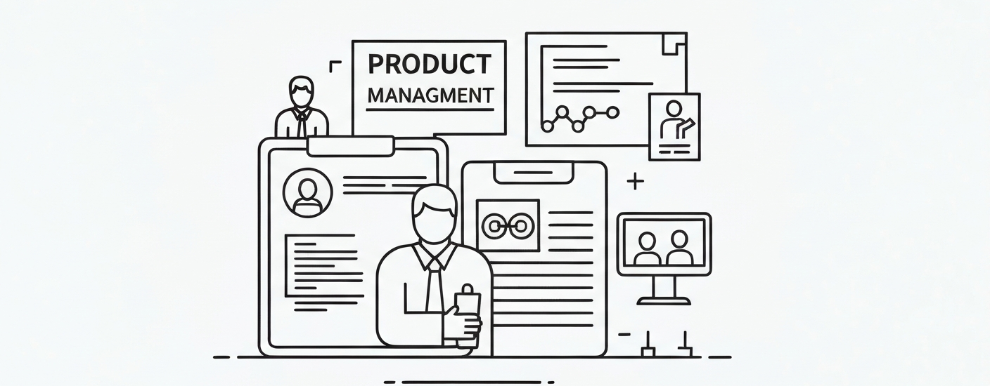
Unlocking Productivity: Leveraging
AI for Product Management
Explore how AI can revolutionize product management workflows and boost productivity

Slide 2
Welcome to the Future of Product Management
Streamline Product Roadmapping
  Leverage AI to efficiently plan and manage your
  product roadmap, ensuring alignment with
  business goals.
Uncover Deeper Customer
Insights
  Harness the power of AI to analyze customer data
  and gain valuable, actionable insights to drive
  informed decision-making.
Prioritize Tasks Intelligently
  AI-driven task prioritization helps you focus on the
  most impactful initiatives and maximize team
  productivity.
Proactively Mitigate Risks
  AI-powered risk analysis tools identify potential
  roadblocks and recommend strategies to
  proactively address them.
Personalize Workflows
  Customize your product management workflows
  with AI-driven recommendations for optimal
  efficiency.

Slide 3





AI-Powered Product Roadmapping
AI-Driven Product
Prioritization
Predictive
Roadmap
Planning
Personalized
Roadmap
Recommendations
Collaborative
Roadmap
Visualization
Dynamic
Roadmap
Adjustments
Leverage AI models
to analyze market
trends, customer
feedback, and
business objectives
to automatically
prioritize product
features and
initiatives for your
roadmap.
AI algorithms can
forecast market
demands, identify
potential
bottlenecks, and
suggest optimal
timelines for product
releases, helping you
build a more reliable
and adaptable
roadmap.
AI-powered tools
can provide
personalized
recommendations
for your product
roadmap based on
your unique
business needs, user
preferences, and
industry best
practices.
Leverage AI-
powered
collaboration and
visualization tools to
easily share your
product roadmap
with cross-
functional teams,
gather feedback,
and align on
priorities.
AI can continuously
monitor market
conditions and user
feedback, and
suggest real-time
adjustments to your
product roadmap to
ensure you stay agile
and responsive to
changing needs.

Slide 4
Intelligent Customer Insights
Key customer metrics powered by AI-driven analysis
85%
78%
12%
25%
Customer Satisfaction
Churn Rate
Lifetime Value
Conversion Rate

Slide 5
Automated Task Prioritization
AI-Powered Task Analysis
Intelligent Task Allocation
Predictive Task Scheduling
Leverage AI algorithms to analyze
your product management tasks and
prioritize them based on factors like
urgency, impact, and resource
requirements.
AI-driven task prioritization can
automatically assign tasks to the right
team members based on their skills,
availability, and workload, ensuring
optimal utilization of resources.
AI models can forecast task
completion times and dependencies,
allowing you to create more accurate
and realistic product roadmaps and
schedules.
Adaptive Task Reprioritization
Collaborative Task Management
As conditions change, AI-powered task prioritization can
dynamically adjust priorities, helping you respond to market
shifts and unexpected challenges.
Integrate AI-driven task prioritization with your team's
collaboration tools, enabling real-time updates and seamless
task coordination across the organization.

Slide 6






Predictive Risk Analysis
1
Leverage AI algorithms to continuously monitor your
product management processes
2
Utilize historical data and real-time insights to identify
potential risks and bottlenecks
3
Receive proactive alerts and recommendations to mitigate
issues before they escalate
4
Simulate different scenarios and model the impact of potential risks on
your product roadmap
5
Prioritize and address critical risks to ensure your product development
stays on track
6
Empower your team with AI-driven risk management capabilities for greater
agility and resilience

Slide 7







Personalized Workflow Optimization
Tailored Automation Recommendations
Adaptive Task Prioritization
Intelligent Workflow
Insights
Seamless Tool Integration

Slide 8




Empowering Your Team
Sarah Johnson
Michael Chen
Fatima Ramirez
Liam Patel
Product Manager
Software Engineer
UX Designer
Data Analyst

Slide 9
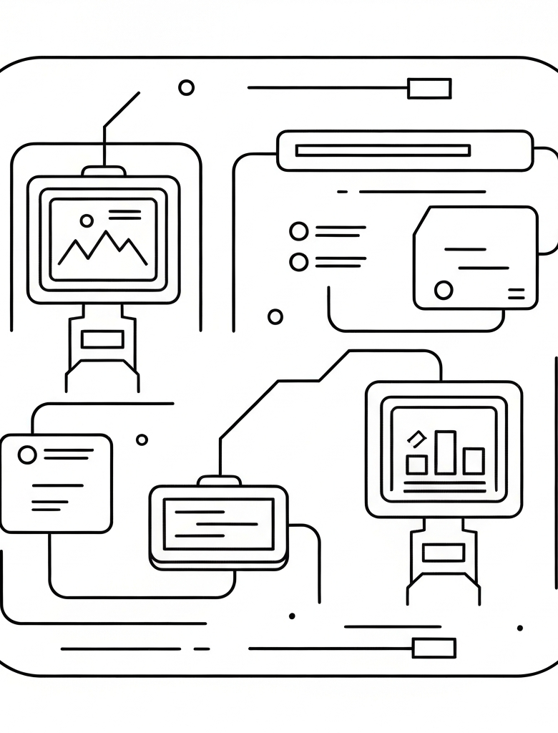
By embracing the power of AI, your product
management team can unlock unprecedented levels
of productivity, efficiency, and strategic insight. With
cutting-edge tools that streamline workflows, uncover
customer insights, and mitigate risks, you'll be
empowered to drive your business forward like never
before.

