Slide 1


Tech Innovators
AI Tools
for Product Management
PRESENTED BY
Jin Zhang

Slide 2

Why AI Matters
AI is transforming product management and marketing strategies in the B2B high tech sector, enhancing decision-making and driving efficiency across various processes.

Slide 3
Categories of AI Tools in B2B PM & Marketing
MARKET RESEARCH
CUSTOMER ENGAGEMENT
CONTENT CREATION
AI tools for market research analyze vast data sets, providing insights into consumer behavior, trends, and competitor strategies, enabling businesses to make informed decisions for product development.
Leveraging AI in customer engagement enhances personalized interactions through targeted messaging and automated responses, allowing businesses to build stronger relationships while improving customer satisfaction and retention rates.
AI-driven content creation tools assist marketers in generating relevant, high-quality content quickly, ensuring alignment with audience interests, ultimately fostering better brand visibility and engagement through tailored messaging.

Slide 4

Tool Spotlight: Gong
Gong is a conversation intelligence platform that analyzes sales calls to identify customer needs, improve messaging, and accelerate sales cycles, enhancing overall sales effectiveness for B2B organizations.

Slide 5
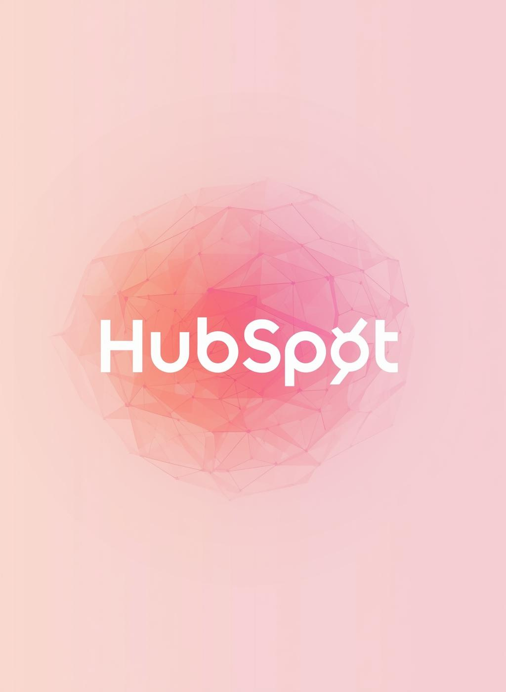
Tool Spotlight: HubSpot
HubSpot AI enhances marketing automation through features like lead scoring and personalization, helping B2B businesses streamline campaigns and improve customer engagement effectively.

Slide 6

Crystal Knows
Crystal Knows is an AI-driven tool that analyzes personality profiles, enabling product managers and marketers to tailor their communication strategies for better engagement and resonance with their audience.

Slide 7

Tool Spotlight: Drift
Drift is an AI chat and conversational marketing platform that automates customer engagement, efficiently qualifying leads and enhancing overall website interaction to shorten sales cycles.

Slide 8
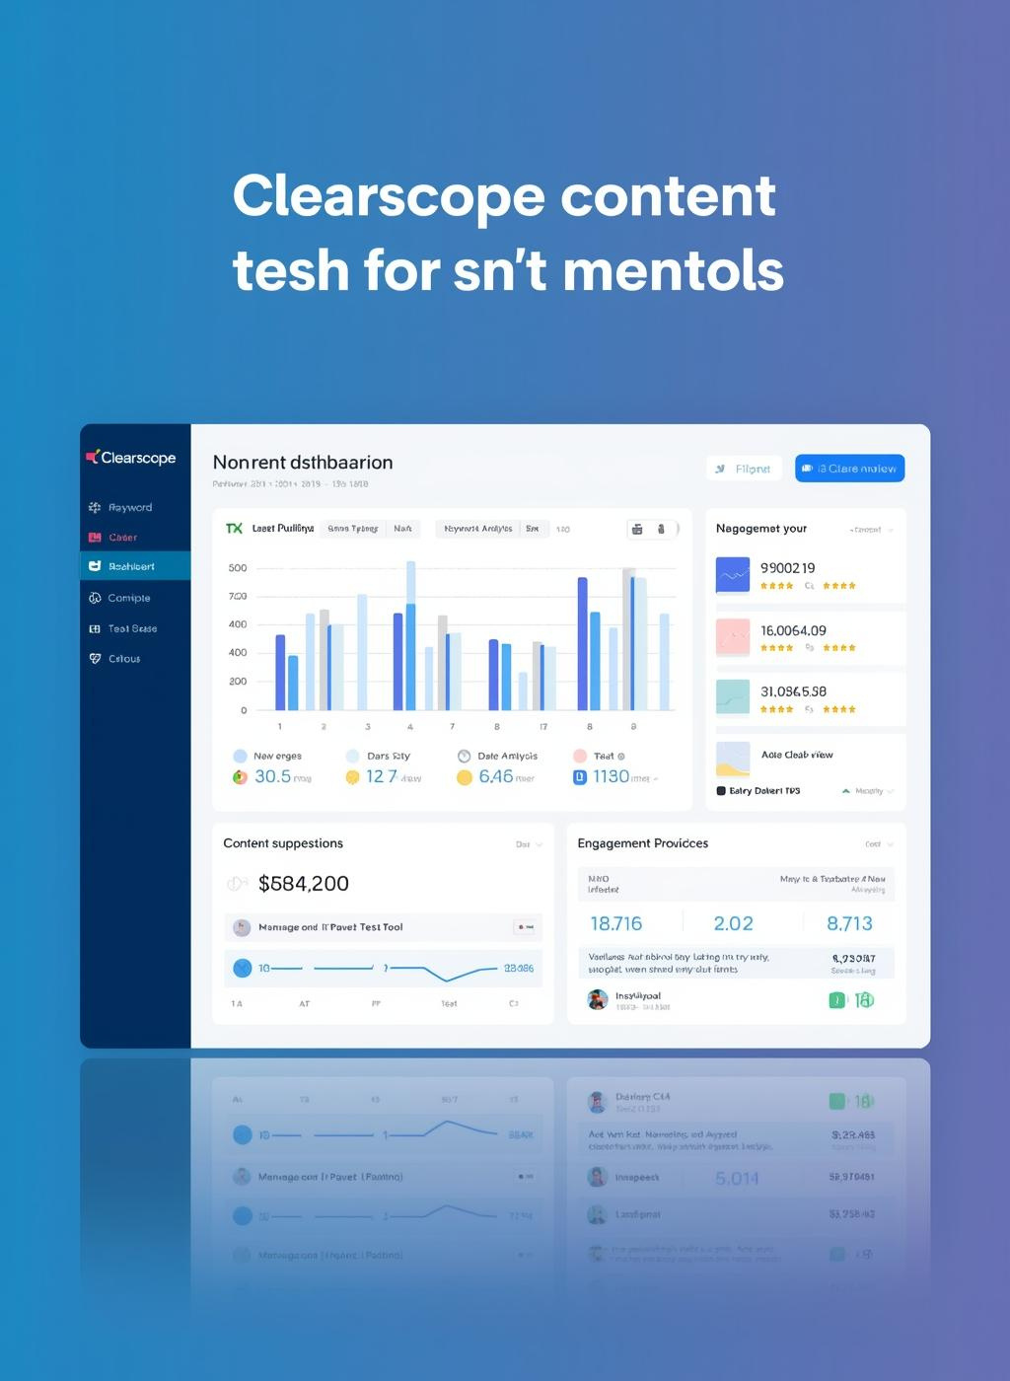
Tool Spotlight: Clearscope
Clearscope is an AI-driven content optimization tool that enhances SEO strategies. It helps marketers ensure content relevance, improves organic search rankings, and supports effective marketing strategies.

Slide 9
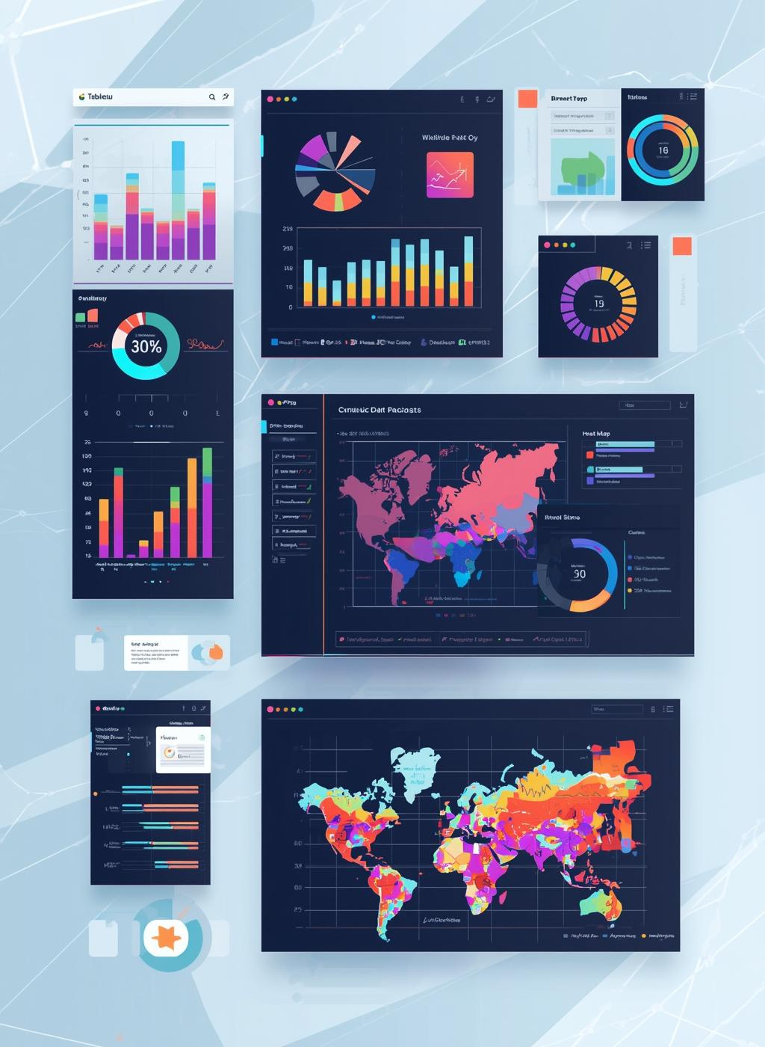
Tableau with AI Features
Tableau is a leading data visualization tool that integrates AI-driven predictive analytics, enabling product managers to make data-informed decisions and enhance marketing strategies effectively.

Slide 10
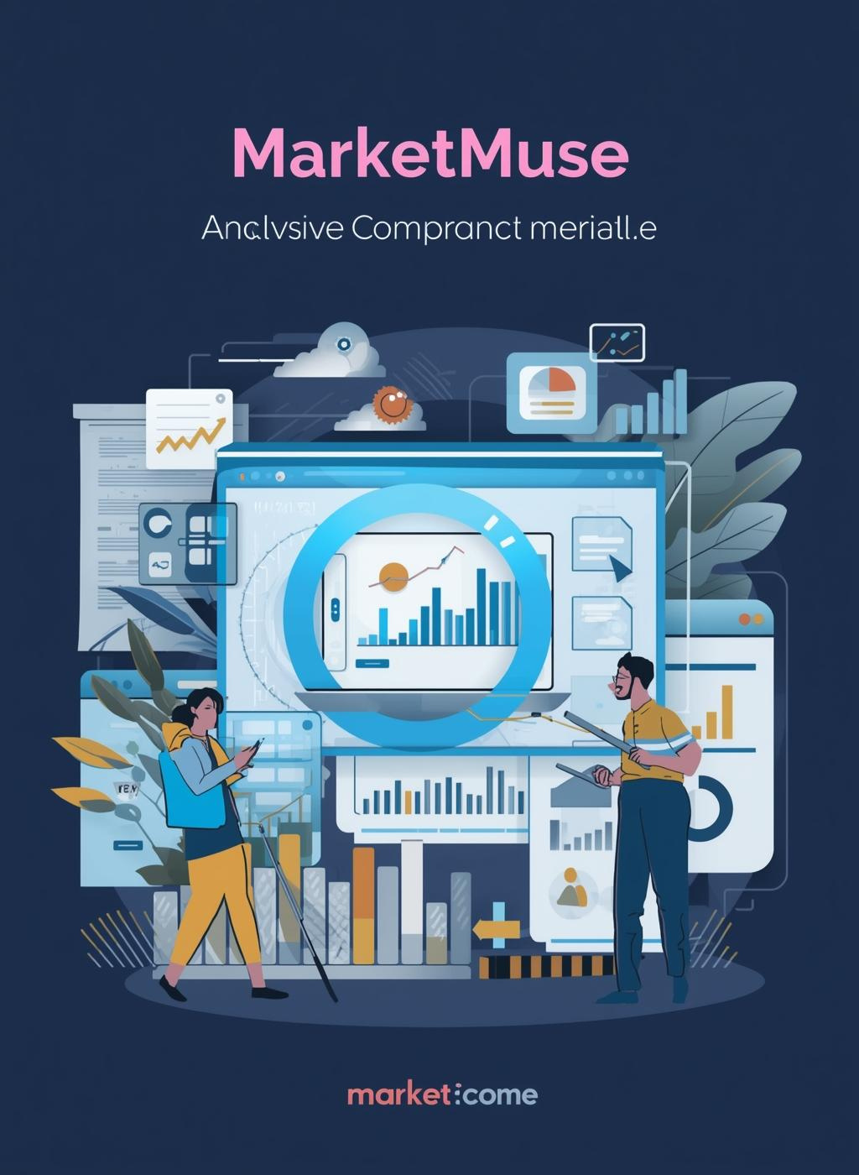
Tool Spotlight: MarketMuse
MarketMuse is an AI-powered content strategy platform that identifies content gaps and guides creation aligned with customer intent, empowering marketers to enhance their content strategies effectively.

Slide 11
Benefits & Considerations
INCREASED EFFICIENCY
AI tools significantly enhance operational efficiency by automating routine tasks, allowing teams to focus on strategic initiatives. This streamlining leads to faster decision-making and improved productivity across departments.
DATA PRIVACY
While leveraging AI tools offers numerous advantages, data privacy concerns must be addressed. Ensuring compliance with regulations and safeguarding sensitive information is crucial for maintaining customer trust and organizational integrity.

Slide 12
Next Steps & Recommendations
EVALUATE WORKFLOWS
Assess current processes to identify areas where AI tools can streamline operations, enhance productivity, and support decision-making, ensuring alignment with strategic business objectives.
PILOT AI TOOLS
Select a few AI tools that meet your team’s unique needs, allowing for initial testing and feedback to measure effectiveness before wider implementation across the organization.
INVEST IN TRAINING
Provide comprehensive training for team members to ensure smooth adoption of AI technologies, maximizing their potential benefits while addressing any technical challenges and promoting user confidence.

Slide 13
Questions and Discussion Time
LET'S EXPLORE YOUR THOUGHTS AND INQUIRIES

