Slide 1
BookMyTable Website
Guide By: Dr. Jasmin Bhootwala
Moradiya Nensi J.(BCA21142)

Slide 2
Abstract
“BookMyTable” is web based application which help restaurant administration to store the details of booking tables and manage sub-admin . The system is also intended to provide better services to users, provide meaningful, consistent, and timely data and information and finally promotes efficiency by converting paper processes to electronic form. The system was developed using basic technologies such as MySQL database and PHP. The system is free of errors and very efficient and less time consuming due to the care taken to develop it. All the phases of software development cycle are employed and it is worthwhile to state that the system is user friendly and strong. Provision is made for future development in the system.

Slide 3
Objectives
The objective of “BookMyTable” is to allow the restaurant administrator to check table booking details and find previous records of booking. It will also facilitate keeping all the record of sub-admins and booking tables, So all the information about them will be available in a few seconds. Basically, “Restaurant Table Booking System” is a system, developed for the restaurant as well as user for booking tables which leads to decrease the waiting time.
Purpose
The purpose of developing “BookMyTable” is to provide an online platform for the restaurant customers to book table without waiting a time and it also computerized the tradition way of recording data of booking tables and to generate the report automatically.

Slide 4
Scope
Visiting restaurant for having good food stuff has become common these days. Besides good food, service is also an important factor which attracts customers. Generally, we have to wait in the restaurant for table availability and it leads to time wasting.
“BookMyTable” is online platform for to the Restaurant Administrator and the Restaurant Users. The application has a simple website that is accessible to anyone where the visitor can book the table of the restaurant. Users can simply submit their booking requests by filling all the fields on the booking form. For Restaurant Administrator, the system contains an Admin Panel where the management can manage the booking list which is sent by the users and mange sub- admin.

Slide 5
Project Modules
In this project we use PHP and MySQL database. It has two modules admin and user.
Admin/Sub-Admin
User

Slide 6
Admin Module
Dashboard: In this section admin can see all detail in brief like total sub-admin, Total Booking, New Booking, Accepted Booking and Rejected booking.
Sub-Admins: In this section, admin can create the sub-admin, delete sub-admins, edit sub-admins, and reset the passwords of sub-admins.
Booking: In this section, admin can view booking request and take actions on new bookings.
Table: In this section admin can manage tables(Add/Delete)
Reports: In this section admin can view table booking details in particular periods.
Admin can also update his profile, change password and recover password.

Slide 7
User Module
In “Restaurant Table Booking System” user visit to website which is accessible to anyone where the user can book the table of the restaurant. Users can simply submit their booking requests by filling all the fields on the booking form.

Slide 8
Requirement Specification
Hardware Configuration:
Client Side
Server Side
RAM | 512 MB
Hard Disk | 10GB
Processor | 1.0 GHz
RAM | 1 GB
Hard Disk | 20GB
Processor | 2.0GHz

Slide 9
Continue.....
Software Requirement:
Client Side
Server Side
Web Browser | Google Chrome or any compatible browser
Operating System | Windows or any equivalent OS
Web Server | APACHE
Server side Language | PHP5.6 or above version
Database Server | MySQL
Web Browser | Google Chrome or any compatible browser
Operating System | Windows or any equivalent OS

Slide 10
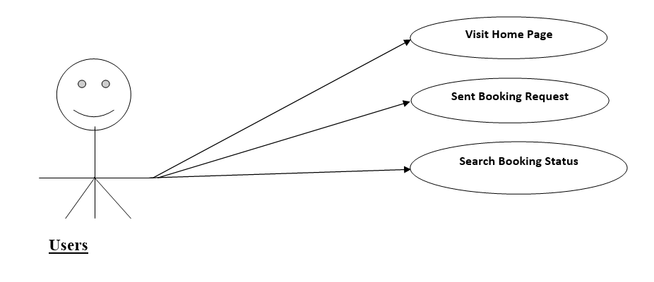
Use Case Diagram
User
Notes:
USECASE DIAGRAM: A Use case is a description of set of sequence of actions. Graphically it is rendered as an ellipse with solid line including only its name. Use case diagram is a behavioral diagram that shows a set of use cases and actors and their relationship. It is an association between the use cases and actors. An actor represents a real-world object. Primary Actor – Sender, Secondary Actor Receiver.

Slide 11
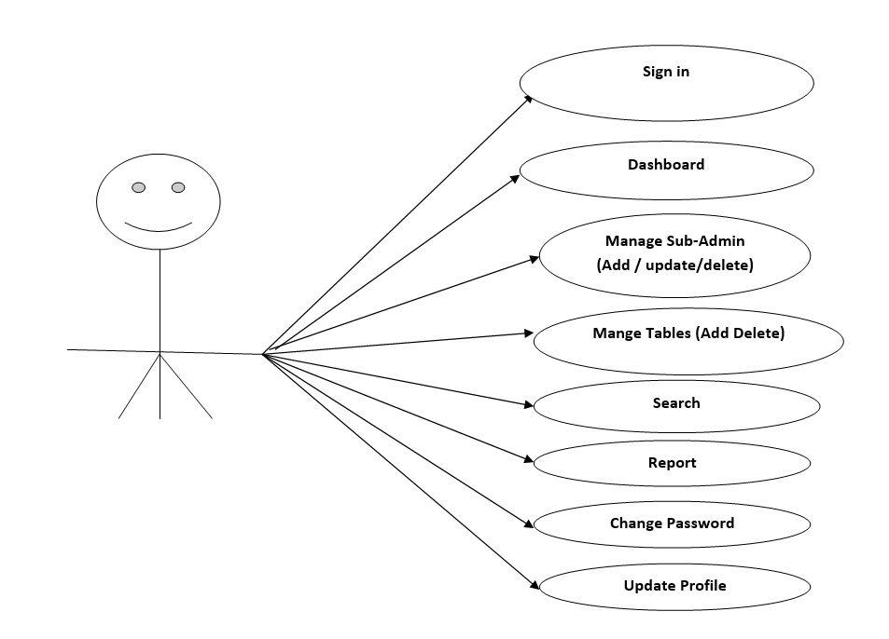
Continue…
Admin

Slide 12
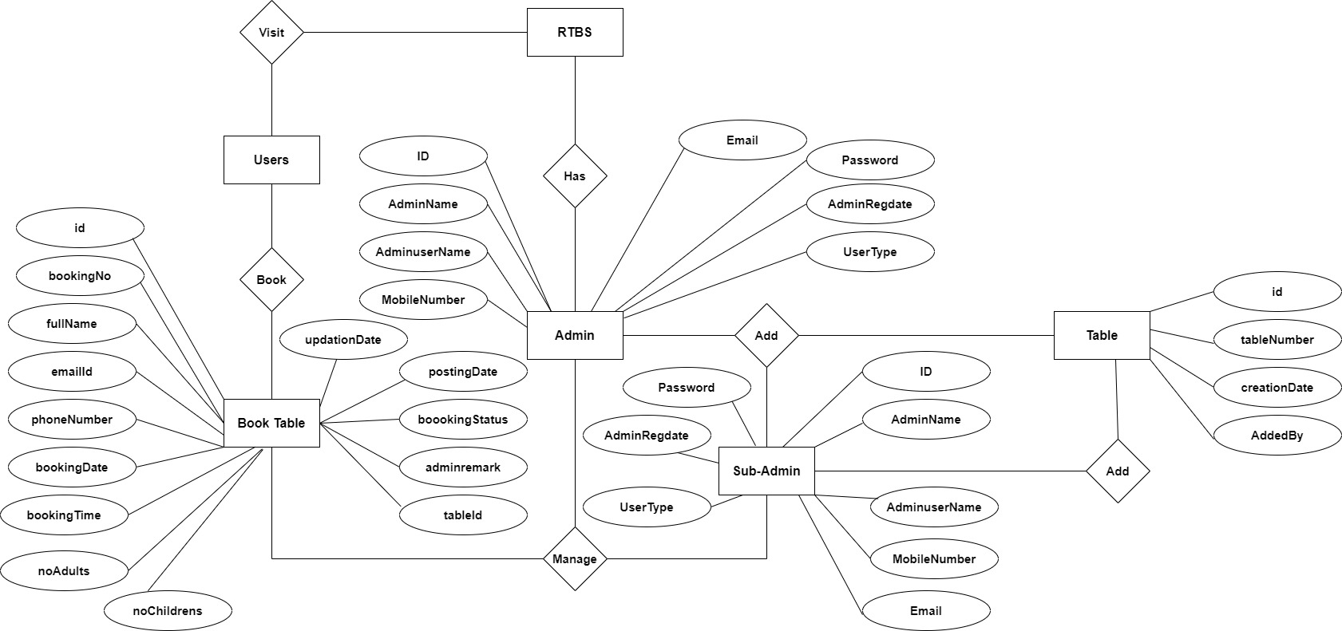
ER Diagram

Slide 13
Dataflow Diagrams (DFDs)
A Data Flow Diagram (DFD) is a traditional visual representation of the information flows within a system. A neat and clear DFD can depict the right amount of the system requirement graphically. It can be manual, automated, or a combination of both.
It shows how data enters and leaves the system, what changes the information, and where data is stored.
The objective of a DFD is to show the scope and boundaries of a system as a whole. It may be used as a communication tool between a system analyst and any person who plays a part in the order that acts as a starting point for redesigning a system. The DFD is also called as a data flow graph or bubble chart.

Slide 14
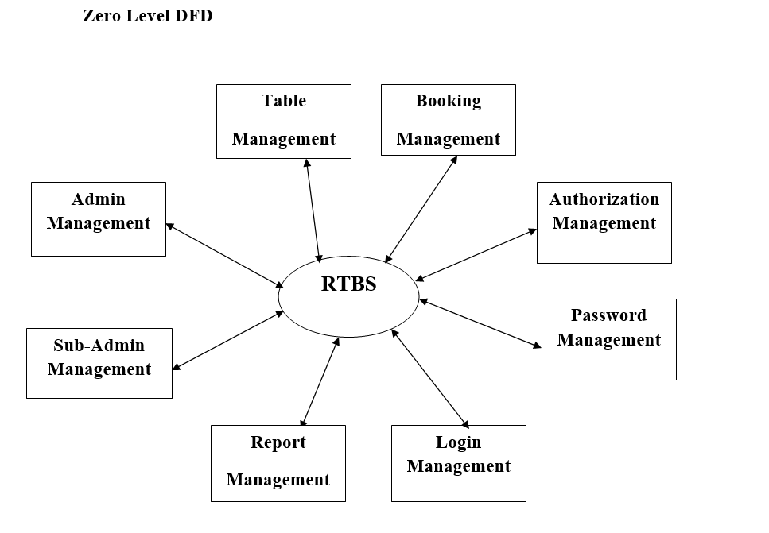

Slide 15
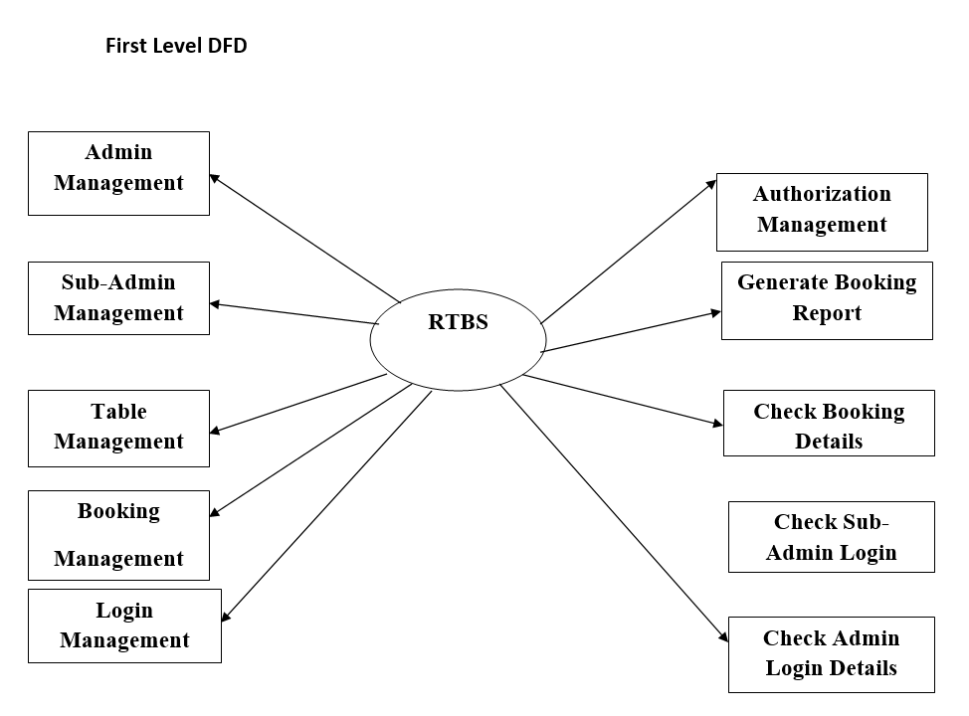

Slide 16
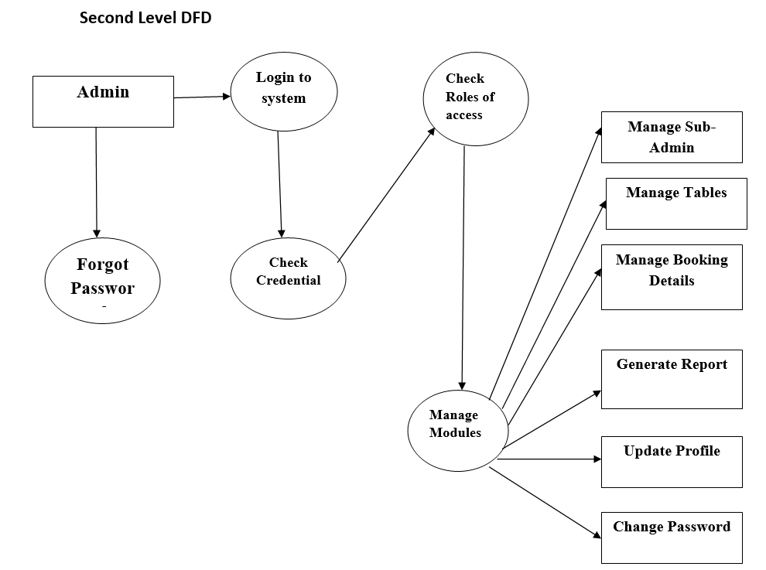

Slide 17
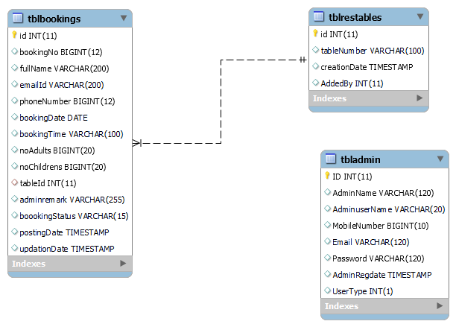
Class Diagram
Notes:
The class diagram shows a set of classes, interfaces, collaborations and their relationships.

Slide 18
Implementation and
System Testing
After all phase have been perfectly done, the system will be implemented to the server and the system can be used.
System Testing
The goal of the system testing process was to determine all faults in our project .The program was subjected to a set of test inputs and many explanations were made and based on these explanations it will be decided whether the program behaves as expected or not. Our Project went through two levels of testing
Unit testing
Integration testing

Slide 19
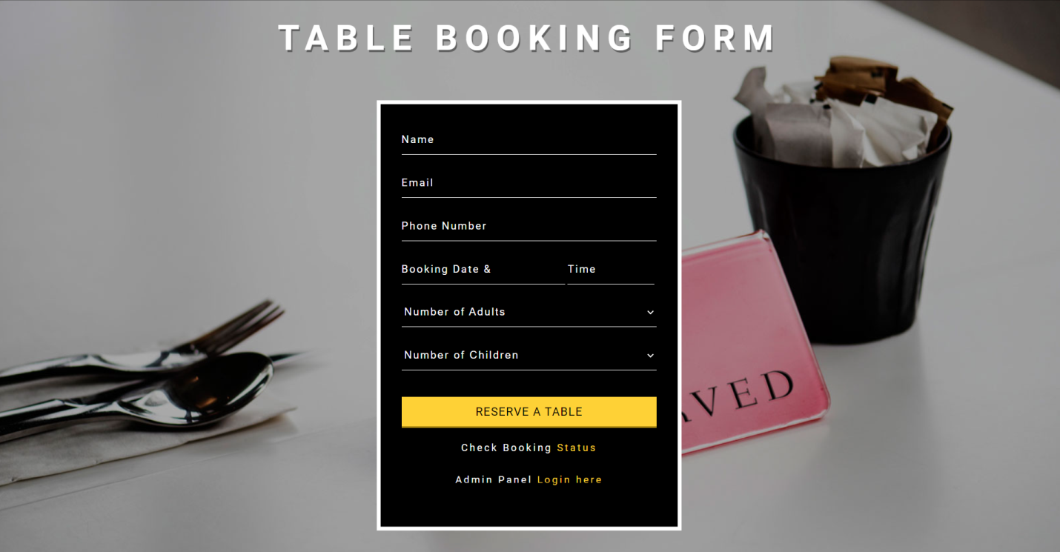
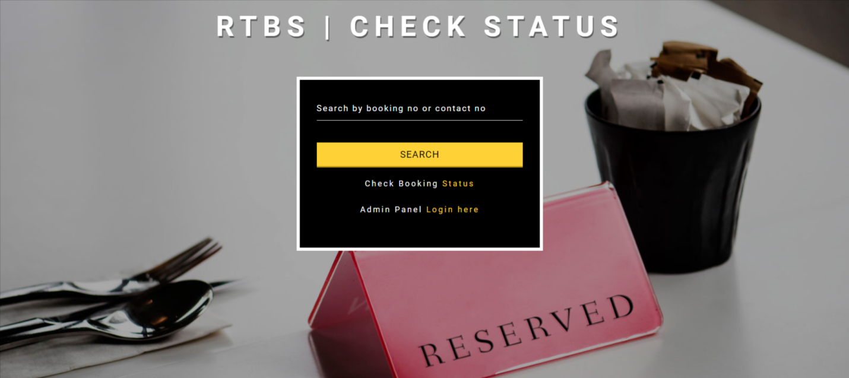
Project Screens

Slide 20
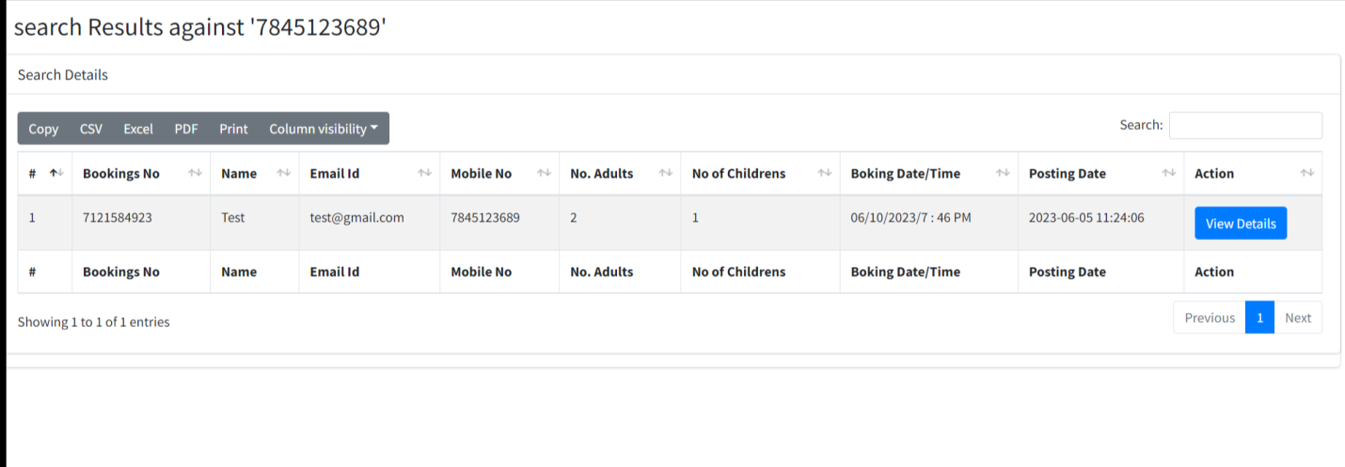
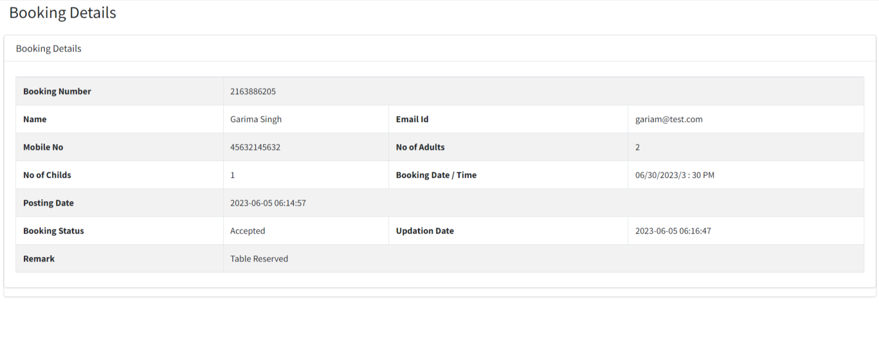

Slide 21
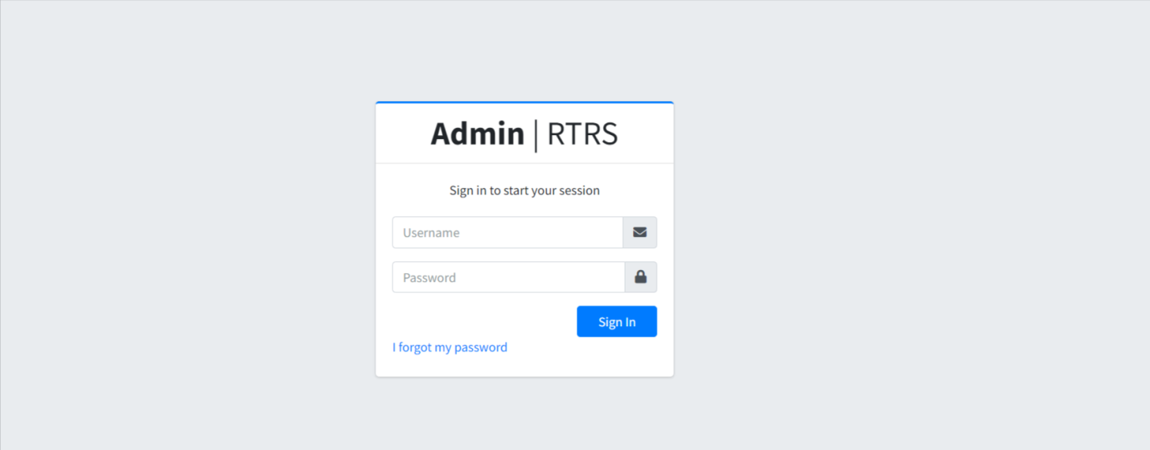
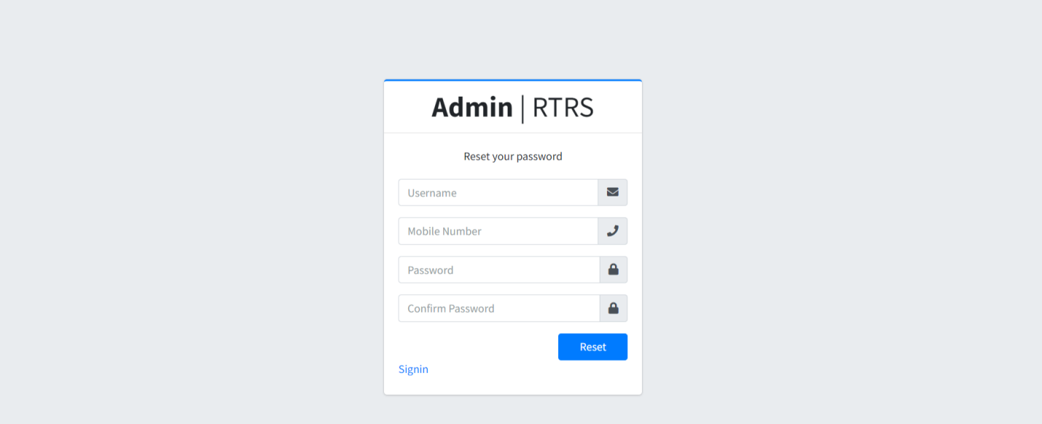

Slide 22
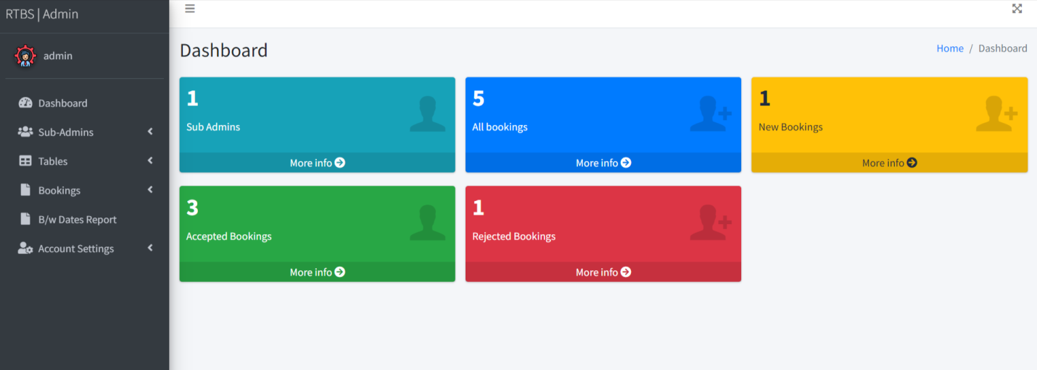
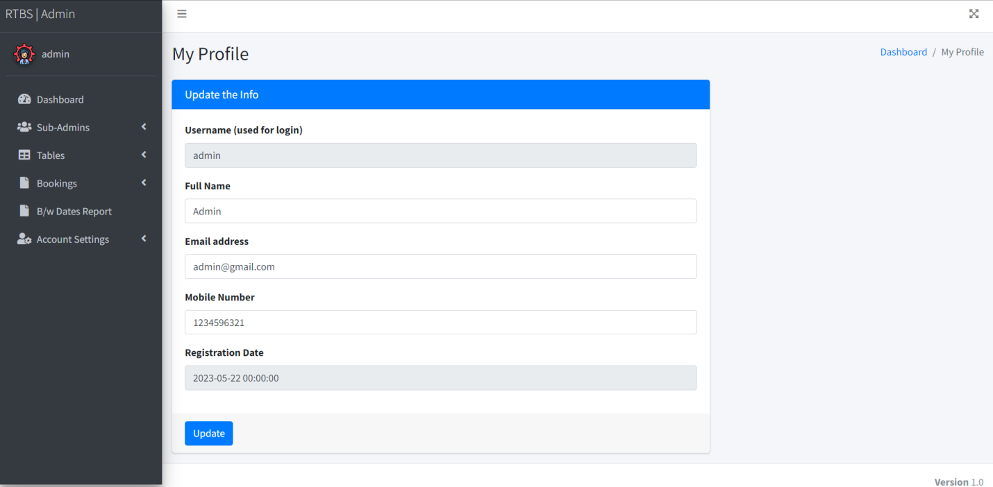

Slide 23
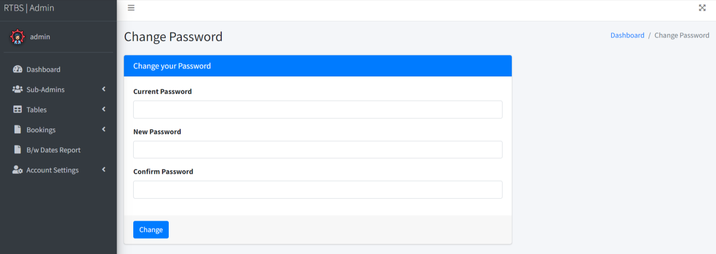

Slide 24

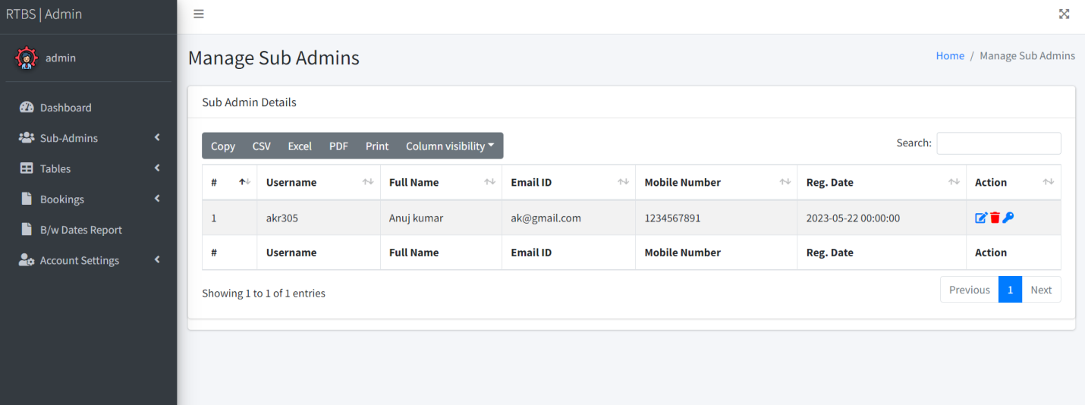

Slide 25
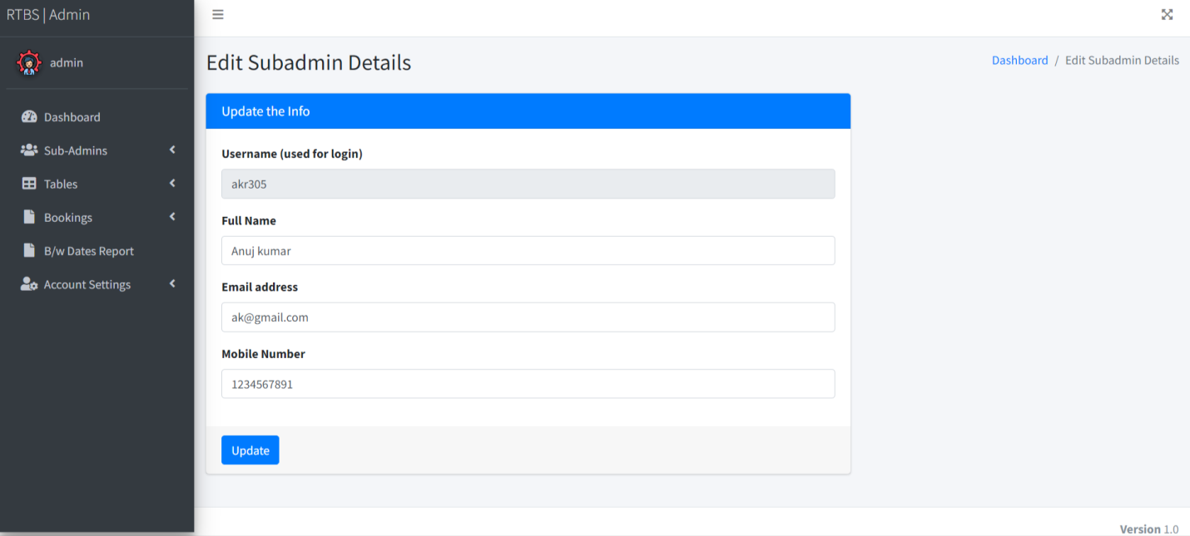
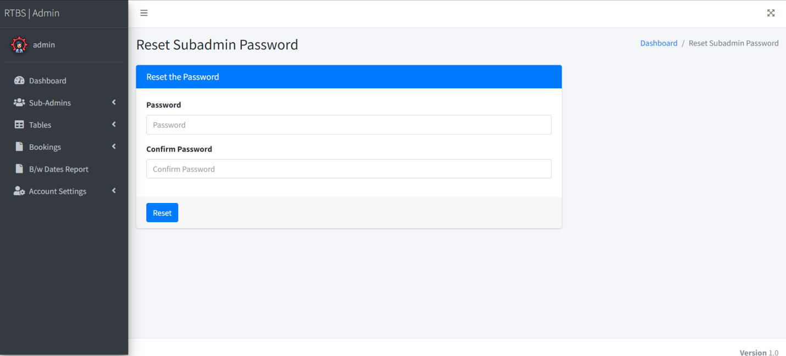

Slide 26
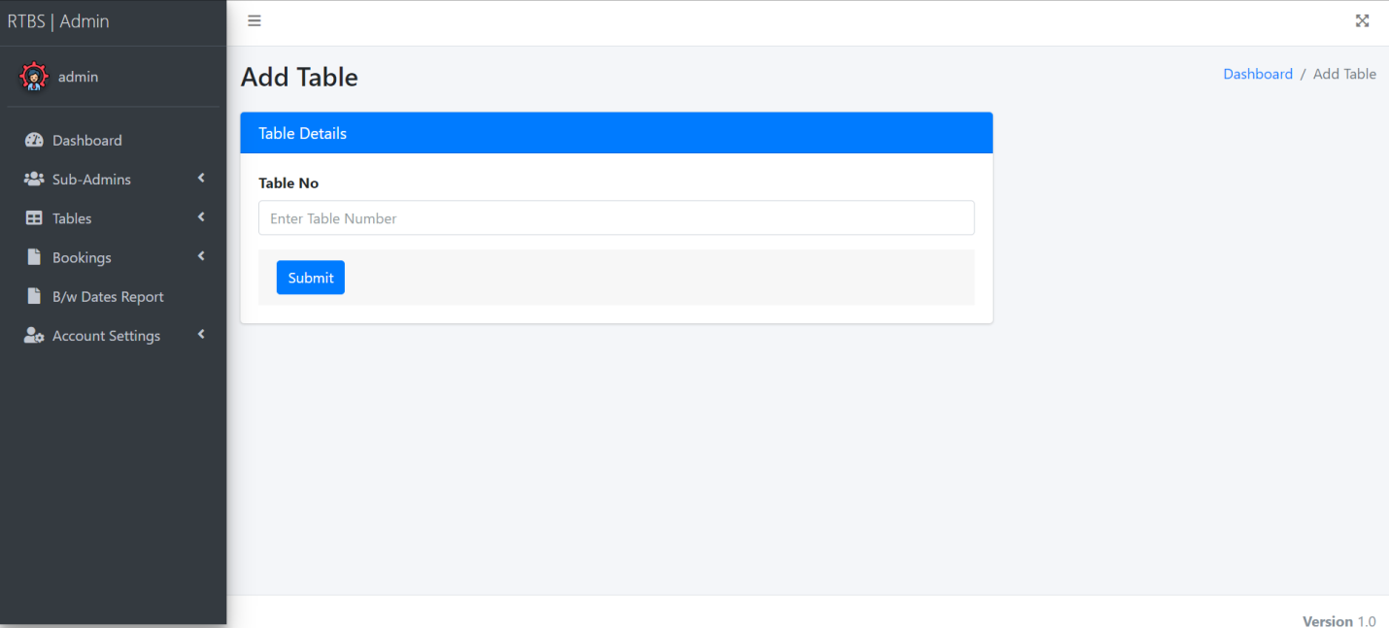
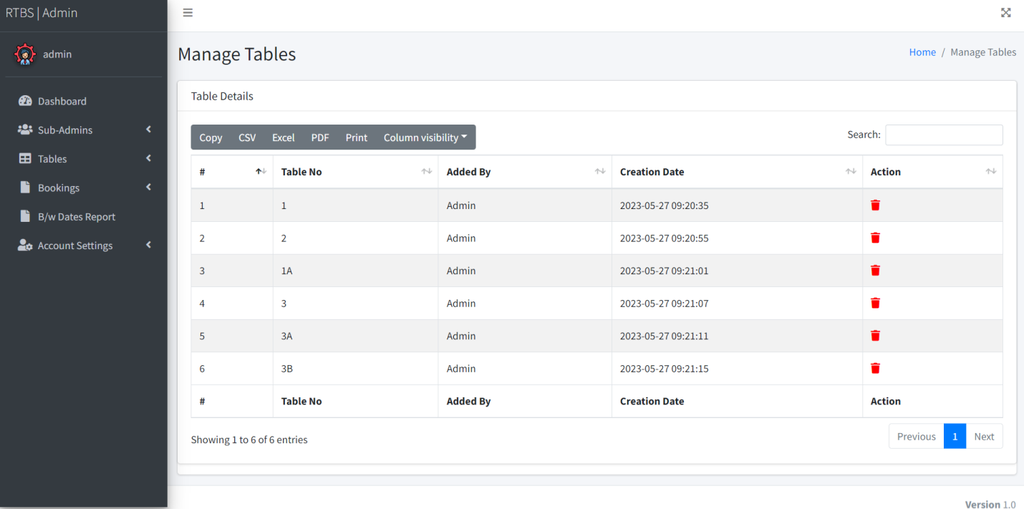

Slide 27
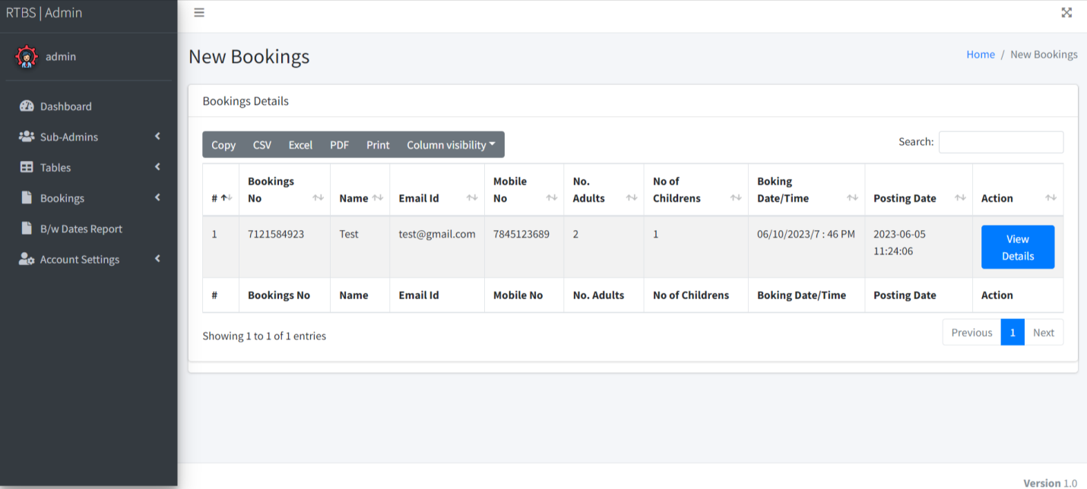
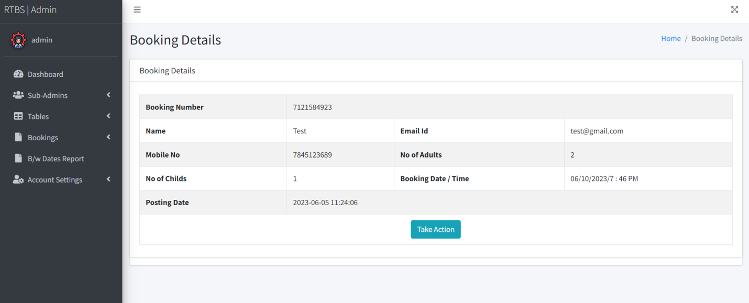

Slide 28
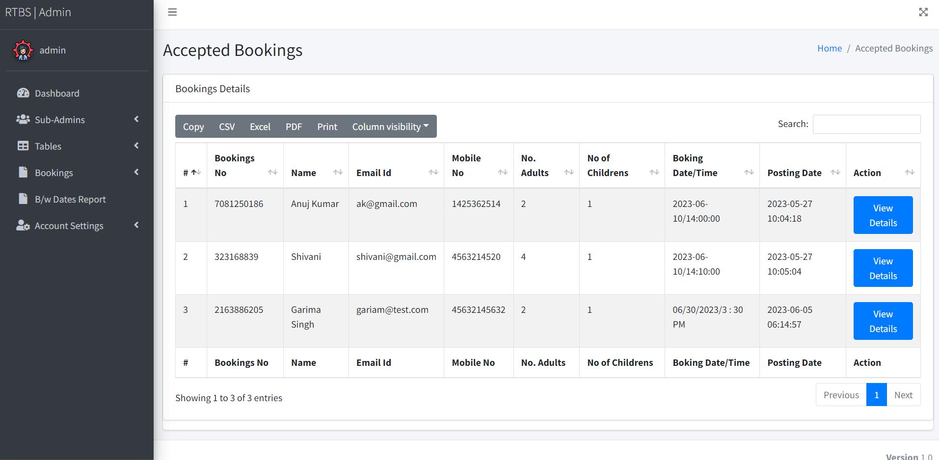
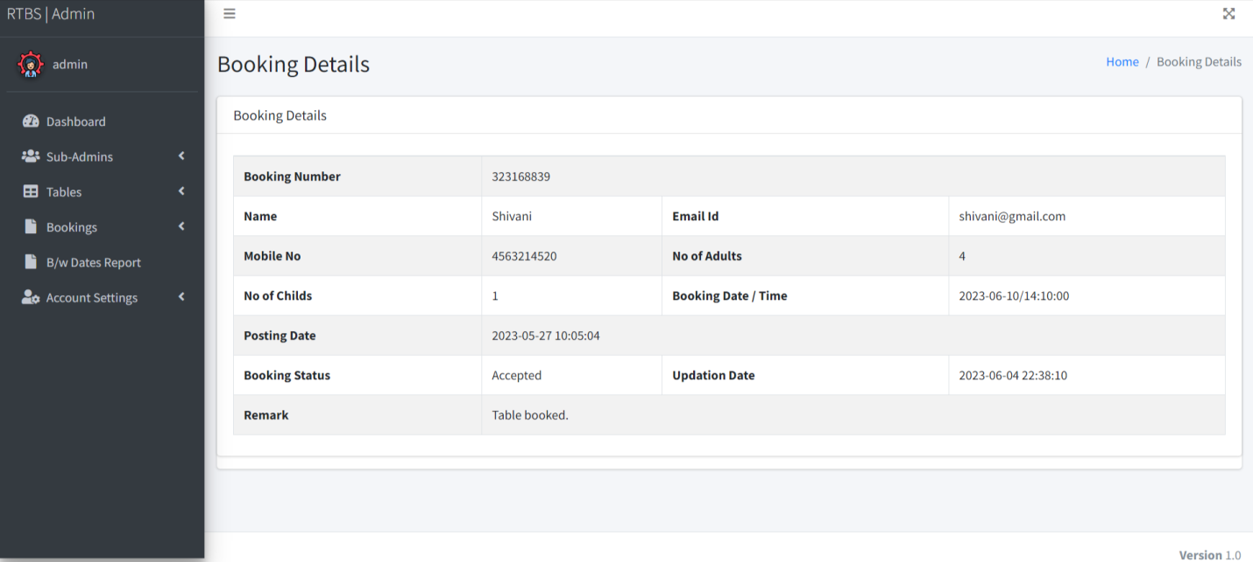

Slide 29
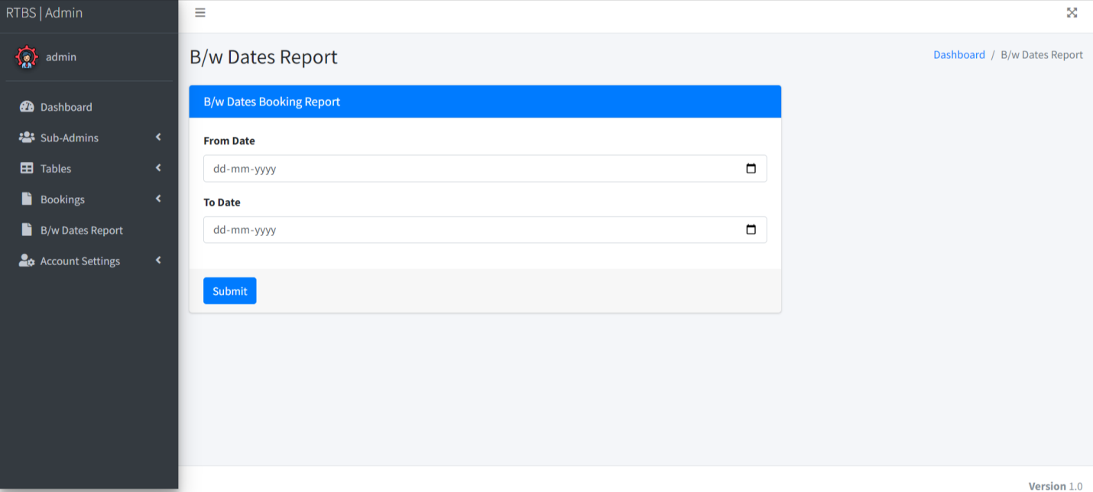
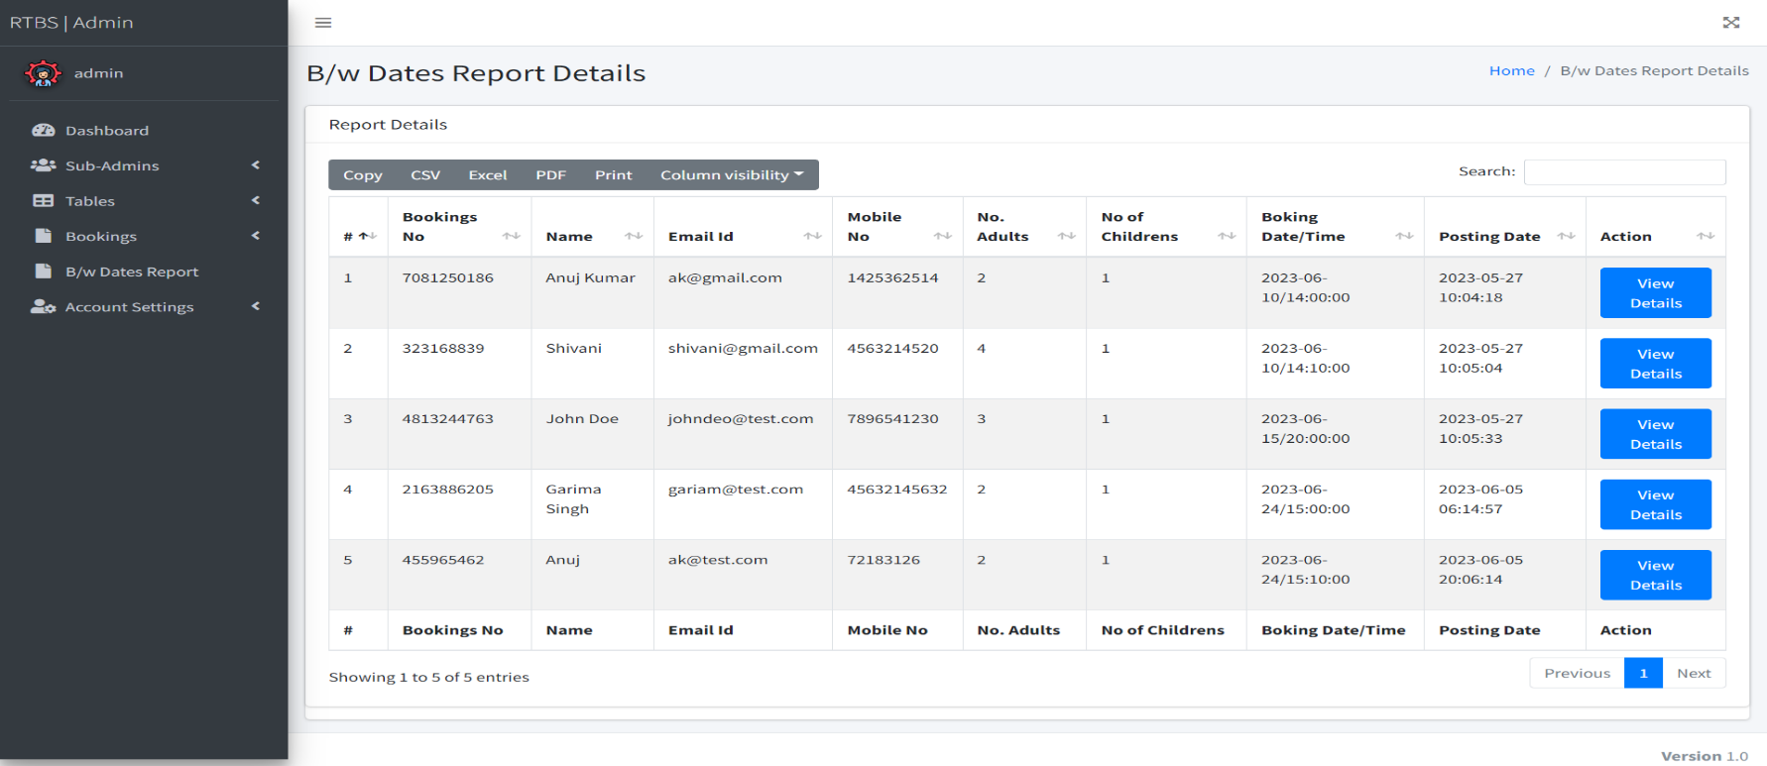

Slide 30
Conclusion
The application was designed in such a way that future modifications can be done easily. The following conclusion can be deduced from the development of the project.
Automation of the entire system improves the efficiency.
It provides a friendly graphical user interface which proves to be better when compared to the existing system.
It gives appropriate access to the authorized users depending on their permissions.
It effectively overcomes the delay in communications.
Updating of information becomes so easier.
System security, data security and reliability are the striking features.
The System has adequate scope for modification in future if it is necessary.

Slide 31
Future Enhancement
I have tried to design the software in such a way that the user may not have any difficulty in using this system and further expansion is also possible. New requirements will be added and risk will be analyzed in every phase until the requirement of user will not be fulfilled. The most priority will be given to keep confidential data secure and easy and simple for use.
The further enhancements which can be made in the system are:
Any requirement that will make system easy to use or make a system secure, these requirement will be add using Spiral Model. Other requirement related to government or municipality will be added when required.
For the identity of user and for their data integrity, digital signature can be added to this system.
For the identity of user and for verification, image of user can be added to this system.
There will be provision of filling form in multiple languages.
A great concern will be given on frontend design which will make user to use system easily and enjoy while using this system.

Slide 32
References
For PHP
https://www.w3schools.com/php/default.asp
https://www.sitepoint.com/php/
https://www.php.net/
For MySQL
https://www.mysql.com/
http://www.mysqltutorial.org
For XAMPP
https://www.apachefriends.org/download.html

Slide 33
Thank You

