Slide 1
TDD
Test Driven Development

Slide 2
What is Test Driven Development?
TDD, in its most basic terms, is the process of implementing code by writing your tests first, seeing them fail, then writing the code to make the tests pass. You can then build upon this developed code by appropriately altering your test to expect the outcome of additional functionality, then writing the code to make it pass again.

Slide 3
TDD?
You can see that TDD is very much a cycle, with your code going through as many iterations of tests, writing, and development as necessary, until the feature is finished. By implementing these tests before you write the code, it brings out a natural tendency to think about your problem first. While you start to construct your test, you have to think about the way you design your code. What will this method return? What if we get an exception here? And so on.

Slide 4
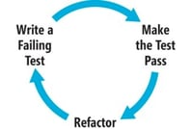
TDD?
By developing in this way, it means you consider the different routes through the code, and cover these with tests as needed. This approach allows you to escape the trap that many developers fall into (myself included): diving into a problem and writing code exclusively for the first solution you need to handle

Slide 5
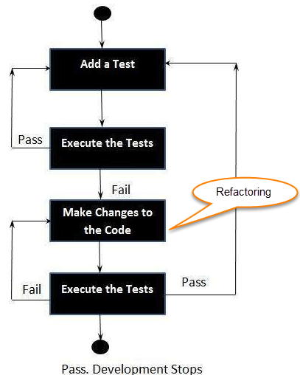
How to perform TDD Test?
Following steps define how to perform TDD test,
Add a test.
Run all tests and see if any new test fails.
Write some code.
Run tests and Refactor code.
Repeat.

Slide 6
TDD cycle defines
Write a test
Make it run.
Change the code to make it right i.e. Refactor.
Repeat process.

Slide 7
Some clarifications about TDD:
TDD approach is neither about “Testing” nor about “Design”.
TDD does not mean “write some of the tests, then build a system that passes the tests.
TDD does not mean “do lots of Testing.”

Slide 8
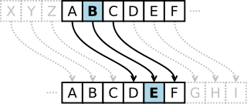
Example of TDD
זהו סוג של צופן החלפה שבו כל אות בטקסט מוחלפת על ידי אות הנמצאת בהיסט קבוע כלשהו ממנה באלף-בית. לדוגמה נקבע את ההיסט להיות 3: A D B E

Slide 9

TDD -Class exercise
BMI הוא מדד הנותן הערכה כמותית האם אדם נמצא במשקל תקין,בעודף משקל או תת משקל.
המדד מחושב על פי נותני גובה במטרים ומשקל בקילוגרם.
BMI בין 18.5 ל-25 נחשב למשקל תקין. BMI מעל 25 נחשב למשקל עודף. BMI מתחת 18.5 נחשב לתת-משקל.

Slide 10
TDD -Class exercise
כתבו פונקציה לחישוב BMI התבססת על שיטת הTDD. בנו בשלבים כפי שהראנו בדוגמה.
Write a test
Make it run.
Change the code to make it right i.e. Refactor.
Repeat process.

