Slide 1
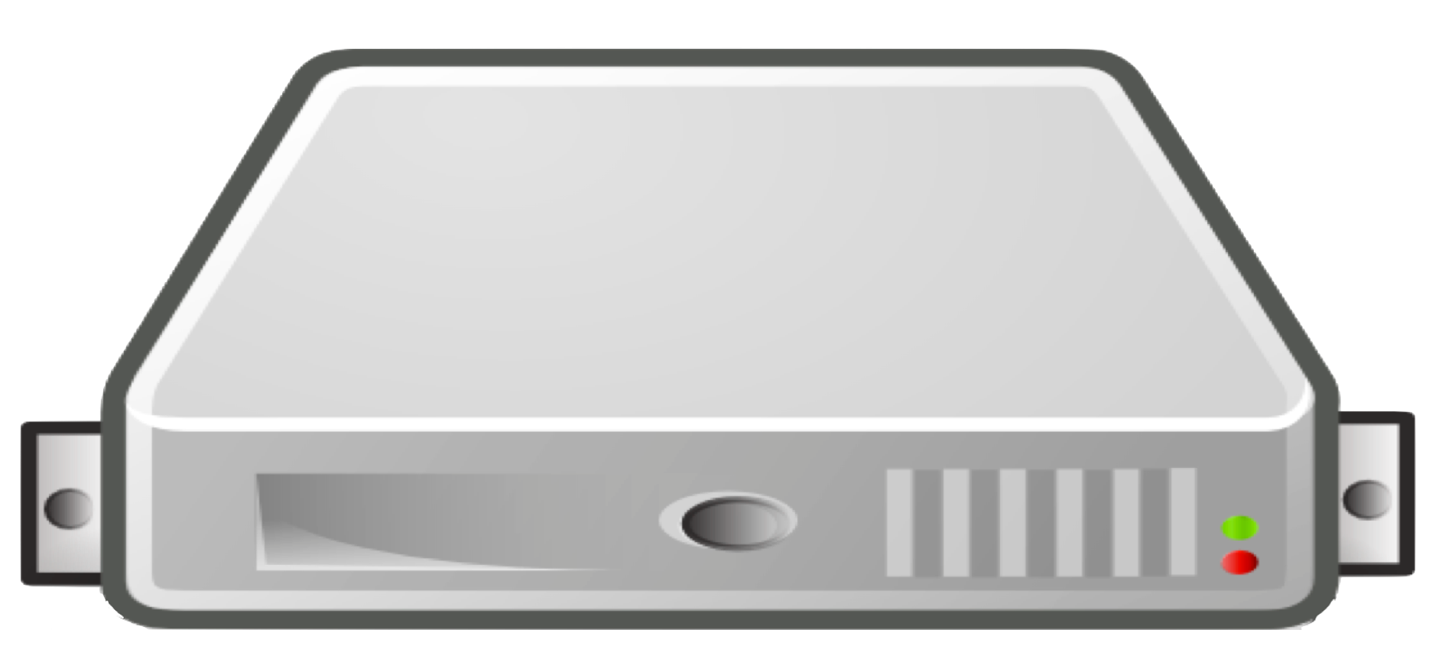
Data Center 1
Data Center 2
Data Center 3
Core Server
Core Server
Core Server
Read Replica
Read Replica
Read Replica
Read Replica
Read Replica
Read Replica

Slide 2
Data Center 1
Data Center 2
Data Center 3
Core Servers
Core Servers
Core Servers
Read Replica
Read Replica
Read Replica
Read Replica
Read Replica
Read Replica

Slide 3
Data Center 1
Data Center 2
Core Servers
Core Servers

Slide 4
Data Center 1
Data Center 2
Core Servers
Core Server

Slide 5
Data Center 1
Data Center 2
Data Center 3
Core Servers
Read Replicas
Read Replicas

Slide 6
Data Center 1
Data Center 2
Data Center 3
Core Servers
Core Servers
Core Servers
Read Replica
Read Replica
Read Replica
Read Replica
Read Replica
Read Replica
Read Replica
Read Replica
Read Replica
Read Replica
Read Replica
Read Replica
Read Replica
Read Replica
Read Replica
Read Replica
Read Replica
Read Replica

Slide 7
Data Center 1
Data Center 2
Data Center 3
Core Servers
Core Servers
Core Servers
Write at Bookmark X
Read Replica
Read Replica
Read Replica
Read Replica
Read Replica
Read Replica
Read Replica
Read Replica
Read Replica
Read Replica
Read Replica
Read Replica
Read Replica
Read Replica
Read Replica
Read Replica
Read Replica
Read Replica
Read later at Bookmark X

Slide 8
north
east
north1
north2
north3
east1
east2
east3
east4
south
west
south1
south2
west1
west2

Slide 9
connect-randomly-within-server-group
typically-connect-to-random-read-replica
connect-to-random-core-server
Most preferred strategy to least preferred

