Slide 1
URISC ISA
8 bit integers
8 bit byte addressable memory
Direct addressing only
1 instruction: subneg a, b, c
M[b] <- M[b] – M[a]
Branch to PC + c if result < 0
3 byte format:
byte 0
byte 1
byte 2
a
b
c

Slide 2
URISC Execution
Load inst. byte 0 (a), increment PC
Load M[a]
Load inst. byte 1 (b), increment PC
Load M[b]
Write M[b] – M[a] to M[b]
Load inst. byte 2 (c), increment PC, if not branch then goto 1
PC = PC + c, goto 1

Slide 3
URISC Datapath
PC
R
MDR
in1
in2
out
ALU
add
incr
N
N
MAR
address
Memory
rd data
wr data

Slide 4
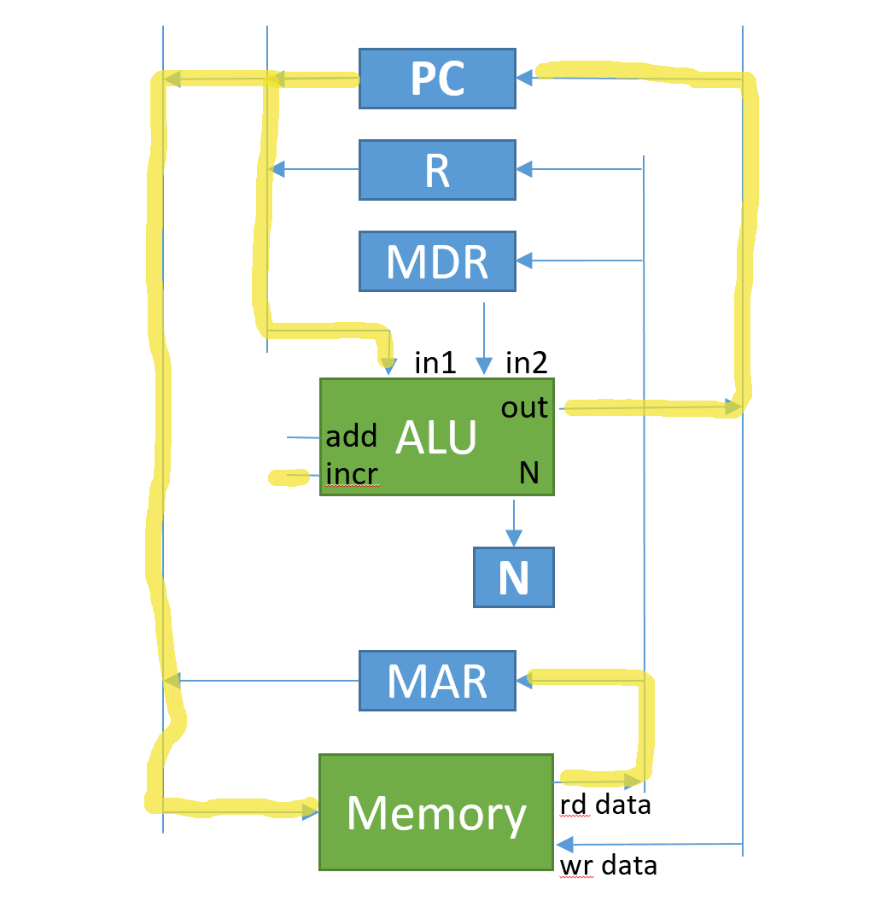
Step 1 – fetch a, incr. PC

Slide 5
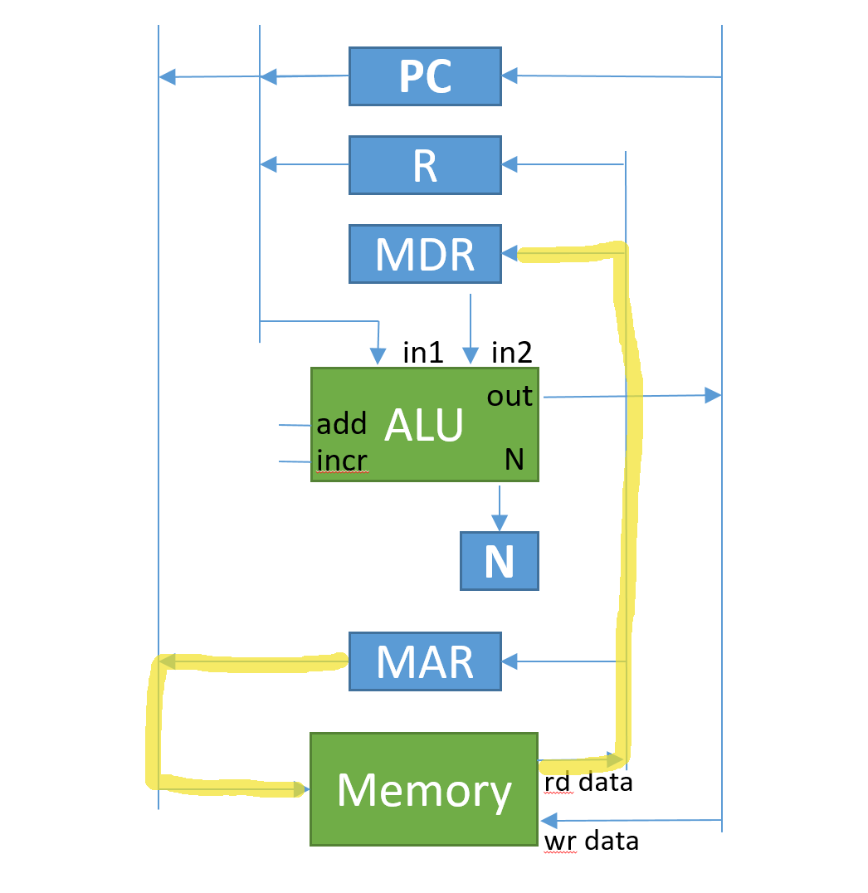
Step 2 – load M[a]

Slide 6
Step 3 – load b, incr. PC

Slide 7
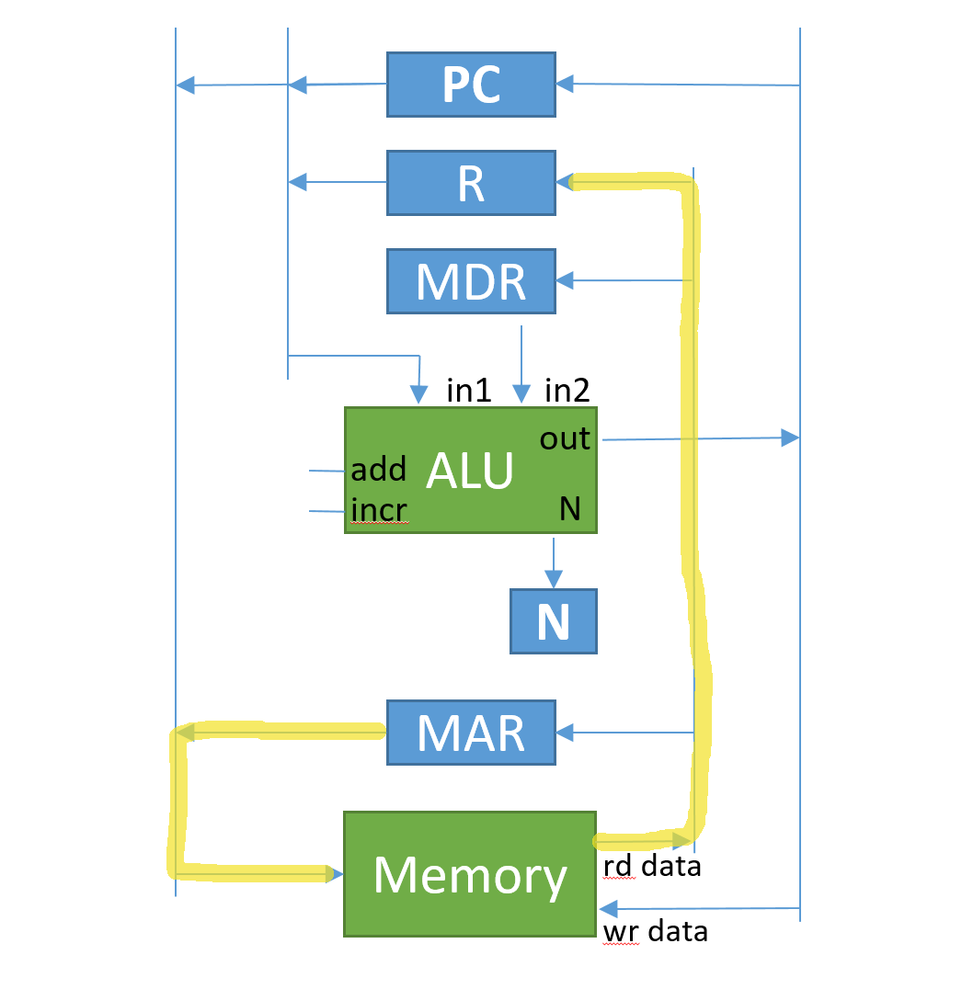
Step 4 – load M[b]

Slide 8
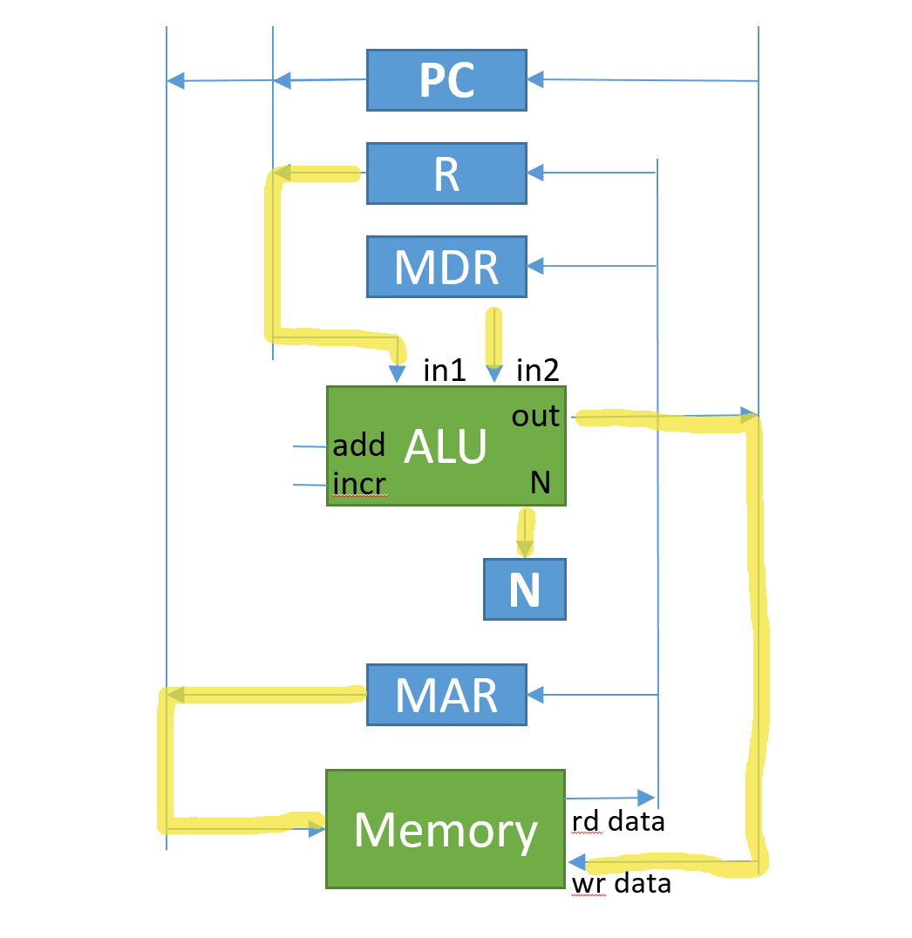
Step 5 – write M[b]

Slide 9
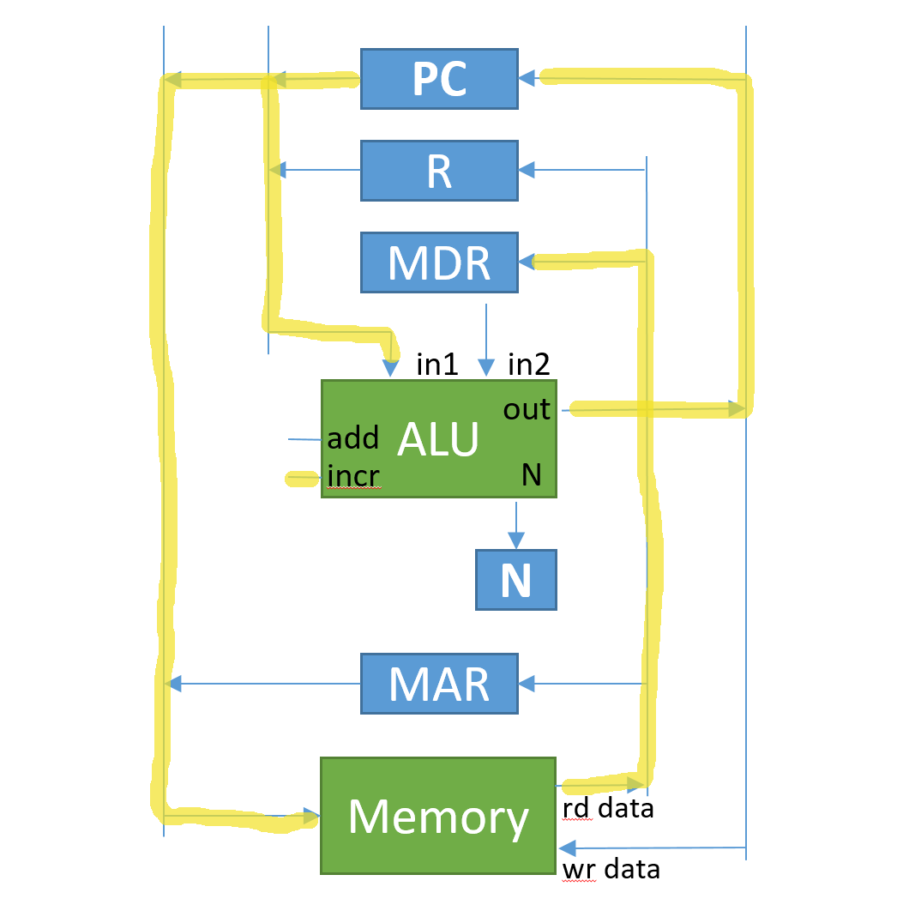
Step 6 – load c, incr. PC

Slide 10
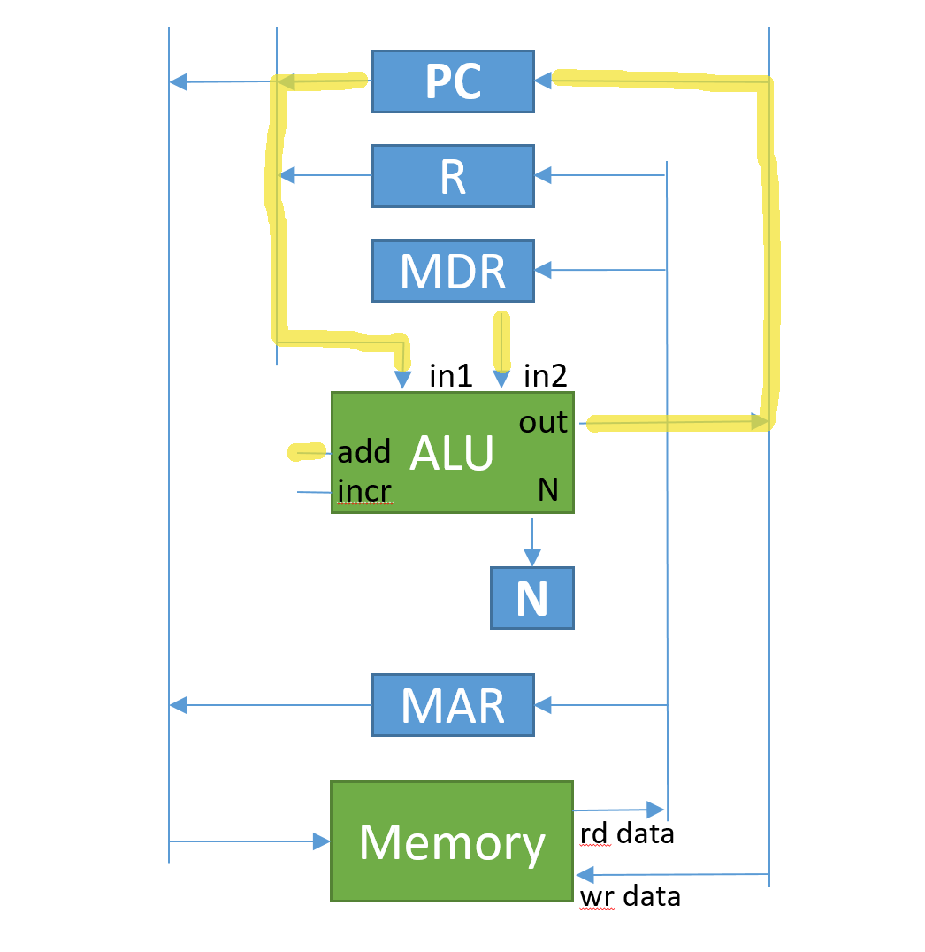
Step 7 - branch

