Slide 1


AI Smart Attendance System
UI/UX High-Fidelity Mockups & Walkthrough
Presenter: Prachi | Friday, August 21, 2026

Slide 2


Phase 1 Design Review
Finalized wireframes, DB schema, and user workflows completed for technical team hand-off.

Slide 3

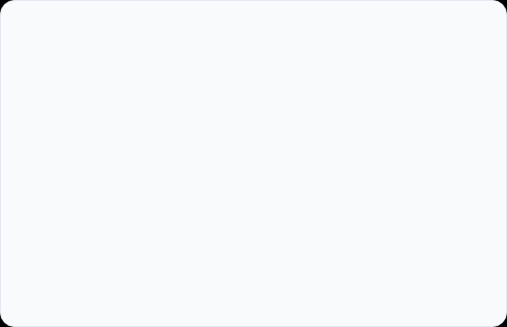


Core Workflows Designed
01. Classroom Teacher Flow
02. Admin & Reporting Flow
Focused on speed and minimal friction during live class sessions:
Designed for attendance auditing and operational insight:
Quick single-click login with course selection
Real-time attendance percentages & metrics
Live camera capture or instant image file upload
Manual override for unassigned or unrecognized faces
Human-in-the-loop face recognition review grid
One-click CSV/PDF report generation for records

Slide 4
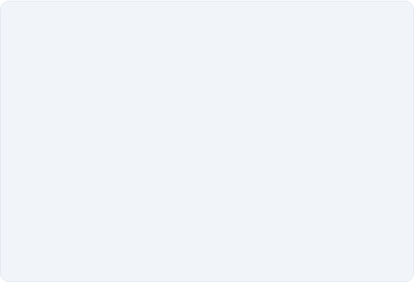
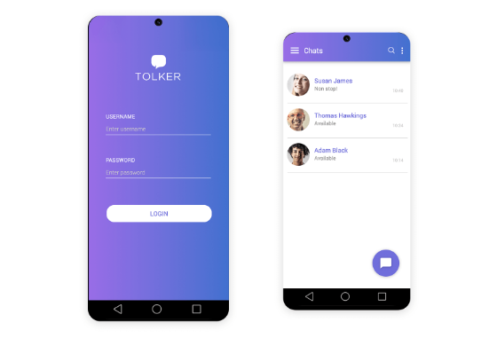
01. Login & Authentication
Clean, Role-Based Access
Secure Auth: Tailored entry for Teachers and System Administrators.
Institution Selection: Multi-department support for seamless access control.
Zero Friction: Designed with clean input states and high contrast CTA buttons.

Slide 5
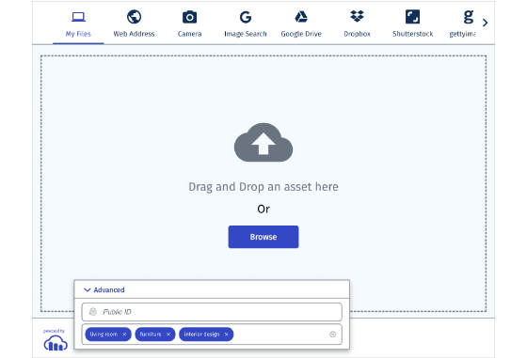
02. Photo Capture & Upload
Flexible Image Input Options
Live Classroom Snap: Web camera integration for capturing instant group photos.
Drag-and-Drop: High-resolution upload container for pre-taken images.
Quality Feedback: Visual status cues for resolution and lighting checks before AI processing.

Slide 6
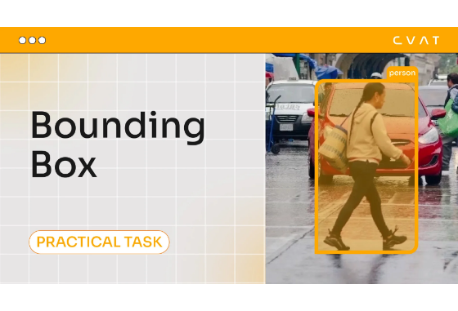
03. Detected Faces Review Grid
Interactive Face Verification
Detected Bounding Boxes: Auto-cropped student faces generated by AI model.
Match Confidence: Clear visual indicators for confirmed matches vs. low-confidence tags.
Manual Overrides: Quick dropdown to tag or correct unknown/absent students.

Slide 7
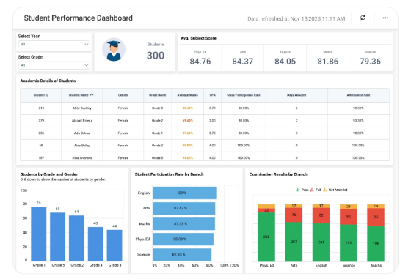
04. Reporting Dashboard
Actionable Attendance Metrics
Summary Analytics: Real-time present vs. absent percentages across classes.
Date Filtering: Historical records drill-down by date range and subject.
Export Tools: Direct download to CSV or PDF formats for school archives.

Slide 8
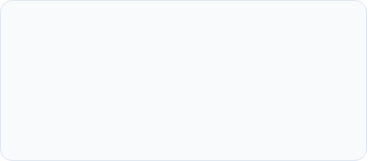
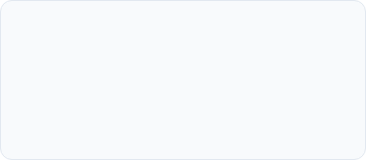
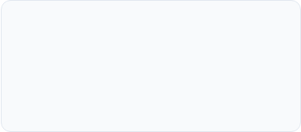
Next Steps & Handoff Plan
Ready for Phase 2 Frontend Implementation (Starting Monday, Aug 24)
GitHub Push
Frontend Skeleton
API Handoff
Pushing to feature/prachi-figma-mockups for final PR review today.
Building UI component hierarchy based on Figma design tokens on Monday.
Mapping endpoints with Priti and Shubhi for facial recognition payload integration.

