Slide 1
Julia in Tokio
A Tour of Concurrency Patterns in Rust
Bhargav Srinivasan

Slide 2
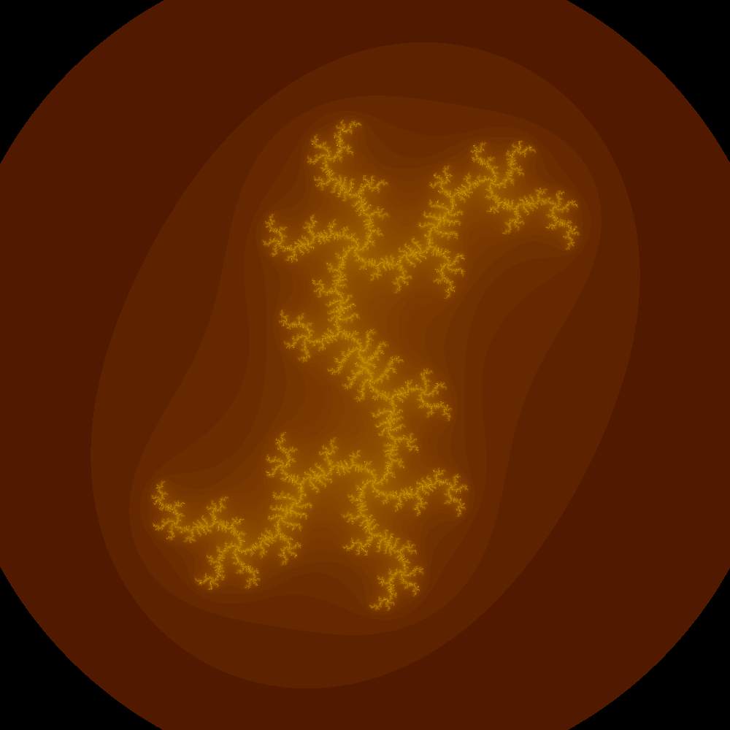
Rendering the Julia Fractal

Slide 3
Rendering the Fractal: Pseudocode
The complex equation for it is: f(z) = z^2 + c
Where f(z) is the n+1th iteration of a complex number, and z represents the nth iteration of it with c being a fixed value complex number that specifies the structure of the fractal.
The escape radius is a parameter used in iterating a point under the Mandelbrot Set and Julia Set functions. It is the radius of a circle on the Complex Plane used as a boundary to determine when iteration can stop. The circle is centered at the origin, and has a radius of at least 2.0.
Essentially, how I understand it is, you take a point on the complex plane and then calculate the value of f(z) for that point, set the resultant value to z and calculate fa(z) then again and again till the norm of the function reaches the escape radius or you hit the max_iterations limit which is set.
Then you assign a color for the value of the function at that point, you can write anything for this, it just needs to be uniform for all the points.

Slide 4
Rendering the Fractal: Pseudocode
R = escape radius # choose R > 0 such that R**2 - R >= sqrt(cx**2 + cy**2)
for each pixel (x, y) on the screen, do:
{
zx = scaled x coordinate of pixel; # (scale to be between -R and R)
# zx represents the real part of z.
zy = scaled y coordinate of pixel; # (scale to be between -R and R)
# zy represents the imaginary part of z.
iteration = 0;
max_iteration = 1000;
while (zx * zx + zy * zy < R**2 AND iteration < max_iteration)
{
xtemp = zx * zx - zy * zy;
zy = 2 * zx * zy + cy;
zx = xtemp + cx;
iteration = iteration + 1;
}
if (iteration == max_iteration)
return black;
else
return iteration;
}

Slide 5
Exploring Different Concurrency Tools
Standard Library: The standard library provides threads, mutexes and other concurrency primitives out of the box, however they do not implement features like pipelining, job stealing etc which can potentially speed up execution
Tokio: A concurrency library which excels when interleaving operational code along with I/O bound tasks asynchronously, can be disk access, network access, etc
Rayon: A concurrency library used when tasks provided to it are mainly CPU bound, and it is great at using all of the CPU cores to the maximum possible extent.
Crossbeam: An advanced and very configurable concurrency library, it is a building block used to create Rayon.
Smol: It is an async runtime, not a full-fledged concurrency library, but it has been trimmed down to the bare minimum.

Slide 6
Benchmarking
We use Bencher and the default #[bench] attribute to write the benchmarks for the code in rust.
We use the test crate which is only available in nightly rust, run `rustup override set nightly` in order to get the nightly toolchain of rust.
Bencher provides an iter() method, which takes a closure. This closure contains the code we'd like to benchmark.
The results of the benchmark are shown as a <x> ns/iter ; this means that it took x nano seconds to run one iteration of the benchmark. In total bencher runs at least 301 iterations of iter() and prints out the average time elapsed for the section of code to complete.

Slide 7
How to Read a Flamegraph
First, the colors are random, don’t bother about the colors!
Each box represents a function on the stack
The y axis is for ancestry, the calling function is at the bottom while the child function is on the top. The function that is currently executing is on the top of the stack of functions on the flamegraph
The x axis consists of all the parent functions, sorted alphabetically
The width of the box is the total CPU time, or the total CPU time for the entire ancestry of the function on the stack. So the longer the boxes, the more cpu cycles they consume, and hence should be the target for perf optimization.
And the timescale is relative, so the most time-consuming function has the longest box, and all other functions are shown/compared relative to it. In practice, this is the main() function.
In the actual svg flamegraph, you can click on each of the larger boxes, and it further drills down into only the call stack of that particular function.

Slide 8
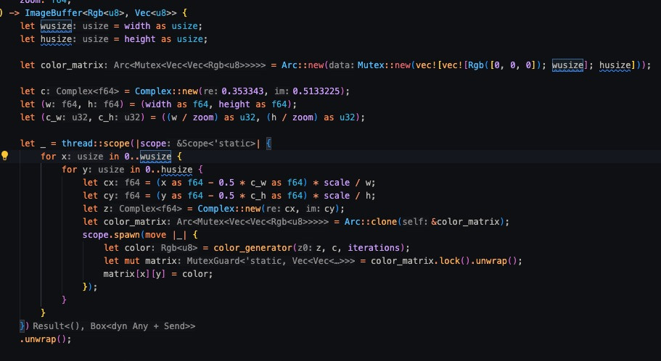
std library

Slide 9
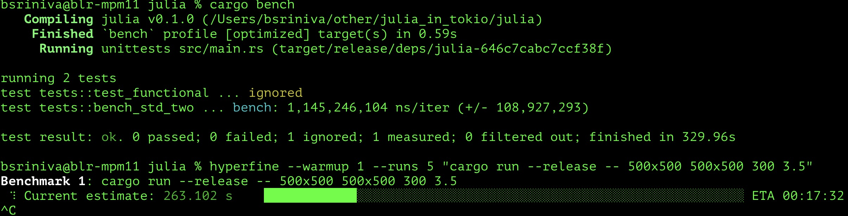
std Library Benchmark

Slide 10
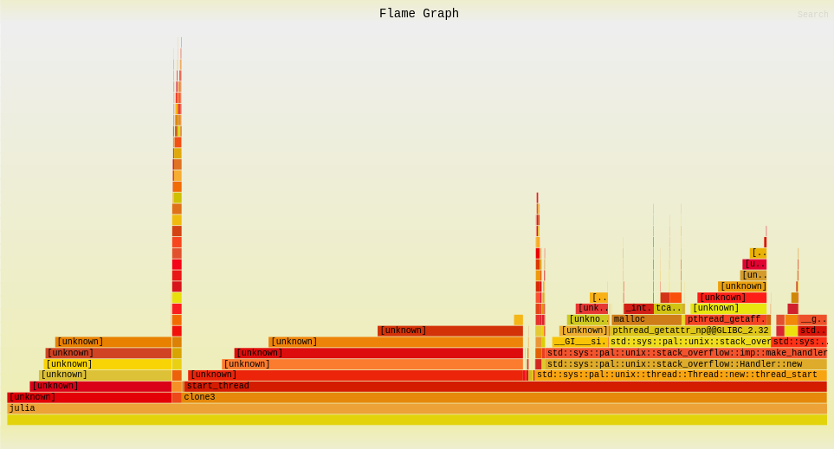
std Library Flamegraph

Slide 11
Crossbeam

Slide 12
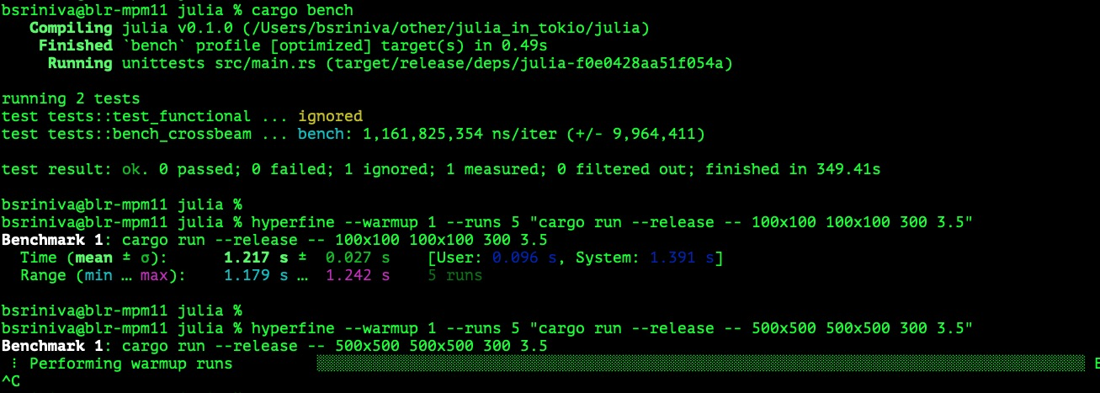
Crossbeam Benchmark

Slide 13
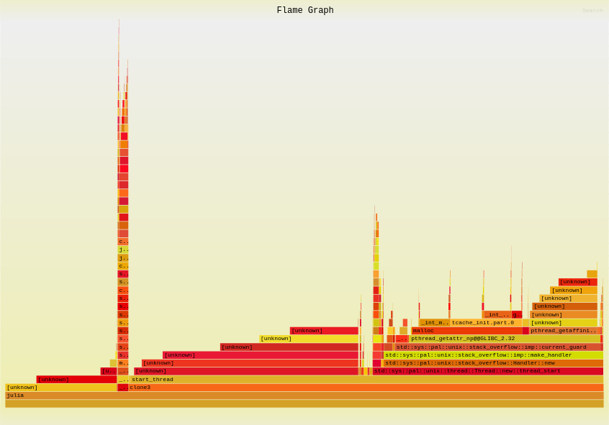
Crossbeam Flamegraph

Slide 14
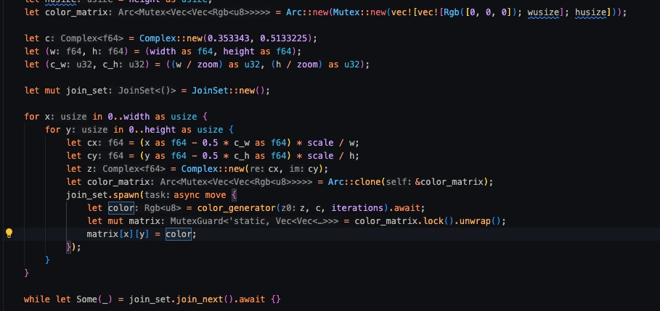
Tokio

Slide 15
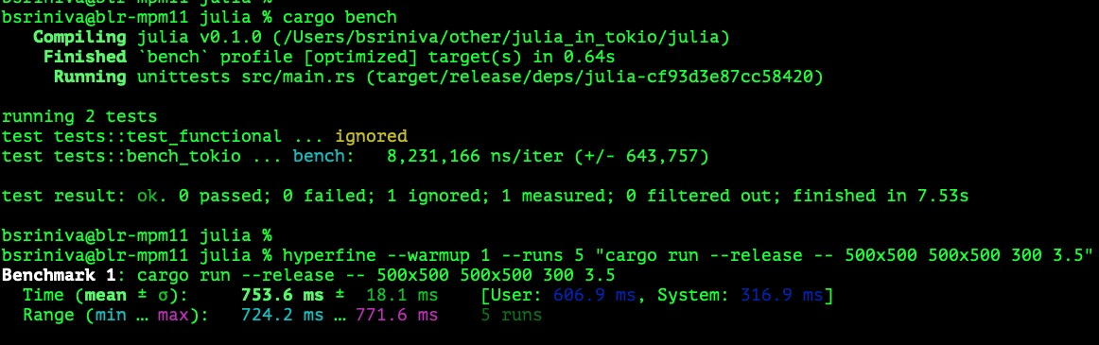
Tokio Benchmark

Slide 16
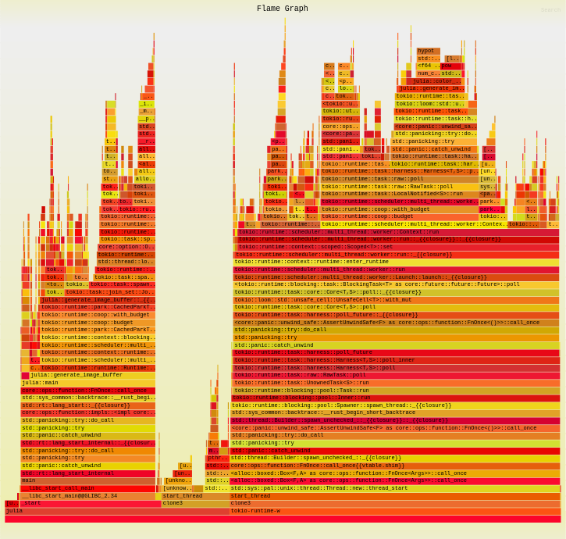
Tokio Flamegraph

Slide 17
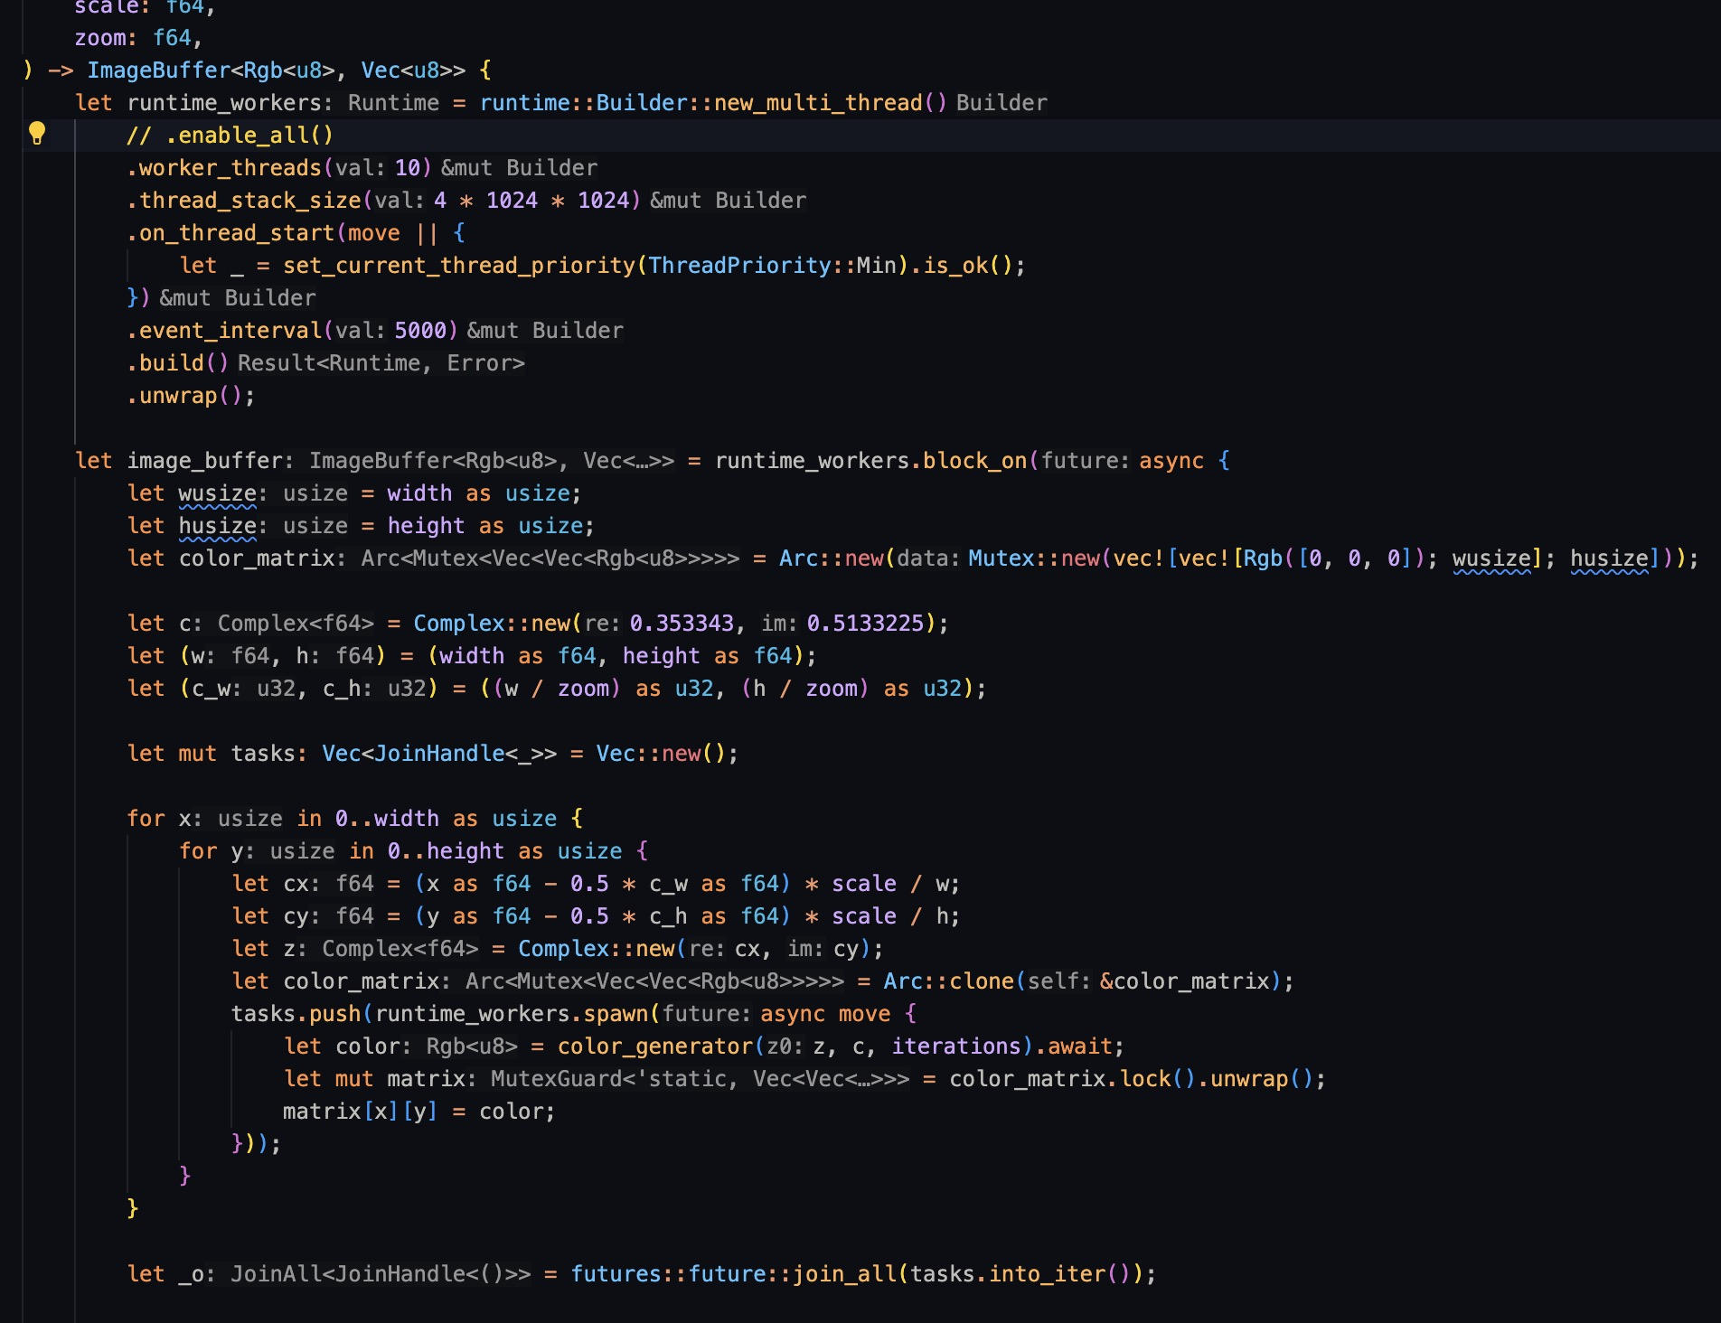
Tokio Custom

Slide 18
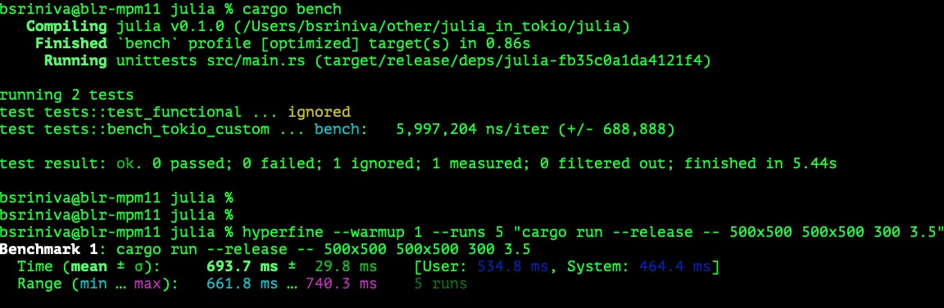
Tokio Custom Benchmark

Slide 19
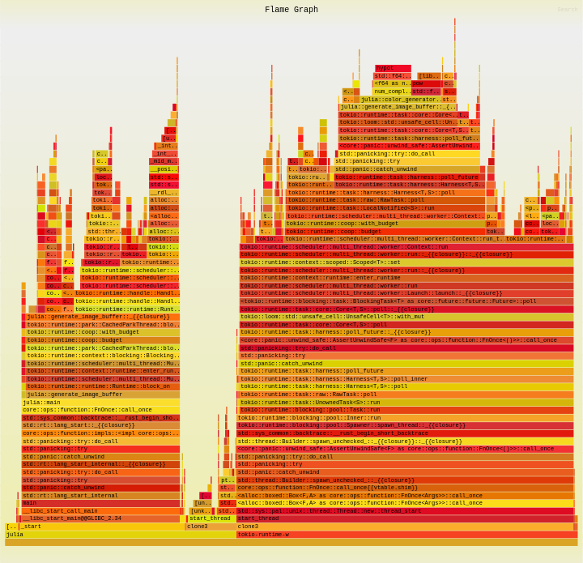
Tokio Custom Flamegraph

Slide 20
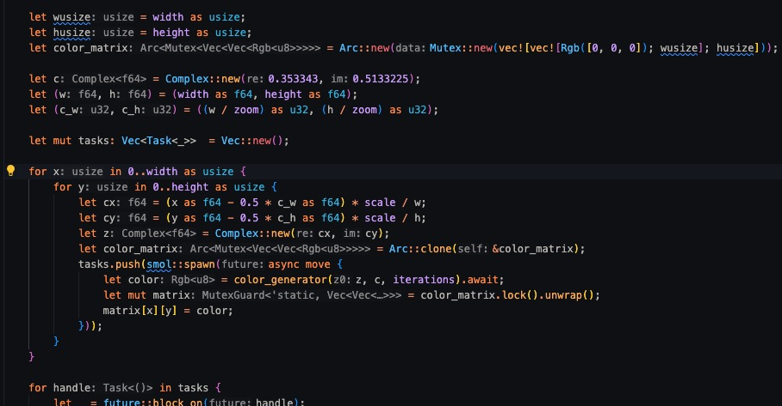
Smol

Slide 21
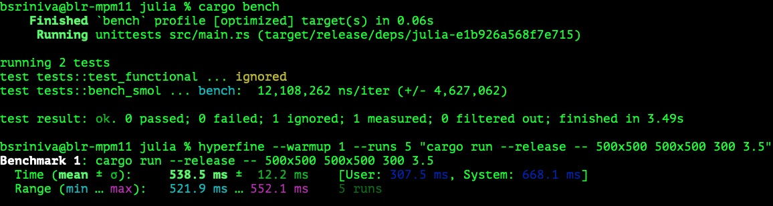
Smol Benchmark

Slide 22
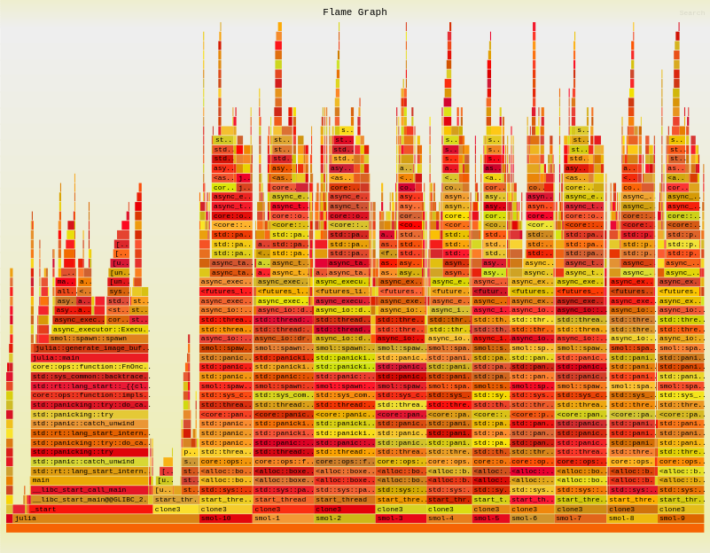
Smol Flamegraph

Slide 23
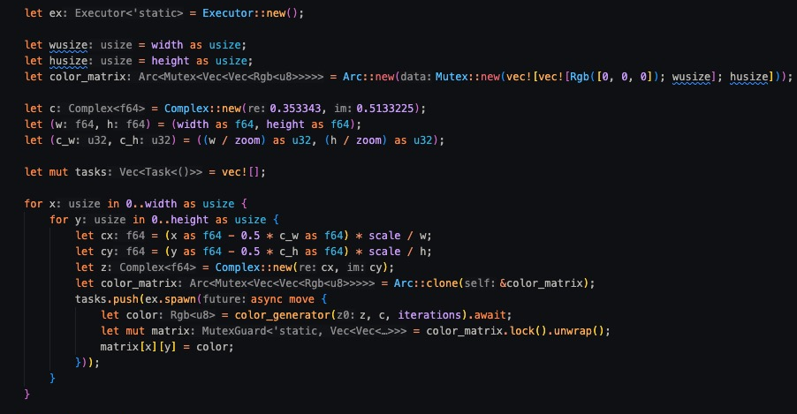
Smol Custom

Slide 24
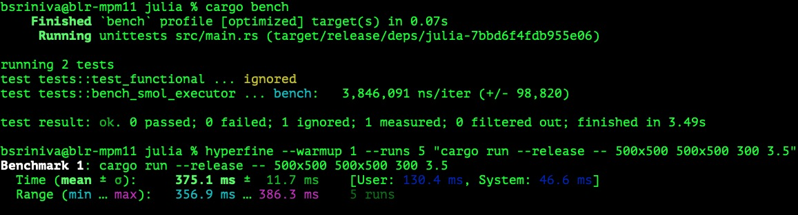
Smol Custom Benchmark

Slide 25
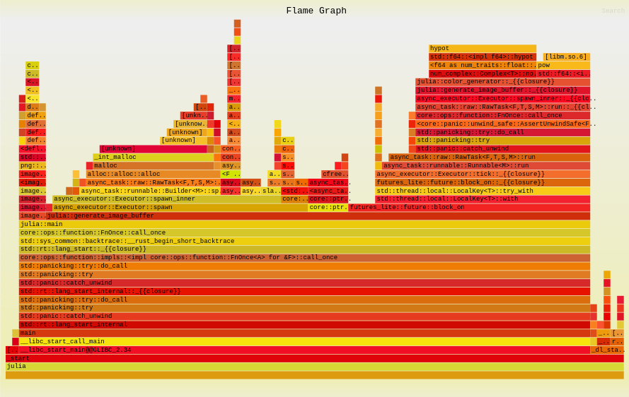
Smol Custom Flamegraph

Slide 26
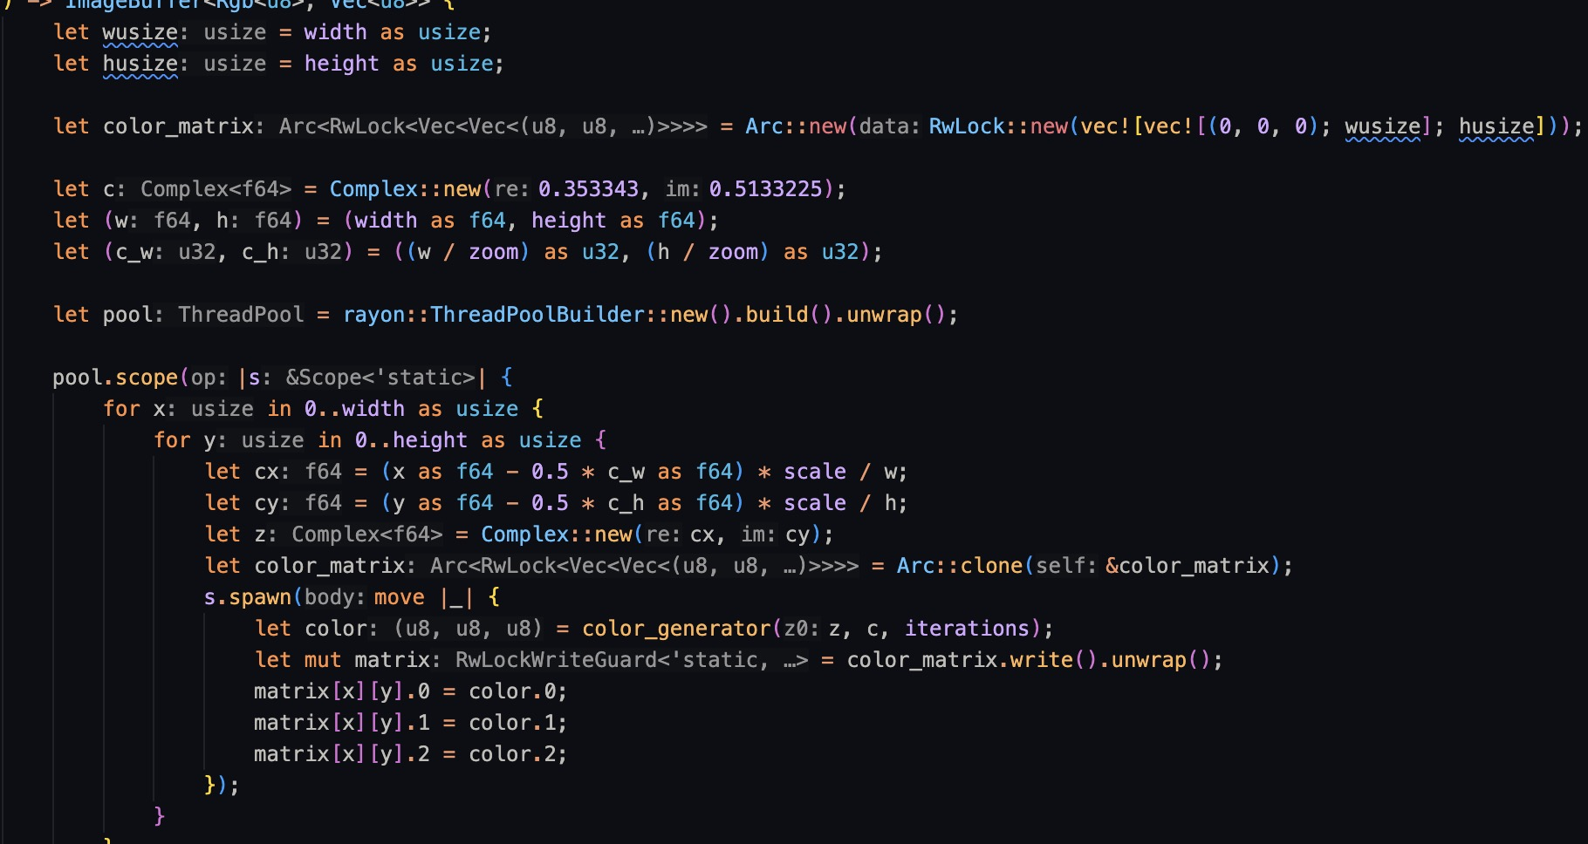
Rayon

Slide 27
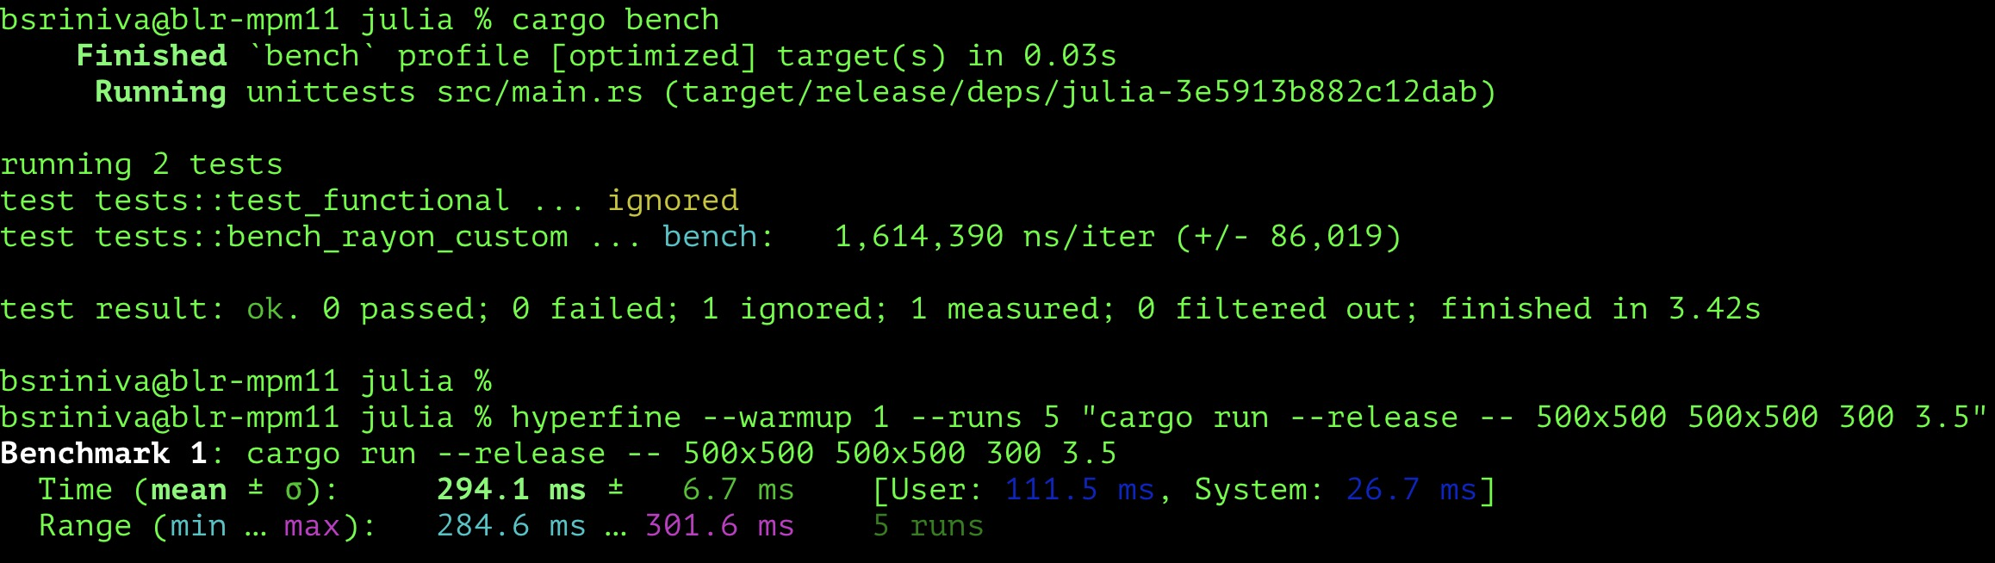
Rayon Benchmark

Slide 28
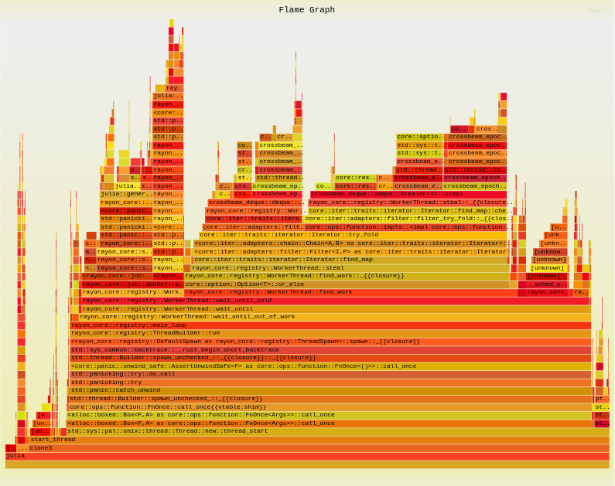
Rayon Flamegraph

Slide 29
References
Julia Fractal (referred but heavily modified after) : https://github.com/NoraCodes/rjulia ; https://rosettacode.org/wiki/Julia_set#Rust
https://en.wikipedia.org/wiki/Julia_set
https://doc.servo.org/tokio/runtime/struct.Builder.html
https://doc.rust-lang.org/beta/unstable-book/library-features/test.html
https://seenaburns.com/benchmarking-rust-with-cargo-bench/#:~:text=The%20benchmark%20harness%20also%20runs,iteration%20takes%20longer%20than%201ms
https://bencher.dev/learn/benchmarking/rust/libtest-bench/
https://www.brendangregg.com/FlameGraphs/cpuflamegraphs.html

