Slide 1
Capstone Project (Week2)
Market Entry Research
- Benny Jose

Slide 2
About Project
Restaurant chain company XYZ Pvt. Ltd planning to open their outlets in Europe, Ireland. They selected Dublin city as their target market for starting the business. Since they do not have any business in Dublin, they want to do a market analysis prior to market entry.

Slide 3
Business Problem
Identify and analyses on below points so that they can make better decisions.
What are the types of restaurants currently available in Dublin? Eg: How many America, Indian, Italian restaurants in each postal district in Dublin
Number of each type of restaurants in the locality.
Identify areas with less saturation of restaurants to minimize competition.

Slide 4
Project Scope
Using Data Science methodology and techniques analyze the scope and challenges in starting a new restaurant or a chain of restaurants in Dublin.
Provide constructive advise on type and location of restaurants to make optimized profit.

Slide 5




Research Project Roadmap
Following are the steps followed in the Research
Section 1 Data Source
Section 2 Exploratory Analysis
Identify the source of data for the research project.
Exploratory analysis and scrubbing for the data collected.
Section 3 Results
Section 4 Conclusion
Generate Results for the analysis of the project.
Review and analyze the results and derive suggestions and provide advise on location and type of restaurant.

Slide 6


Data Source
Details of sources of data used
Source 1 : Autoaddress
Source 2: Foursquare
Auto address is an address management consultancy company in Ireland.
They have all the postal district addresses and other location details of entire Ireland.
Using coordinates as input extract all the venues from Foursquare and filter to shortlist names and types of Restaurants in Dublin.

Slide 7
Exploratory Analysis
Analyzing data sets to summarize their main characteristics using with visual methods and tables.
Identification and formatting data within the scope of analysis.
Data for Dublin’s geospatial analysis extracted from Autoaddress and Foursquare. Data appended with other required details like coordinates and location details.
Data cleaDelivery ET (Ciaran/Darren/Graeme/Marcus/Martin) nup done by eliminating unwanted columns and by deleting rows without required information.
Utmost care taken not to impact the final results due to clean up and elimination of data
Geospatial details of Dublin generated to support exploratory analysis based on the location
Graphs generated with total number of restaurants generated for each postal district and also with categorization with type of restaurant

Slide 8
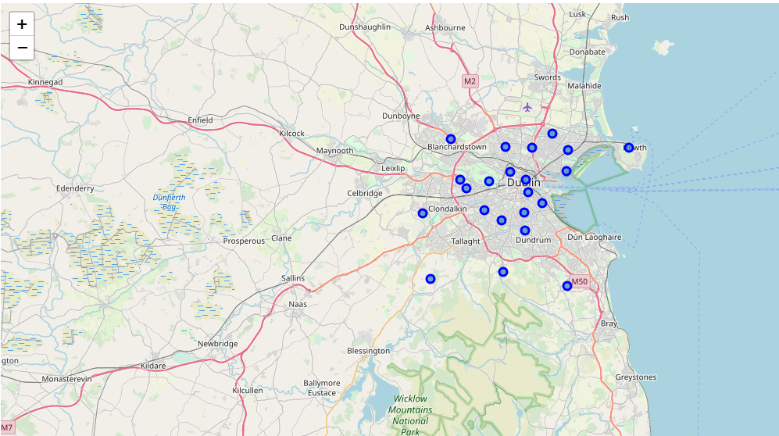
Exploratory Analysis (Contd.)
Geospatial Analysis of Dublin Postal Districts.
This map support location specific analysis of Dublin City.
The map will use in conjunction with other graphs to derive meaningful information.

Slide 9
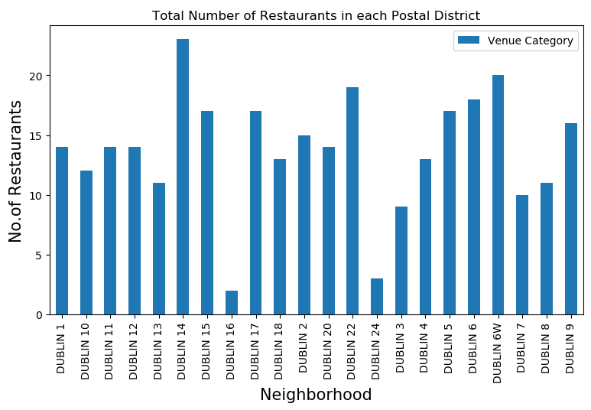
Exploratory Analysis (Contd.)
Count of Restaurants in Each Postal Districts
This graph will provide details of sectorization of restaurants in each postal districts.
Dublin 1 to Dublin 10 are the postal districts close to City center. This caused high density of restaurants in this area.
Dublin 14 is away from city but contains more office spaces.
Dublin 16 and Dublin 24 is less saturated.

Slide 10
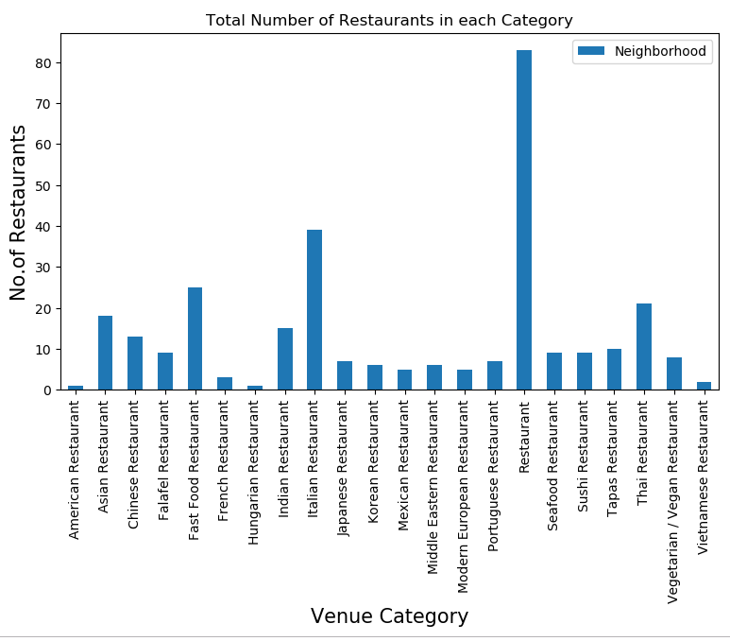
Exploratory Analysis (Contd.)
Count of Restaurants in Each Category
This graph will provide details of type of restaurants.
General restaurants with any specific menu has high density.
Under specific menu restaurants Italian restaurants came to top position.
Clear indication of high popularity of Italian menu in Dublin Area.

Slide 11
Discussion & Results
Across all postal districts, Dublin 16 got a smaller number of restaurants. But it may not be advisable to start a restaurant there as it away from city center.
As we move away from city center the density of offices and schools will be lesser and will have less scope for restaurants.
Though Dublin 14 is much away from city center this postal district got maximum number of restaurants. This could be due to high number of offices towards south side of Dublin.
Highest number of restaurants is general in nature. They don’t specific to any type of special menu.
In other type of restaurants Italian restaurants are more. This indicates that Italian food is more popular in Dublin if we go with specific type of menu.

Slide 12
Results
Dublin 14 and Dublin 3 are ideal locations with high potential.
Dublin 3 has high potential for general restaurants. Also, will have less competition and will attract general customers who don’t a have any specific choice. Since it is close to city center customers probably look for general restaurants. So, opening a restaurant with general menu would be advisable for Dublin 3.
Dublin 14 also has high potential, but this location is away from City center.
Specific menus will have more impact.
Opening an Italian restaurant at Dublin 14 will be advisable.

Slide 13
THANK YOU!
Benny Jose
Email:
bennyjose1975@gmail.com

