Slide 1

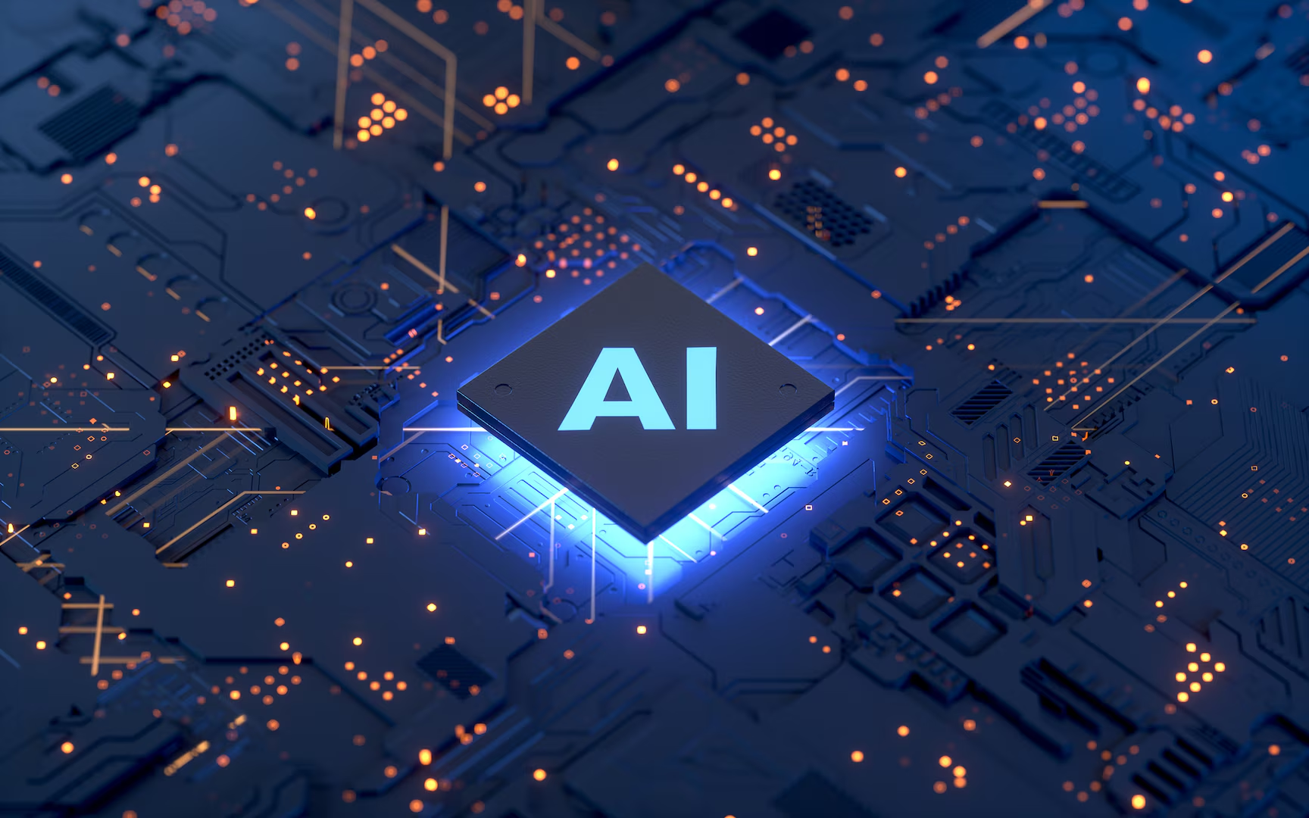
Can Ai agents build software together ?
Team member – Kyaw Bhone khant
Sparshdeep kaur
Satt Linn Tun

Slide 2
Can Ai agents build software together ?

Slide 3
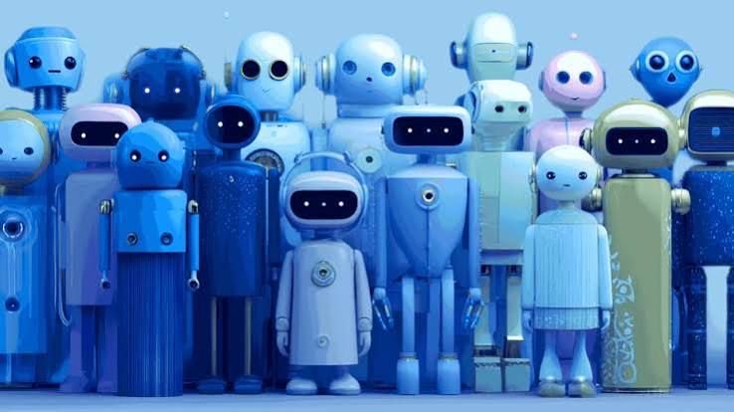
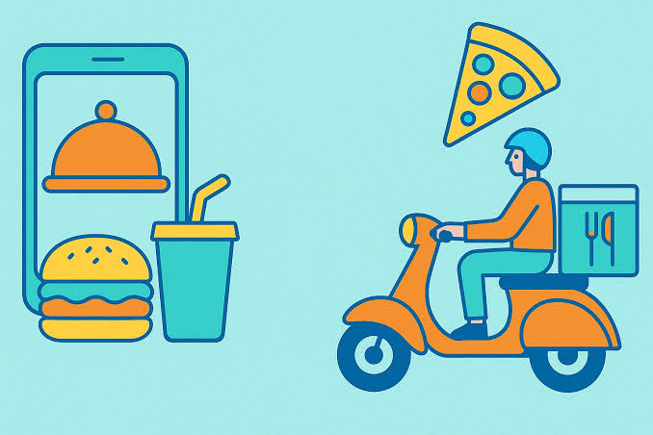

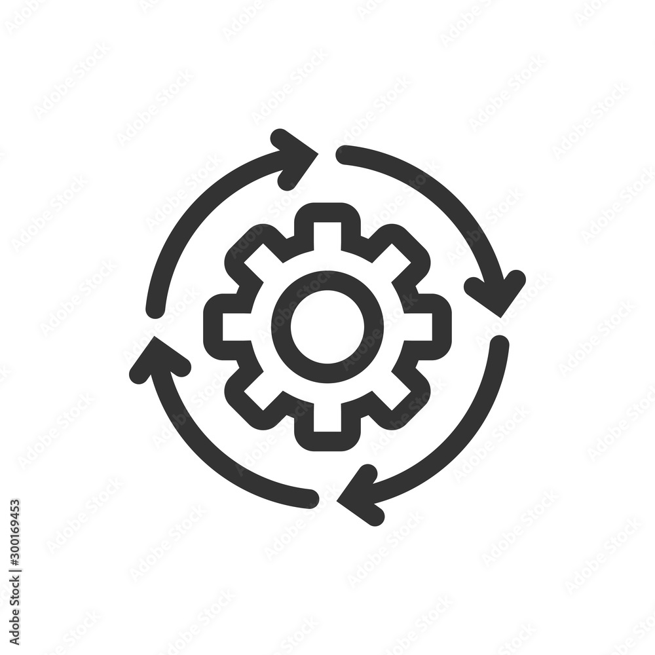

Slide 4
How AI agents can build software together​

Slide 5
How AI agents can build software together
1. Planning agent
2. Coding agent
3. Testing agent
4. Integration and review agent

Slide 7
Ai agent building
food delivery application​

Slide 8
Ai agent building food delivery application
Example
Agent 1 — Project Manager: Plans the project, defines requirements, and assigns tasks.
Agent 2 — Frontend Developer: Builds restaurant listings, menus, shopping carts, and checkout screens.
Agent 3 — Backend Developer: Develops user accounts, order processing, and APIs.
Agent 4 — Database Specialist: Designs databases for customers, restaurants, menus, orders, and payments.
Agent 5 — QA Tester: Tests registration, order storage, checkout, and error handling.

Slide 10
On October 15, 2026
Real Event

Slide 11
Real Event On October 15, 2026
BAND announced BAND for Developers, a desktop application designed to help software developers coordinate multiple AI coding agents across different tools and work environments. It aims to make it easier to manage tasks, share information, and coordinate agents without manually transferring information between them. This shows that companies are developing practical tools for AI agents to collaborate on software projects.
• AI can build software together by Using advanced reasoning models (like Claude Opus) to read feature requests, map out technical architecture, and write detailed task tickets .
• Specialized agents review the code concurrently for security vulnerabilities, UI/UX consistency, design standards, and code quality.
• Orchestrators / Approvers: A supervisory agent or human approver evaluates whether the output satisfies the criteria before merging code into the main repository

Slide 13
Common Multi-Agent Workflows​

Slide 14
Common Multi-Agent Workflows
Spec-Driven Development: Define requirements and test cases before coding begins.
Loop-Based Validation: Agents write code, test it, fix errors, and repeat until it works correctly.
Shared Workspaces: Agents collaborate through shared repositories and project tools.
Challenges and Limitations
High costs: Running multiple AI agents can require significant computing resources and money.
Security risks: More agents with access to code or infrastructure can create more security vulnerabilities.
What Makes Multi-Agent Systems Work?
Clear roles: Each agent has a separate responsibility, such as planning, coding, testing, or reviewing.
Good communication: Agents should explain their decisions when handing tasks to other agents.
Human supervision: Humans should approve important decisions about architecture, security, and software releases.
THANK YOU FOR LISTENING

Slide 15
THANK YOU FOR LISTENING

Slide 16
Credit to all the photo we used
https://share.google/kjG5B688r4YWEw3oa
https://share.google/n11OeFyZyh3SocZGn
https://share.google/xWSVnk9F21wtfvn3c
https://share.google/SQ4IXsxhOLGTyOB8R
https://share.google/yCflIT31mOrIqlt1O

