Slide 1
Book Optimization Introduction
Objective: Render the high traffic pages without blocking CSS/JS so that the page is perceived as being near instantaneous, positively impacting bounce rates.
The page was divided into distinct reusable components then each component was recreated from scratch utilizing new / native technologies. This micro-optimization includes:
Replace existing Foundation layout and functionality with capabilities that are native to browsers
Replace existing interactive JQuery with performant native JavaScript
Replace conduit images (icons) with inline CSS / SVG
The pages accessibility was enhanced
The pages was made semantic to enhance SEO

Slide 2
Book Optimization Test Definition
Test Plan: Compare the same book page on both Stage and Stage2.
The new optimized book page is on Stage2 and the legacy book in on Stage.
Use all major performance measuring tools, including:
Google Lighthouse, PageSpeed, and Chrome Performance Tab
Akamai WebPageTest and mPulse
Book Legacy URL: https://stage.ltdcommodities.com/browse/Christmas-Gifts-2017/_/N-1z0t35d
Book Optimized URL: https://stage2.ltdcommodities.com/browse/Christmas-Gifts-2017/_/N-1z0t35d
Test Metrics:
Google Lighthouse audit: Performance
Google Lighthouse audit: Accessibility
Google PageSpeed Insights audit
Google Chrome Performance Tab audit
Akamai - WebPageTest audit
Akamai – mPulse verification

Slide 3
Google Chrome Lighthouse audit: Performance
Google Lighthouse is Google’s new tool to measure performance, accessibility, and best practices.
Book Legacy | Book Optimized
Overall Score¹ – 22 | Overall Score – 58
First Meaningful Paint² – 12850ms | First Meaningful Paint – 950ms
First Interactive³ – 16280ms | First Interactive – 11290ms
Perceptual Speed Index⁴ – 6 | Perceptual Speed Index – 94
 | Metric | Description
1 | Overall Score | These encapsulate the app’s performance. Higher is better.
2 | First Meaningful Paint | First meaningful paint measures when the primary content of a page is visible.
3 | First Interactive | The first point at which necessary scripts of the page have loaded and the CPU is idle enough to handle most user input.
4 | Perceptual Speed Index | Speed Index shows how quickly the contents of a page are visibly populated.

Slide 4
Google Chrome Lighthouse audit: Accessibility
These checks highlight opportunities to improve the accessibility of the page for screen readers and other assistive technologies.
Book Legacy | Book Optimized
Overall Score 83 | Overall Score 94

Slide 5
Google PageSpeed Insights audit
PageSpeed Insights measures the performance of a page for mobile and desktop devices. It fetches the url twice, once with a mobile user-agent, and once with a desktop user-agent.
PageSpeed Insights checks to see if a page has applied common performance best practices and provides a score, which ranges from 0 to 100 points. Higher is better.
Book Legacy | Book Optimized
Overall Score 49 | Overall Score 58
Industry Reference category page scores:
Wayfair: 66
Mileskimball: 34
Collectionsetc: 44

Slide 6
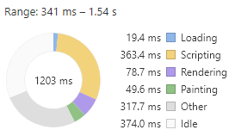
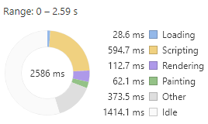
Google Chrome Performance Tab Audit
Book Legacy | Book Optimized
The idle time is significant because it confirms that the legacy design is waiting
for Foundation to load before rendering the page.

Slide 7
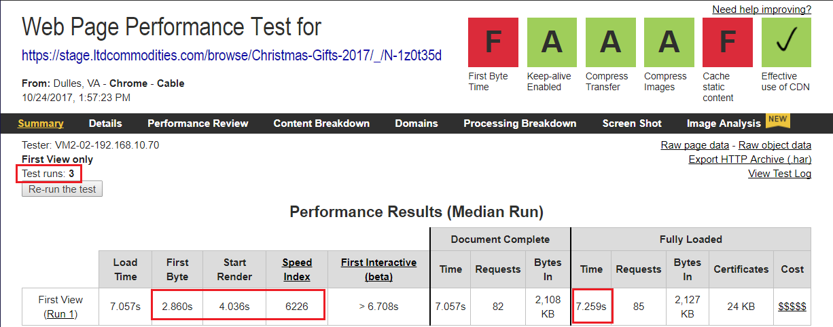
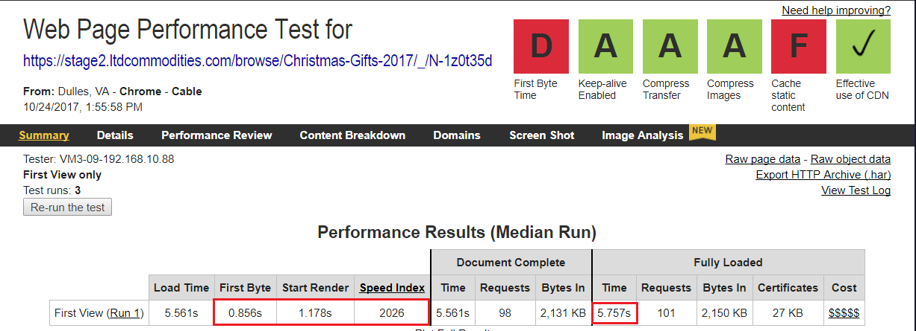
Akamai WebSpeed Test Audit
Book Legacy
Book Optimized

Slide 8
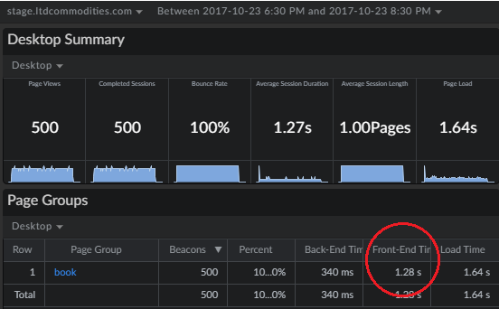
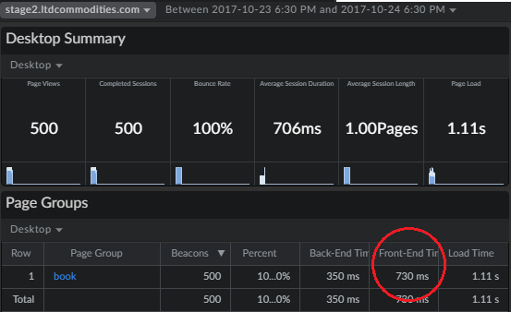
mPulse – Day 1
Book Legacy | Book Optimized

Slide 9
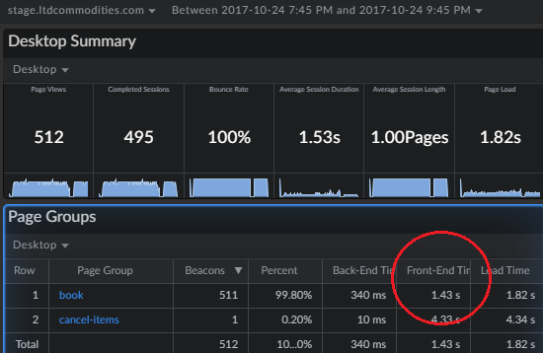
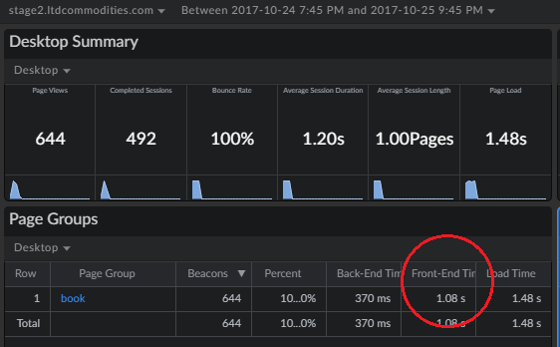
mPulse – Day 2 (LTD)
Book Legacy | Book Optimized

Slide 10
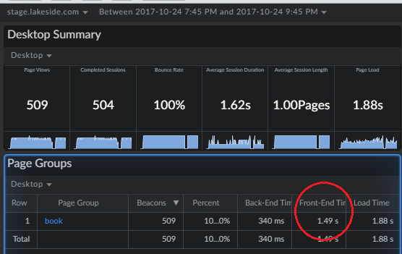
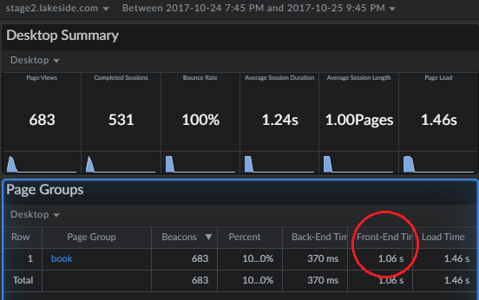
mPulse – Day 2 (Lakeside)
Book Legacy | Book Optimized

