Slide 1
Book Page Optimization Metrics
About Google Lighthouse Metrics
Score | Description
Overall Score | These encapsulate the app’s performance
First Meaningful Paint | First meaningful paint measures when the primary content of a page is visible.
First Interactive | The first point at which necessary scripts of the page have loaded and the CPU is idle enough to handle most user input.
Perceptual Speed Index | Speed Index shows how quickly the contents of a page are visibly populated.

Slide 2
Book Page Optimization Metrics
Google Chrome Lighthouse audit: Performance
Book Optimized | Book Legacy
Overall Score 58 | Overall Score 22
First Meaningful Paint 950 ms | First Meaningful Paint 12850 ms
First Interactive 11290 ms | First Interactive 16280 ms
Perceptual Speed Index 94 | Perceptual Speed Index 6
Google Chrome Lighthouse audit: Accessibility
Book Optimized | Book Legacy
Overall Score 94 | Overall Score 83

Slide 3
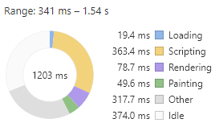
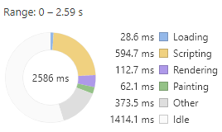
Book Page Optimization Metrics
Google PageSpeed Insights audit
Book Optimized | Book Legacy
Overall Score 60 | Overall Score 49
Google Chrome Performance Tab audit
Book Optimized | Book Legacy

Slide 4
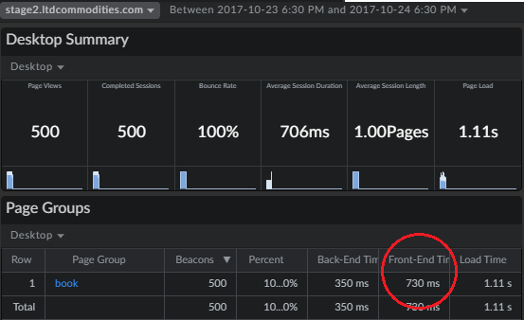
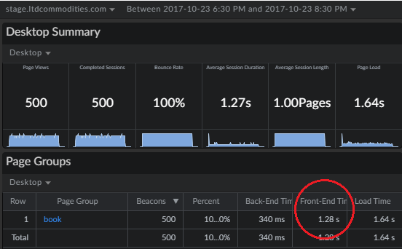
Book Page Optimization Metrics
mPulse - LTD
Book Optimized | Book Legacy

Slide 5
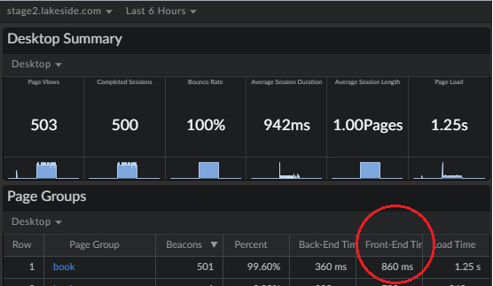
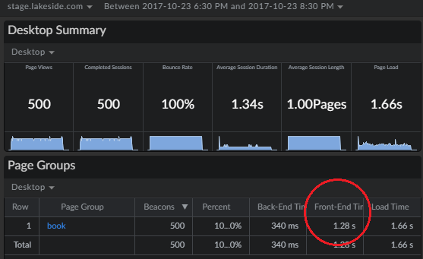
Book Page Optimization Metrics
mPulse - Lakeside
Book Optimized | Book Legacy

Slide 6
Book Page Optimization Metrics
“Alice: How long is forever?
White Rabbit: Sometimes, just one second.” —
Lewis Carroll. “Alice’s Adventures in Wonderland.”

