Slide 1

Feed a soul ;help a soul is a feeding scheme foundation based in cullinan,refilwe east of Pretoria.

Slide 2

We are a non government organization set to provide all the nutritional meals to the needy especially school children as one cannot learn on an empty stomach.
We provide school children with breakfast,lunch and supper to take home with.OUR OUR MAIN PURPOSE IS TO ERADICATE HUNGER.
WE ALS0 OFFER AFTERNOON STUDIES,AFTER CARE ,SELF DEFENSE CLASSES AND TRAUMA COUNSELING TO THOSE IIN NEED OF IT.

Slide 3
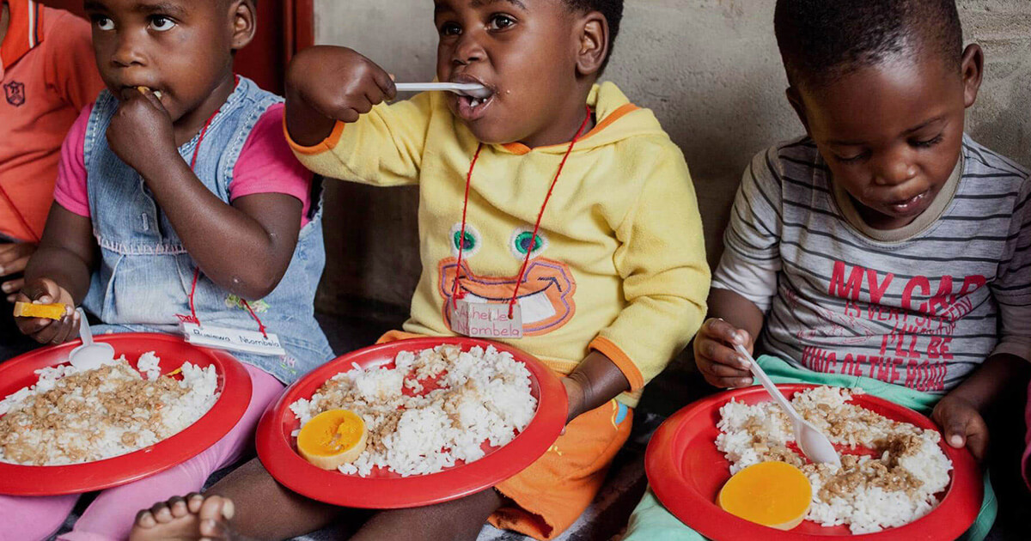
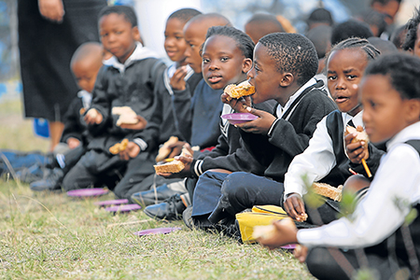
OUR BIGGEST PLAN DREAM IS TO GROW ACROSS SOUTH AFRICA OR AFRICA AND BEYOND.to provide more than a meal and help save lives.

Slide 4
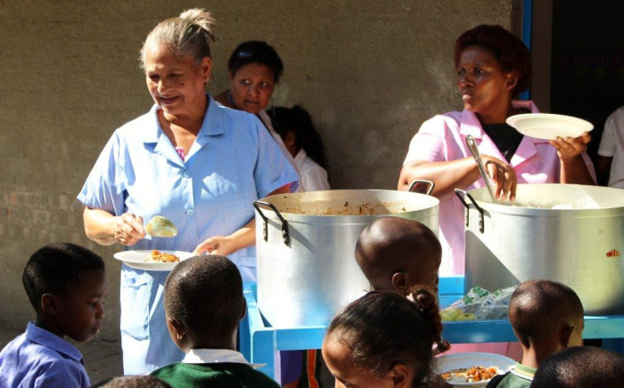
We will be more than happy to receive any kind of help that there is one can offer us. help us save lives by feeding a soul , clothing a soul and sheltering a soul.

