Slide 1
Merchants Segmentation and Churn Prediction
A journey from meta data to business insights

Slide 2
Problem Statement
Q1: How do we identify different kinds of business in the sample?
Q2: Which active merchants are mostly likely to churn in the near future?

Slide 3
Project Summary
I developed a clustering model to segment 10 different kinds of business based on features such as transition activity. The top clusters are xxx, xxx, xxx, xxx, xxx
I

Slide 4
Presumption
Active merchants mean they have transactions at the end of 2034.
A churn means the time since last transaction is so long that it has less 10% chance of happening.
If one merchant does not have transaction at the last day of 2034, I will not automatically take them as stop processing with Stripe and they are not taken as churn. My definition of churn is defined in section 4. This could cause a big difference in terms of model performance. One would have far more positive (churn) labels than another, hence, change the underlying data distribution.
If merchants churn, they will not be back. Whether with the same id or a different id.
Different merchant id means different merchant, there will not be two ids associated with same store or merchant.

Slide 5
Mechants Segmentation

Slide 6
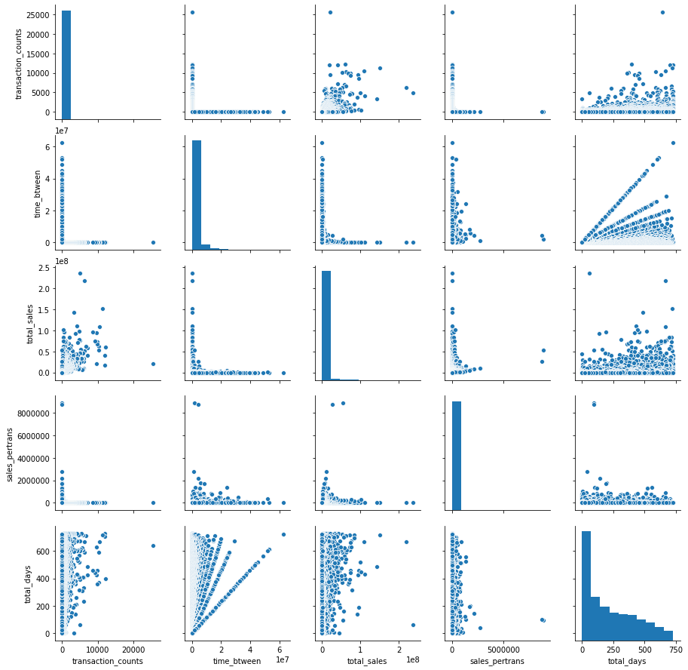
Part I Data Analysis and Feature Engineering
Feature Engineering ideas
sales volume, amounts (mean, variance).
Frequency of the transitions (daily, weekly etc.)
when did sales happen (sales per day/week/month, time of the day morning, noon, night.
start and date on strip, how long they have been as a customer.
TSFresh to extract other TS features

Slide 7
Introduction
In this project, a two-year transaction history data from Stripe’s merchant was given for merchant segmentation and churn prediction
For segmentation, I created features for individual merchants and trained two clustering models with unsupervised learning algorithms with the best number of clusters and hyper-parameter. I was able to visualize my clustering result and have an interpretation of individual clusters from the center of the clusters.
For prediction, I first defined churn and created churn labels for the merchants in both empirical and theoretical ways. I then compared, trained and hyper-tuned a classification model with the labels and features from part 1 and other time series features from the original data to predict future churns of individual merchants. I tried to provide the reasons for the churn and provided some insights on how to proceed with the churning merchants.

Slide 8
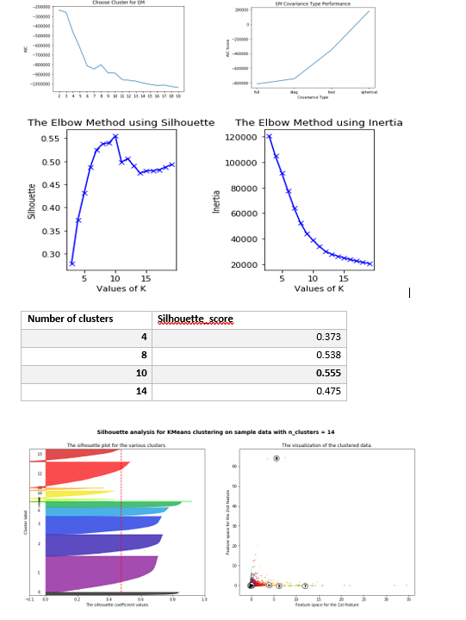
Question 1: Segmentation
Clustering and model training
Metrics to define success: AIC score, Silhouette Score and Inertia
Model selection: Kmeans and Gaussian Mixture
Hyper-parameter Tuning

Slide 9
Question 1: Segmentation Interpretation and insights
Clusters | Evidence | Hypothesis | My Estimates | Suggestion
2, 9 | large amounts per transaction, large number of transactions | data error, internal test merchant | outliers | Look into data quality
3, 4, 5 | transactions at the night, newer merchants, lower to medium transaction and amount | on board when stripe expend to international business in the late stage | international business | support in the night to help growth; language barrier
1 | have been with stripe the longest, loyal customer, more transactions as well. | they trust stripe and use frequently | power users | use resource to guarantee power users retention
6 | largest total volume, more transactions at noon, transaction is the third highest | people buying lunch during daytime | lunch dining service | Offer customized service like convenient way for tipping
7 | lowest in transactions, sales per day, second longest history | small business could struggle with scaling up | Small business owners that has been with stripe since beginning | Offer service like SaaS CRM tools to scale up
0, 8 | 4th and 5th largest in terms of total transactions, transactions in the morning | shorter history with higher volume could mean they are growing | newer business that just starts to use Strip | provide help for better growth for Stripe to grow exponentially
Result Analysis/ Cluster Interpretations
After getting the centers, I inversed the center to find original data. For the 10 clusters, my understanding is as follows.
Clustering Ensemble
I chose ClusterEnsembles to combine two labels. This would be a nice area for future work to first try different clustering models and then explore options for ensembles.

Slide 10
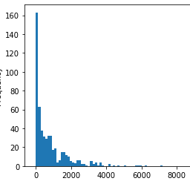
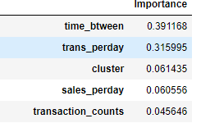
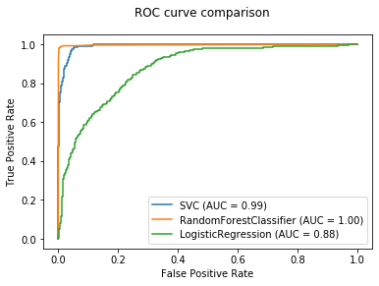
Question II: Model selection and business insights
Churn Definition and Identification
Theorical way: exponential distribution
Empirical way: 90th point after ranking
Model comparison:
RandomForest, GradientBoosting, SVM, LogisticRegression
Business Insights
The frequency and the trade volume rank high.
Transforming that into business insight is to focus on getting the merchant to use Stripe more frequently.
Stripe could provide some incentive for merchants to use the service more often to avoid churn

Slide 11
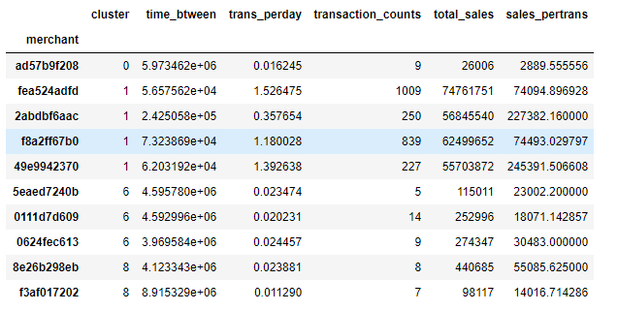
Question 2: Churning active mechants
Churning Active Merchants
Out of 12k merchants, 601 of them have transactions at the end of 2034. I define them as active users.
I calculated the probability of churn with predict_prob method. The top likely churn merchants are selected for further analysis.
Out of 601, 9 merchants are churning according to my model. Again, this is under the assumption that the definition of churn is less than 10% chance of happening.
Many of them show proof of churning, for example decreasing in sales amount, less frequent transactions etc.
Clusters | Counts
0 | 1
1 | 4
6 | 2
8 | 2

Slide 12
Question II-Potential Loss of Churn and Solution
A potential of 2510179 in revenue to save if actions are taken with the help from the model.
If my hypothesis is correct on the clusters, business should pay immediate attention on cluster 1 as power user is important for revenue and short-term company goals.
For cluster 0 and 8, try to reach out to them and see if they have a problem learning to use Stripe. Thye individual maybe smaller in terms of transaction amount, but the number of the smaller business could be exponentially expanded and getting to know their need should be beneficial in the long run.
For cluster 6, maybe reach out to see if COVID situation affects downtown restaurant business. Workers are working from home and demand is just not as much as before. With that case, maybe offer some discount for the moment in terms of fees and connect them with government or institutional help.
It’s all about a balance between business cost and lifetime value. Short-term goal vs long term goal. Identifying the churn can help business to fast and accurately control the problem and clustering helps to identify the reason faster.

Slide 13
Summary
In this project, I created new features from historical merchant transaction data and use them trained unsupervised learning for segmentation and defined and identity churn both empirically and theoretically. Then used the label to train a classification model to predict active merchants’ probability to churn.
There are a few parts I would like to explore further in the future. First is looking into extruded_features to hand-pick some valuable feature to help is training.
Secondly when dealing with dimension reduction, ICA, random projection are all valid approaches to try and compare with PCA.
Lastly, clustering ensemble is an active area where new ideas and packages are created. It would be nice to improve model performance with ensemble.

