Slide 1


2D Heat Conduction Convergence Discrepancies
I was using this scheme with an error (Tn*as).
The convergence of the code corrected itself when using this equation with relaxation.
The code now converges with a limit set to 1e-9. Although, results don’t seem to change from 1e-7 to 1e-9.

Slide 2
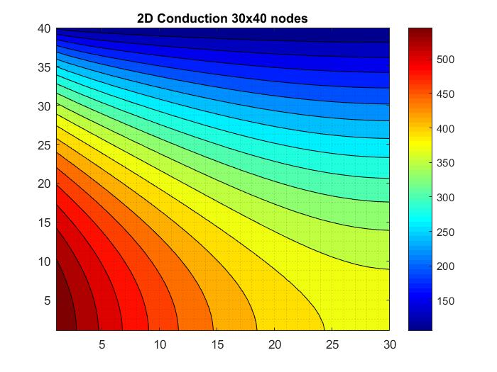

2D Heat Conduction Grid Independency

Slide 3
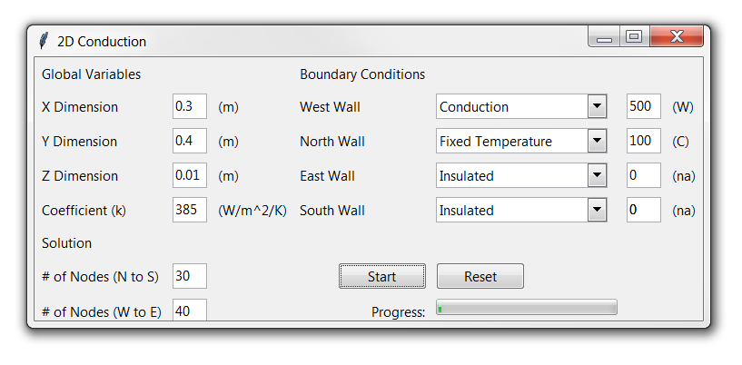
2D Heat Conduction User Interface

Slide 4


2D Heat Conduction User Interface – How it works
GUI for Input Data
(IC, BC, etc.)
Program Scheduling*
Fortran Compiler
(TDMA and Convergence)
Visualization for 2D
plots

Slide 5
2D Heat Conduction Next Steps
Python Program:
Finish the 2D plotting aspect of the program.
Add relaxation term.
Add load and save functionality.
Add scheduling controls to GUI.
Test program against book examples for 2D Conduction (diffusion) problems.
Fortran Code:
Fix / Complete the parallel 2D TDMA code.
Add parallel 2D TDMA code to the Python program.
Run comparisons against the serial case.
Move to 3D case once acceptable results are obtained.

