Slide 1
CSUN Graduate Research
Matt Blomquist
September 1, 2017

Slide 2
Summer Progress Update
Completed Work
Writing (Current 36 pgs. / 8,000 words)
Solver Code
2D and 3D comparisons are 90% completed.
Helper functions to replace 3DTDMA are ready for testing.
BiCGStab(l) – Completed
Matrix-Vector Compressions – Completed
Next Steps
Writing
Update preliminary chapters (1 – 4).
Write Results and Conclusions.
Solver Code
Finish testing GPU cases and PARDISO Case.
Integrate BiCGStab(l) with microchannel code.
Run side-by-side cases for results.
Thesis Deadlines
Committee – 9/29
Formatting – 11/3
Final Submission – 12/8

Slide 3
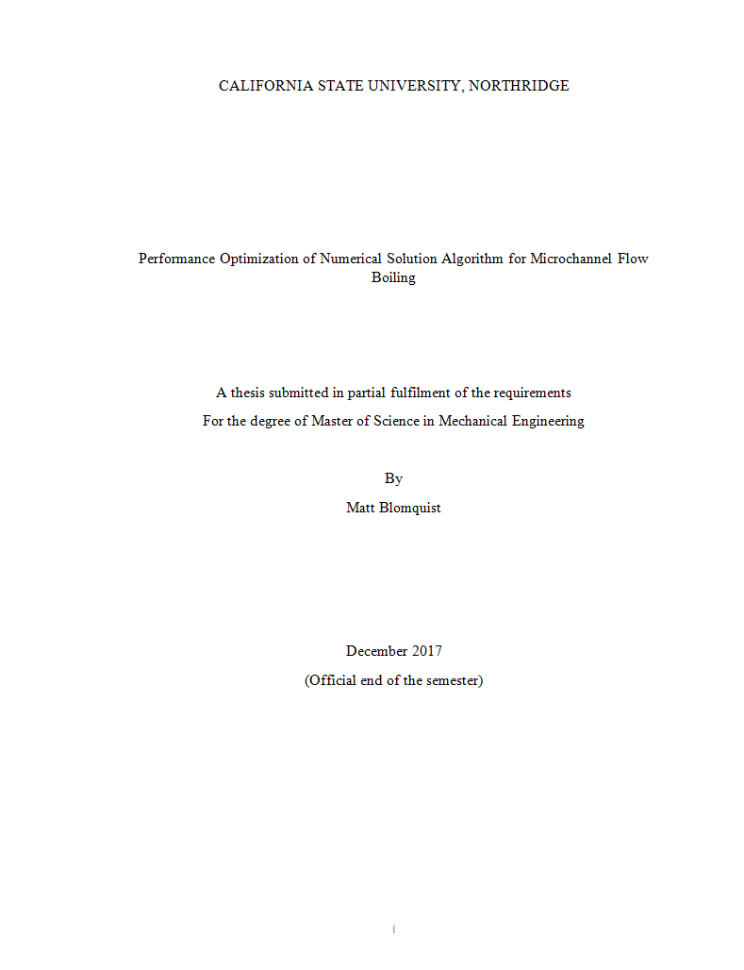
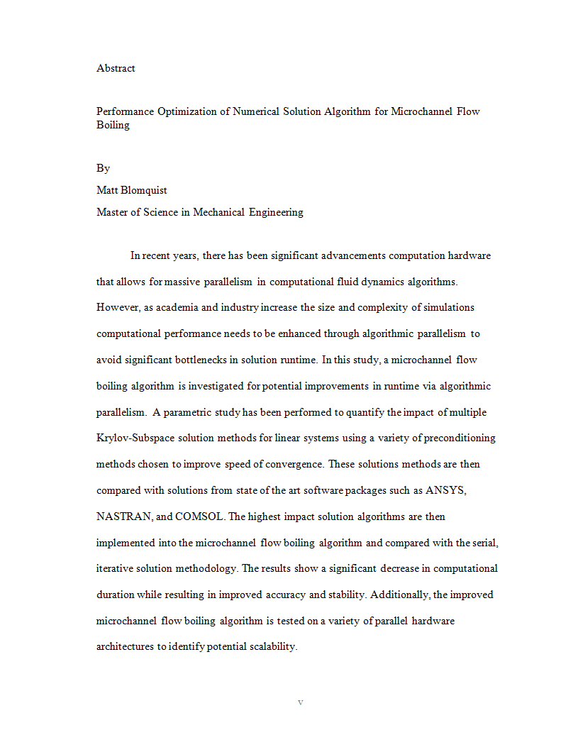
Thesis Update Overview and Proposed Chapters
Document Outline (Chapters / Sub-Chapters)
Abstract
Preliminary – Completed
Revision – Completed
Ready for Review – Yes (Sent: 9/1)
Introduction
Preliminary – Completed
Revision – In progress
Ready for Review – No (ECD 9/6)
Objective
Preliminary – Completed
Revision – In progress
Ready for Review – No (ECD 9/6)
Mathematics
Preliminary – Completed
Revision – In progress
Ready for Review – No (ECD 9/19)
Numerical Model
Preliminary – Completed
Revision – In progress
Ready for Review – No (ECD 9/19)
Results
Integration of BiCGStab(l) – In progress
Run simulations (cases) – Up next
Preliminary – Not Started
Conclusion
Preliminary – Not Started

Slide 4
Thesis Objective
Objective
The objective of this study [thesis] is to optimize the performance of a numerical solution algorithm for micro-channel flow boiling problems (code used in previous work). The performance indices for this study are (1) solution accuracy, (2) computational duration [runtime], and (3) stability of solution algorithm [does the algorithm find convergence]. The study involves the following steps:
Identify the bottlenecks in the existing microchannel flow boiling solution algorithm that significantly impact computational runtime.
Identify bottlenecks in literature.
Hardware
Algorithms for Iterative Solutions
Identify bottlenecks in actual code.
TDMA
Identify potential improvements to significant bottlenecks from literature review.
New hardware like Multi-core IC, GPU, etc.
Krylov Methods (BiCG, GMRES, etc.)
Perform a comparative / parametric study of potential improvements (linear solvers) on a simplified problem (3D diffusion).
Perform a comparative analysis of the different improvement methods.
This is done in Mathematics chapter.
Test difference linear system solution methods on a 3D diffusion problem (parametric study).
Tested in 2D and 3D in MATLAB and FORTRAN.
Determine the cost of implementation of each potential improvement method.
How big of a change is it to implement new methods in CFD?
This is the part where
Implement (? #) of potential improvements in the microchannel flow boiling solution algorithm.
Perform an analysis of the impact made by improving bottleneck areas.
Identify additional areas related to this study that can be investigated in future research.

Slide 5
Single CPU 2D Cases Overview
2D Cases used dense matrix formatting.
MATLAB mldivide performed the best with all 2D Cases.
The mldivide algorithms uses LU factorization and partial pivoting after analyzing the matrix structure.
6.24 second duration at 100x100.
Biconjugate Gradients
Performed the best out of the non-proprietary algorithms.
12.99 second duration at 100x100.
TDMA
Performed the slowest out of all algorithms tested.
96.42 seconds at 100x100.
Hardware Used:
Windows 10
Intel i7-6700 HQ (2.6 GHz)
16.0 GB RAM

Slide 6
Single CPU 2D Cases Table
2D Cases
N | Total A_{ij} | TDMA |  | BiCGStab |  | GMRES |  | BiCGStab (1) |  | MLDIVIDE (MATLAB)
 |  | Iterations | Duration (s) | Iterations | Duration (s) | Iterations | Duration (s) | Iterations | Duration (s) | Iterations | Duration (s)
10 | 460 | 811 | 0.047753 | 20 | 0.008307 | 1, 20 | 0.019684 | 9.5 | 0.01015 | 1 | 0.000269
20 | 1,920 | 3,016 | 0.250226 | 40 | 0.067992 | 1, 59 | 0.066286 | 19 | 0.073263 | 1 | 0.003685
30 | 4,380 | 6,381 | 0.805161 | 54 | 0.0832 | 1, 89 | 0.106821 | 29.25 | 0.092945 | 1 | 0.015647
40 | 7,840 | 10,783 | 2.241302 | 75.5 | 0.198761 | 2, 16 | 0.237173 | 39 | 0.228455 | 1 | 0.067977
50 | 12,300 | 16,137 | 4.434877 | 94.5 | 0.451546 | 2, 51 | 0.494138 | 44 | 0.470569 | 1 | 0.224183
60 | 17,760 | 22,377 | 8.611036 | 118.5 | 1.086839 | 2, 77 | 1.150746 | 53 | 1.045504 | 1 | 0.380389
70 | 24,220 | 29,449 | 13.911085 | 131 | 2.071761 | 3, 34 | 2.342088 | 66.25 | 2.193684 | 1 | 0.938829
80 | 31,680 | 37,309 | 40.732182 | 185 | 5.017049 | 3, 66 | 4.253277 | 76.25 | 4.265002 | 1 | 1.848341
90 | 40,140 | 45,918 | 65.542217 | 183 | 7.386533 | 4, 14 | 7.296452 | 83.25 | 6.926063 | 1 | 3.666259
100 | 49,600 | 55,242 | 96.421548 | 211 | 12.992204 | 4, 33 | 11.38612 | 91 | 11.530792 | 1 | 6.242787

Slide 8
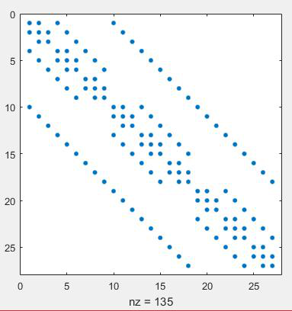
Single CPU 3D Cases Overview
3D Cases used sparse CSR formatting.
This formatting drastically reduces the duration of each algorithm.
Biconjugate Gradients
Performed the best.
1.288 seconds at 60x60x60.
Jacobi Pre-Conditioner
Performed better than non-preconditioned solvers with lower number of nodes.
The preconditioner is ill-conditioned for larger matrices.
Hardware Used:
Windows 10
Intel i7-6700 HQ (2.6 GHz)
16.0 GB RAM

Slide 9
Single CPU 3D Cases Table
3D Cases
Nodes | BiCGStab | BICGStab PC | GMRES | GMRES PC | BiCGStab1 | BICGStab1 PC | mldivide
20 | 0.052 | 0.033 | 0.173 | 0.153 | 0.085 | 0.055 | 0.093
30 | 0.093 | 0.092 | 0.577 | 0.579 | 0.154 | 0.154 | 0.700
40 | 0.218 | 0.272 | 1.097 | 1.177 | 0.388 | 0.424 | 3.016
50 | 0.464 | 0.634 | 2.235 | 2.356 | 0.965 | 1.119 | 11.107
60 | 1.288 | 1.703 | 5.495 | 5.918 | 2.976 | 3.800 | 39.888

