Slide 1
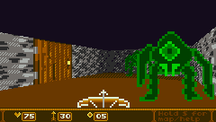
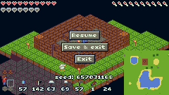
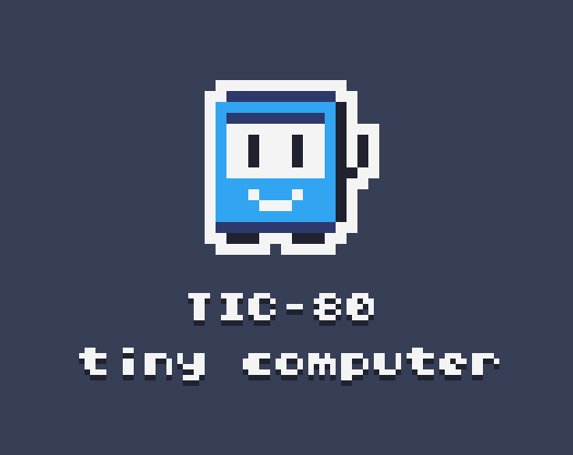
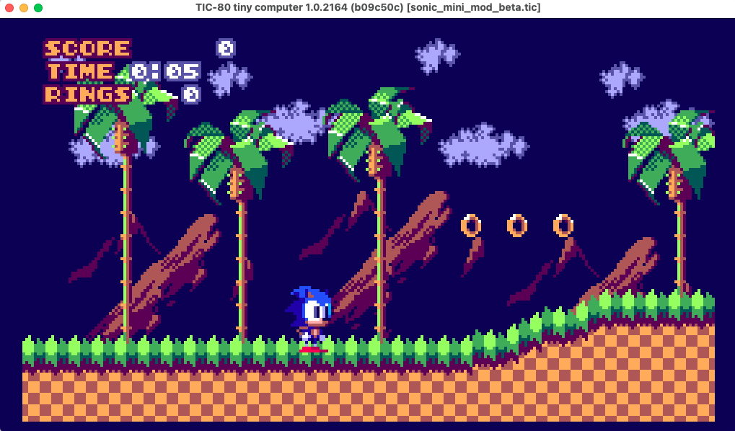
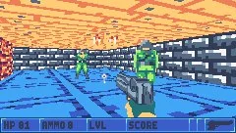

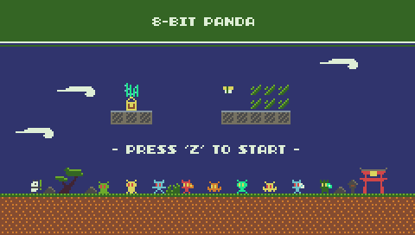
Diviértete programando con TIC-80

Slide 2
Presentador
Anthony Suárez
Desarrollador de software. Partidario del open-source.
- github: @neolight1010
- instagram: @neolight1010
- linkedin: /in/neolight1010

Slide 4
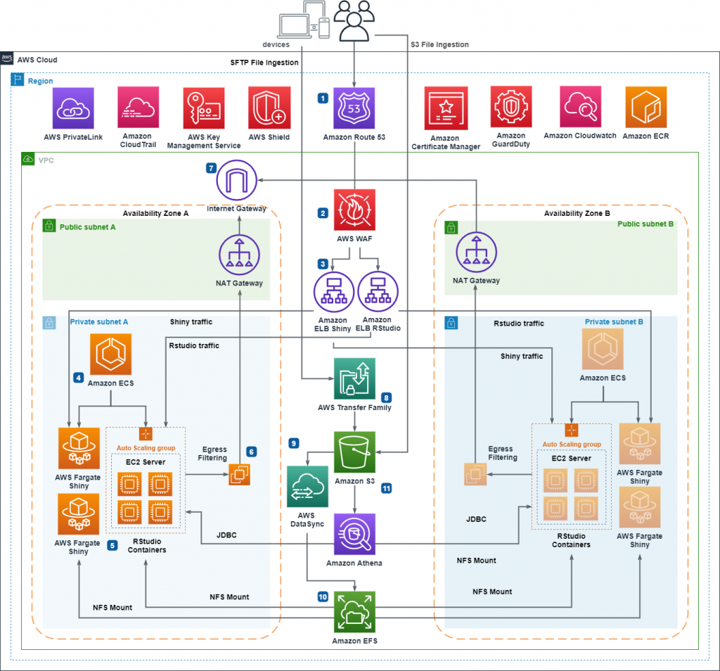
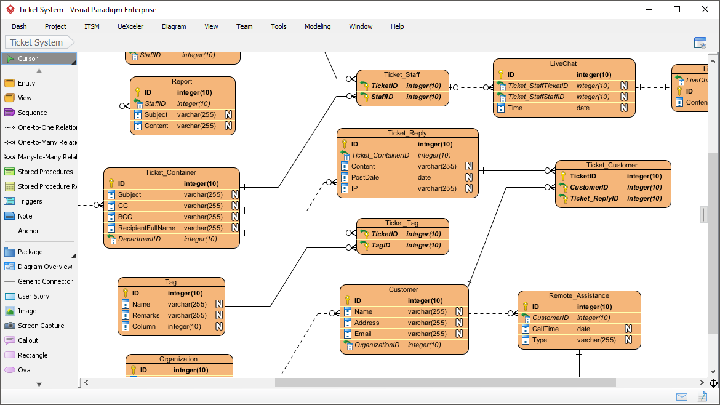
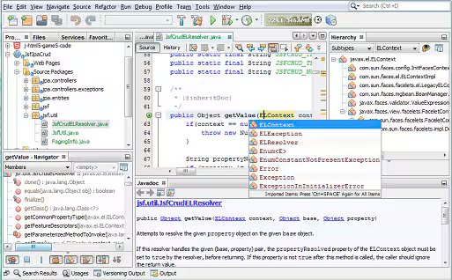
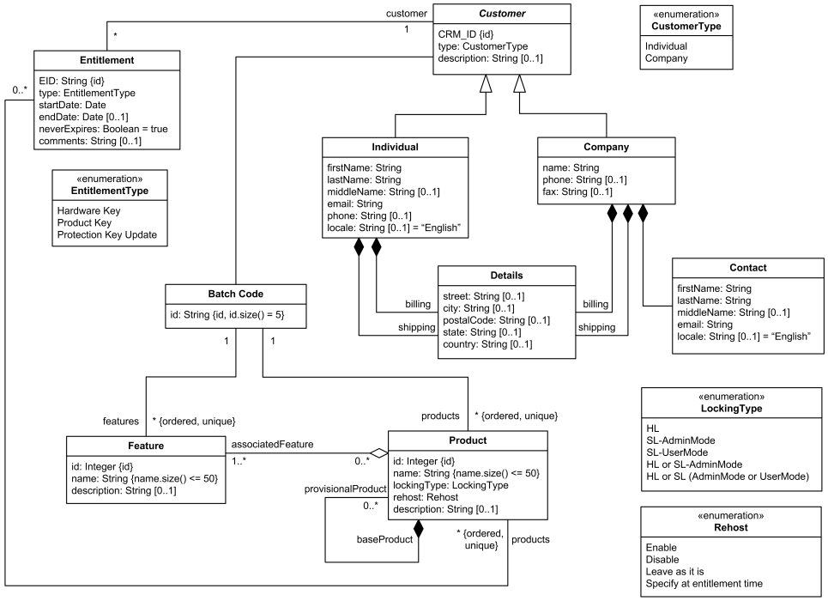


Slide 5
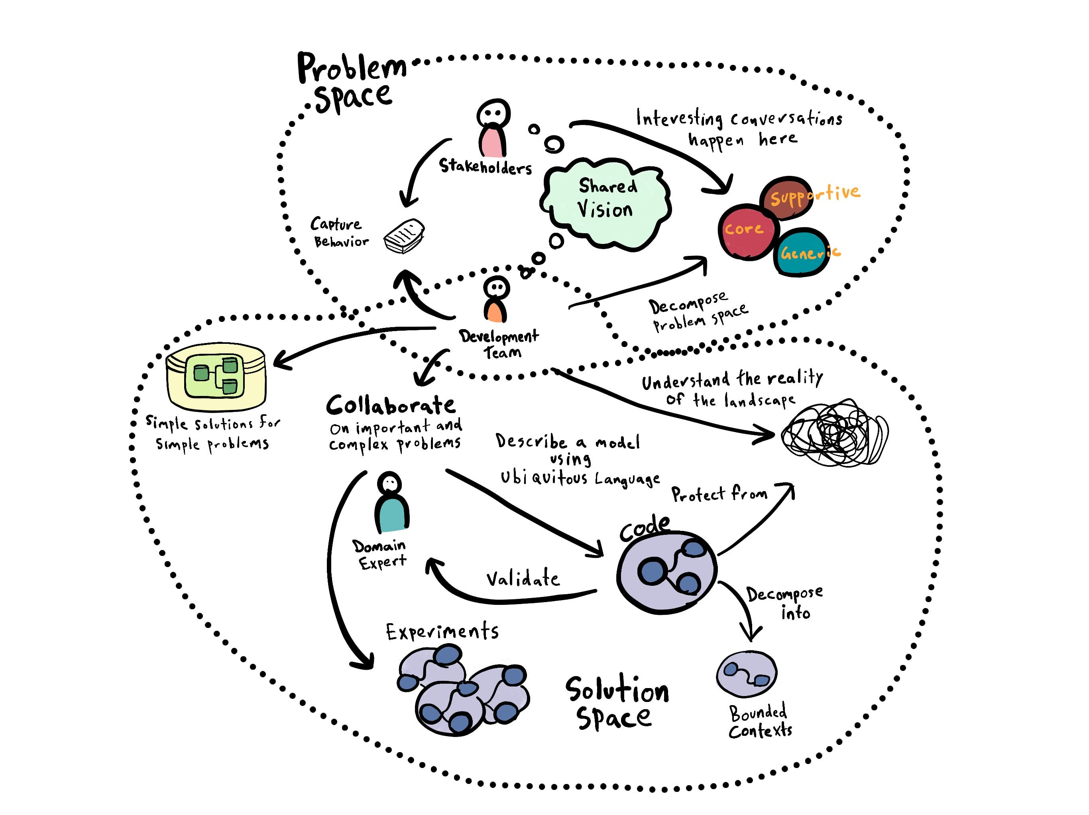
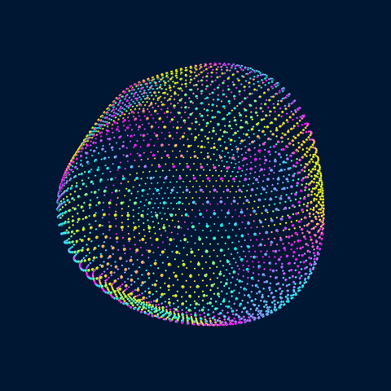
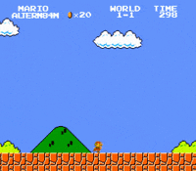

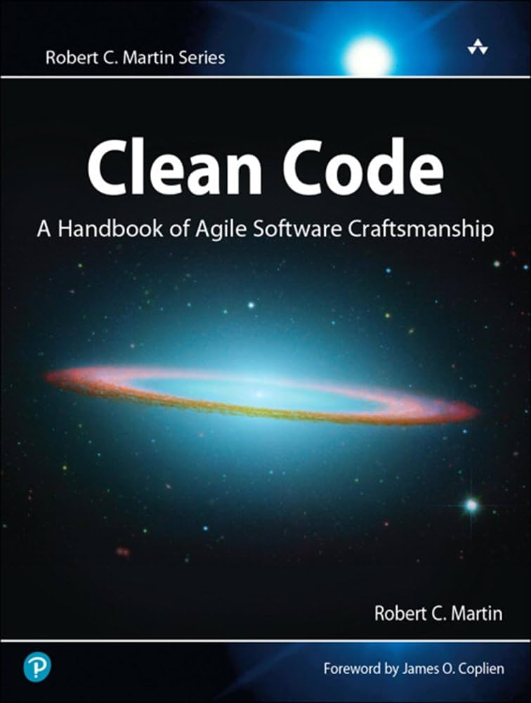
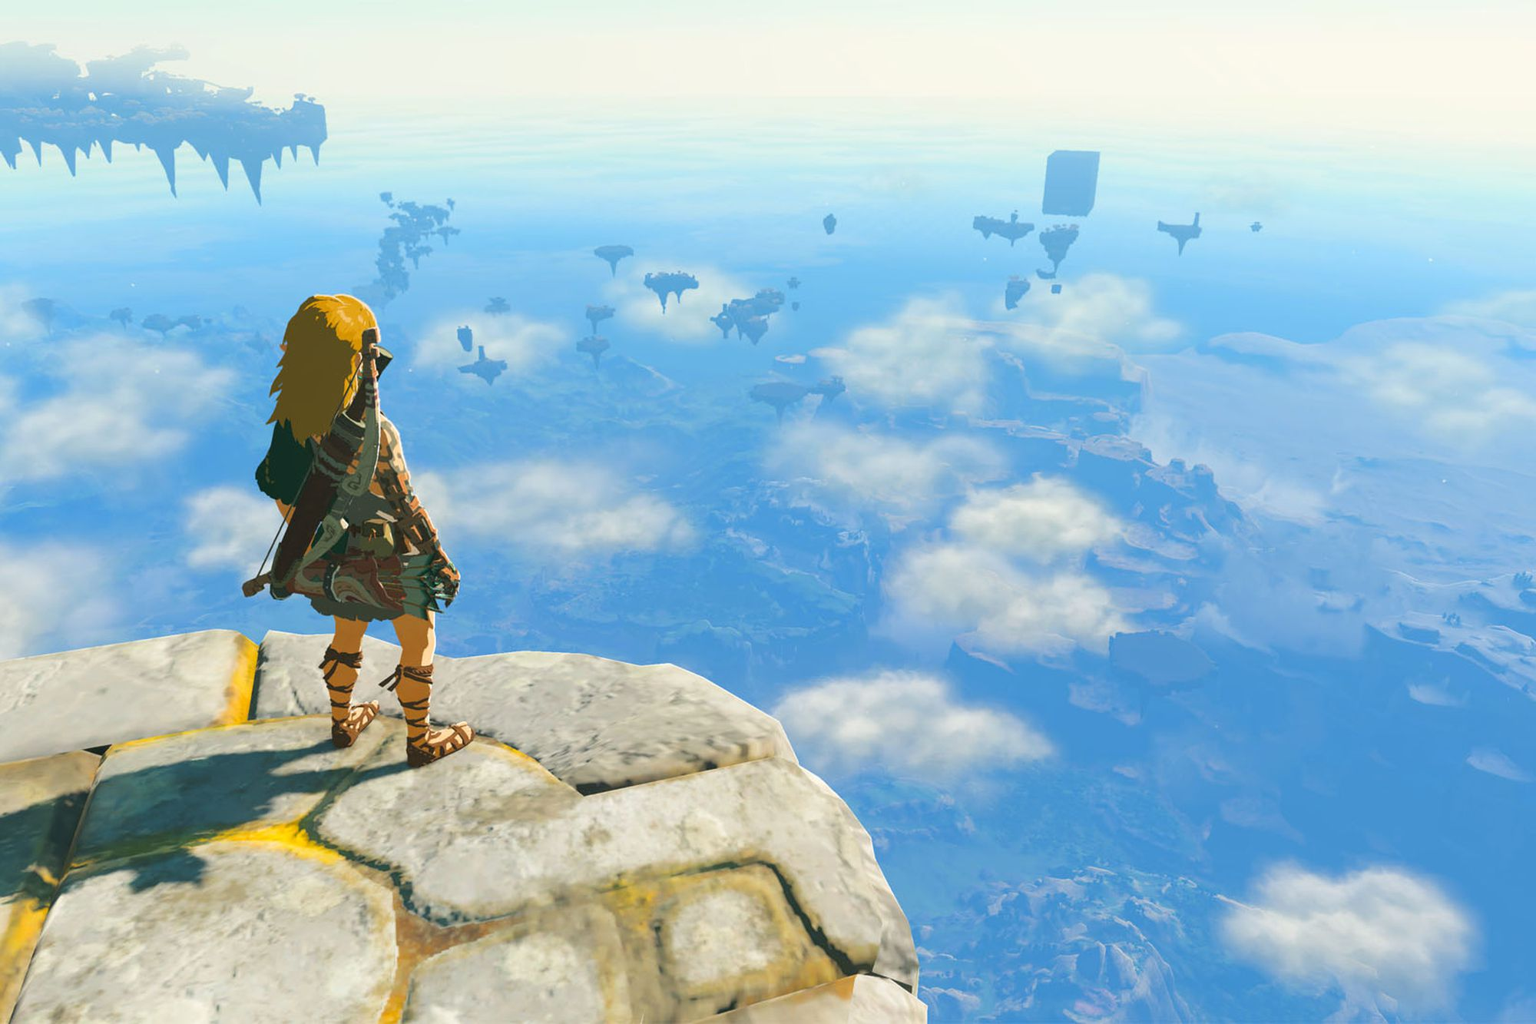

Slide 6

TIC-80 https://tic80.com
DISPLAY 240x136 pixels, 16 colors palette.
INPUT 4 gamepads with 8 buttons / mouse / keyboard.
SPRITES 256 8x8 tiles and 256 8x8 sprites.
MAP 240x136 cells, 1920x1088 pixels.
SOUND 4 channels with configurable waveforms.
CODE 64KB of lua, ruby, js, moon, fennel, scheme, squirrel, wren, wasm, janet or python.

Slide 7
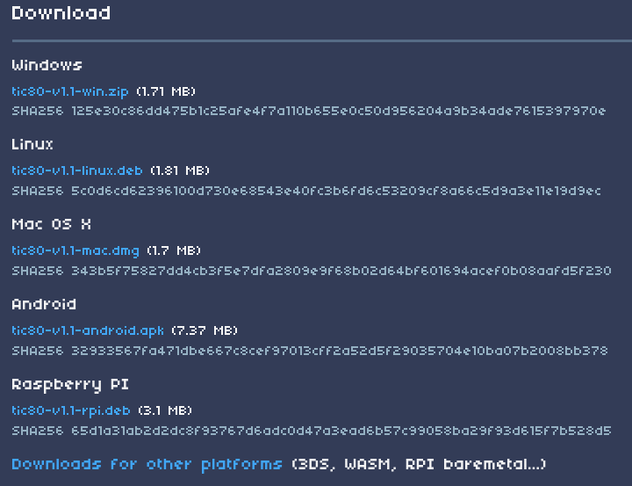
Download TIC-80 https://tic80.com/create

Slide 8
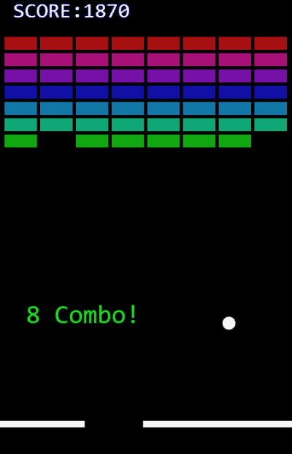
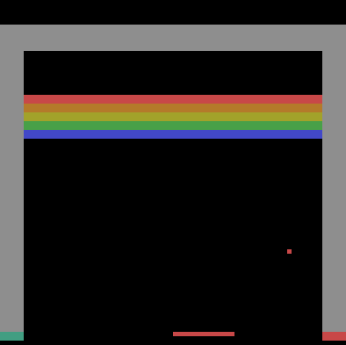
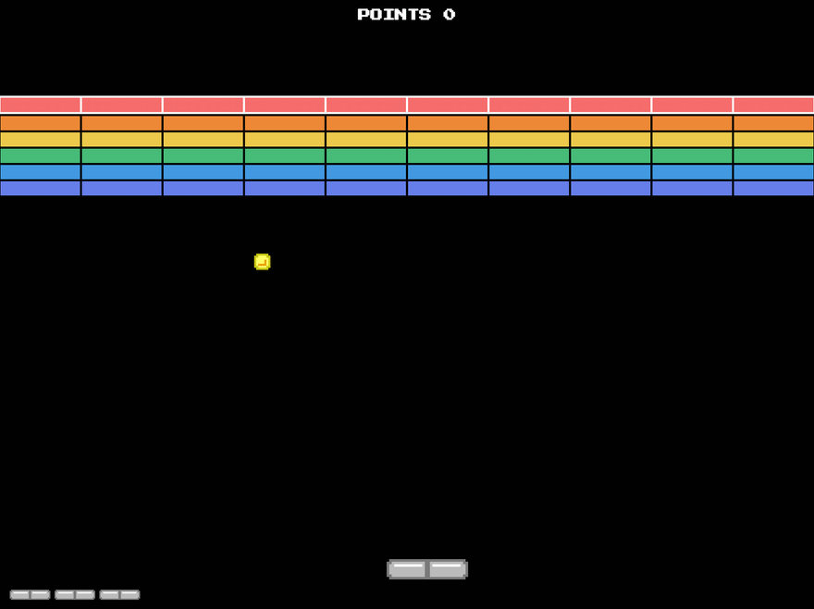
Nuestro objetivo

Slide 9
Comencemos!

