Slide 1
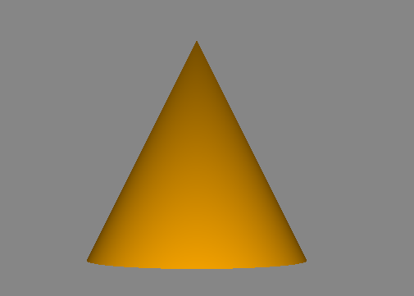
A simple voxelent scene
view
var view; function runVoxelentApp(){ view = vxl.api.setup('view-1');
vxl.api.loadAssets('cone2.json');
view.start();
}
<body onload='runVoxelentApp()'>
Scene
Actor (cone.json)
AssetManager
Model(cone.json)

