Slide 1



Outreach Committee Meeting
Nov 4, 2026

Slide 2
Anti Trust Police Notice
›Linux Foundation Europe meetings involve participation by industry competitors, and it is the intention of the Linux Foundation to conduct all of its activities in accordance with applicable antitrust and competition laws. It is therefore extremely important that attendees adhere to meeting agendas, and be aware of, and not participate in, any activities that are prohibited under applicable US state, federal or foreign antitrust and competition laws.
›Examples of types of actions that are prohibited at Linux Foundation Europe meetings and in connection with Linux Foundation activities are described in the Linux Foundation Antitrust Policy available at http://www.linuxfoundation.eu/antitrust-policy. If you have questions about these matters, please contact your company counsel, or if you are a member of the Linux Foundation, feel free to contact Andrew Updegrove of the firm of Gesmer Updegrove LLP, which provides legal counsel to the Linux Foundation.

Slide 3
Important Notice
Driven by the TAC, the NeoNeoNephos Foundation works on a joint definition for all Special Interest Groups (SIGs).
The current state of the proposal can be reviewed here.
When approved, this changes a few formal things for SIGs of the Outreach Committee:
    2 Leads instead of a single Chairperson
    Introduction of a “Parent Committee SIG liaison role”
    Updated reporting rules
    Every SIG has a charter in form of a .yaml file
    Every SIG needs to have its own repository
      Nevertheless, in practical terms nothing changes.
      No direct action required from any of the assembled.
    You will be informed on Zulip as required.

Slide 4
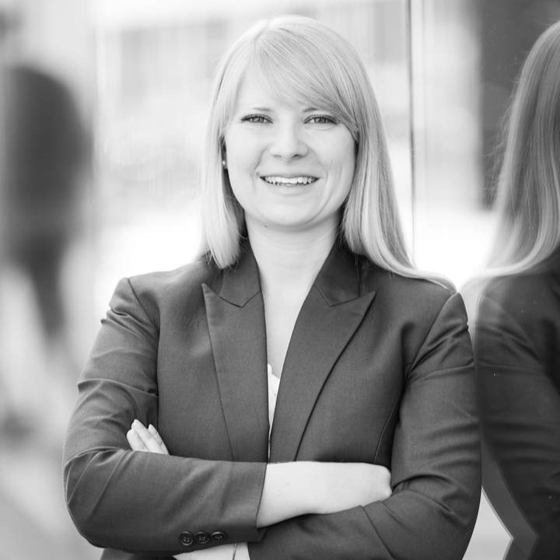
News from Events SIG
(Roberto, Annika, Tristan, Anna, Alexandra)
Events SIG Lead
Events
Finalized Event Proposal 2027 → will be presented in next GB Meeting
Feedback round regarding Events/Merch,..2026 set up (Nov 18)
KubeCon+CloudNativeCon EU’27
  Silver Sponsorship saved
  tbd: Organization with or without LF services
KubeCon+CloudNativeCon NA’26
  Orlin Vasilev and Maximilian Braun (OCM) attend as visitors.
  Orlin meets with other company representatives. To do: Review his shared list.

Slide 5
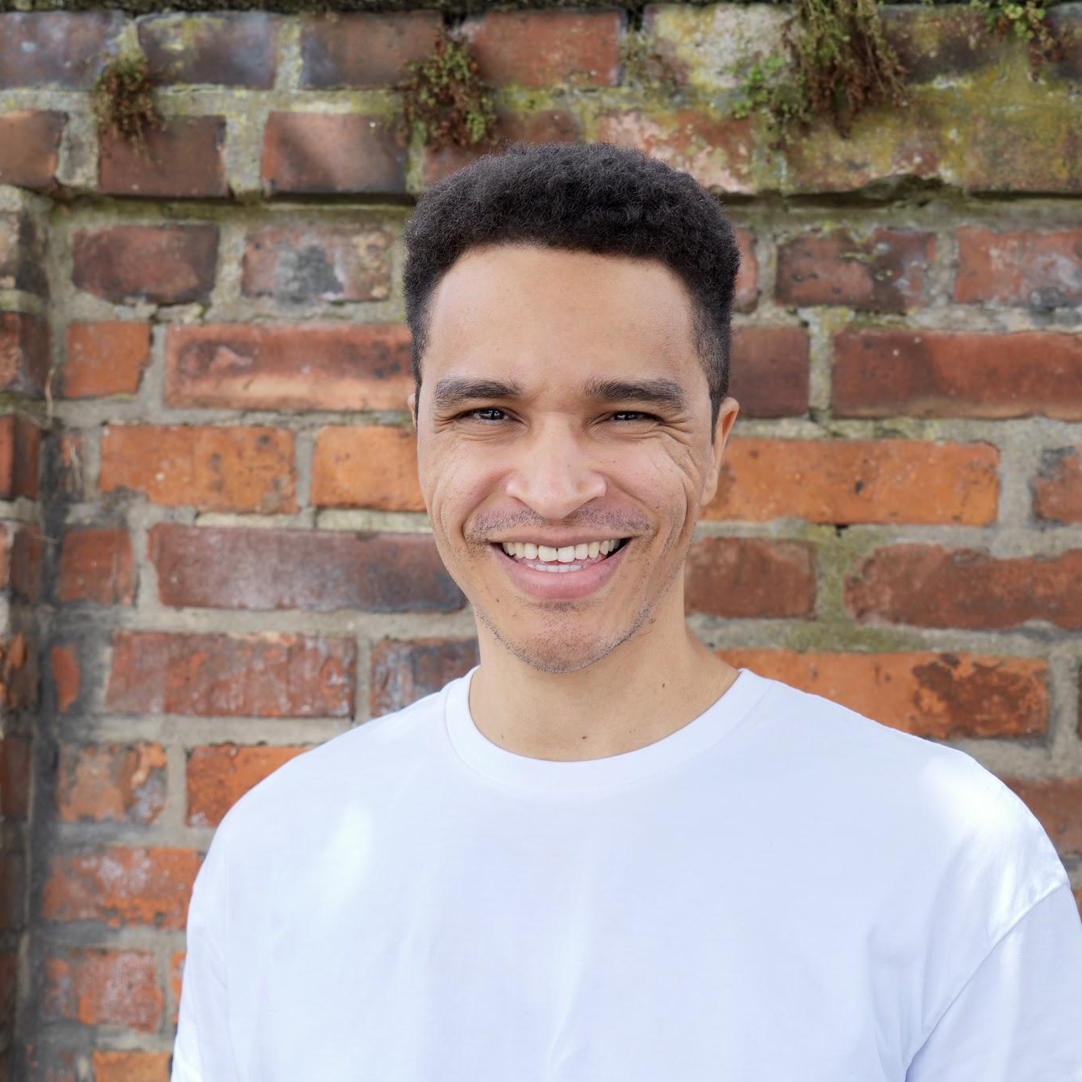

News from Ambassador SIG
(Abu, Tristan, Christine, Annika, Alexandra, Constanze)
Ambassador
SIG Lead
Alexandra Haenig, Christine Sandmark, Annika Opitz and Constanze Roedig form the Ambassador Evaluation Committee
SIGs have stated their ambassador needs here.
5 Applications still open
Next steps:
Interview rounds with applicants
Vote on applicants (and support drafting their 90-day plan)
Create extended application form for 2027

Slide 6
News from Marketing & Social Media SIG
(Roberto, Abu, Jürgen, Katarina)
Marketing / Social Media Temporary SIG Lead
Community Mascot
  https://github.com/neonephos/outreach/issues/80 (see upcoming slide for more details)
NeoNephos Newsletter
  Really nice improvement in the last Newsletter with all the pics! Kudos!
  Please give your input for the Nov NL: https://github.com/neonephos/outreach/issues/92
New Member Promotion #65
  We have a new Associate Member (Deutsche Bundesbank) which must be promoted.
mogenius promotional video
  A promotional video was shot with mogenius CEO Gerrit Schumann in Cologne.
  More updates on that within the next 2 weeks.
NNF News (project wise) are now covered in the LWCN digest (thanks Orlin).
Relevant Project news have been filtered via LLM from the NNF RSS feed.
  Evaluation of this trial still pending.

Slide 7
Vote on Mascot
As presented in more detail in #51, today the Outreach Committee votes on the mascot animal type.
Everyone has three votes. The top three types will be presented to GB.
Next Steps:
Please vote on Zulip today.
🦭 🐙 🦫 🐱 🦦 🐝 🦛🦧 🐀🐒🐶🦒🦁

Slide 8
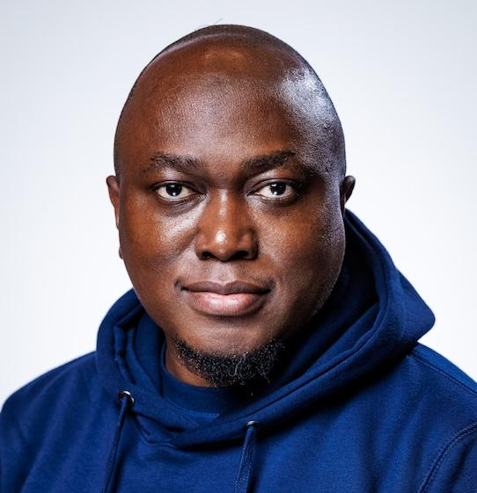
News from KPI SIG
(Tristan, Abu, Alexandra)
KPI
SIG Lead
On Oct. 22 it was agreed a new SIG “SovScore” will be created (#6)
    Reasoning: The SovScore project is out of scope for the KPI SIG
    The TAC is that SIGs parent committee
The TAC Chair is working on a metrics dashboard that is a superset of the metrics presented by LFX insights.
    It was agreed to have the KPI SIG support its progress and review the metrics calculated.
All variables for standardized calculation of the Elephant factors have been determined. (#55)
Next Steps:
Support work on the metrics dashboard of the TAC chair
Work together with the Events SIGs on event metrics for quantifying success of an event

Slide 9
External Feedback
We have received constructive feedback from Lauri, a member of the community.
  Some Points:
    A project did not respond to her efforts to contribute (very bad).
    Unclear what the adoption stories of the projects are.
    The website neonephos.org needs updating
    The monthly community call is not very inviting
    It appears nobody knows the direction the foundation is heading to (mission statement still not final).
    What is the role of IPCEI-CIS? How does it affect the foundation long tem?
    Overall, it appears that there is a lack of urgency and open source spirit.
The criticism has been shared in this feedback document.
Question:
Do you feel the same?
Todo:
Temporary task force to classify and address the issues as feasible
  Relay feedback out of scope to the Outreach Committee to the Governing Board

Slide 10
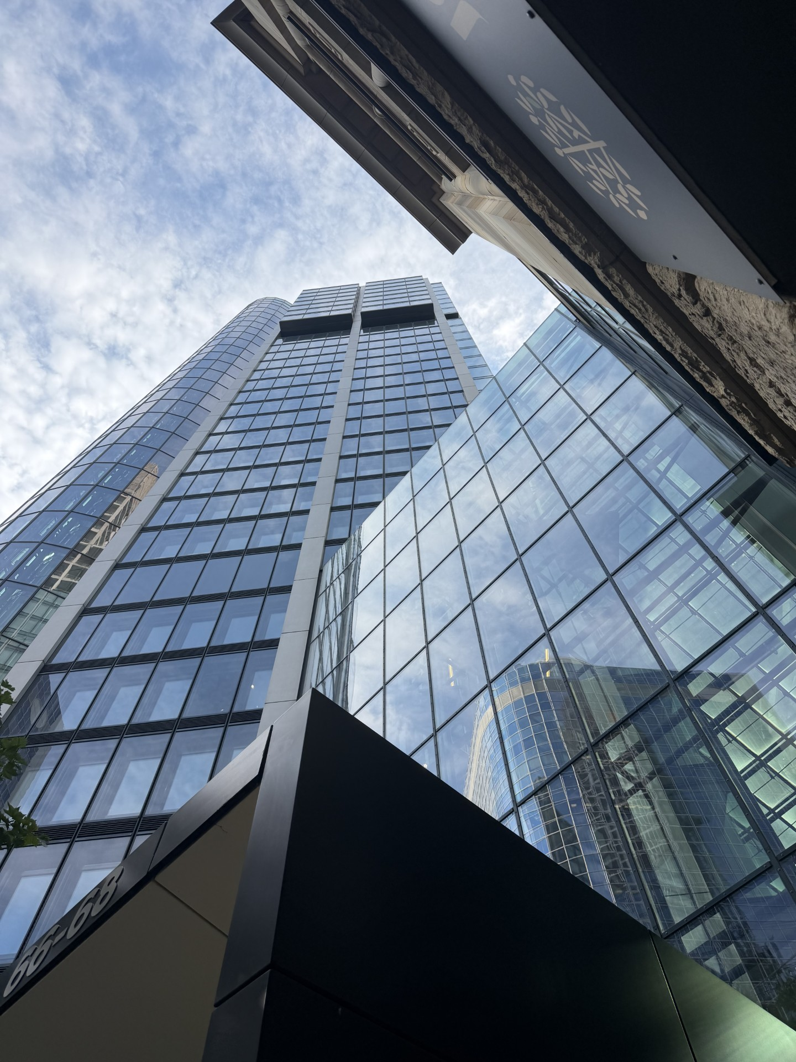
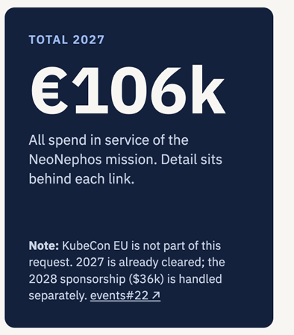
Topics for the Governing Board
The following topics should be addressed at the GB:
  Outreach Committee Budget 2027
    Within the budget, the sub-budget for activities can be reallocated.
    If approved, planning for the OSS-mini summit should start.
In December, the GB meets on-site at the testlab in Frankfurt am Main.
  What topics do we need addressed?
Relay some of the feedback from Lauri’s document, e.g.:
  What is the status of the blueprints?
  What about adoption stories?

