Slide 1



Outreach Committee Meeting
Sept 2026

Slide 2
Anti Trust Police Notice
›Linux Foundation Europe meetings involve participation by industry competitors, and it is the intention of the Linux Foundation to conduct all of its activities in accordance with applicable antitrust and competition laws. It is therefore extremely important that attendees adhere to meeting agendas, and be aware of, and not participate in, any activities that are prohibited under applicable US state, federal or foreign antitrust and competition laws.
›Examples of types of actions that are prohibited at Linux Foundation Europe meetings and in connection with Linux Foundation activities are described in the Linux Foundation Antitrust Policy available at http://www.linuxfoundation.eu/antitrust-policy. If you have questions about these matters, please contact your company counsel, or if you are a member of the Linux Foundation, feel free to contact Andrew Updegrove of the firm of Gesmer Updegrove LLP, which provides legal counsel to the Linux Foundation.

Slide 3
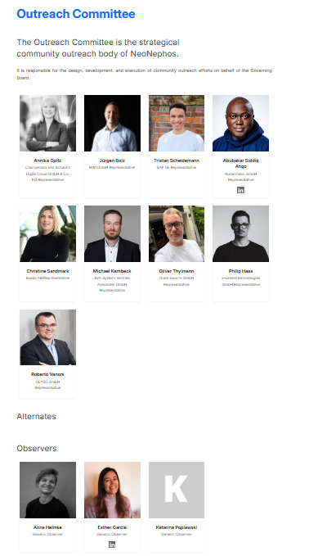
Avatar Task Complete!
👤
THANK YOU ALL FOR SUPPLYING YOUR AVATARS!

Slide 4
News from Events SIG (Roberto, Annika, Tristan, Anna)
Events
ContainerDays is taking place this week (accompanying Social Media Posts planned + posted)
Next Event with a booth: KCD Sofia
Video proposal: https://github.com/neonephos/events/issues/30#issuecomment-5491474568
Do we want to give and send Goodies for the Goodie bags?
Note: We have enough Stickers to send.
To clarify: Who can attend? We have 10 tickets!
Open Source Summit Prague
Organized by Erin from LF
Contract is signed, design for booth handed in
Discount Codes received
Attendee list needs to be finalized

Slide 5
News from Ambassador SIG
(Abu, Tristan, Christine)
Abubakar is at Container Days in Hamburg and represents NNF
Next steps:
Deadline to review Ambassador Management Proposal until today
Coordinate with the SIGs to define work items for future ambassadors
Process currently pending NNF ambassador applications

Slide 6
News from Social Media SIG
(Roberto, Abu, Jürgen, Katarina)
Proposal: Renaming of SIG from “Social Media” SIG to “Marketing & Social Media SIG”
see https://github.com/neonephos/outreach/issues/52
Reasoning: there is a lot of overlap between marketing and social media topic, for both topics there is also overlap in members, we do not have enough active people to staff yet another meeting
To do: Discussion and voting!

Slide 7
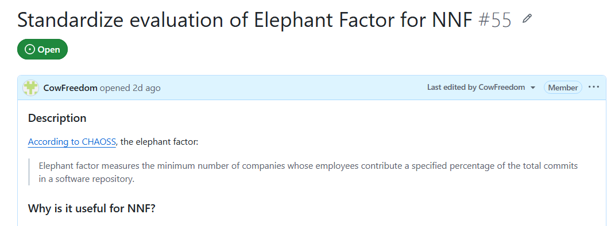
News from KPI SIG
(Tristan, Abu)
The newly formed KPI SIG has initiated work.

Slide 8
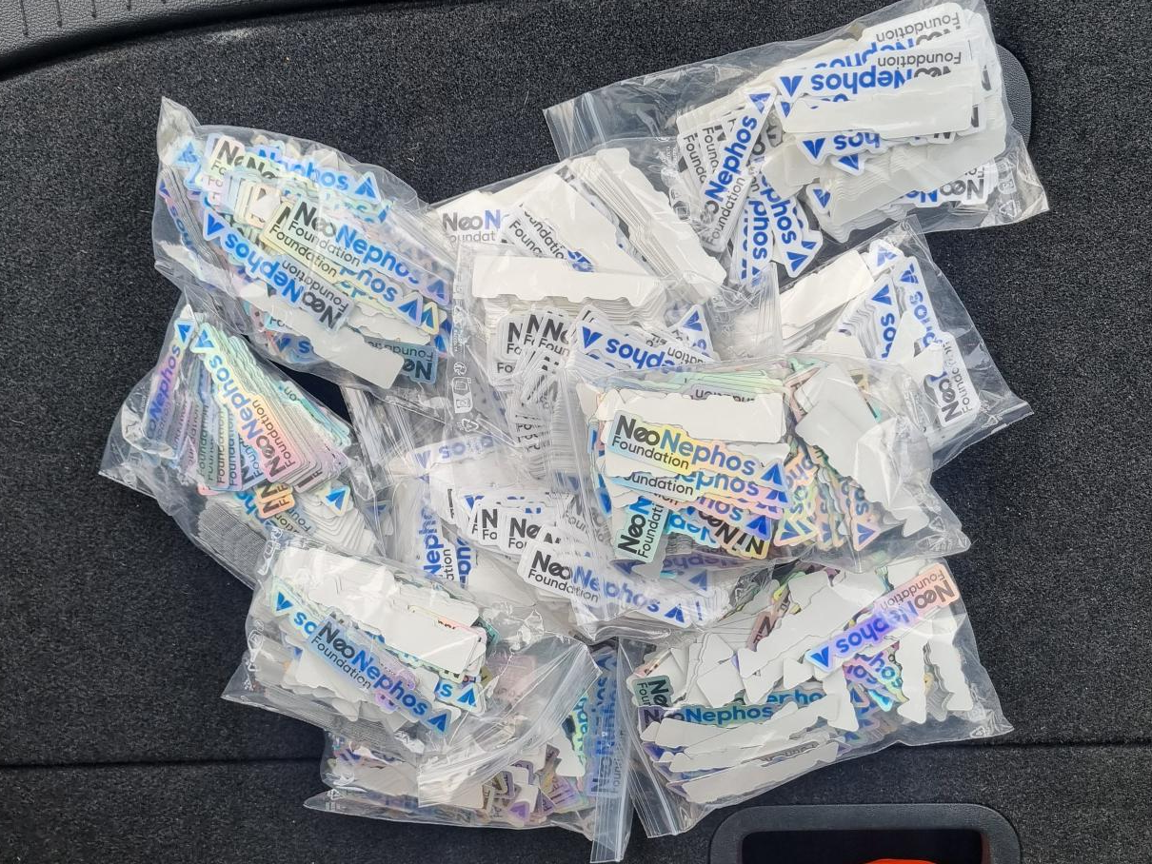
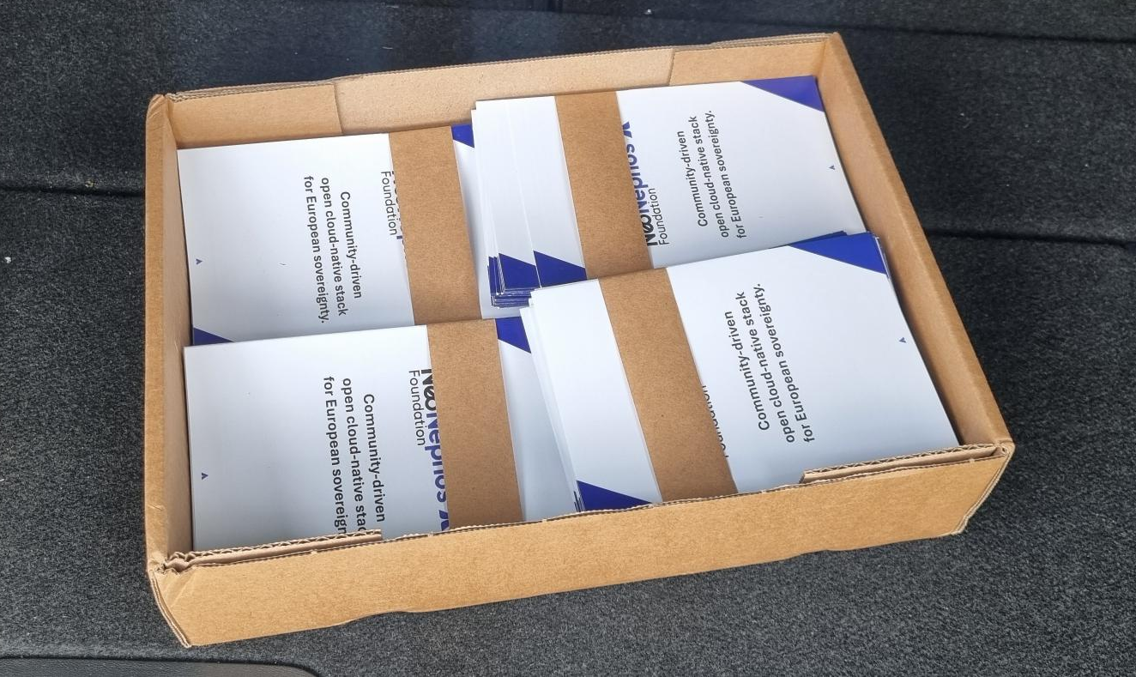
Merch Update
Stickers and Flyers have arrived
Payment from LF went through -> Shirts, Sweaters, Swagbags, Caps etc. are in production
Socks will arrive around September 16

Slide 9
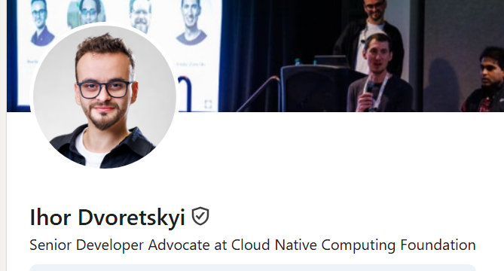
Overall Relations
Ihor Dovertsy from the CNCF offered to assist NNF with guidance.
Todo: Find areas we need guidance in.
Ihor Dvoretskyi LinkedIn

Slide 10
Other topics
Formalization of membership in SIGs: https://github.com/neonephos/outreach/issues/50
To Do: Discuss! Proposal accepted?
Outreach Activities 2027:
https://github.com/neonephos/outreach/issues/54
Preliminary Discussion about the need to kickoff the process to propose our planned activities in 2027 in order for the Governing Board to consider them in their budget discussions.
Outreach Committee Chairperson election
Election of new Chairperson is upcoming
Annika Opitz Chair until End of September

