Slide 2

KPI Open Issues
World of Open Source Survey
LFX Insights Feasibility
Elephant Factor
Investigate survey for results pertinent to NNF.
Investigate feasibility of LFX for metrics.
Determine elephant factor for NNF.

Slide 3

World of Open Source Survey (#66)
NNF is among the survey’s sponsors.
Survey is yet-to-be-released but we have a preprint.
Task: Investigate if findings relate to NNF and liaise with other SIGs accordingly.

Slide 4

LFX Insights Feasibility (#62)
LFX Insights contains many statistics about projects.
Task: Investigate if we need reproducibility and if LFX Insights is appropriate for that.

Slide 5
Elephant Factor

Slide 6
Elephant factor measures the minimum number of companies whose employees contribute a specified percentage of the total commits in a software repository.

Slide 7
Example elephant factors
Repository | Elephant Factor
kubernetes/kubernetes | 3
kubernetes/website | 7
platform-mesh/platform-mesh | 1

Slide 8
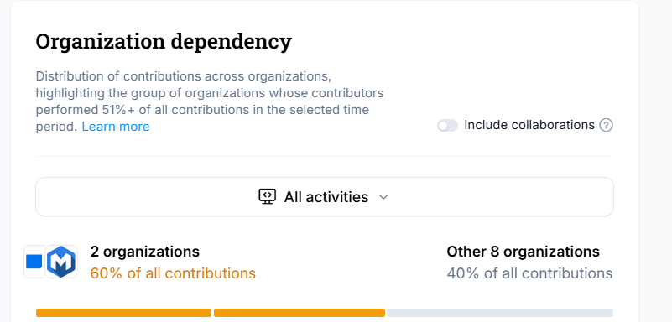
How to measure the elephant factor?
The Elephant factor is measured by LFX Insights.

Slide 9
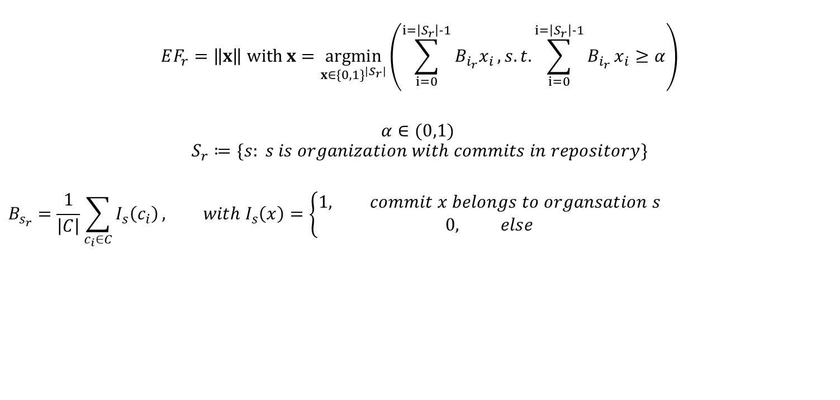
Elephant factor for a repository
$$EF_{r}=\left\|x\right\| withx=\underset{x{∈\{0,1\}}^{\left|S_{r}\right|}}{argmin}\left(\sum_{i=0}^{i=\left|S_{r}\right|-1}{{B_{i_{r}}x}_{i}}, s.t.\sum_{i=0}^{i=\left|S_{r}\right|-1}{B_{i_{r}}}x_{i}≥α\right)$$
$$α∈(0,1)$$
$$S_{r}≔\{s: s is organization with commits in repository\}$$
$$B_{s_{r}}=\frac{1}{\left|C\right|}\sum_{c_{i}∈C}{I_{s}\left(c_{i}\right)}, with I_{s}\left(x\right)=\left\{\begin{aligned}1, commit x belongs to organsation s \\ &0, else\end{aligned}\right.$$

Slide 10
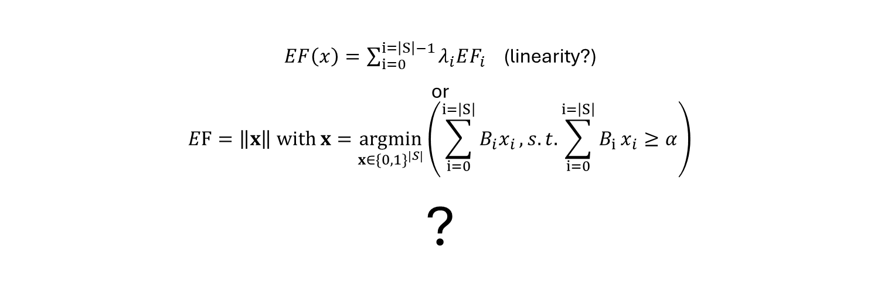
Elephant factor for multiple repositories
$EF\left(x\right)=\sum_{i=0}^{i=\left|S\right|−1}{λ_{i}EF_{i}}$ (linearity?)
or $$EF=\left\|x\right\| withx=\underset{x{∈\{0,1\}}^{\left|S\right|}}{argmin}\left(\sum_{i=0}^{i=\left|S\right|}{B_{i}x_{i}}, s.t.\sum_{i=0}^{i=\left|S\right|}{B_{i}}x_{i}≥α\right)$$ ?

Slide 11
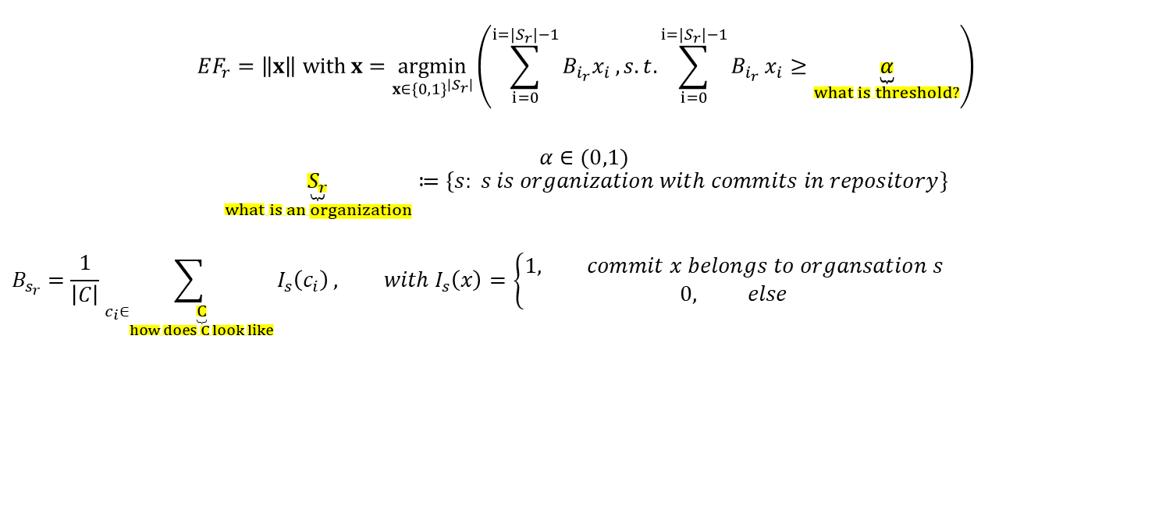
Elephant factor needed work
$$EF_{r}=\left\|x\right\| withx=\underset{x{∈\{0,1\}}^{\left|S_{r}\right|}}{argmin}\left(\sum_{i=0}^{i=\left|S_{r}\right|−1}{{B_{i_{r}}x}_{i}}, s.t.\sum_{i=0}^{i=\left|S_{r}\right|−1}{B_{i_{r}}}x_{i}≥\underset{what is threshold?}{\underbrace{α}}\right)$$
$$α∈(0,1)$$
$$\underset{what is an organization}{\underbrace{S_{r}}}≔\{s: s is organization with commits in repository\}$$
$$B_{s_{r}}=\frac{1}{\left|C\right|}\sum_{c_{i}∈\underset{how does C look like}{\underbrace{C}}}{I_{s}\left(c_{i}\right)}, with I_{s}\left(x\right)=\left\{\begin{aligned}1, commit x belongs to organsation s \\ &0, else\end{aligned}\right.$$

Slide 12
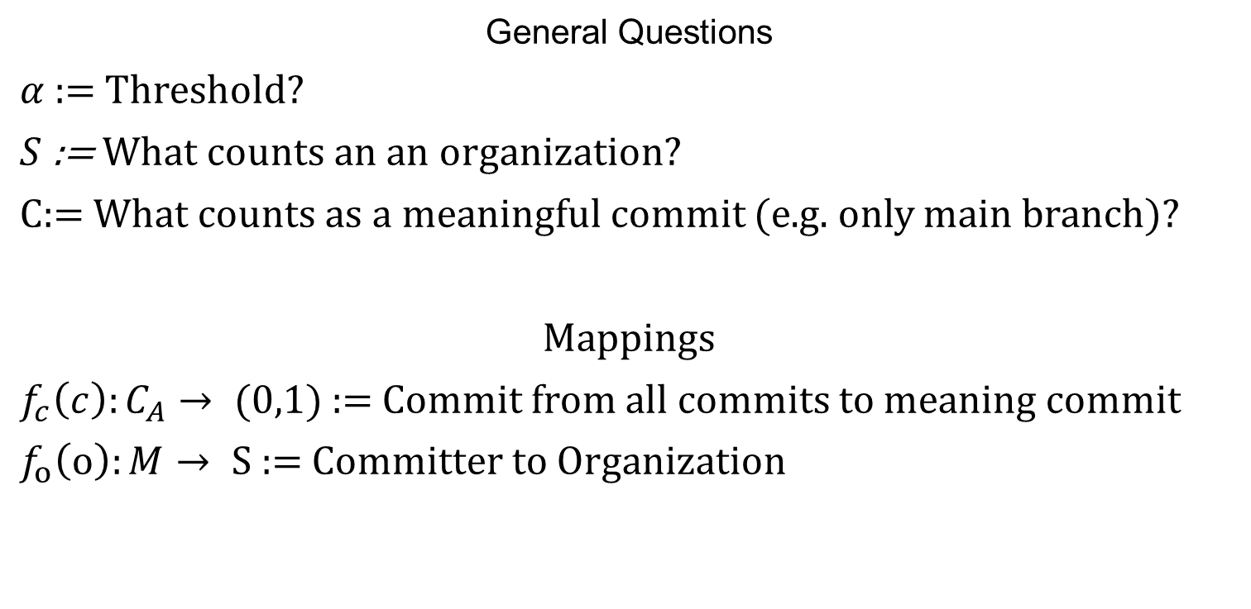
Work Items Shown
General Questions
$α$ := Threshold?
$S$ := What counts an an organization?
$C$:= What counts as a meaningful commit (e.g. only main branch)?
Mappings
$f_{c}\left(c\right):C_{A}→ (0,1)$ := Commit from all commits to meaning commit
$f_{o}\left(o\right):M→ S$ := Committer to Organization

Slide 13

Work Items Shown Cont.
Generalization Questions
$EF_{p}$ from repository to project
$EF_{NNF}$from project to NeoNephos

Slide 14
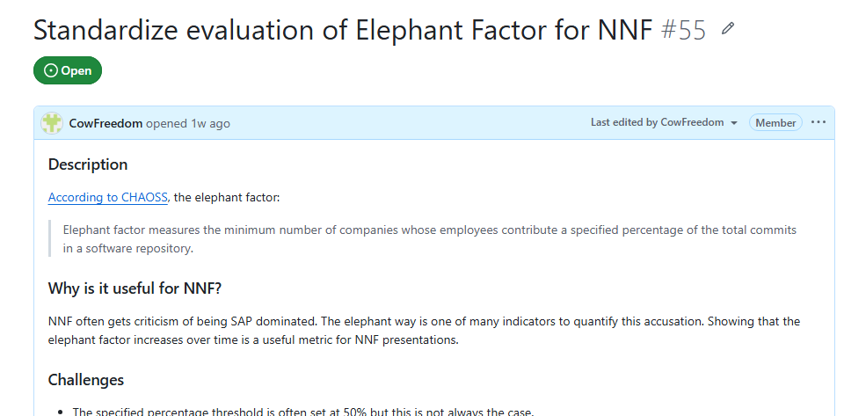
Work Items Shown Cont.
Contribute in Issue 55.

Slide 15
Honorable Mentions
#63 Ensure Garden Linux is listed appropriately in LFX Insights

