Slide 1
Outreach Committee Meeting July

Slide 2
Antitrust Policy Notice
Linux Foundation Europe meetings involve participation by industry competitors, and it is the intention of the Linux Foundation to conduct all of its activities in accordance with applicable antitrust and competition laws. It is therefore extremely important that attendees adhere to meeting agendas, and be aware of, and not participate in, any activities that are prohibited under applicable US state, federal or foreign antitrust and competition laws.
Examples of types of actions that are prohibited at Linux Foundation Europe meetings and in connection with Linux Foundation activities are described in the Linux Foundation Antitrust Policy available at http://www.linuxfoundation.eu/antitrust-policy. If you have questions about these matters, please contact your company counsel, or if you are a member of the Linux Foundation, feel free to contact Andrew Updegrove of the firm of Gesmer Updegrove LLP, which provides legal counsel to the Linux Foundation.
Notes:
THIS SLIDE IS MANDATORY!

Slide 3
Agenda
Updates on the SIGs
Questions on Zulip
Active Discussion

Slide 4
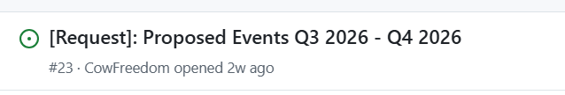


Events Group Update
🎉Proposed Events are submitted to the GB!
To Do: Engage to get them approved.
Goal: „Make“ the GB vote on the package by the end of July.
Open Questions: Should travel costs be covered by GB?

Slide 5

Ambassador SIG Update
+1 Ambassador: Abubakar Ango
Info: We have 4 additional Ambassador applications.
Their applications are on hold, see decision.
To Do‘s:
What Ambassador costs can be covered by NNF?
How to best manage existing Ambassadors.
To find out the answer to these questions, visit the SIG!

Slide 6
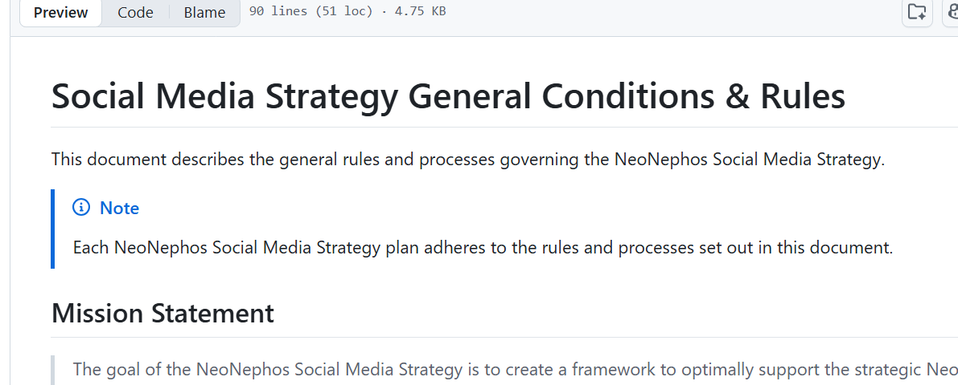
Social Media SIG Update
Goal: Develop a Social Media Strategy
Drafts are being created here.
To Do‘s: Contribute!
Related Info: An additional member (Katarina) joins this SIG.

Slide 7
„Should we make our SIG‘s public?“

Slide 8
„Should we make our main meeting public?“

Slide 9

NNF: “Community-driven
open cloud-native stack
for European sovereignty.”
👍or 👎

Slide 10
Should we remind other NNF members that they can send reps to the Outreach Committee?

Slide 11
NNF GB Roadmap Item: “Improve General Member Relations”

