Slide 1

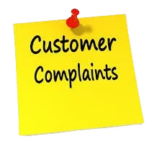

Customer Complaints Analysis Dataset
Objective:
To analyze consumer complaints data to improve product and service quality of the financial service sector.
by Nitesh Srivastava

Slide 2

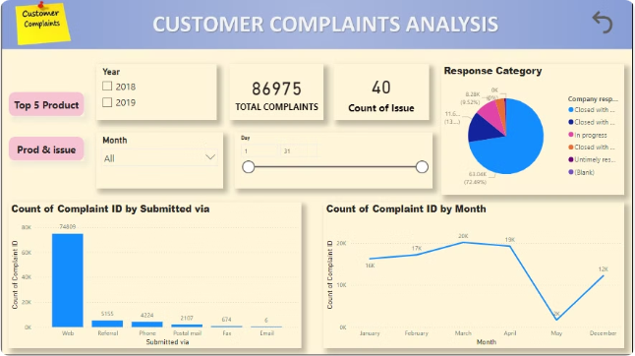
Data Collection Methodology
1
Complaint Gathering
Collecting customer complaints from multiple channels, including web, emails, referral, phones etc.
2
Data Aggregation
Consolidating the complaints into a structured dataset for analysis.
3
Visualizations
Various visual elements such as bar chart, line chart, pie chart, slicers etc. were added to represent the data clearly and interactively.

Slide 3

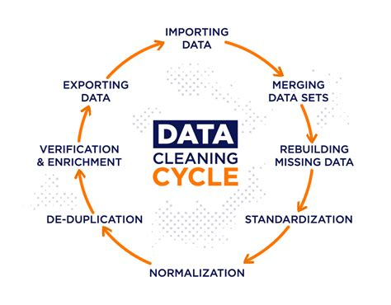
Data Cleaning and Preprocessing
1
Text Normalization
Standardizing the formatting and language used in the complaint descriptions.
2
Spelling and Grammar Corrections
Improving the overall quality and readability of the data.
3
Categorization
Assigning relevant tags or categories to each complaint for better organization.

Slide 4
Exploratory Data Analysis
Complaint Volume Trends
Product or Service Issues
Clean and Preprocess Data
Power BI's ETL tools (Power Query) were utilized to clean and preprocess the data, which included handling missing values, removing duplicates, and converting data types.
Analyzing the frequency and distribution of complaints over time to identify patterns and outliers.
Identifying the most common product or service-related problems based on complaint descriptions.

Slide 5

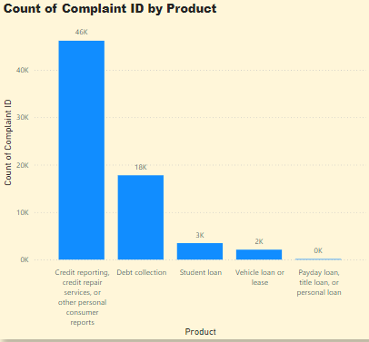
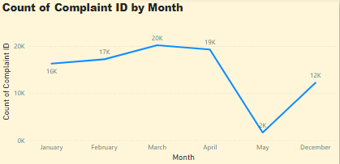
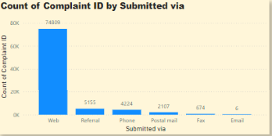
Identifying Common Complaint Patterns
What are the top 5 most common products associated with complaints?
How many complaints were received each month?
What numbers of complaints were submitted via different channels?

Slide 6
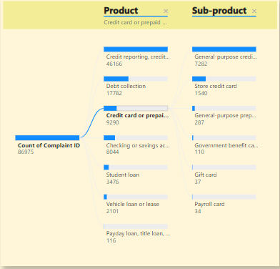
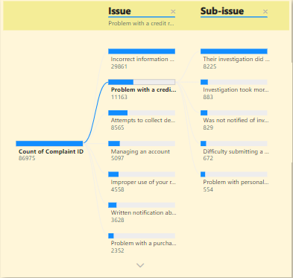
Identifying Common Complaint Patterns
What is the breakdown of complaints by sub-product for a specific product category?
What are the most common sub-issues within the top complaint issues?

Slide 7





Deriving Actionable Insights
Identify Root Causes
Determine the underlying reasons for the most prevalent customer complaints.
Prioritize Improvements
Focus on the issues that will have the greatest impact on customer satisfaction.
Implement Solutions
Develop and execute strategies to address the identified pain points.

Slide 8

Key Findings
1
Most Common Products and Issues
2
Monthly and Yearly Trends
3
Submission Channels
4
Resolution and Response
Recommendations
1
Improvement in Issue Management
2
Enhancing Consumer Experience
3
Leveraging Submission Data

Slide 9

Conclusion
The analysis of the consumer complaints dataset highlights significant trends for improvement in the financial services sector. By addressing common issues, focusing on regional variations, enhancing consumer satisfaction through timely resolutions, and leveraging detailed complaint narratives, companies can better meet consumer needs and reduce the volume of complaints. These insights can guide strategic initiatives to improve overall service quality and consumer trust in financial institutions.

Slide 10

THANKYOU

