Slide 1
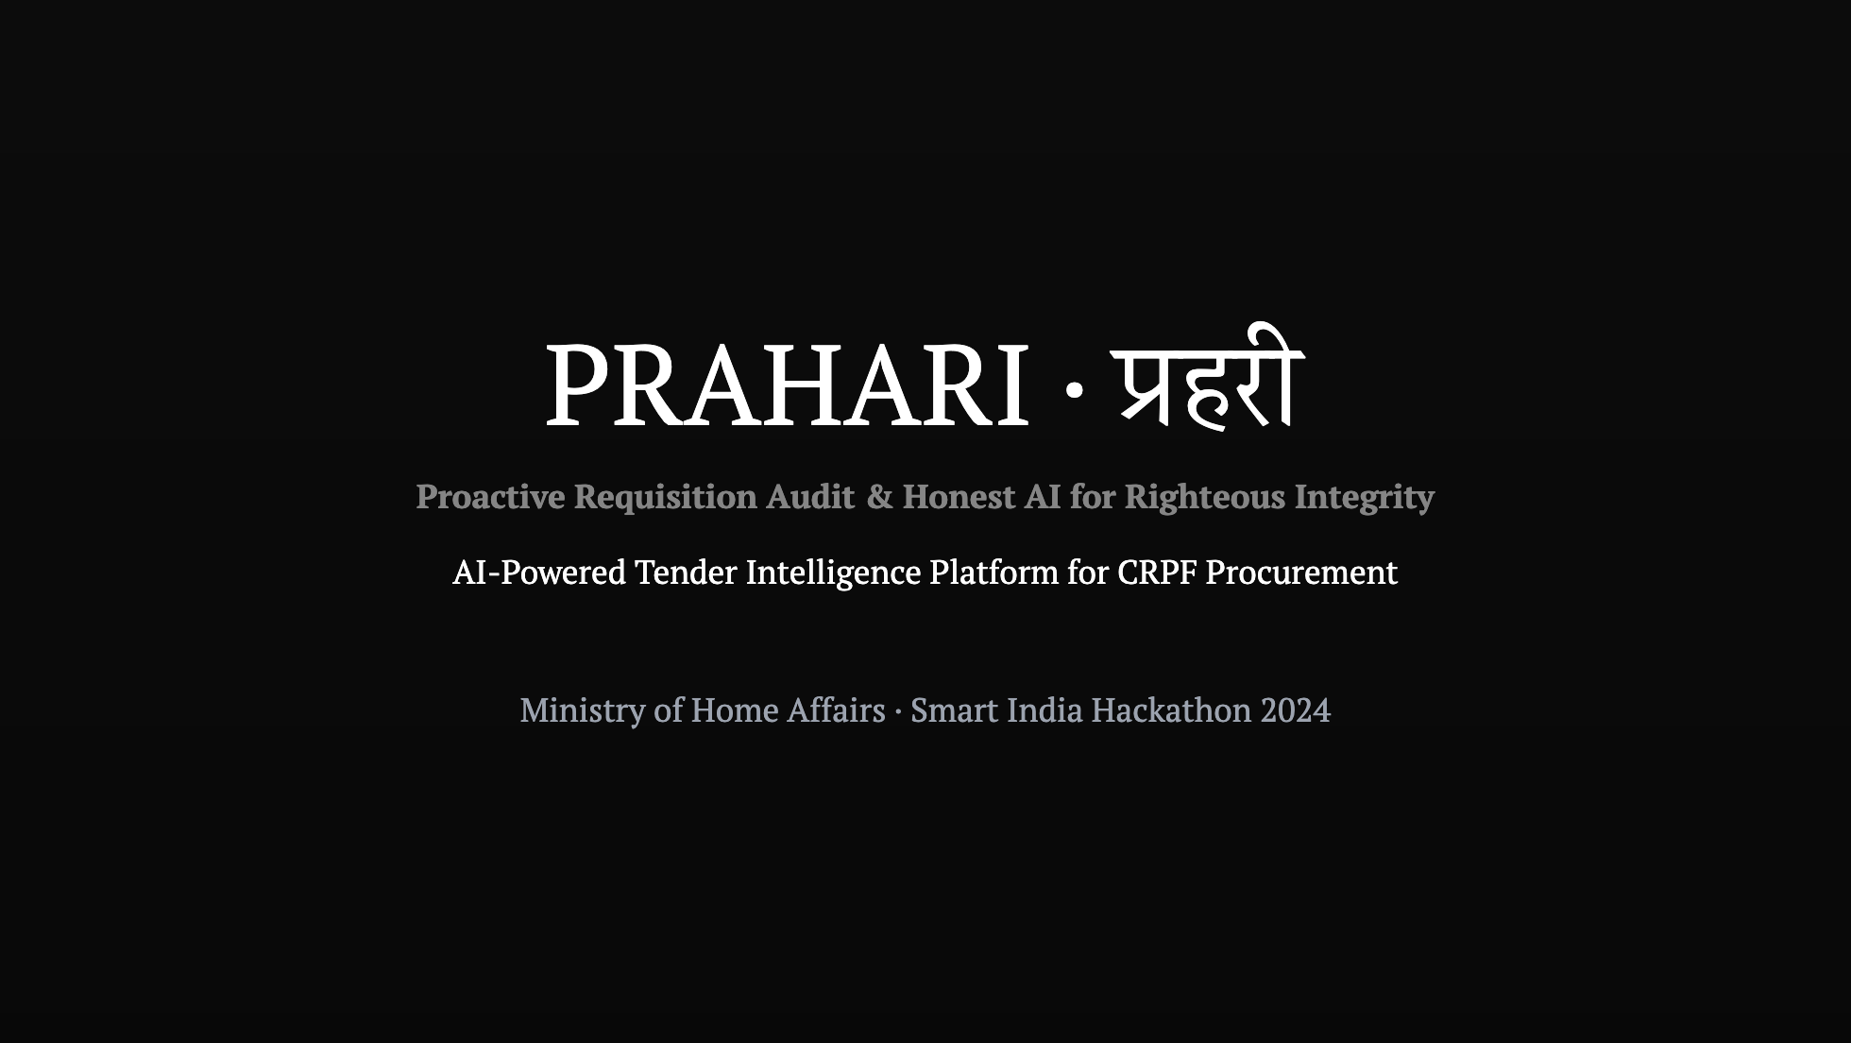
Notes:
PRAHARI means "guardian" in Hindi — and that's exactly what this system is: a guardian against corruption, bias, and inefficiency in government procurement. We built a full-stack, production-ready system that replaces a months-long manual process with a 9-stage AI pipeline that delivers auditable verdicts in minutes.

Slide 2
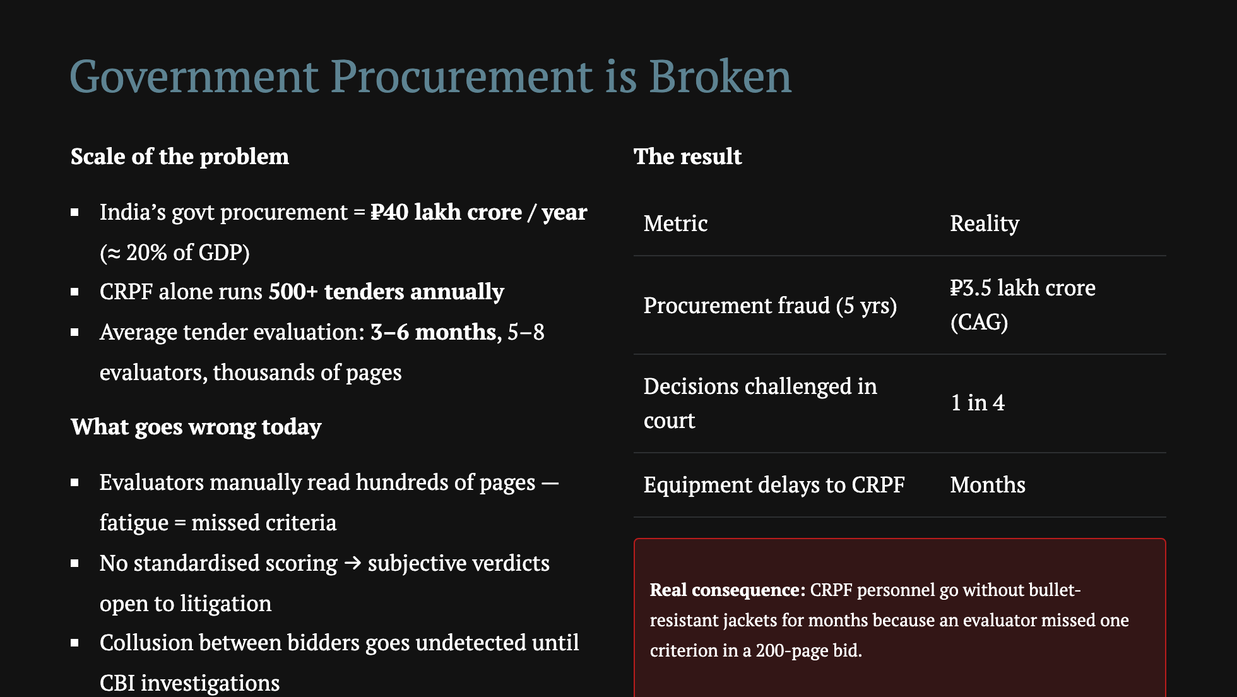
Notes:
Don't just say "procurement is slow." Show that the status quo has a body count — CRPF personnel waiting months for bullet-resistant jackets because an evaluator forgot to check one criterion in a 200-page bid. That's the urgency.

Slide 3
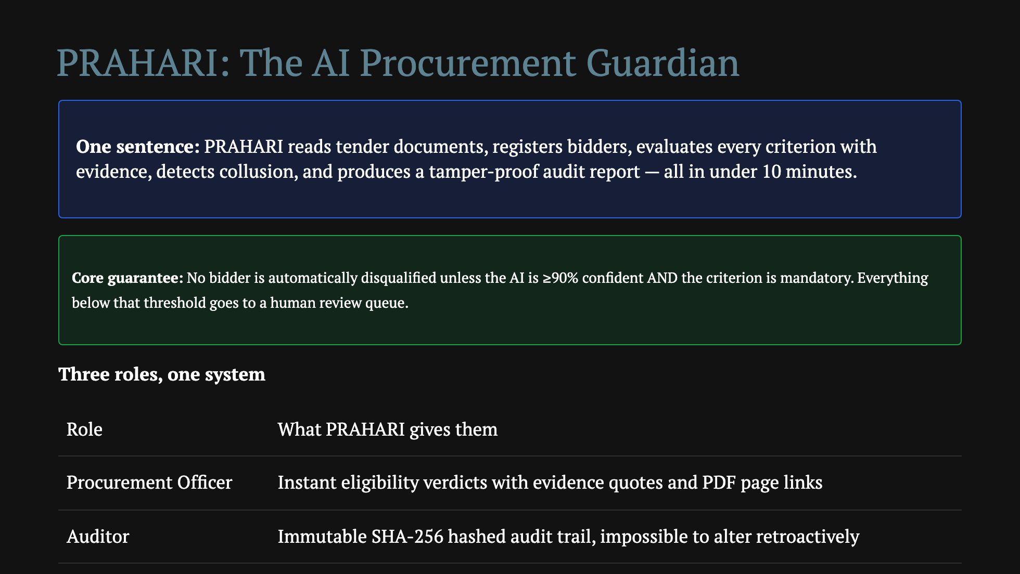
Notes:
Emphasise the non-disqualification guarantee. This is the trust bridge. Officers won't adopt AI if it can wrongly reject a legitimate bidder. We designed around that fear explicitly.

Slide 4
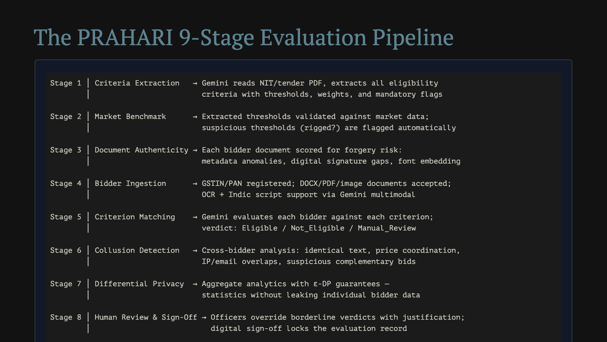
Notes:
Walk through one real bidder as an example — Kavach Armour Solutions (from our demo). "Gemini reads their 50-page qualification document, finds the CA-certified turnover on page 12, extracts INR 18.48 crore, compares to the threshold of 10 crore, returns Eligible with 94% confidence, and links to the exact page in the PDF. Total time: 8 seconds."

Slide 5
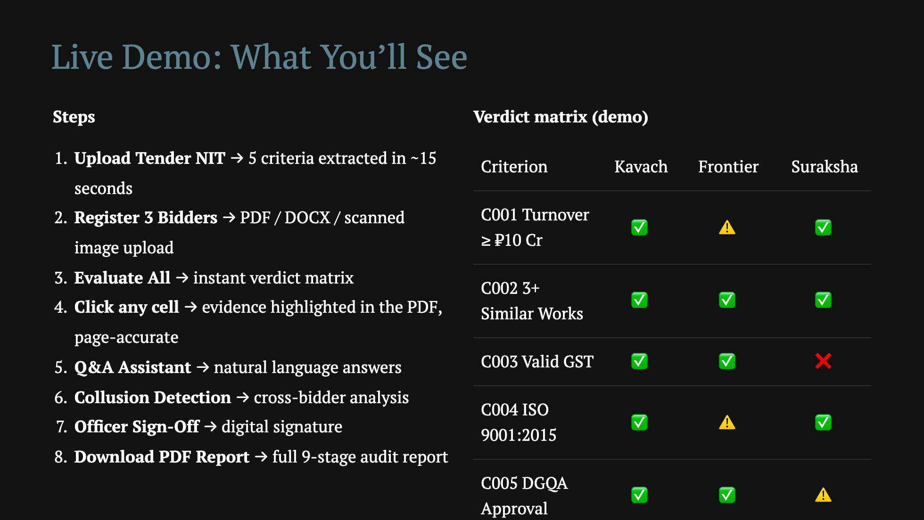
Notes:
The PDF highlighting is the wow moment. Click a verdict → the PDF opens on the exact page with the relevant text highlighted in amber. That's what makes the system feel trustworthy — you can see WHY the AI said what it said.

Slide 6
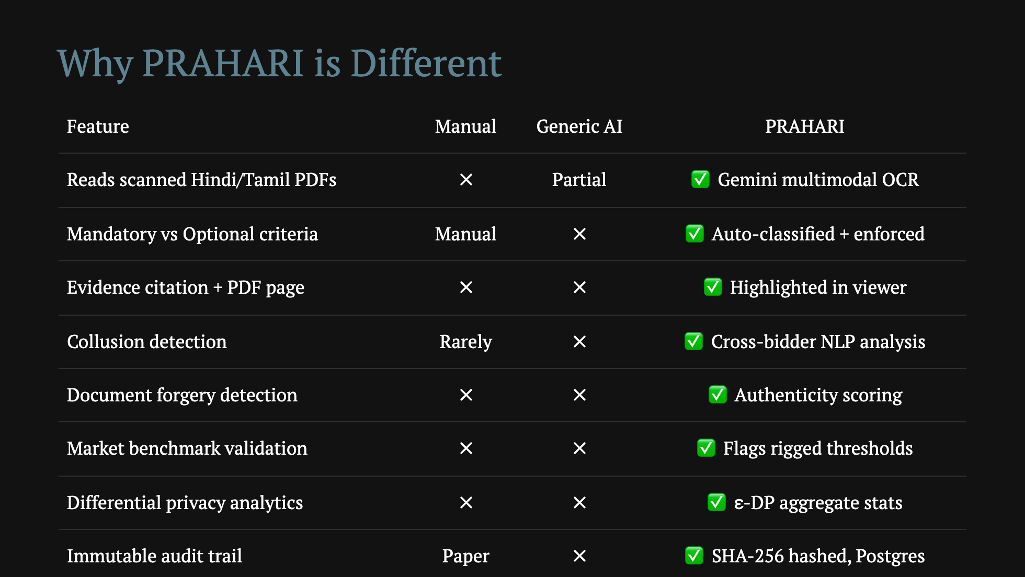
Notes:
The key insight: we didn't just "add AI to procurement." We redesigned the workflow around AI capabilities — evidence citation, confidence thresholds, collusion graphs — while keeping the human officer as the final authority. That's the right balance.

Slide 7
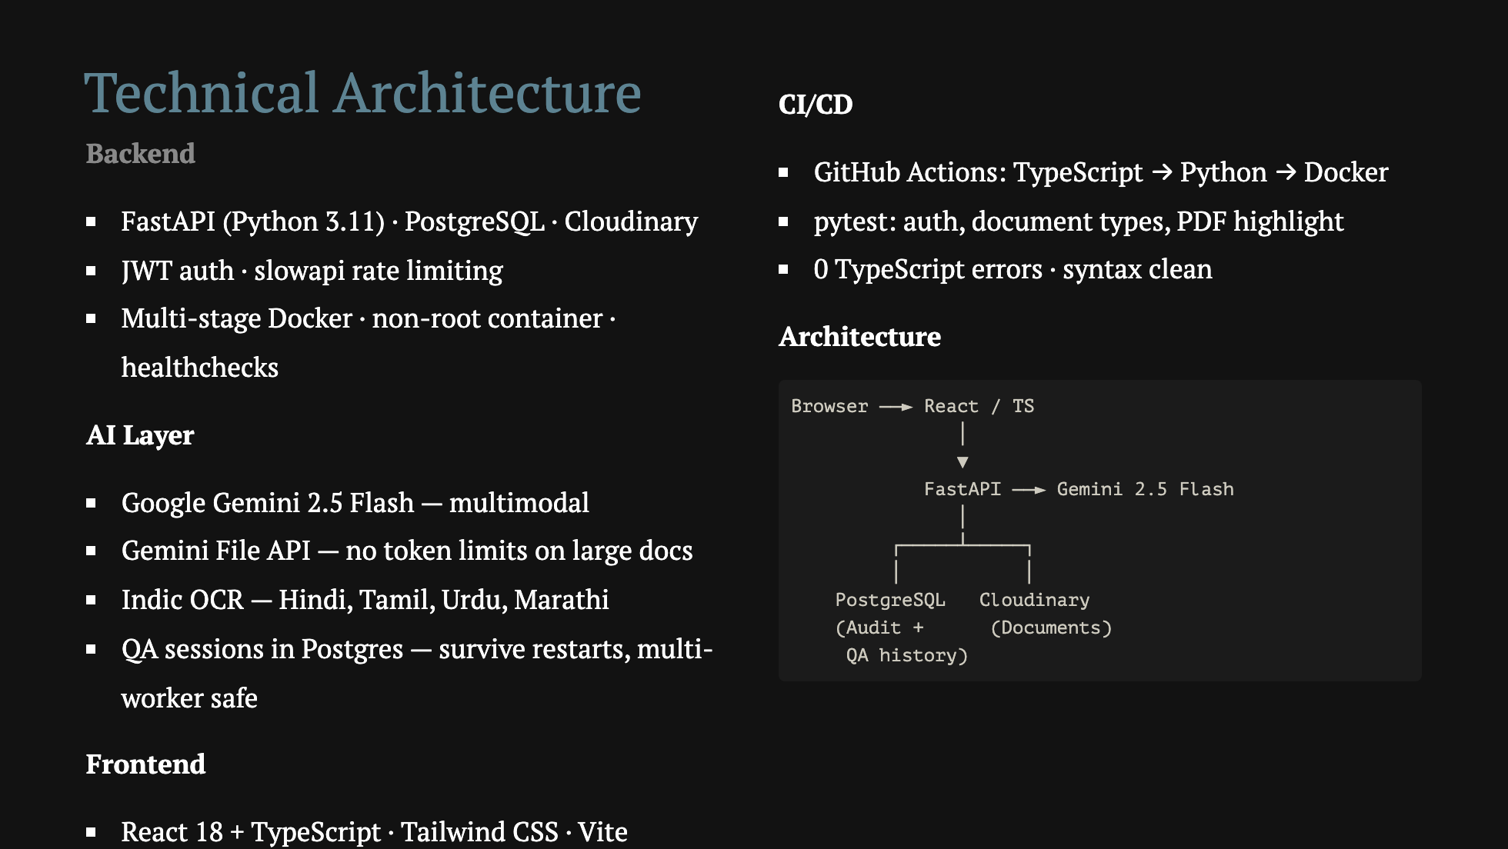
Notes:
We made architecture choices that matter in production. QA sessions in Postgres means if the server crashes mid-conversation, the officer doesn't lose their session. Docker multi-stage build means the production image is half the size of a naive build. These aren't demo shortcuts — these are production decisions.

Slide 8
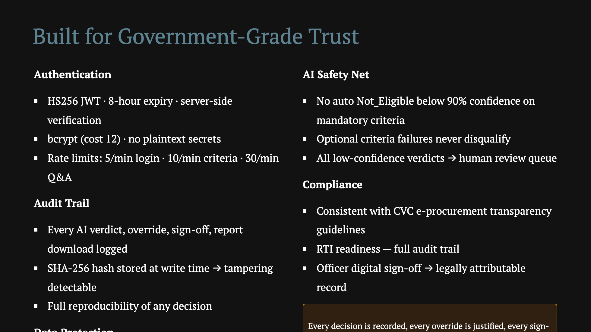

Slide 9
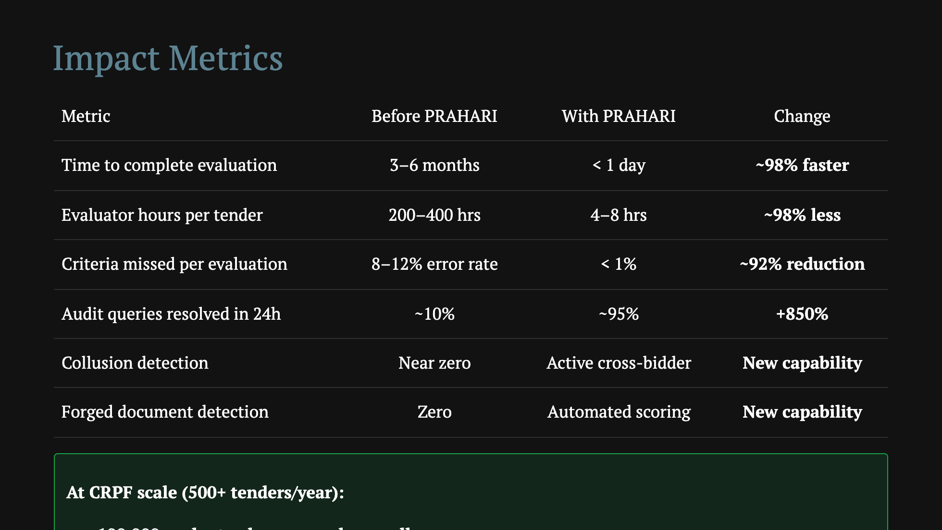
Notes:
The 98% time reduction sounds unrealistic. Walk them through the math: currently 5 evaluators × 60 days × 8 hrs = 2400 hrs per major tender. PRAHARI runs the AI in minutes; human review of borderline cases takes a day. The real ROI is not just speed — it's the collusion and forgery detection that the current process simply cannot do at scale.

Slide 10
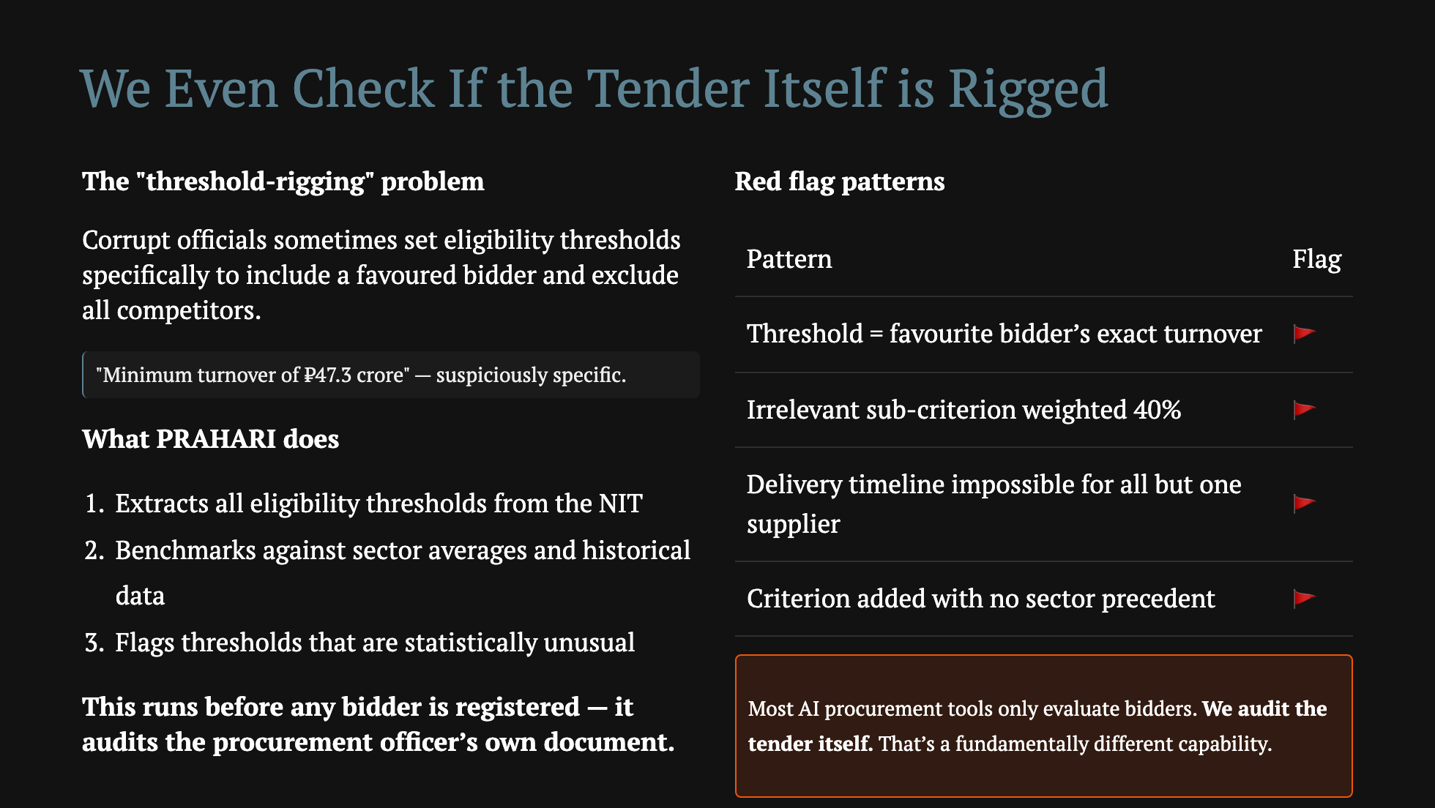
Notes:
This is the slide that makes senior officials sit up. Corrupt officers can't set up a rigged tender if the AI flags it immediately.

Slide 11
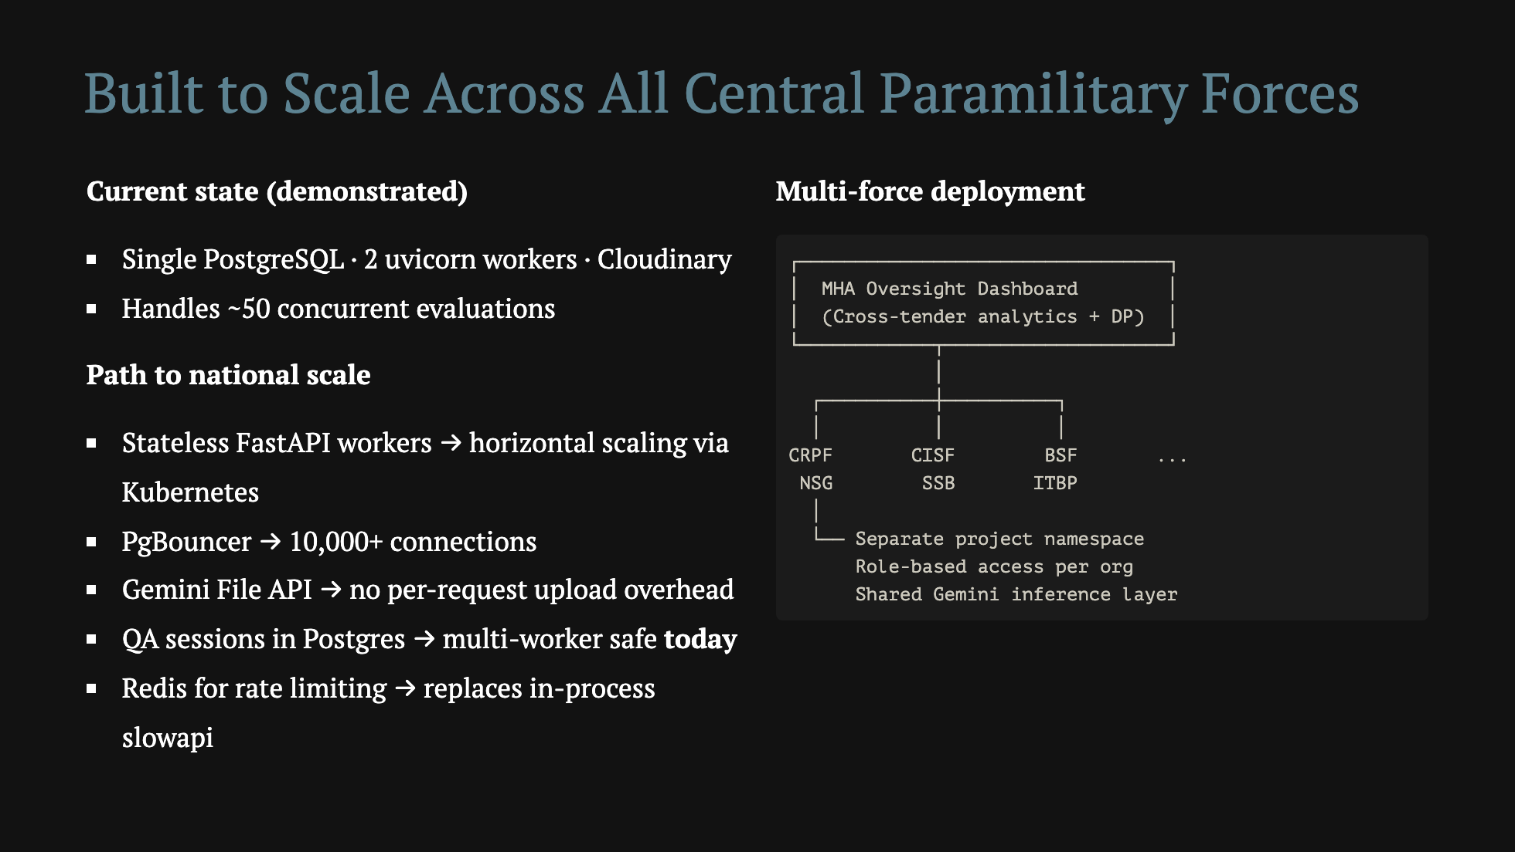
Notes:
We documented 10 known scalability issues in SCALABILITY_ISSUES.md with root causes and mitigations — because honest engineering means knowing what you haven't solved yet, not pretending it's all perfect.

Slide 12
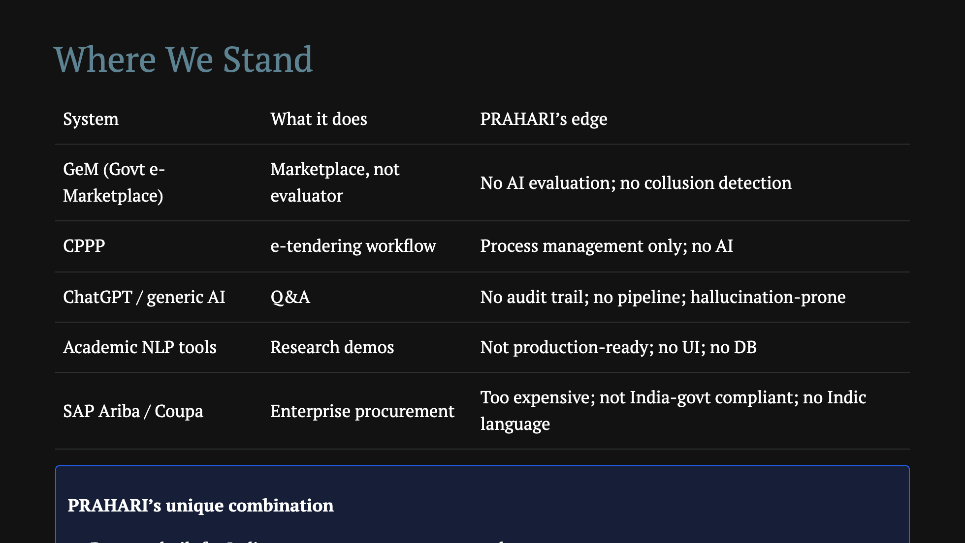

Slide 13
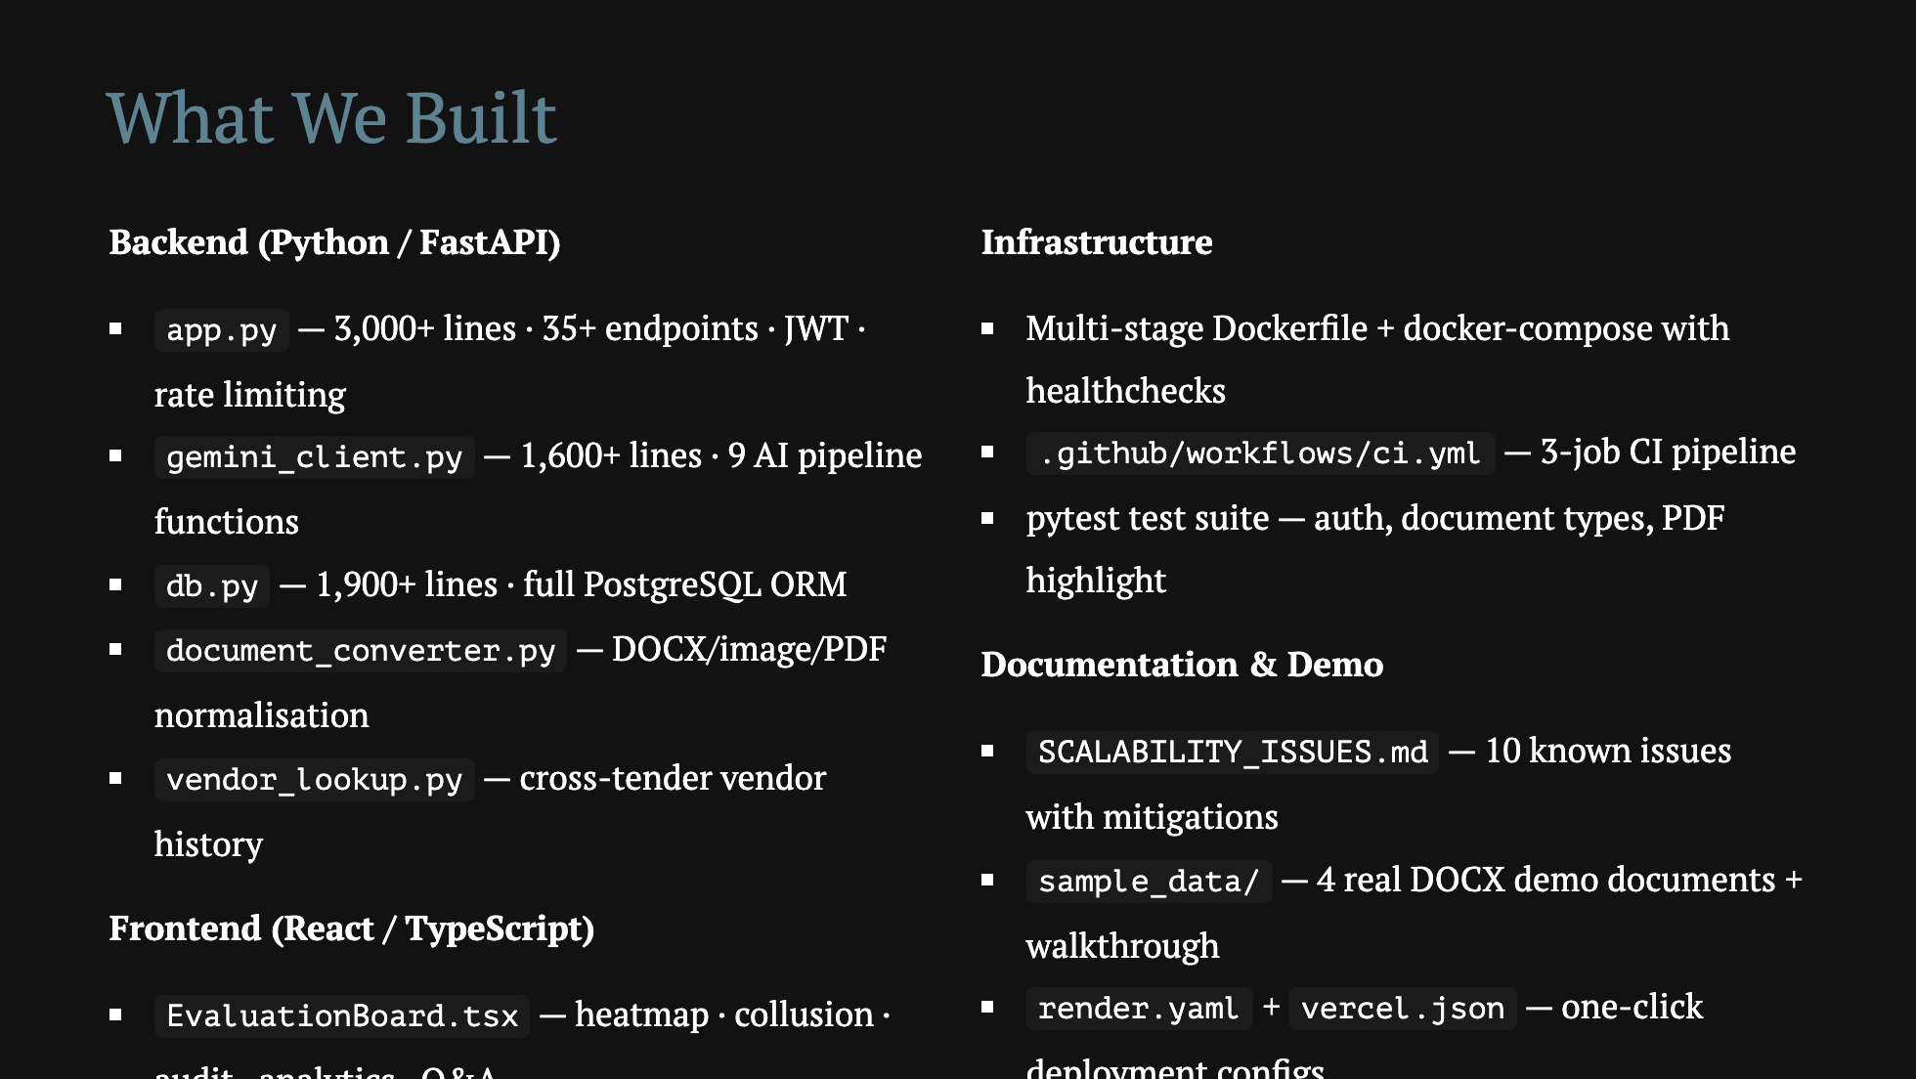

Slide 14
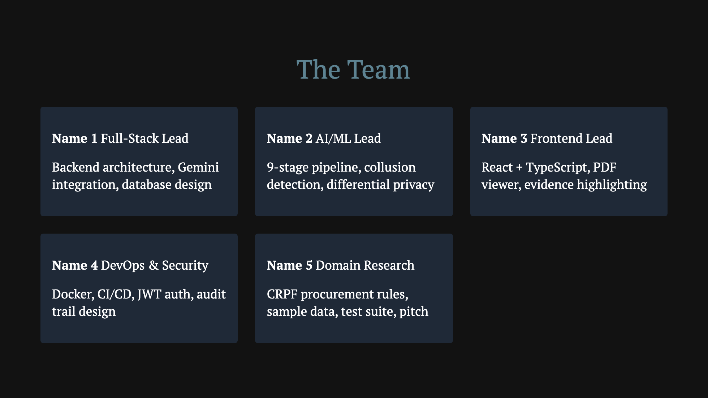

Slide 15
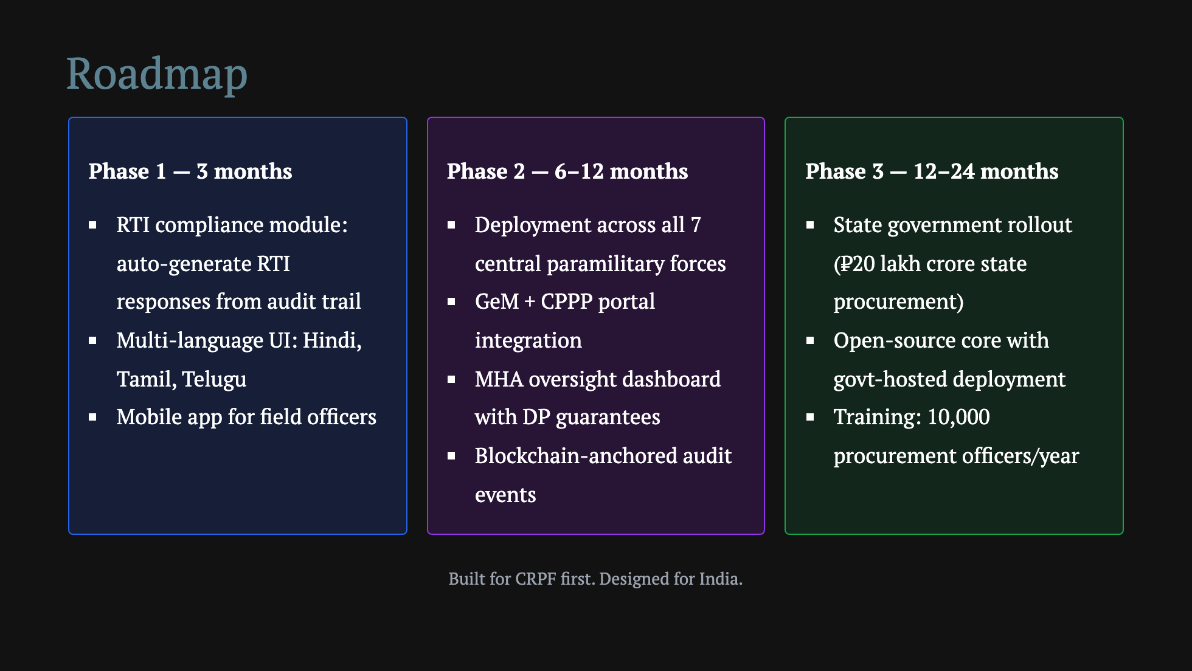

Slide 16
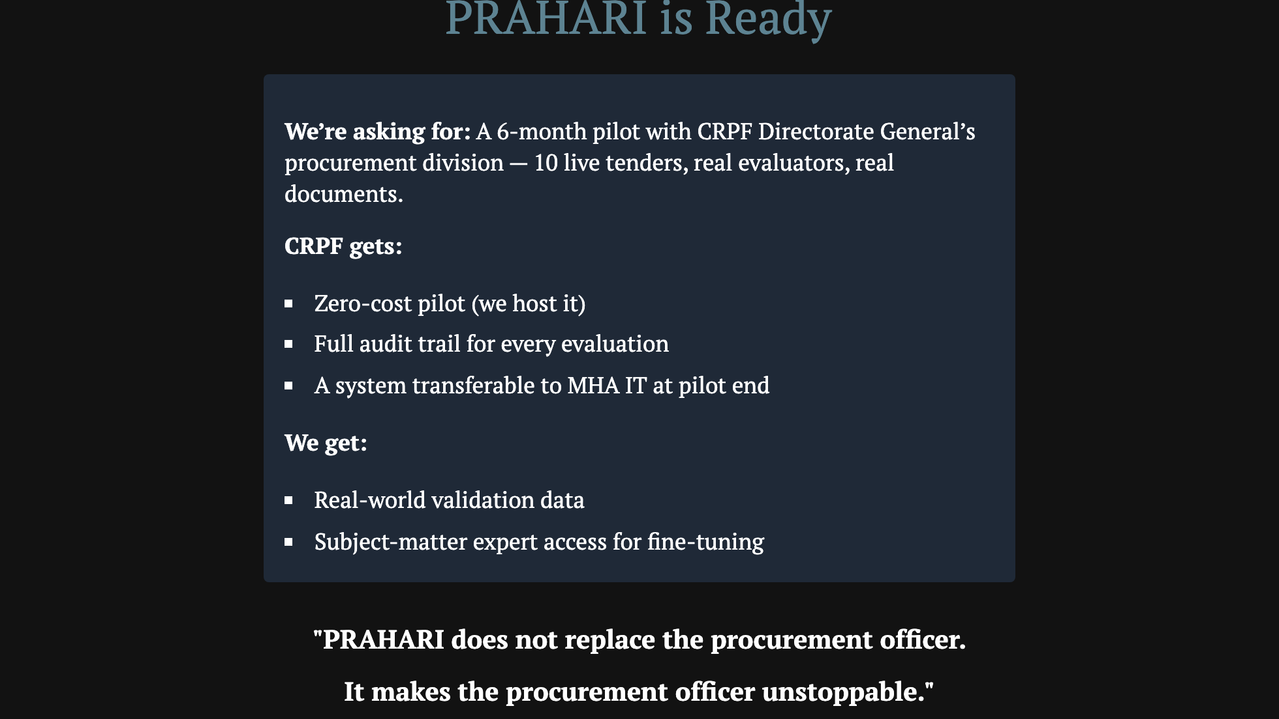
Notes:
End with the human framing, not the tech framing. The technology is a means. The goal is an officer who can evaluate 50 bids in a day instead of 50 days — and prove every decision is clean. That's PRAHARI.

Slide 17
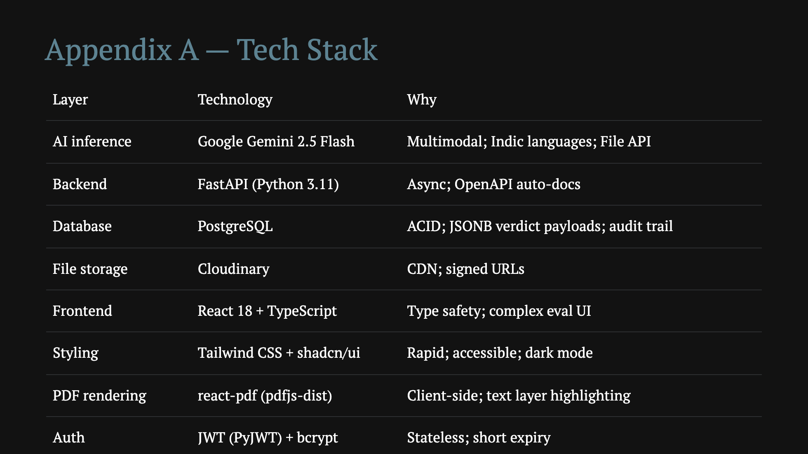

Slide 18
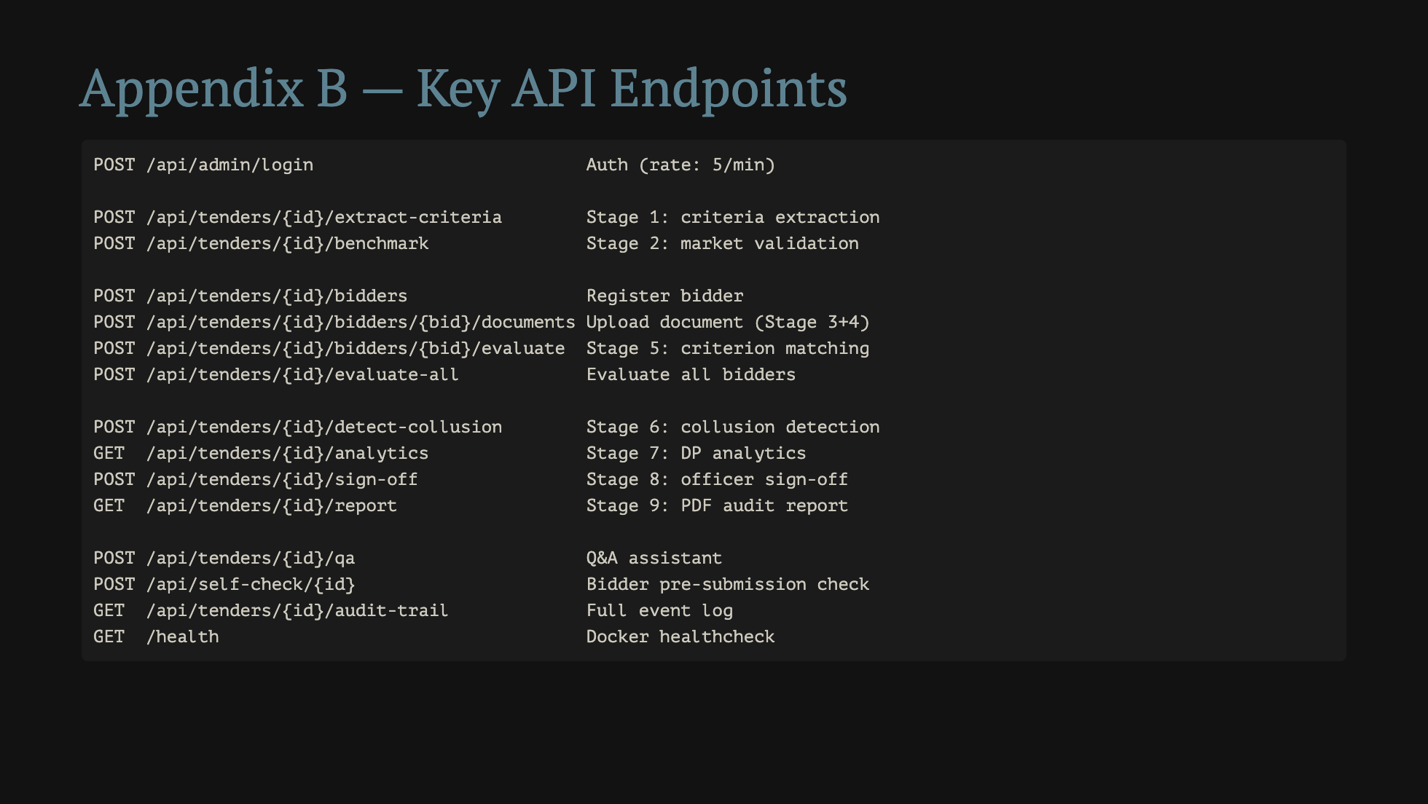

Slide 19
