Slide 1
World Population Dataset
Team-53
Lihong Luo and Boyan Yu
MISY225

Slide 2


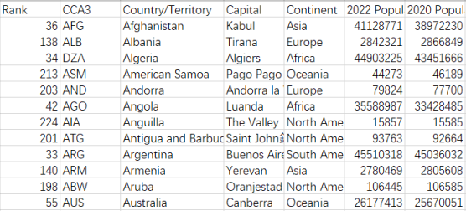
brief introduction
This Dataset contains Population data of every Country in the world.
The rapid growth of world population has caused many problems. In particular, the excessive population growth in some economically underdeveloped countries has affected the economic development, social stability and improvement of people's living standards of the whole country, and has brought many problems to human life

Slide 3
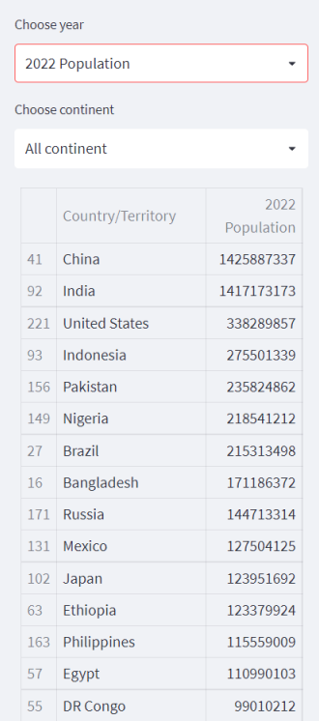
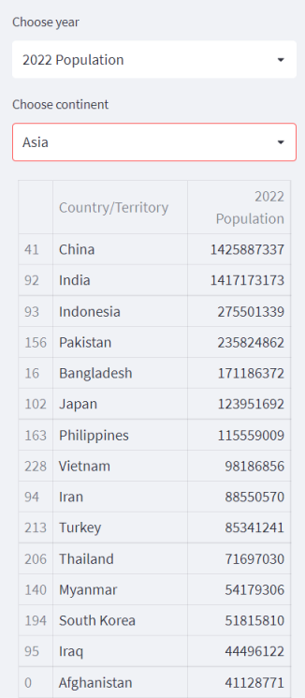
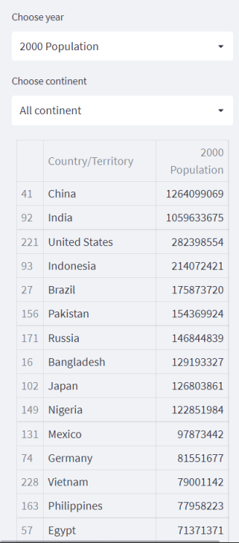
data app demo

Slide 4
The Trend of World Population.
QUESTION 1

Slide 5
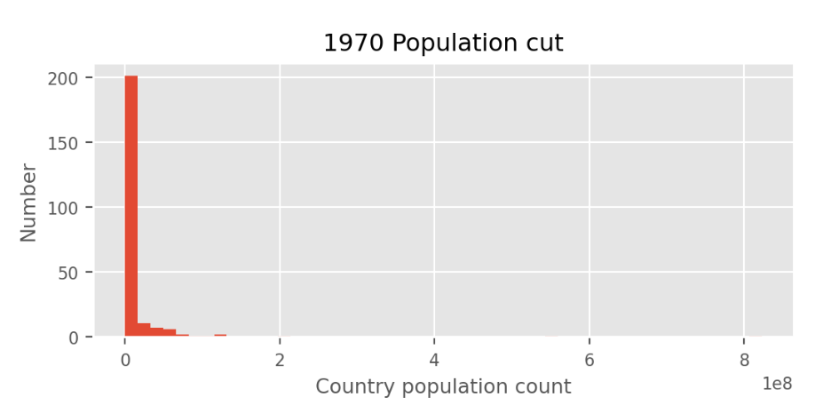
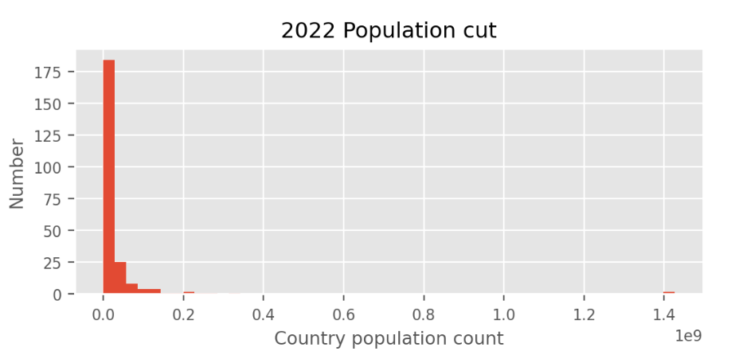
It is not difficult to find out from the chart of population cut of each year, the number of countries in the first range decreased from 200 to about 175.

Slide 6
Why are the populations of Africa and Asia growing together, but the growth rate of Africa is much higher than that of Asia.
QUESTION 2

Slide 7
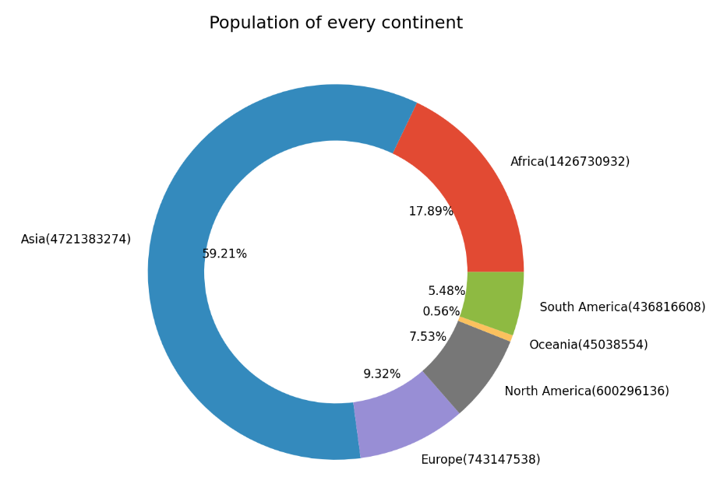
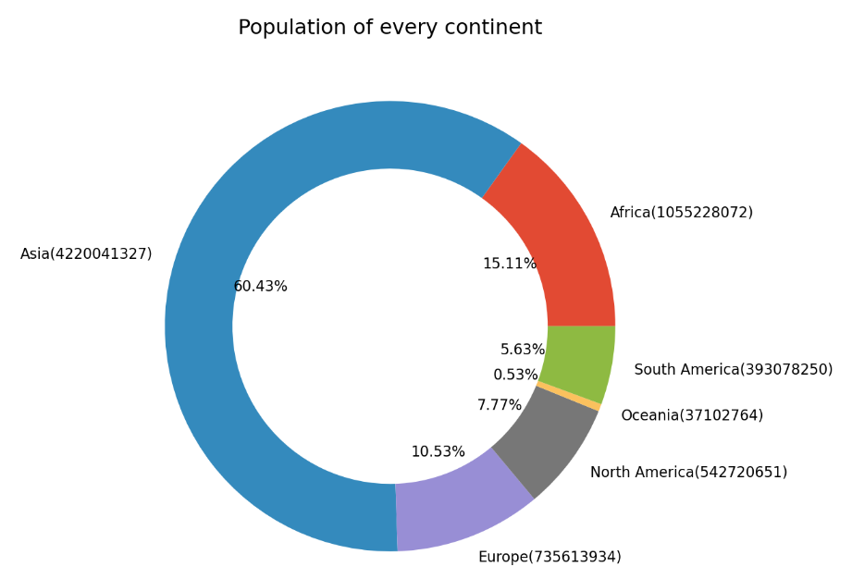
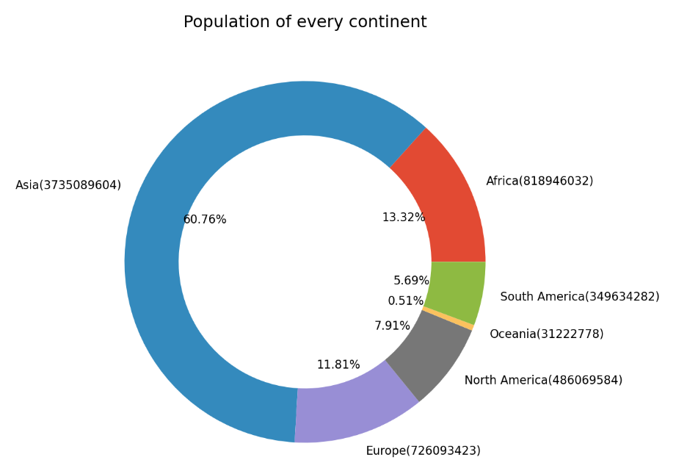
2022
2010
2000

Slide 8
Thanks

