Slide 1
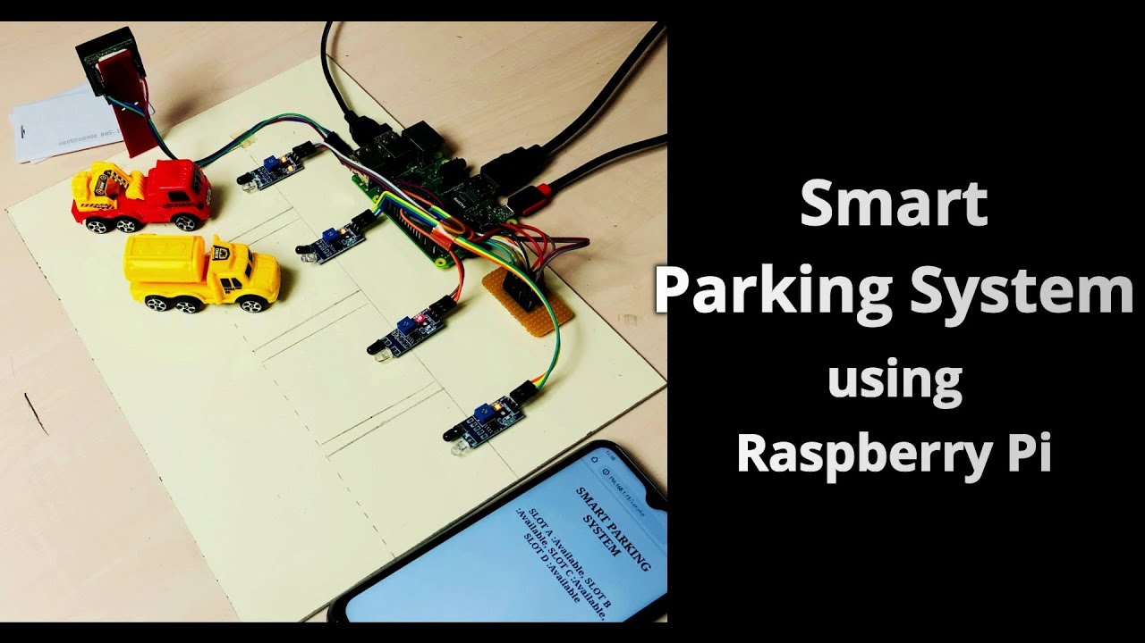
Smart Parking System
Tanmay Nale - 31145
Kasturi Patil - 31151
Siddharth Patil - 31152
Pranay Rewane – 31159
TE-01 Batch M1

Slide 2
Purpose and Requirement Specification
Purpose : A smart vehicle parking is a system that helps drivers to find a vacant spot using sensors in each parking space by detecting the presence or absence of a vehicle.
Behavior : System monitors and keeps track of available parking space.
System Management Requirement : System should remotely provide monitoring and control functions.

Slide 3
Process Specification
Slots
Available
Not Available
Signal
Signal
Monitoring State: ON
Monitoring State: OFF

Slide 4
Domain Model Specification
Physical Entity : Parking Area ( to be monitored), Vehicles, Sensors
Virutal Entity :
  Device : Sensors are used to gather information. Tags are used to identify physical entities
  Resources : Wifi

Slide 5
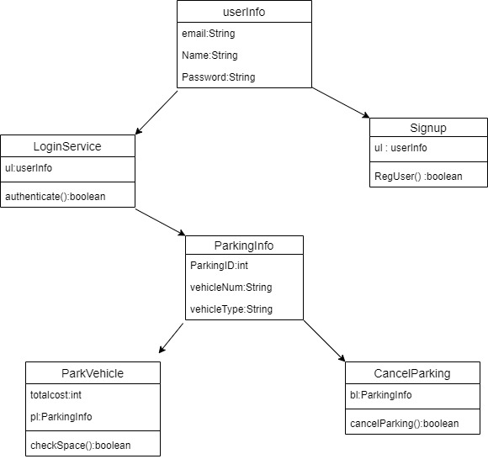
Information Model Specification
System – Save Data into database
User – Read Data
Sensor – Check Available space, Send Result to system

Slide 6
Service Specification
Threshold Services : Sets signal to high or low depending upon the availability of space.
State Services : Sets the parking slot state: Available or Unavailable
Controller Services : Monitors availability. Changes state and updates in the database

Slide 7
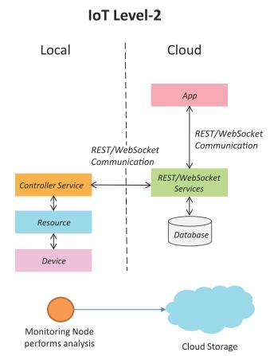
IoT Level Specification
IoT Level 2

Slide 8
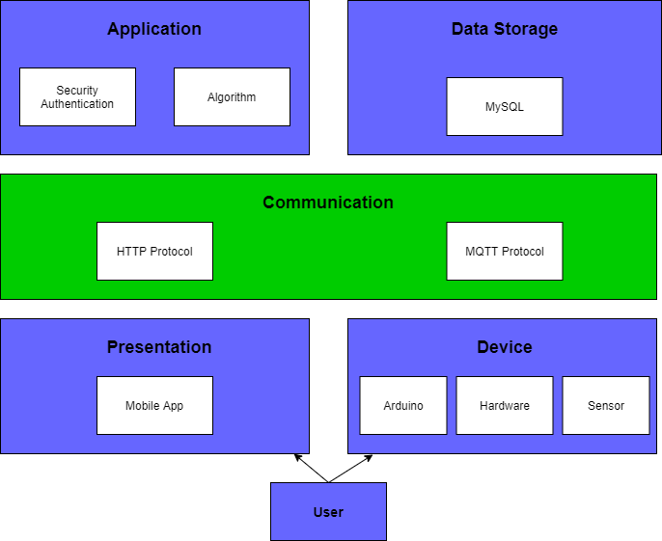
Functional View Specification
Functional View Specification provide the functionalities for interacting with the concepts definde in domain model specification
Device : Sensors

Slide 9
Operational View Specification
Elaboration of the device options and Storage options and application hosting option
Communication
Communication API's : REST
Services
Web: REST
Application
Database Server: MongoDb Atlas
Android based mobile application
Management
Device management- Arduino device/Raspberry Pi
Application management using a mobile app.
Database Management - NoSQL
Security
Firebase Login

Slide 10
Device and Component Integration
Integrates the devices and components
IR Sensor
Raspberry Pi 3
Camera Module

Slide 11
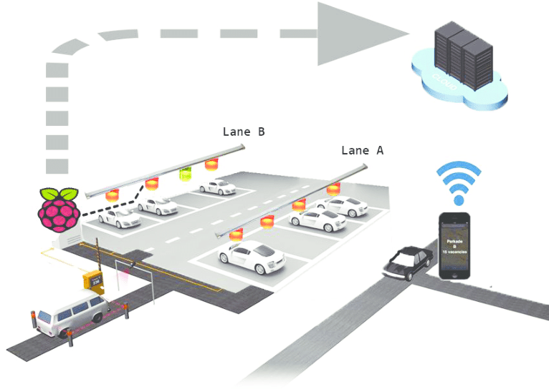
Application Deployment

