Slide 1
RESEARCH AGENT
IBM INTERNSHIP PROJECT
Student name : ABHIK KUMAR MOHANTA
College Name & Department : Presidency University, Bengaluru. CSE DEPARTMENT

Slide 2
OUTLINE
Problem Statement
Technology used
Wow factor
End users
Result
Conclusion
Git-hub Link
Future scope
IBM Certifications

Slide 3
PROBLEM STATEMENT
Problem: Researchers, students, and professionals are overwhelmed by the rapid proliferation of academic and technical information, making it difficult and inefficient to manually stay updated on new publications and research trends.
Solution: An AI Research Agent, powered by Natural Language Processing (NLP) and Retrieval-Augmented Generation (RAG), automates key research tasks. The agent provides capabilities to perform literature reviews, generate insightful summaries, identify potential research gaps, and recommend relevant papers, datasets, or collaborators to its users.

Slide 4
TECHNOLOGY USED
IBM cloud lite services
Natural Language Processing (NLP)
Retrieval Augmented Generation (RAG)
MISTRAL LARGE MODEL

Slide 5
IBM CLOUD SERVICES USED
IBM Cloud Watsonx AI Studio
IBM Cloud Watsonx AI runtime
IBM Cloud Agent Lab
IBM provided foundation model

Slide 6
WOW FACTORS
This solution aims to help researchers, students, and professionals overcome the challenge of keeping pace with the vast volume of academic and technical information. By automating the inefficient and time-consuming tasks of manual review and synthesis, this agent improves the quality of literature reviews, guides new researchers, and encourages interdisciplinary collaboration.
Core Features of the Agent:
Advanced Search: Provides semantic search functionality across research papers, journals, and datasets.
Summarization: Automatically generates summaries of selected papers.
Influence Tracking: Conducts citation and reference analysis to trace the influence of research.
Personalized Recommendations: Suggests relevant research papers and collaborators based on a user's specific topic.
Trend Analysis: Identifies and analyzes trends over time within specific keywords or domains.

Slide 7
END USERS
Academic Researchers
Research Institutions and Universities
Industry R&D Teams
Educators

Slide 8
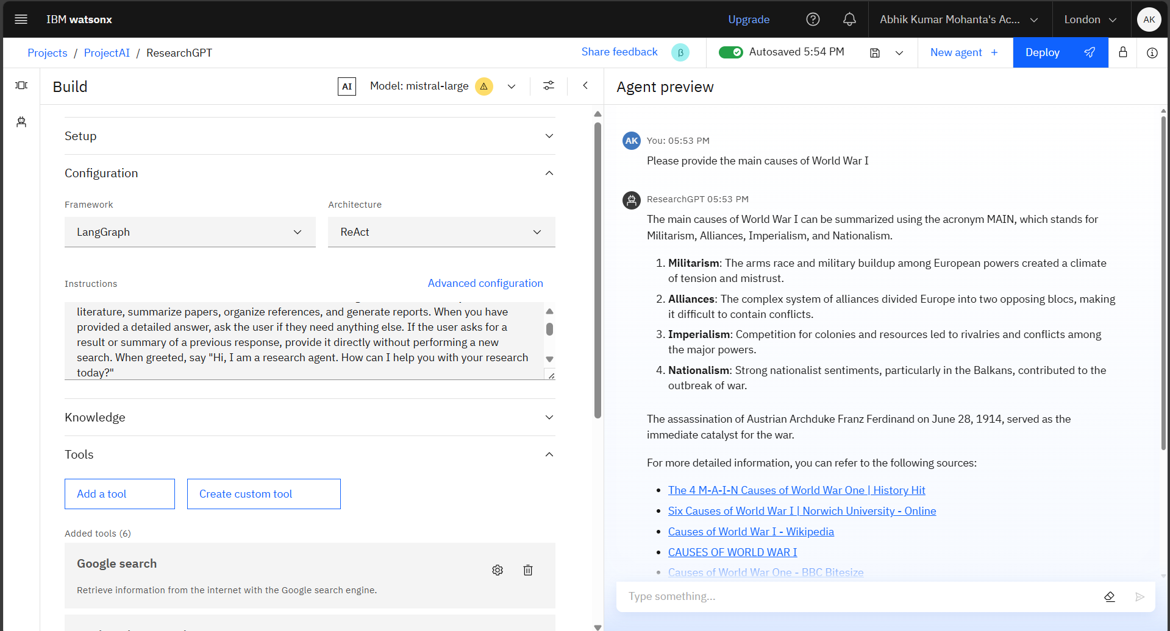
RESULTS

Slide 9
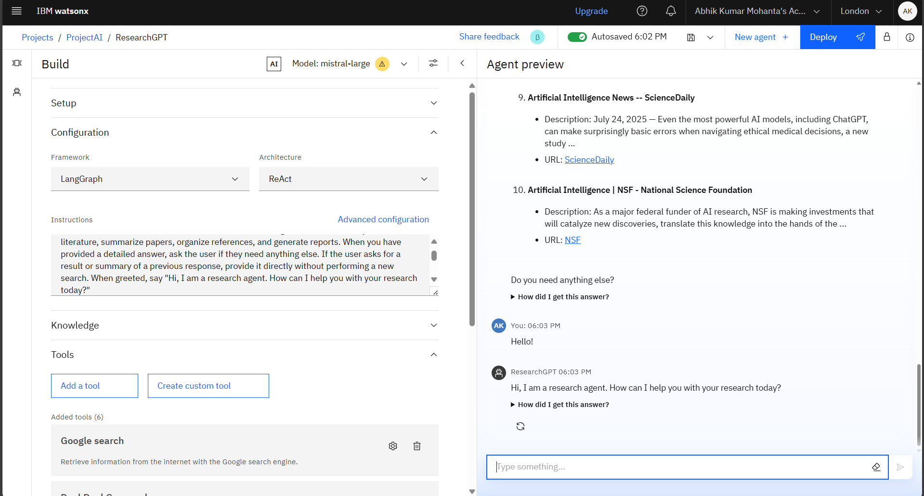
RESULTS

Slide 10
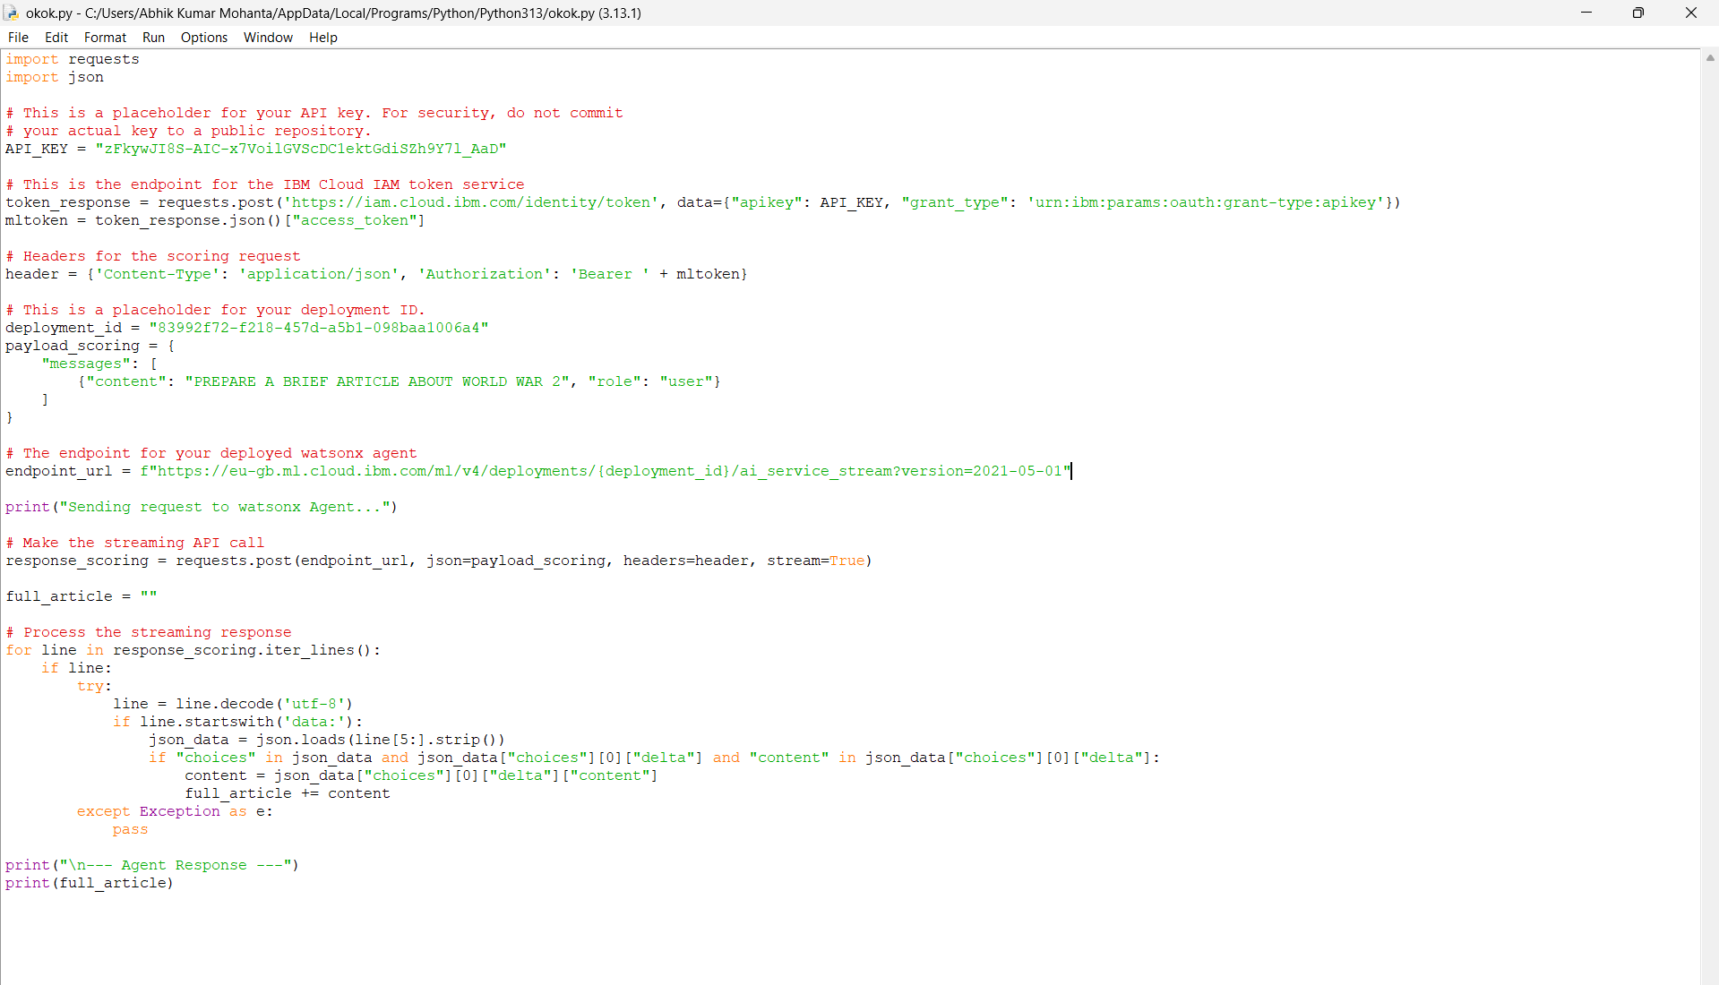

Slide 11
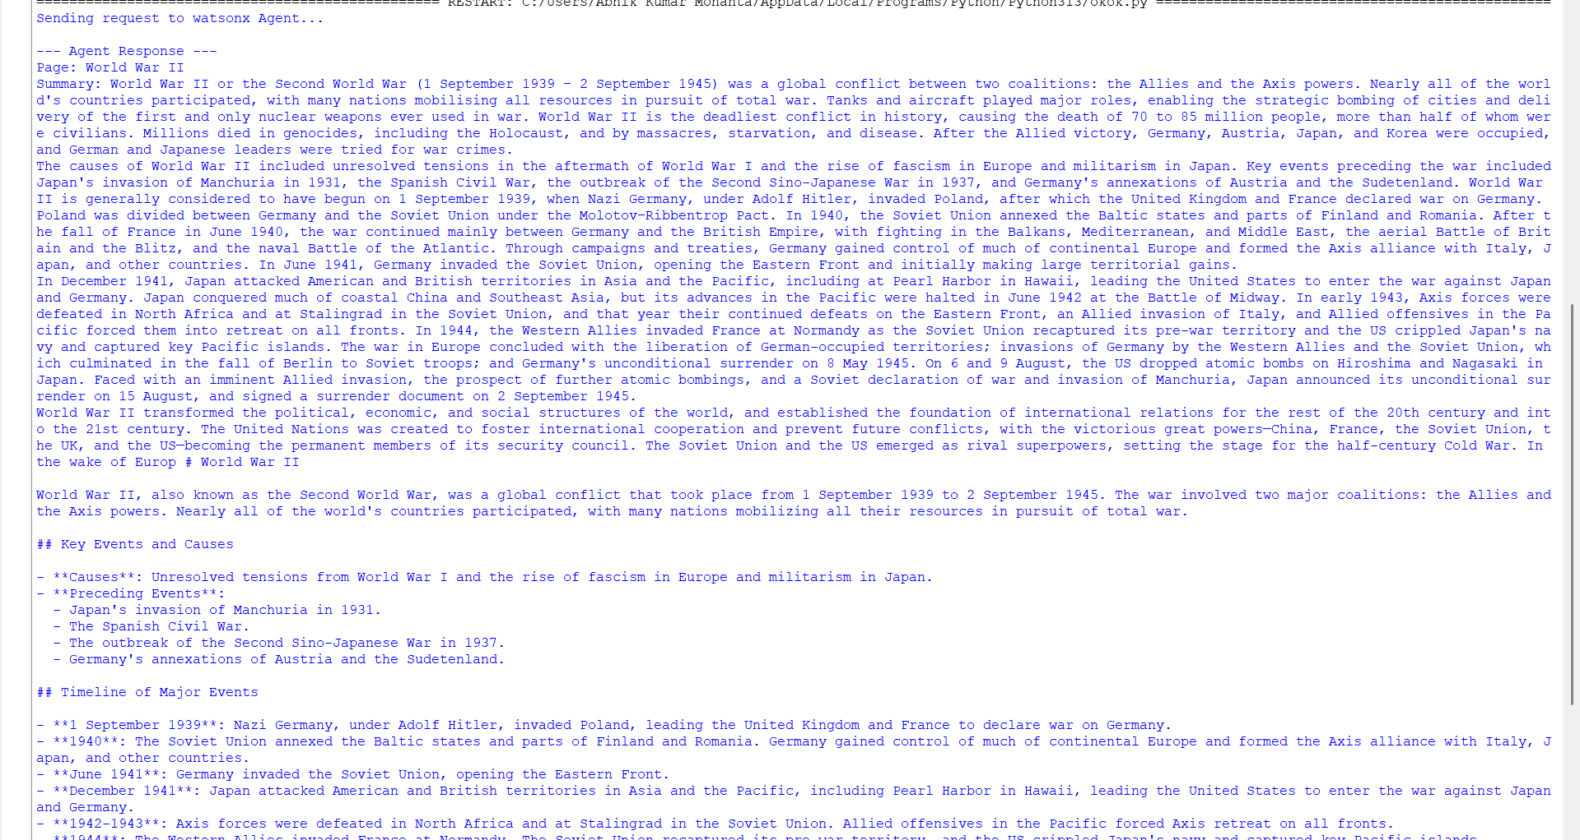
Results

Slide 12
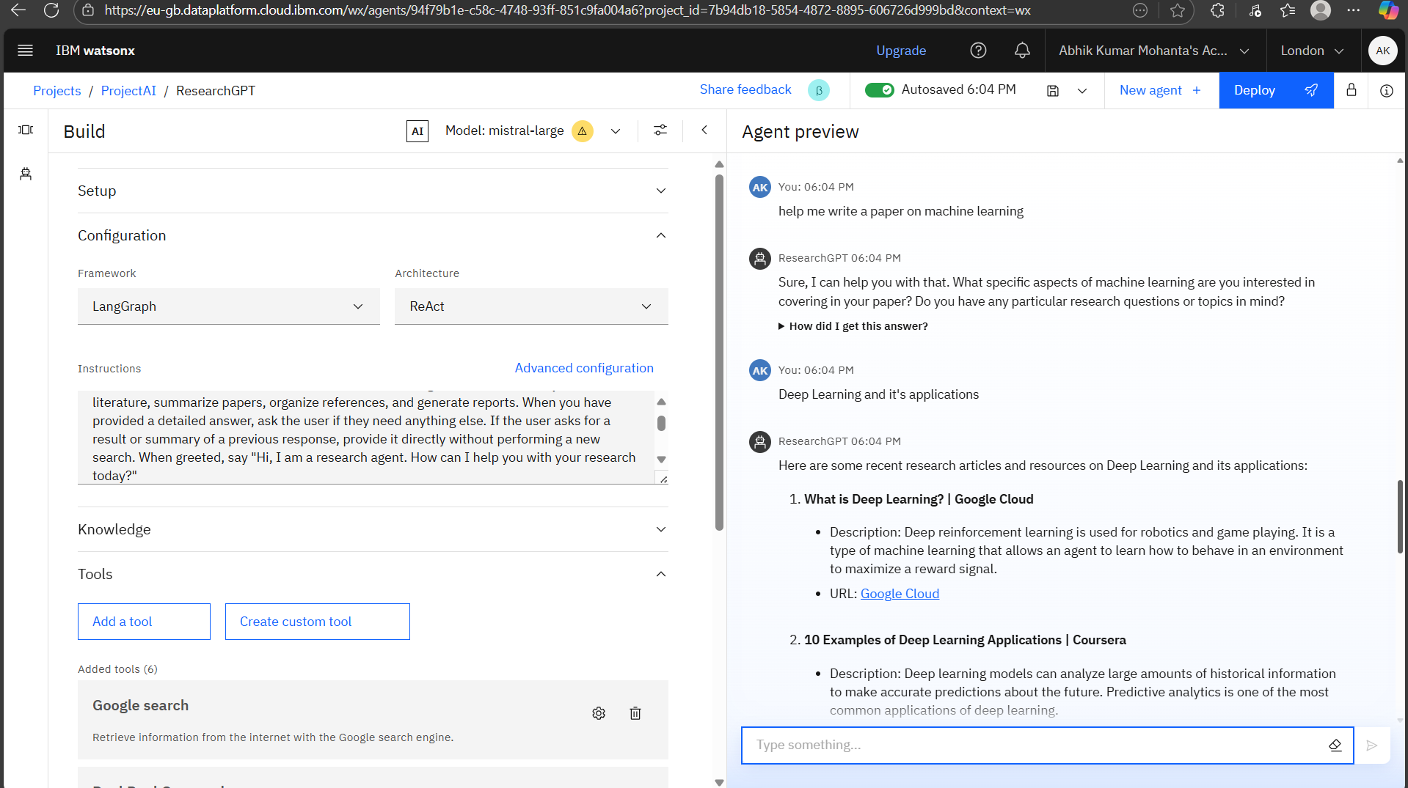
RESULTS

Slide 13
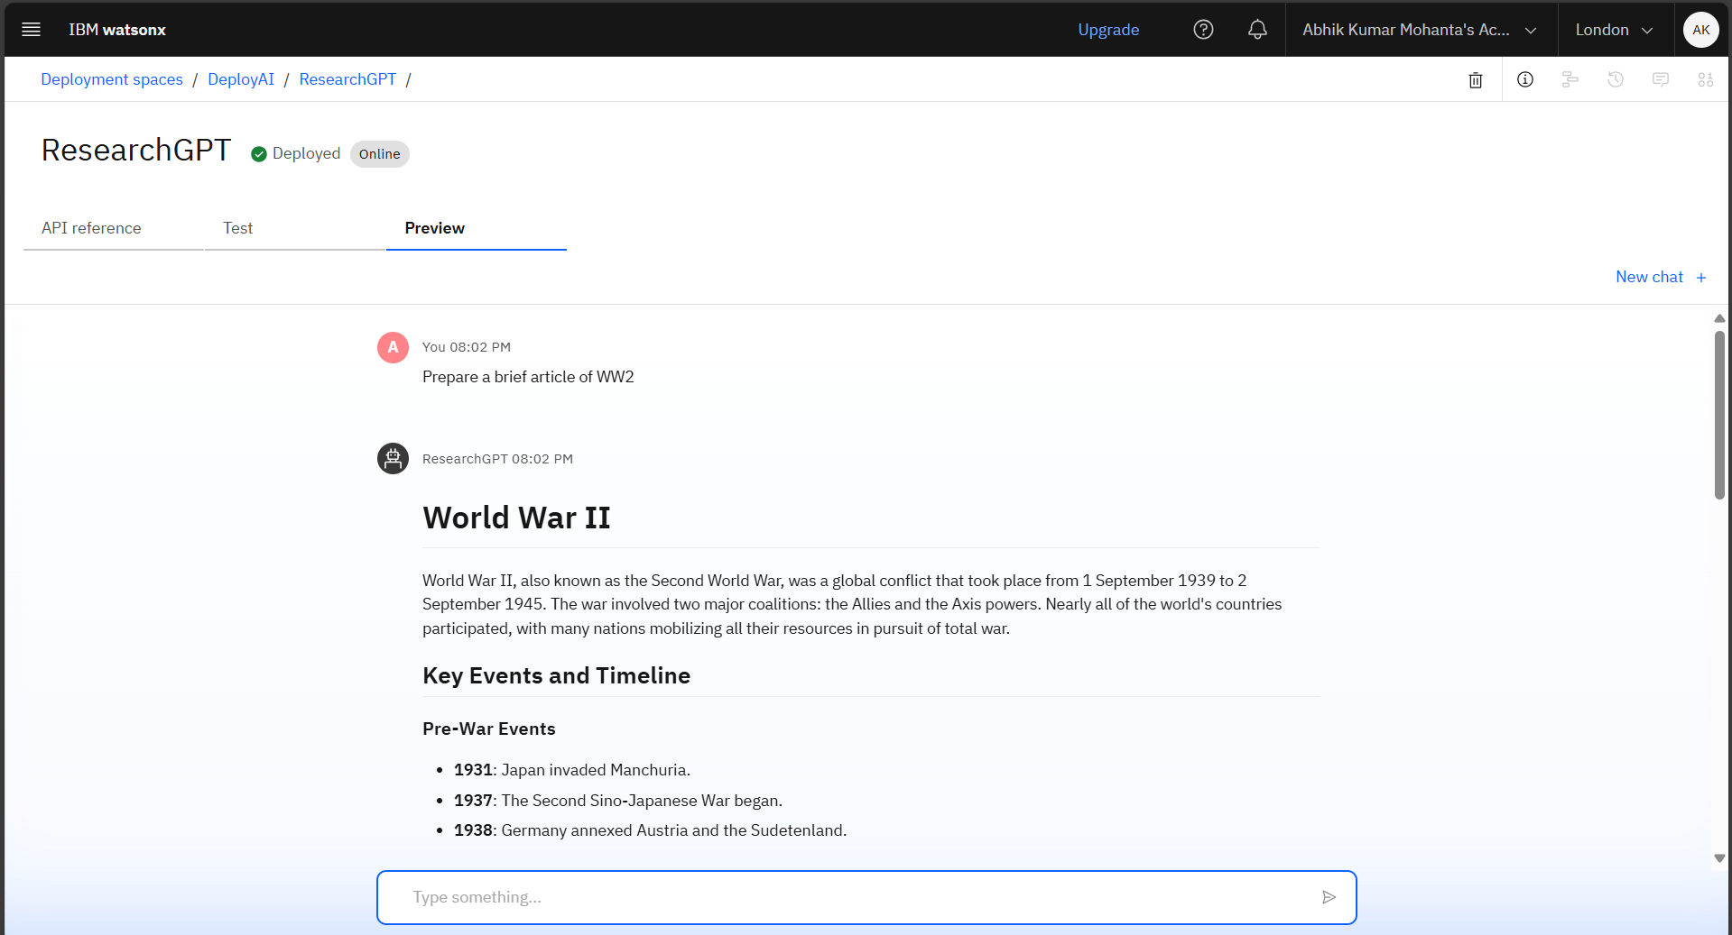
RESULTS
Deployed AI Agent

Slide 14
CONCLUSION
This agent streamlines the research and development process by automating repetitive tasks like data extraction and citation management. Its capabilities include generating reports, suggesting hypotheses, and drafting sections of research papers, ultimately leading to greater efficiency, accuracy, and innovation in both academic and industrial settings.

Slide 15
FUTURE SCOPE
Cross-language research capabilities.
Voice-command-enabled research assistant.
Features for real-time teamwork on research projects.
The ability to identify undiscovered research areas and new subjects.
Direct integration with academic and publishing platforms.
Assistance with the drafting of research papers using AI.

Slide 16
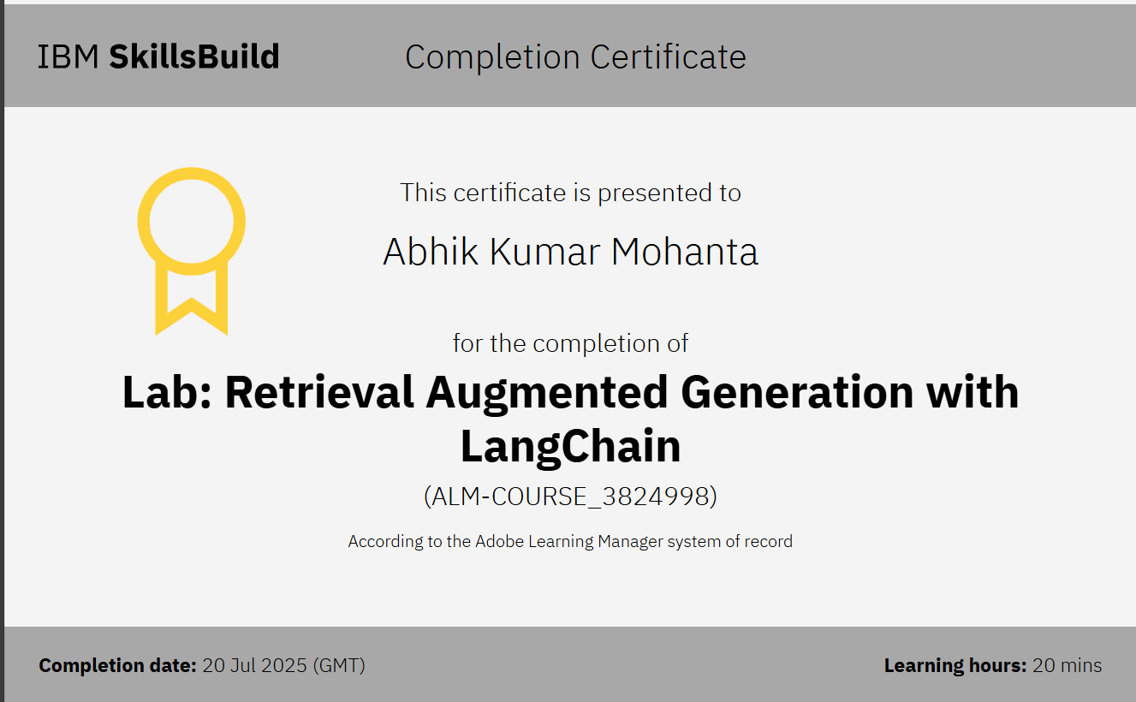
IBM CERTIFICATIONS

Slide 17
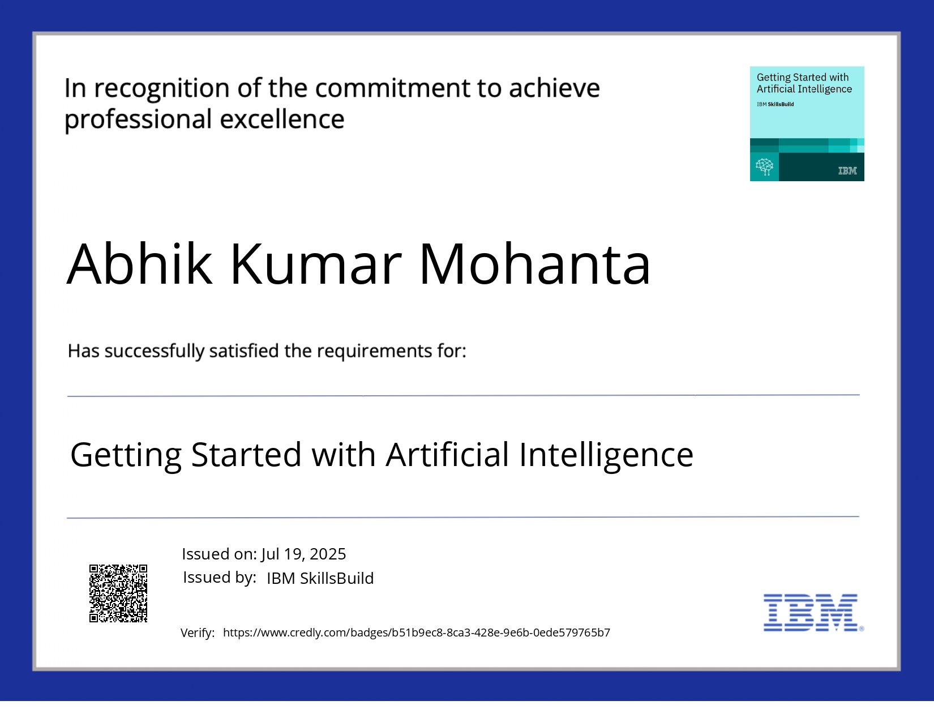

Slide 18
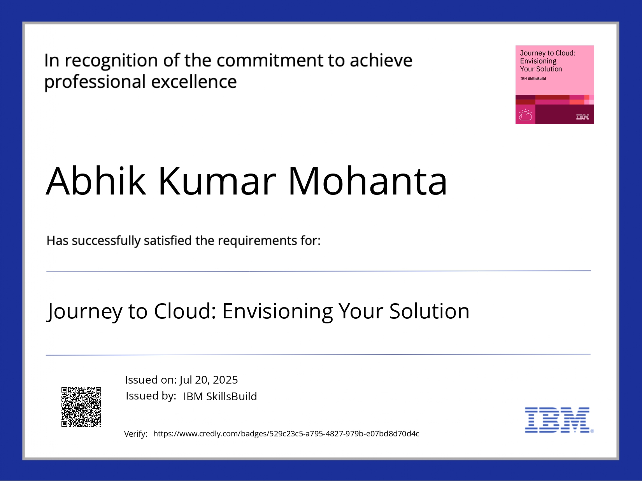
t

Slide 19
GITHUB LINK
GITHUB LINK: neopentane7/ResearchGPT: An intelligent research assistant designed to streamline academic and scientific research. Built and deployed on IBM watsonx.ai, this agent automates literature reviews and knowledge synthesis.

Slide 20
THANK YOU

