Slide 1
Median and Order
Statistics

Slide 2
Medians and Order Statistics
The ith order statistic of a set of n elements is the ith smallest element
The median is the halfway point
Define the selection problem as:
  Given a set A of n elements, find an element x ∈ A that is larger than x-1 elements
Obviously, this can be solve in O(n lg n). Why?
Is it really necessary to sort all the numbers?

Slide 3
Medians and Order Statistics
We can use an algorithm that runs in O(n) on average
We can also use an algorithm that runs in O(n) in the worst case!

Slide 4
Review
How do you find the smallest element (the first order statistic)?
What is the running time?
What about the largest element?
What about both at the same time?
What about the second smallest?

Slide 5
Selection in Expected Linear Time
The general selection problem seems much harder, but runs in Θ(n)
Works like QUICKSORT
  Partition the array recursively
  Unlike QUICKSORT: only works on one partition!
  QUICKSORT runs in O(n lg n), SELECT runs Θ(n)

Slide 6
The Algorithm
RANDOMIZED-SELECT (A, p, r, i)
1 if p = r
2 then return A[p]
3 q ← RANDOMIZED-PARTITION (A, p, r)
4 k ← q – p + 1 // k is offset from p
5 if i = k
6 then return A[q]
7 elseif i < k
8 then return RANDOMIZED-SELECT (A, p, q - 1, i)
9 else return RANDOMIZED-SELECT (A, q+1, r, i - k)

Slide 7
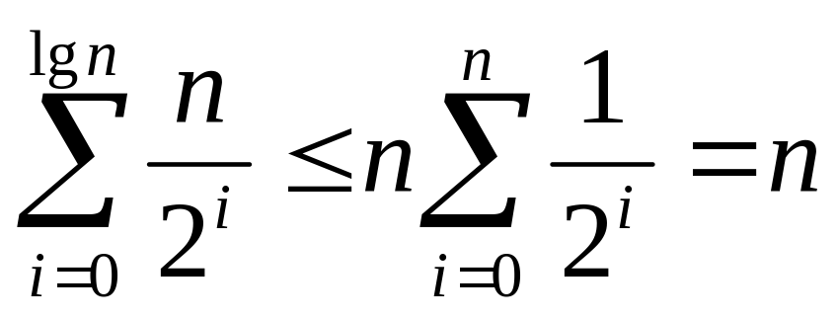
Nasty Analysis
Skip it
Intuitively, this runs in Θ(n)
  On average, how much work is done each pass?
  n/2 + n/4 + n/8 + ... + n/2^{lgn} = n

Slide 8
Guaranteeing a Good Split
Which element do you want to partition around?
Worst-case: elements are sorted
Does RANDOMIZED-SELECT guarantee a good split?
Idea: recursively find the median of medians
  Divide elements into groups of 5
  Find the medians of those five elements
  Find the median of those medians
  Partition around that median
  Your partition point will have k elements to the left, and
  n -k elements to the right. Make decision.

Slide 9
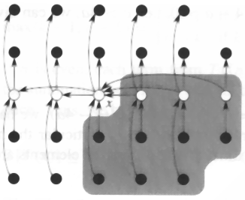
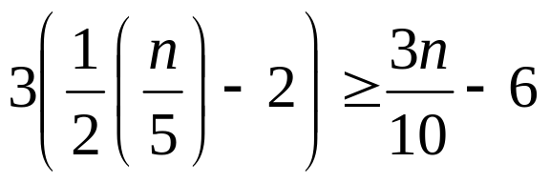
Interesting Results
At least half of the medians are greater than the median of medians
This means 3 of the 5 of those are greater than x is at least
This also means we only have 7n/10 elements left!

Slide 10
The Recurrence Equation
T (n) = T (n/5) + T (7n/10 + 6) + O(n)
This turns out to be linear
Time to find the
median of medians
The remaining part
of the problem
Dividing, finding the medians
and partitioning around the
median of medians.

Slide 11
Summary
Finding the ith order statistic using sorting takes Ω(n lg n).
Not necessary to sort everything
Can leverage off of the PARTITION method from QUICKSORT
You can guarantee a good split by finding the median of medians

