Slide 1
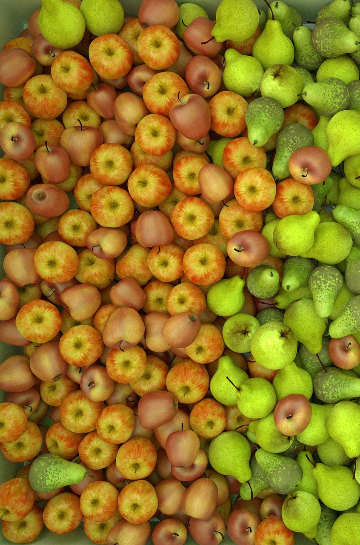
The effects of weather in production of apple and price change
Rodny perez
Graduation date: Fall 2016
I will be doing an internship as a software developer for apple Inc. this summer 2016. After graduation, I plan to get a full-time job as a software developer

Slide 2
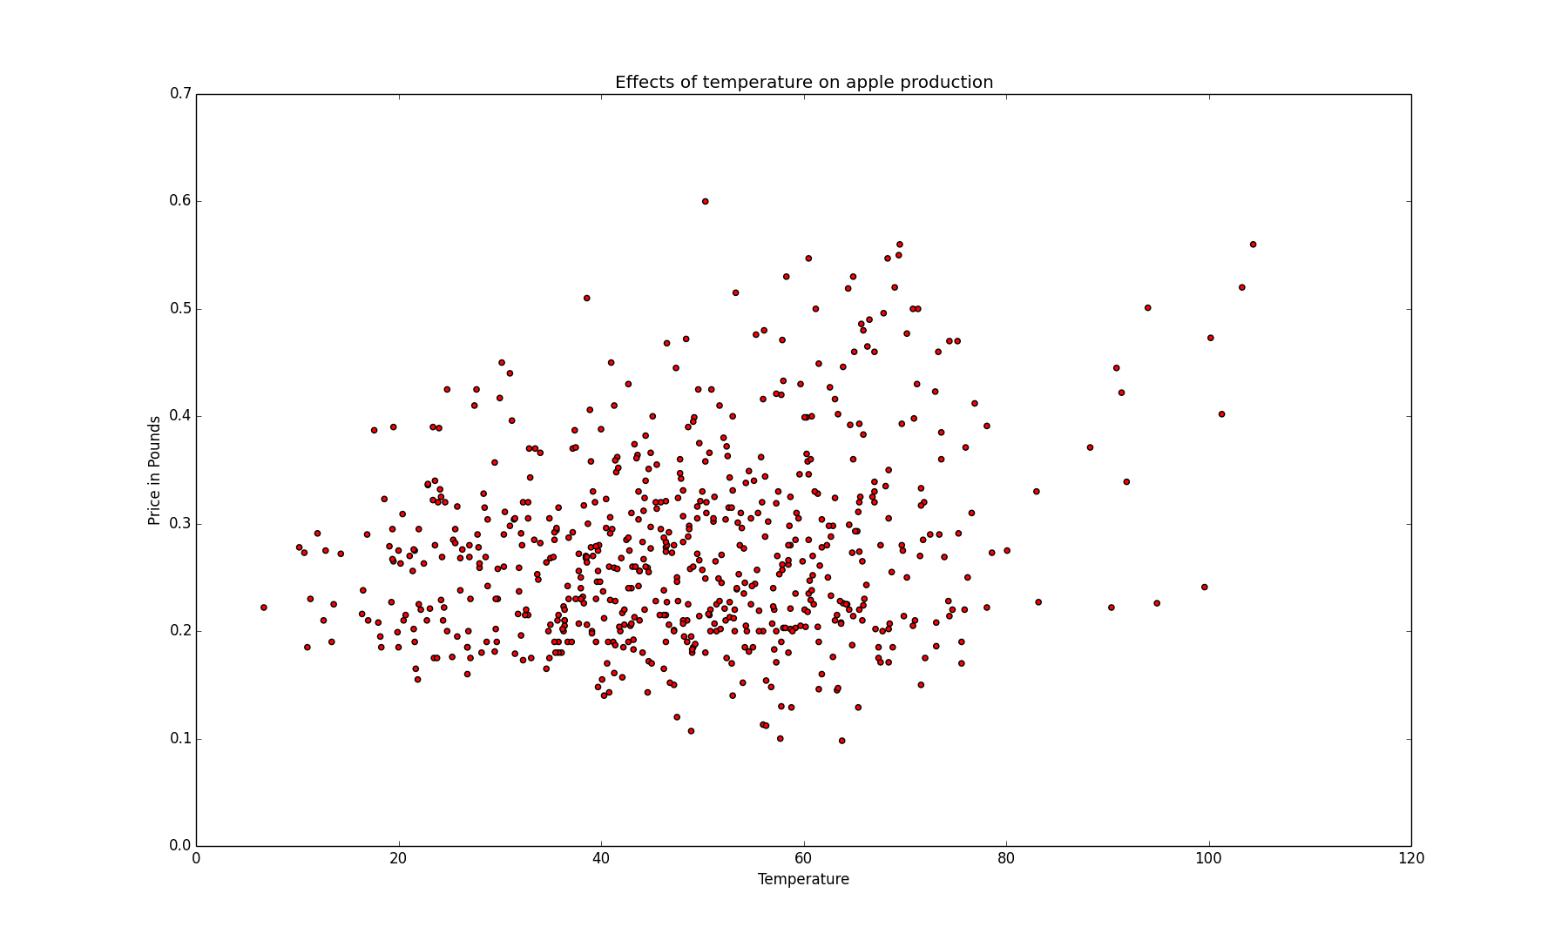
Discoveries
The warmer it is the more expensive the apples.
Apple’s are mostly produced in temperatures between 35F and 50F.
There is a positive correlation between price and temperature. mu 22%.
There is a negative correlation between production of apples and price 33%.

