Slide 1
The effects of weather in production of apple and price change
Rodny perez

Slide 2
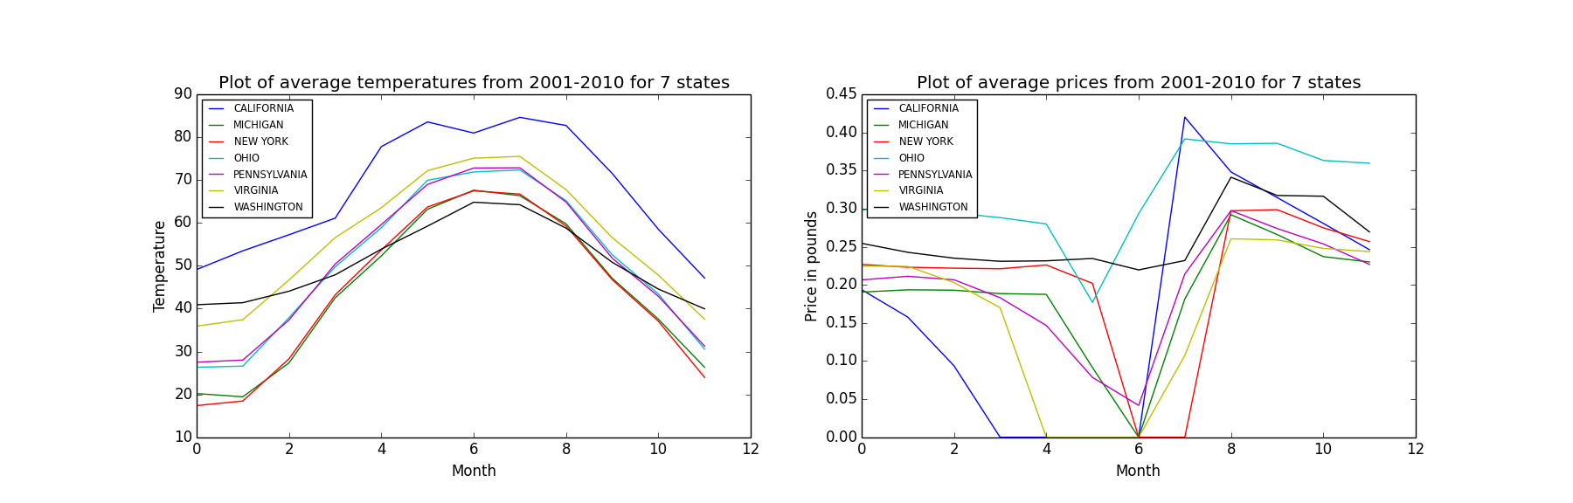
Discovery

Slide 3
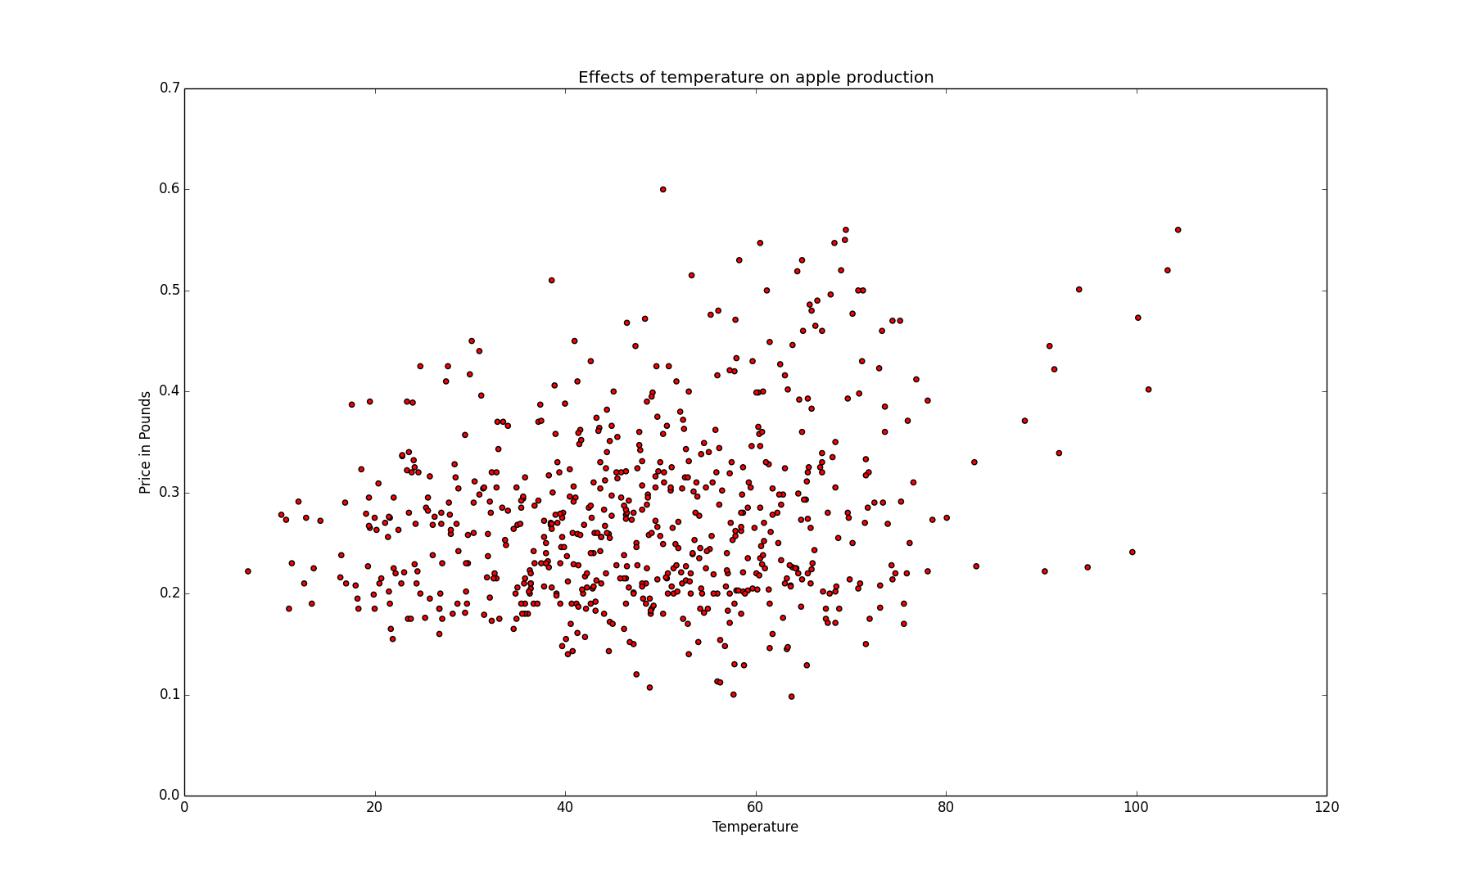
Discoveries
The warmer it is the more expensive the apples.

Slide 4
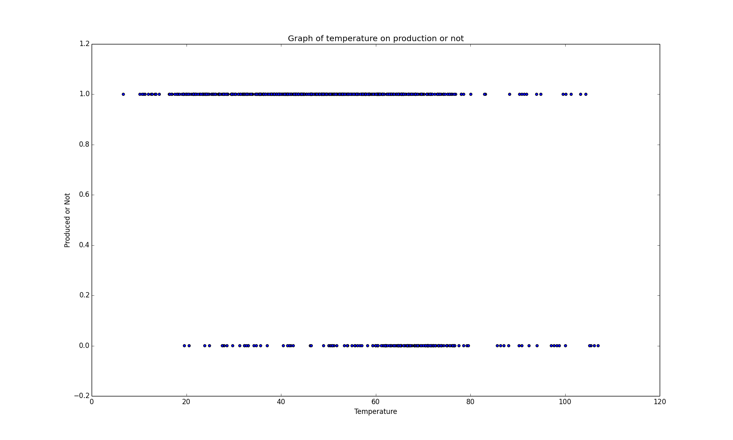
Discovery
More production is reported during lower temperatures

