Slide 1
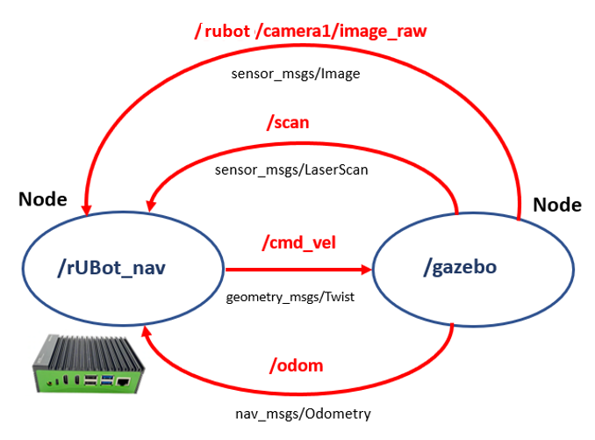
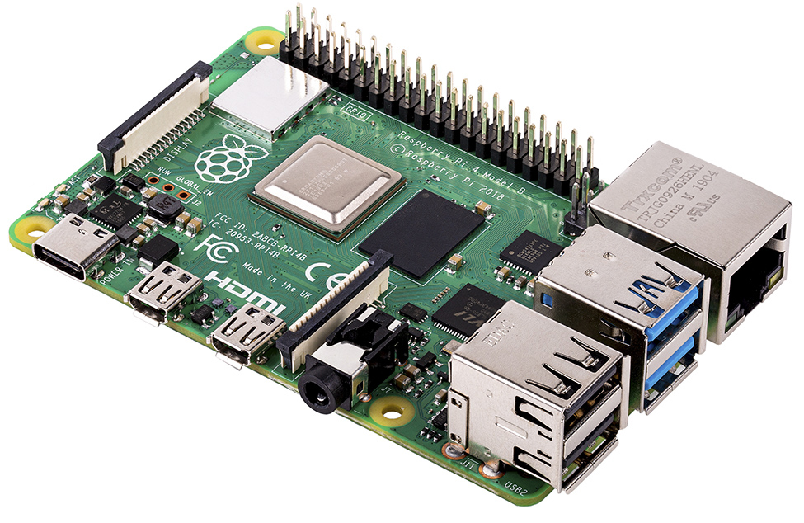
robot_control_node

Slide 2
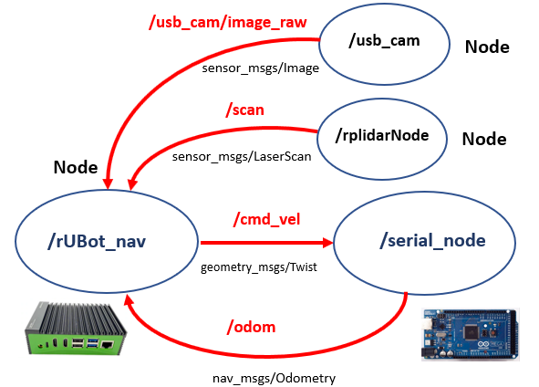
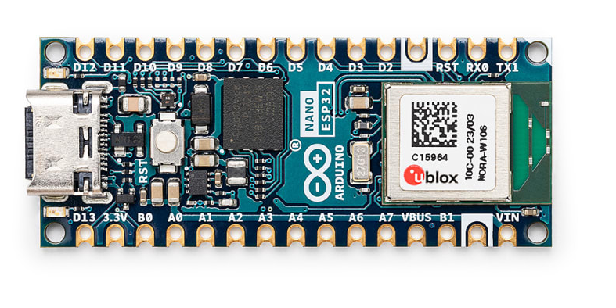
/rplidar_node
robot_control_node
/rubot_nano_driver_mecanum

Slide 3
/navigate_to_pose
geometry_msgs/ PoseStamped
/traffic_waypoint
geometry_msgs/ PoseStamped
/usb_cam
bt-navigator
/image_raw
sensor_msgs/Image
custom_nav2
/Yolov8_Inference
custom_msgs/ Yolov8Inference
/initialpose
geometry_msgs/ PoseStamped
/cmd_vel
geometry_msgs/Twist
object_detection
/rubot_nano_driver_mecanum
Nav2-stack
/inference_result
sensor_msgs/Image
/odom
nav_msgs/Odometry

