Slide 1

PittFood
By: Song Jin, Chakravarthy Koduru, Steven Nunnally, & Yuwei Zhan

Slide 2

Introduction
Yelp Data
286 Restaurants
2255 users giving 6,008 ratings
< 1% ratings matrix completed
Collaborative Filtering
SVD
Offline
Android Interface
MongoLabs Database

Slide 3
Algorithm
Singular Value Decomposition
Rating matrix of Yelp data and our users
Fill blanks with average or middle ranking
Determine rank-k with best cross validation
Get predictions from SVD: US^{1/2}*S^{1/2}V^{T}
Store system user predictions without ratings
k = 257, MSE < 0.0000008

Slide 4
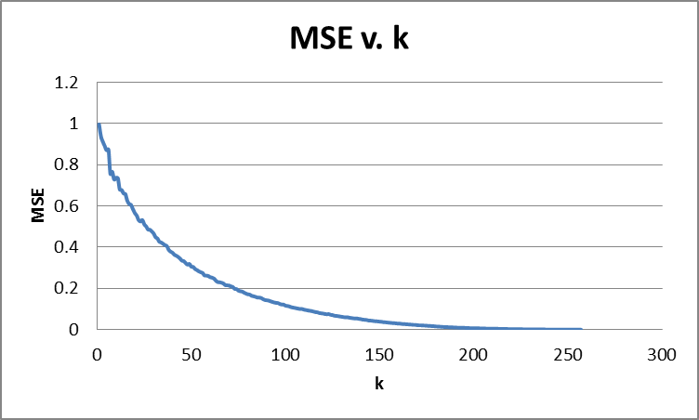
Finding k

Slide 5
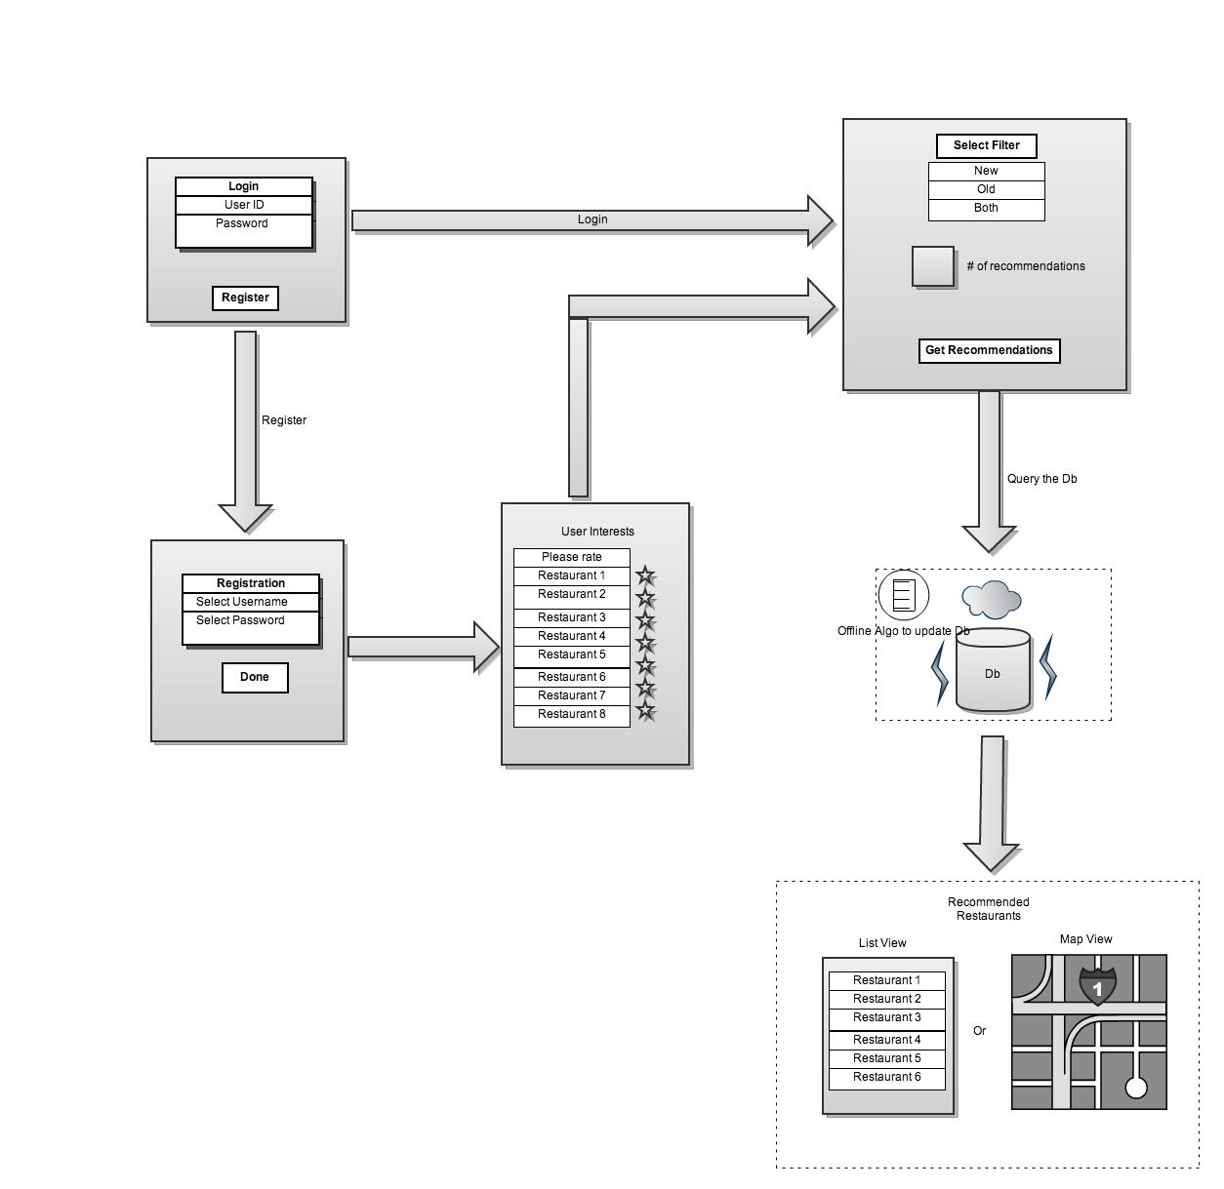
Interface

Slide 6
Future Work
Restaurant search and cuisine filtering
Modify existing ratings and add others
Change registration rating format
Add restaurants
More empirical results on recommendations
Automatic prediction updates

Slide 7
Demo

Slide 8
Questions?

