Slide 1
Movie Ticket Booking System
A presentation on
PRESENTER
Anish Shrestha
Saugat Nepal

Slide 2
Introduction
The Movie Ticket Booking System is a web-based application designed to streamline the process of reserving and purchasing movie tickets. With just a few clicks, movie enthusiasts can effortlessly secure their seats for a desired showtime and choose preferred seats from the comfort of their homes.

Slide 3
Problem Statement
Purchasing movie tickets by standing in queues consumes significant time.
Customers are unable to preselect their seats in advance.
- Customers are unaware of the movie showtime.
Objectives
-To enable customers to purchase movie tickets along with their favorable showtime.
-To allow customers to select seats of their choice

Slide 4
Scope and Limitation
Scope
Our system is concerned with effortlessly browsing a diverse catalog of movies, selecting preferred showtimes, and completing online payments for booked seats.
Limitation
The significant limitation of our system is the reliance on a single theatre for showing movies.

Slide 5
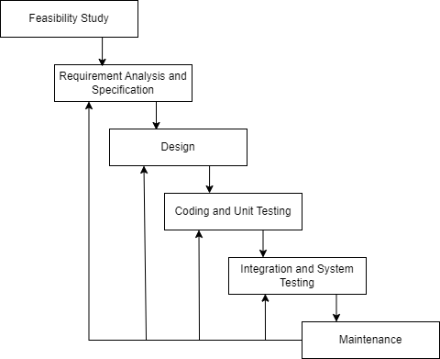
System Analysis
Fig : Iterative waterfall model

Slide 6
Functional Requirement
Customers can log in with valid credentials.
The system enables users to browse movies, pick a showtime, and book their preferred seat.
The system will maintain a record of all the bookings made by the users.
Non Functional Requirement
Security
Usability
Performance

Slide 7
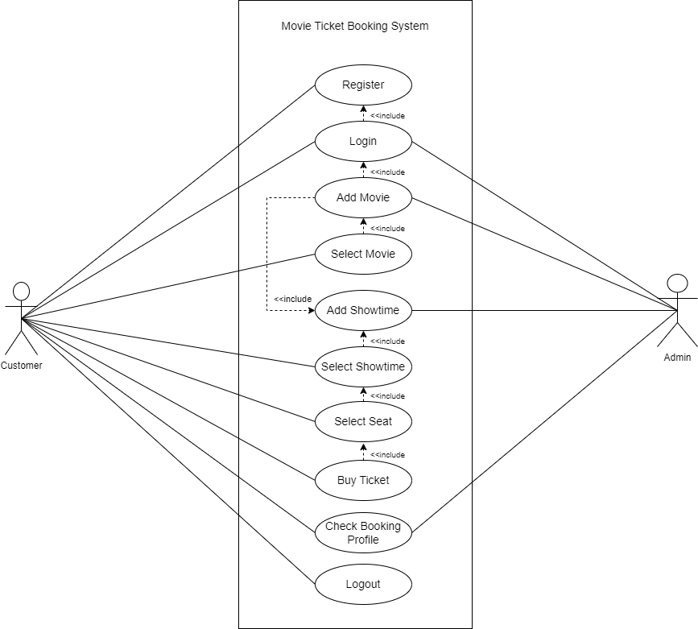
Use Case Diagram
Fig : Use Case Diagram

Slide 8
Feasibility Study
Technical
The system was developed using HTML, PHP, CSS, and Javascript, which were all sufficient to meet the needs
Economic
The system was created entirely from free resources; no outside purchases were necessary
Operational
The system’s simple UI makes it easier to use.

Slide 9
Gantt Chart
Weeks Work | 1 | 2 | 3 | 4 | 5 | 6 | 7 | 8 | 9
Planning
Analysis
Data Modelling
Process Modelling
Database Implementation
Coding
Testing
Documentation

Slide 10
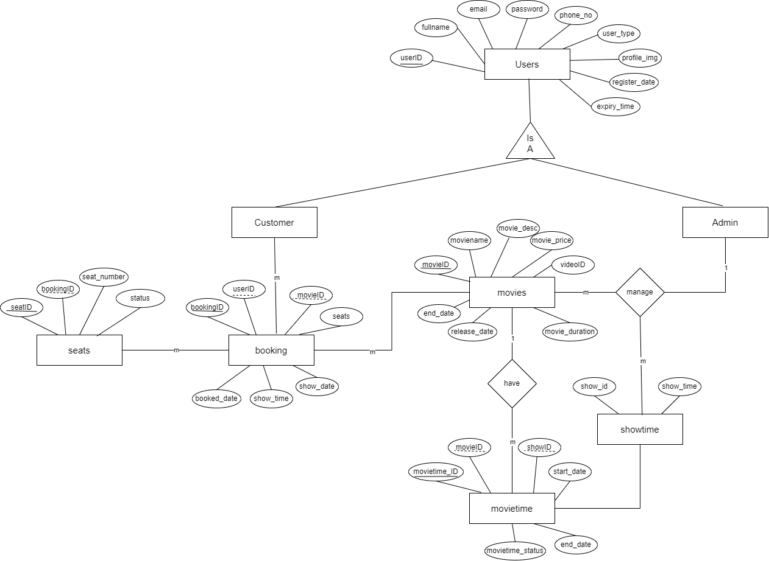
Data Modeling
Fig :ER diagram

Slide 11
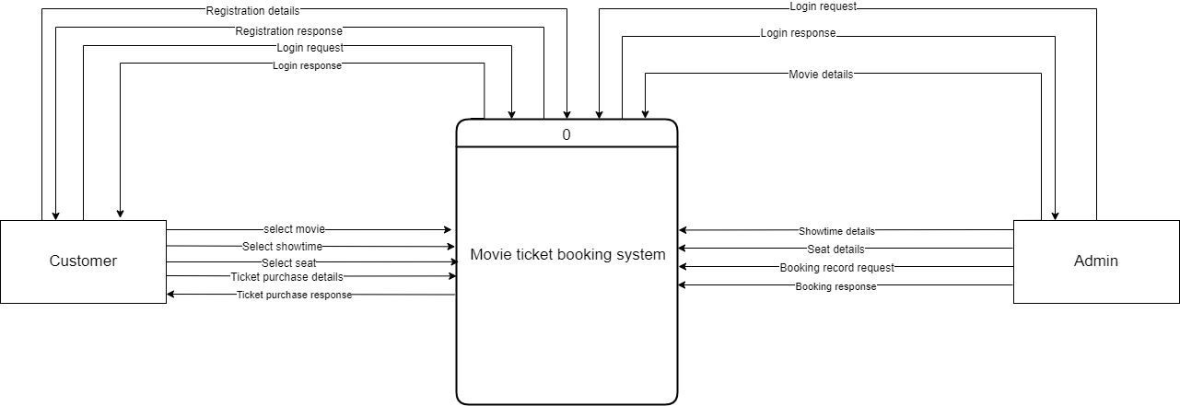
Process Modeling
Fig: Context level DFD

Slide 12
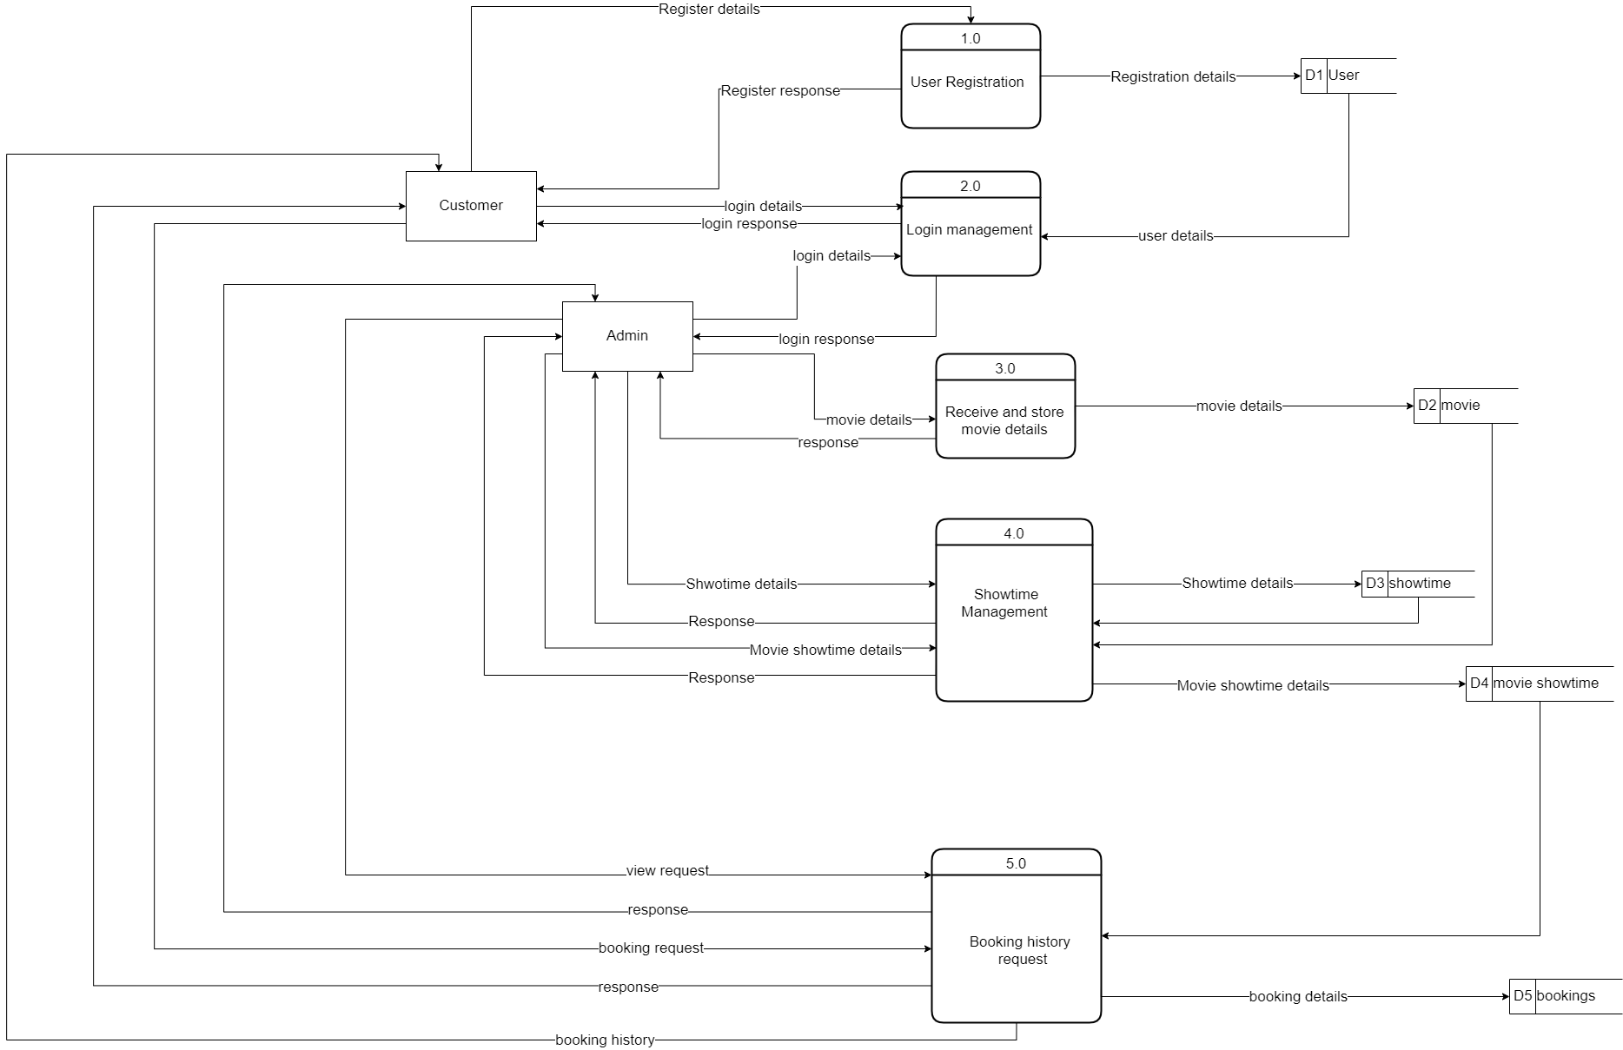
Fig: Level 0 DFD

Slide 13
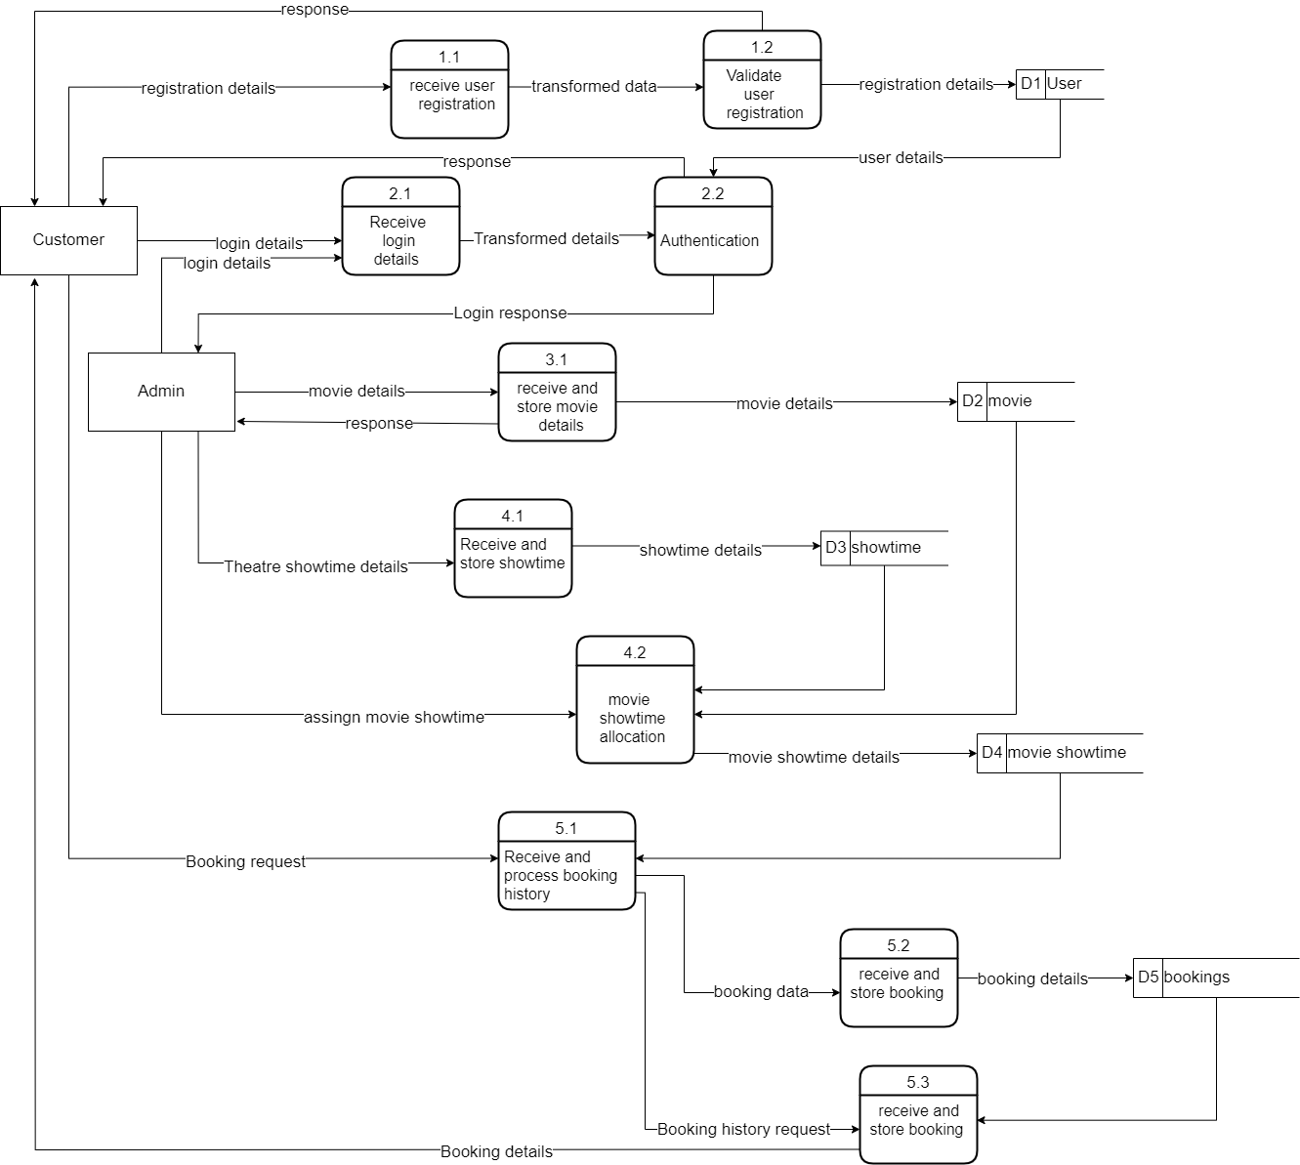
Fig: Level 1 DFD

Slide 14
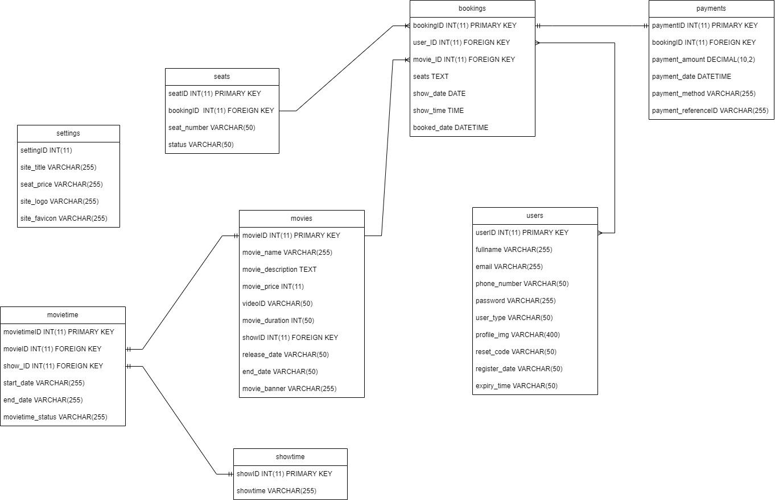
Database Schema Design
Fig : Database schema design

Slide 15
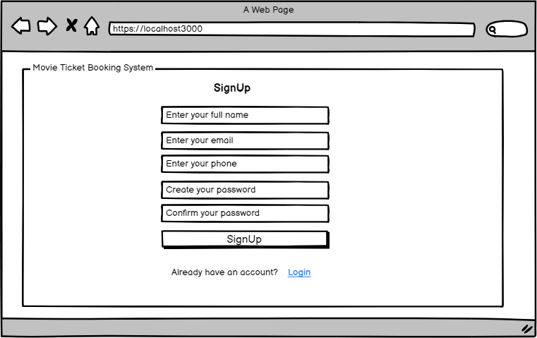
Interface Design
Registration page UI

Slide 16
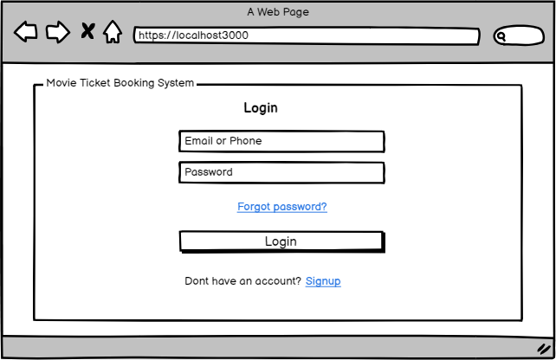
Login page UI

Slide 17
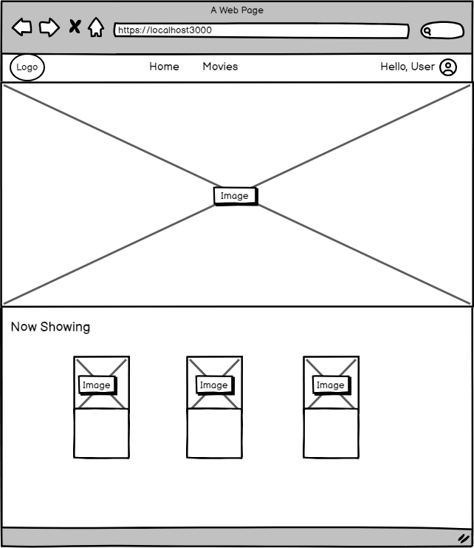
Home Page UI

Slide 18
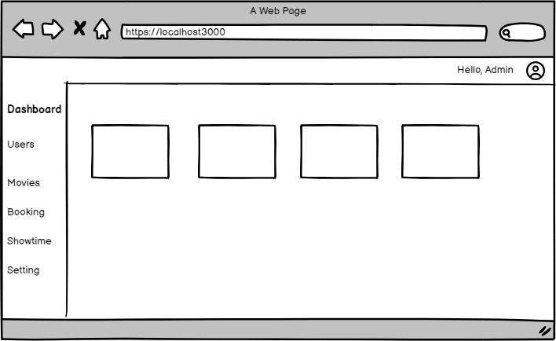
Dashboard UI

Slide 19
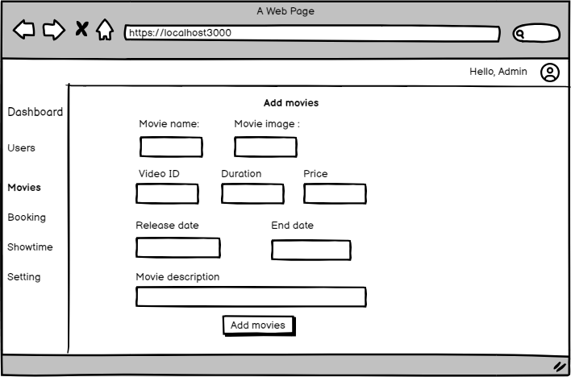
Add movies

Slide 20
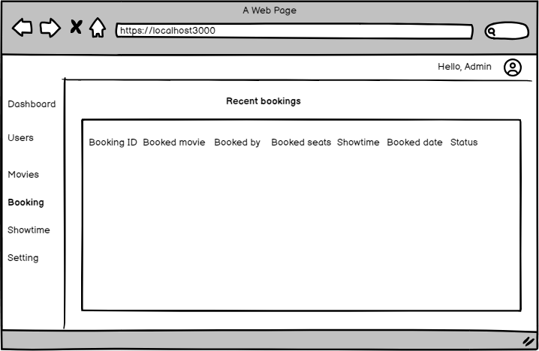
Booking UI

Slide 21
Implementation
Tools Used
Front End
HTML
CSS
JAVASCRIPT
Back End
PHP
MYSQL

Slide 22
Modules
Customer module
Register to the system
Login to the system
Select movie
Select showtime
Select seat
Book ticket
Payment
Admin module
Login to the system
Add movie
Add showtime
View booking record

Slide 23
Test Case for Unit Testing
Registration form
Symbol no. | Test Cases | Expected Result | Test Result
101 | Enter valid full name, email, phone, password, and confirm password and click submit | User registration successful | successful
Login form
Symbol no. | Test Cases | Expected Result | Test Result
101 | Enter a valid email and password | The system should display the dashboard | Successful
102 | Invalid email and password | Display error result | Successful

Slide 24
Select movie and showtime
Symbol no | Test Cases | Expect Result | Test Result
101 | Actual time is beyond the showtime | The showtime cant be selected | Successful
Book seats
Symbol no | Test Cases | Expect Result | Test Result
101 | Book seat | Seat booked successfully | Successful
Make payment
Symbol no | Test Cases | Expect Result | Test Result
101 | Choose a payment method | Payment made successfully | Successful

Slide 25
Test Case for system Testing
Login to the system
Test Scenario | Test-Case ID | Test Case | Test-Data | Expected Output | Actual Output | Status
TC_00_01 | TC_001 | Login | Type URL: login | Redirect to the dashboard if the correct email and password else reload the same login page | Redirect to the dashboard if the correct email and password else reload the same login page | Pass
 | TC_002 | Load dashboard | Type URL: dashboard | Dashboard loaded | Dashboard loaded | Pass

Slide 26
Adding movies
Test Scenario | Test-Case ID | Test Case | Test-Data | Expected Output | Actual Output | Status
TC_00_02 | TC_001 | Add movies | Click a link: Add | Movies are added based on information provided by Admin. | New movies will be added and the user can book the room of his choice | True
 | TC_002 | Again add the movie but without filling in the fields | Click a link: Add | Message: You must fill in all the field | Message: You must fill in all the field | True

Slide 27
Future Enhancements
We can assign QR codes to the tickets.
We can add more Halls to show different movies at a time.

Slide 28
Any Queries?

Slide 29
Thank you!

