Slide 1
Semi-automated Segmentation Pipeline for Analysis of Knee Joint Kinematics
Wissenschaftliches Werner Kaiser-Sommersymposium
AG Med Phys
A comparision with manual based segmentation
Jena | 12.09.2024 | Aayush Nepal

Slide 2
Motivation

Slide 3
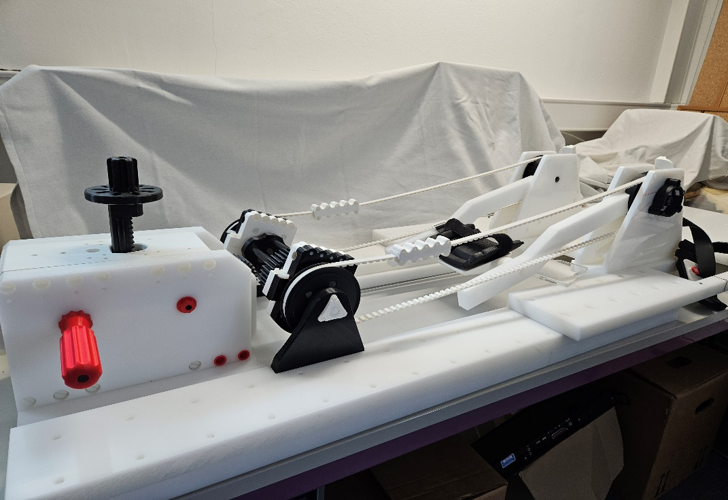
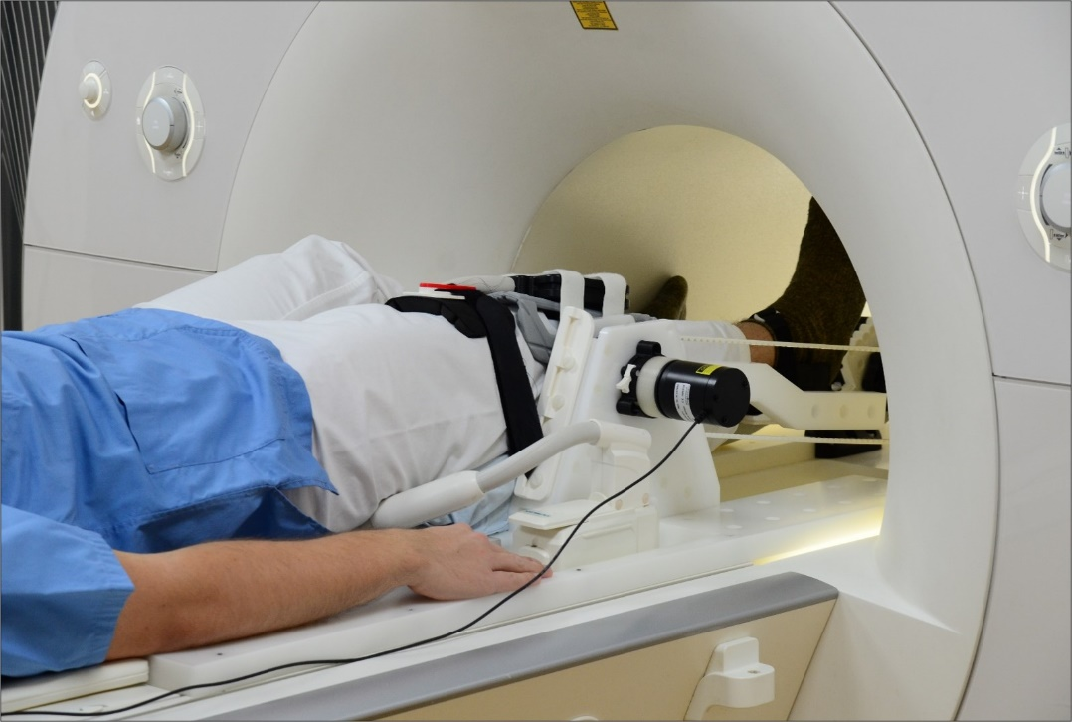
Knee flexion-extension device

Slide 4
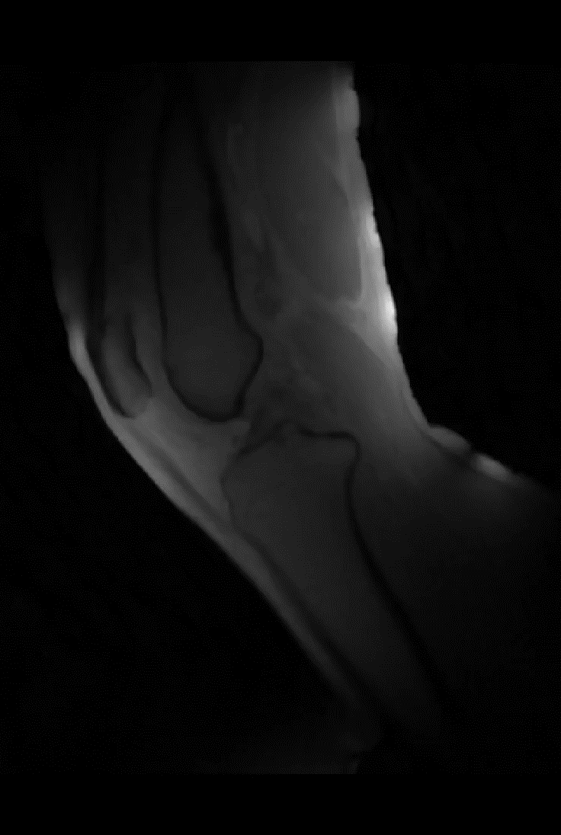
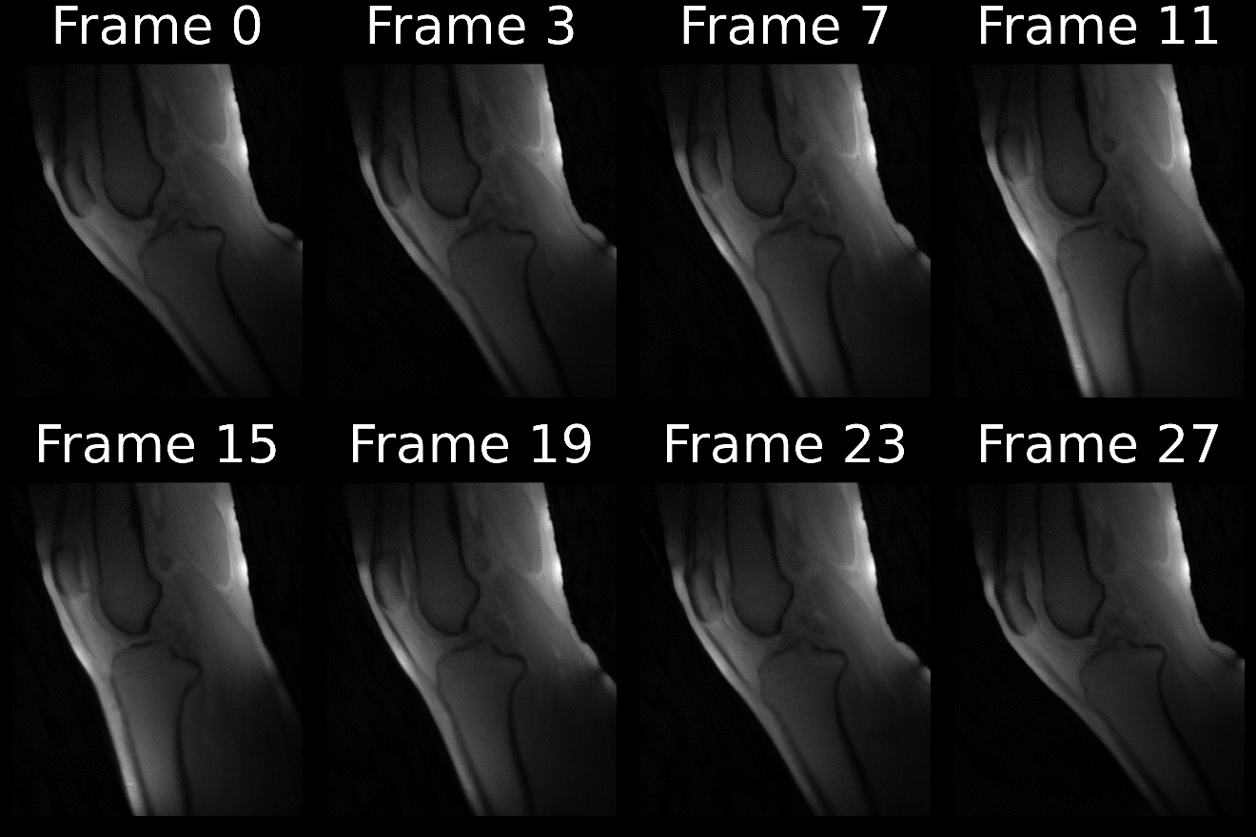
Reconstructed frames

Slide 5
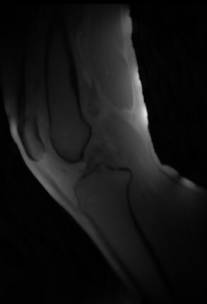
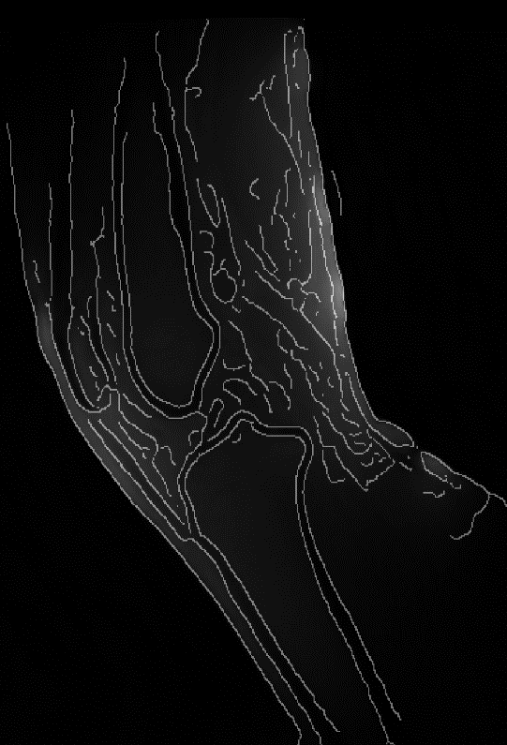
Methods

Slide 6
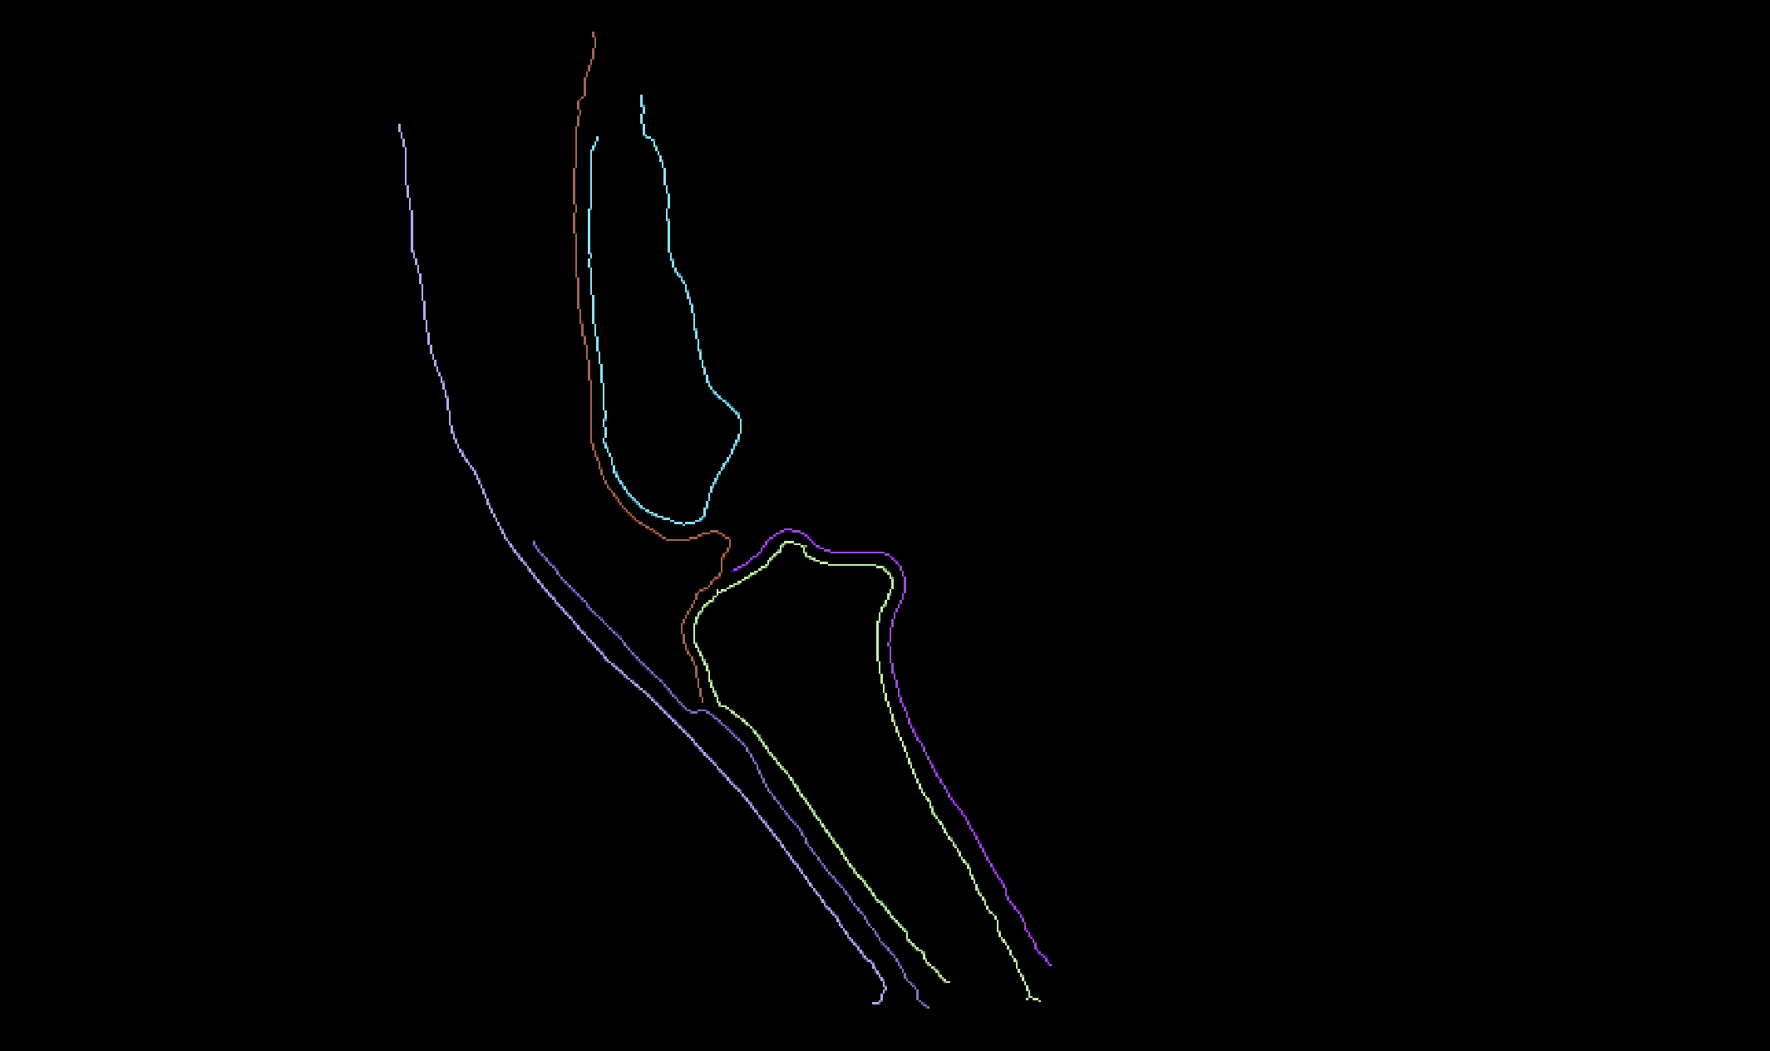
Methods

