Slide 1
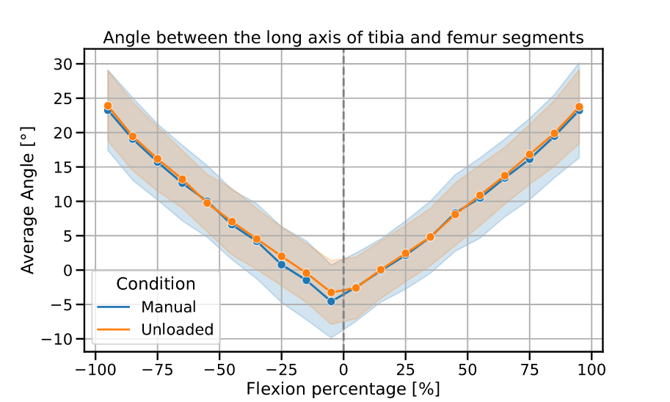

Slide 2
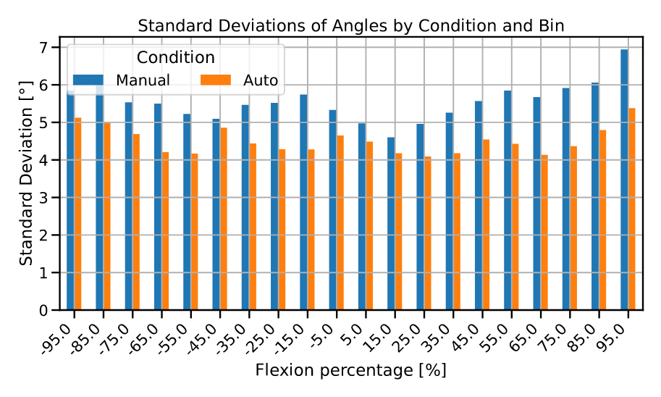

Slide 3
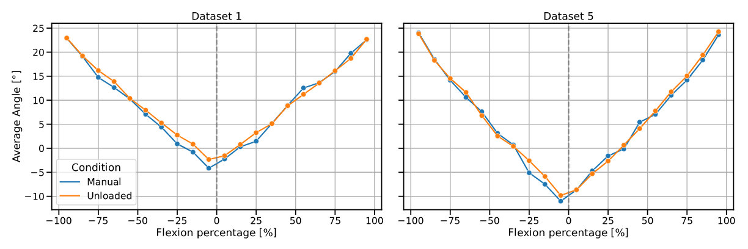

Slide 4
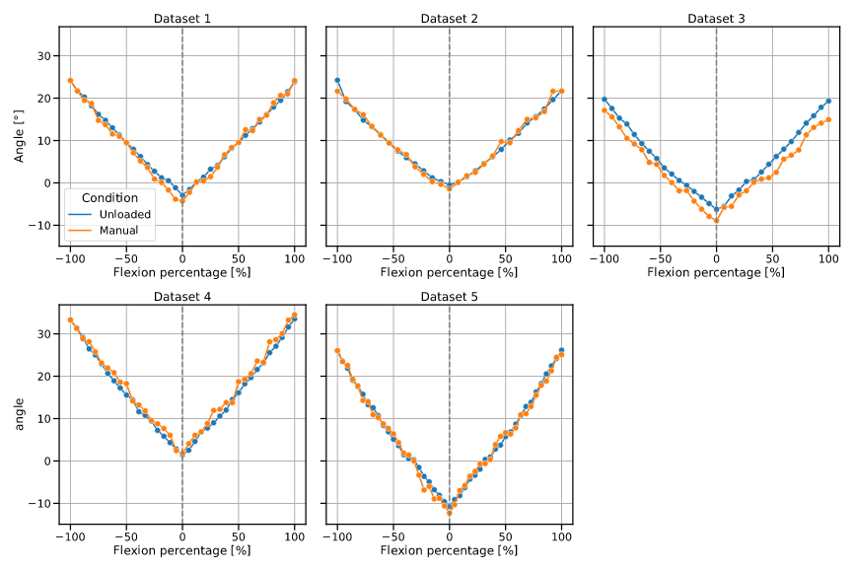

Slide 5
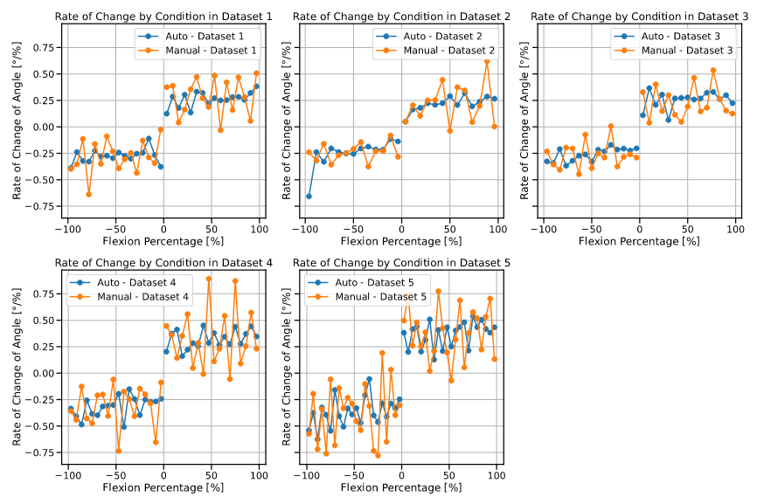
to visualize the rate of change of angles across varying levels of knee flexion, differentiated by experimental conditions within multiple datasets

Slide 6
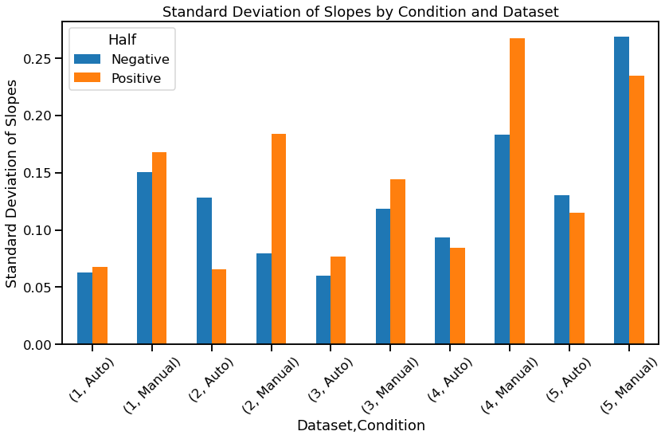

Slide 7
Dataset 1, Condition Auto:
Standard deviation of slopes from -100% to 0%: 0.063
Standard deviation of slopes from 0% to 100%: 0.068
Dataset 1, Condition Manual:
Standard deviation of slopes from -100% to 0%: 0.151
Standard deviation of slopes from 0% to 100%: 0.168
Dataset 2, Condition Auto:
Standard deviation of slopes from -100% to 0%: 0.128
Standard deviation of slopes from 0% to 100%: 0.066
Dataset 2, Condition Manual:
Standard deviation of slopes from -100% to 0%: 0.080
Standard deviation of slopes from 0% to 100%: 0.184
Dataset 3, Condition Auto:
Standard deviation of slopes from -100% to 0%: 0.060
Standard deviation of slopes from 0% to 100%: 0.077
Dataset 3, Condition Manual:
Standard deviation of slopes from -100% to 0%: 0.119
Standard deviation of slopes from 0% to 100%: 0.144
Dataset 4, Condition Auto:
Standard deviation of slopes from -100% to 0%: 0.094
Standard deviation of slopes from 0% to 100%: 0.084
Dataset 4, Condition Manual:
Standard deviation of slopes from -100% to 0%: 0.184
Standard deviation of slopes from 0% to 100%: 0.268
Dataset 5, Condition Auto:
Standard deviation of slopes from -100% to 0%: 0.130
Standard deviation of slopes from 0% to 100%: 0.115
Dataset 5, Condition Manual:
Standard deviation of slopes from -100% to 0%: 0.269
Standard deviation of slopes from 0% to 100%: 0.235

Slide 8
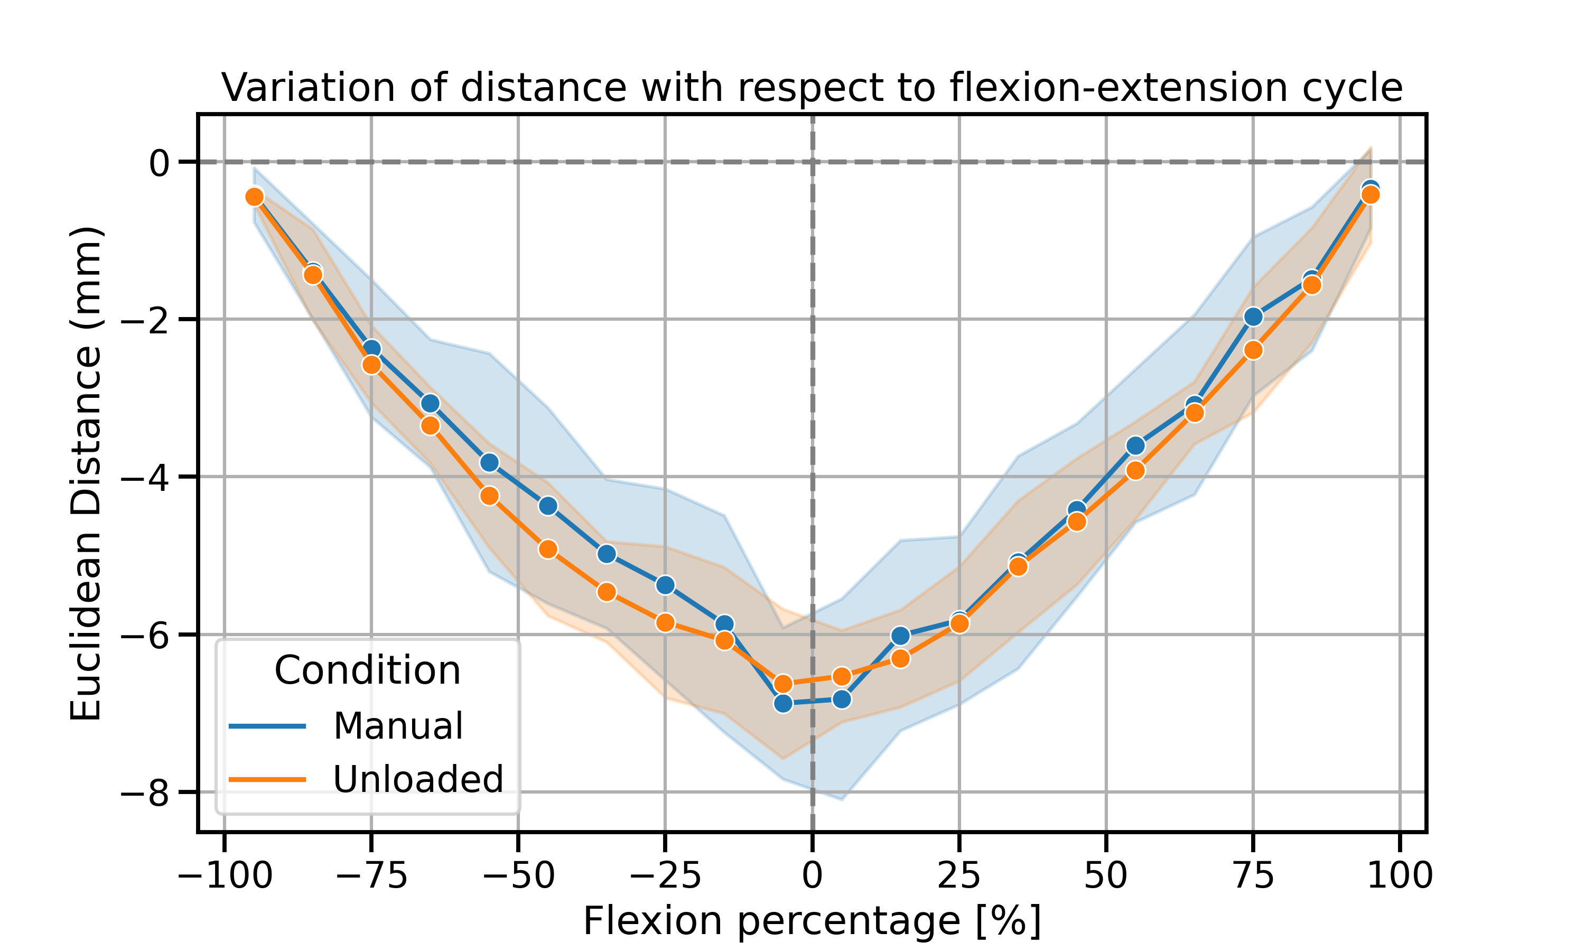

Slide 9
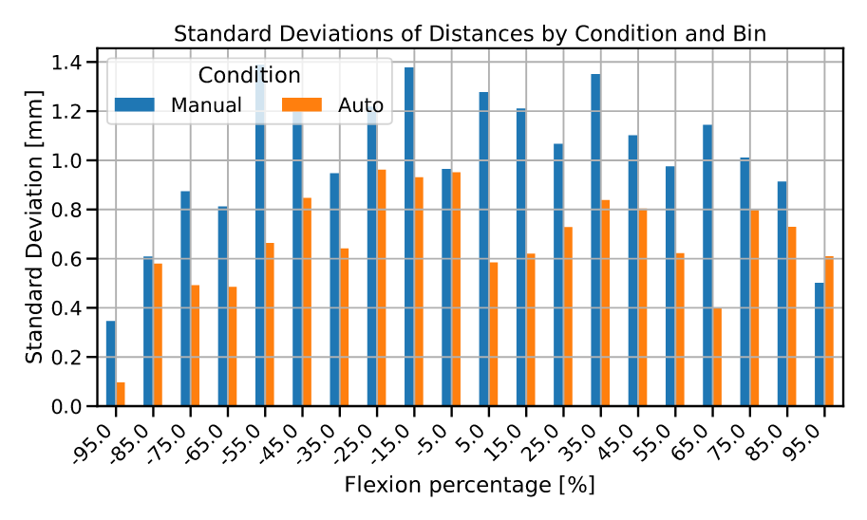

Slide 10
