Slide 1
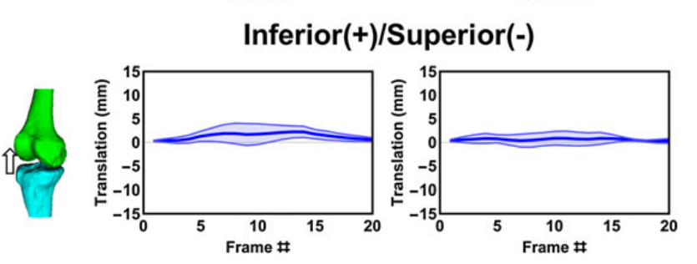
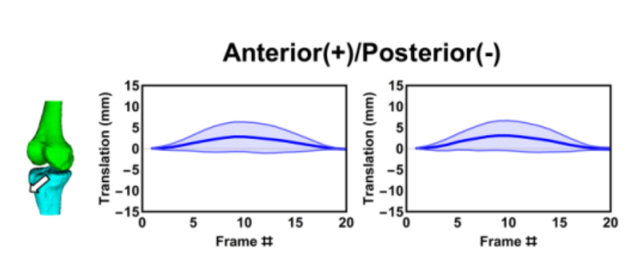
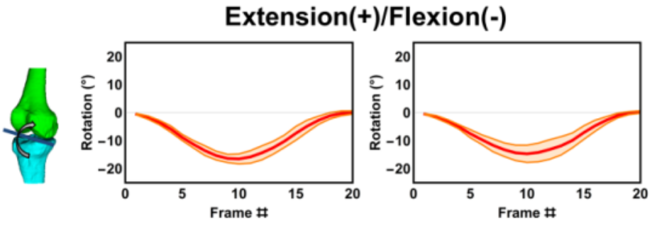
Mazzoli et al (2017)
Range of motion: 16.2° ± 1.7°
#Subjects: 5

Slide 2
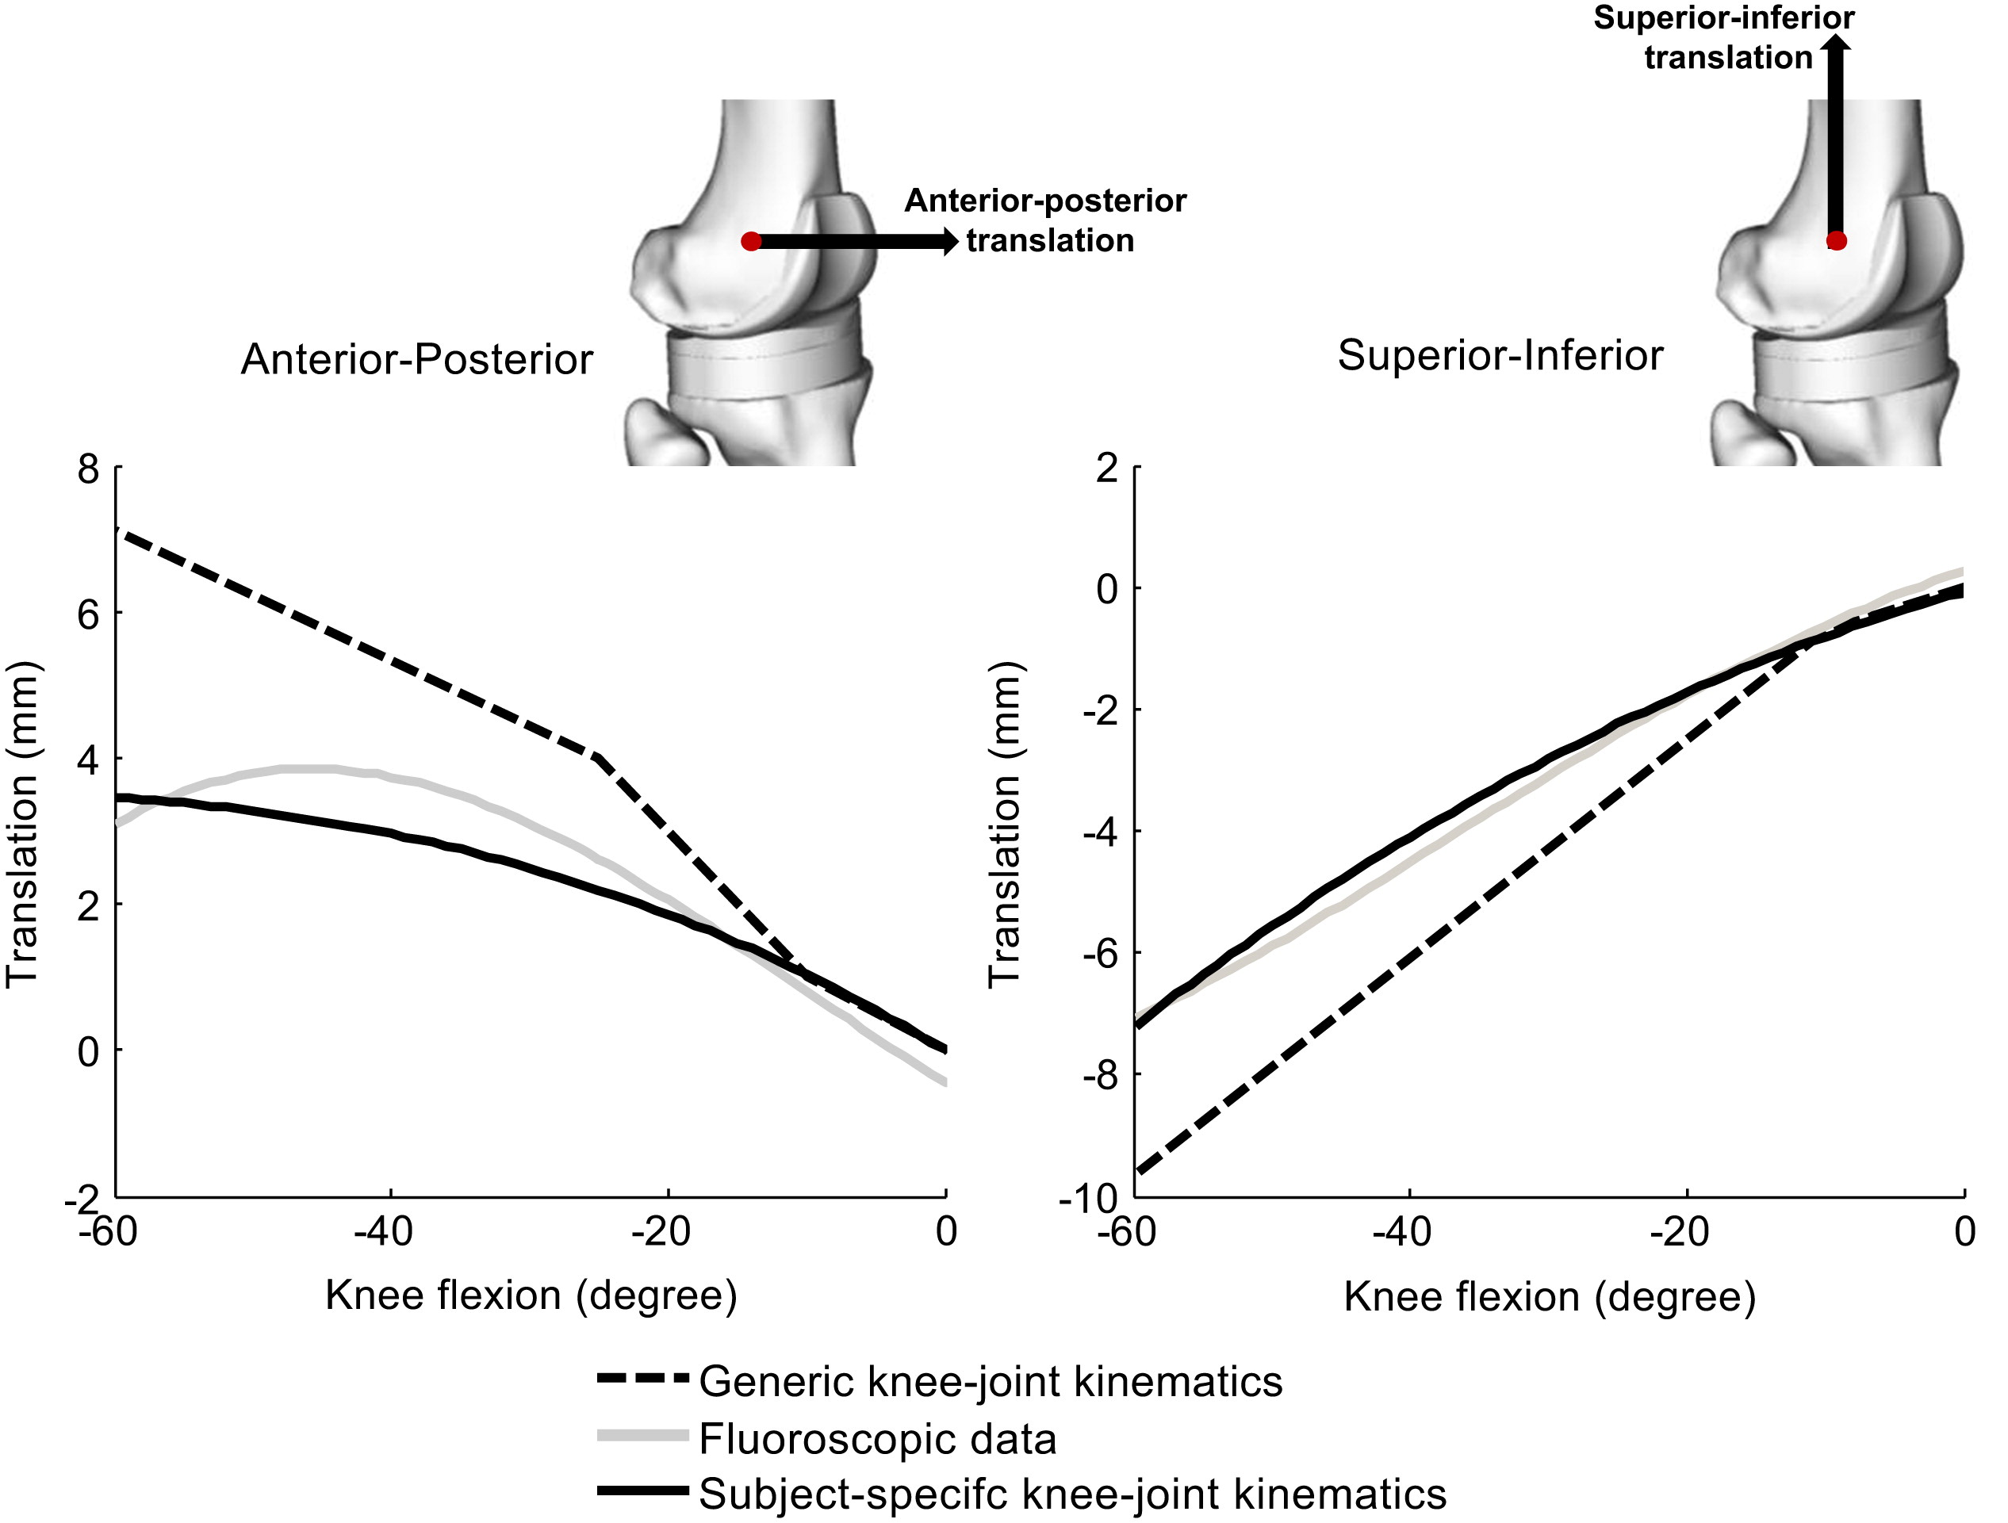
Gerus, 2013
Fig. 1. Anterior–posterior and superior–inferior translation of the tibia relative to the femur defined in OpenSim for the generic and subject-specific knee joint kinematic model using fluoroscopic data. The reference (0,0) is the initial position of the knee joint center, and the translation is the displacement of the knee joint center relative to its initial position

Slide 3
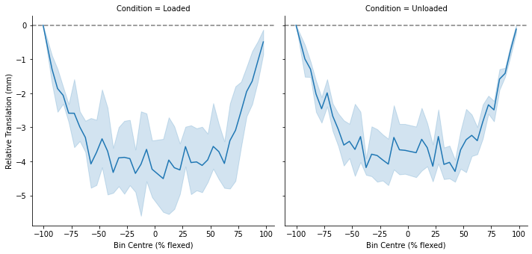
Using bin center of width 5 for aggregation

Slide 4
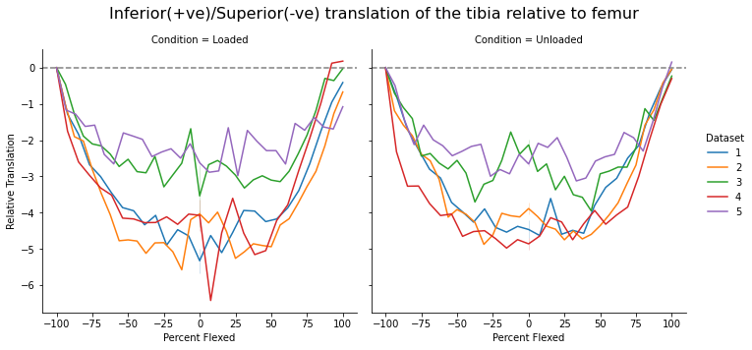

Slide 5
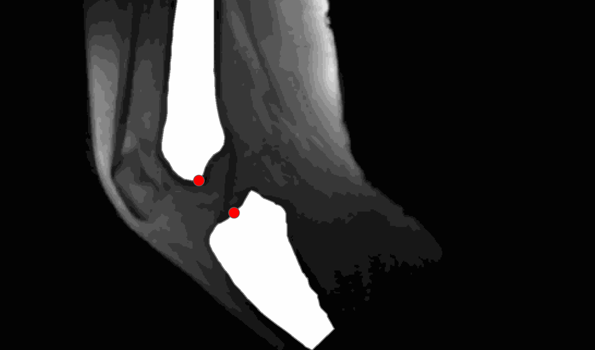

Slide 6
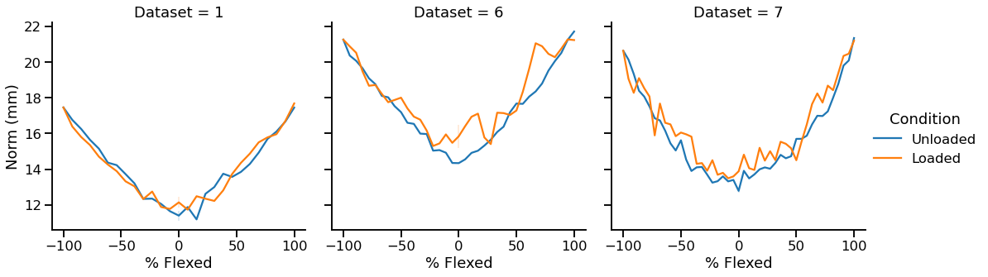
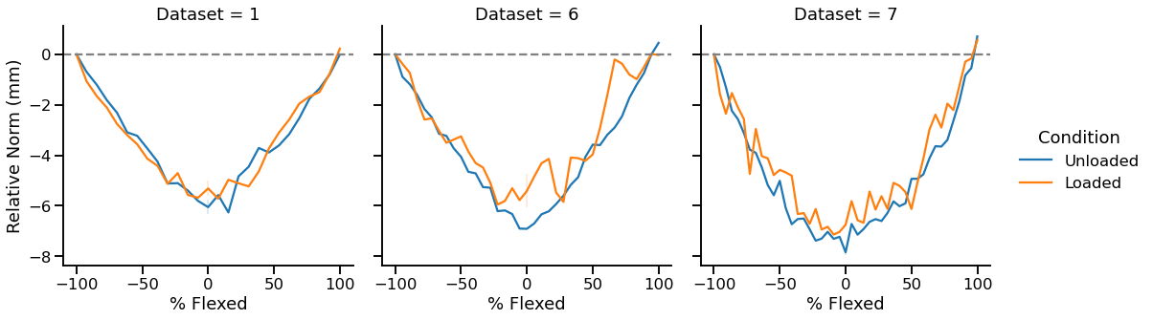

Slide 7
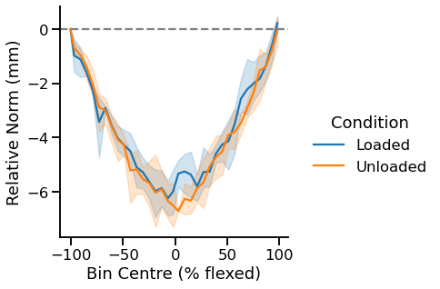
Averaging 5 datasets:

Slide 9
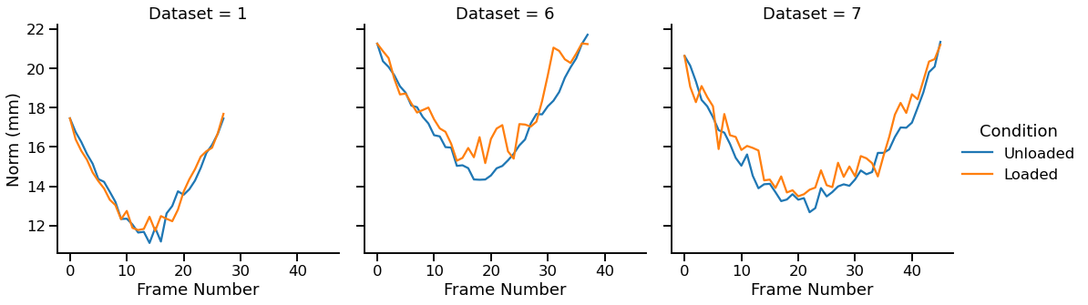

Slide 18
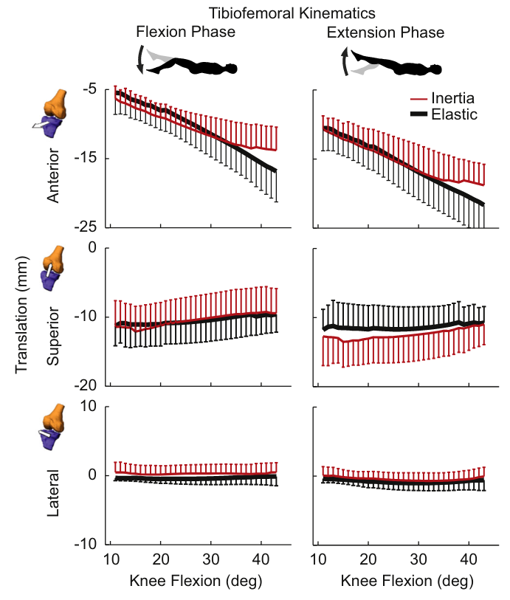
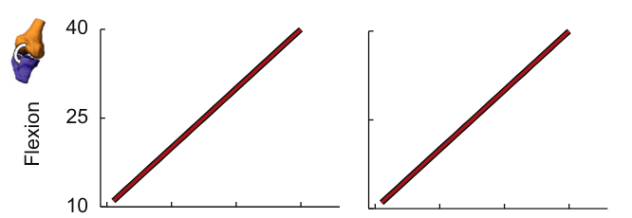
Westphal (2013)
# of subjects : 8

Slide 20
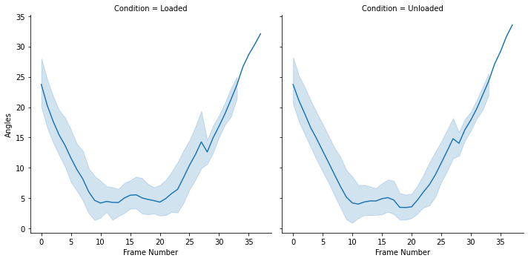
Average angle between long axis of femur and tibia w.r.t frame number

