Slide 2
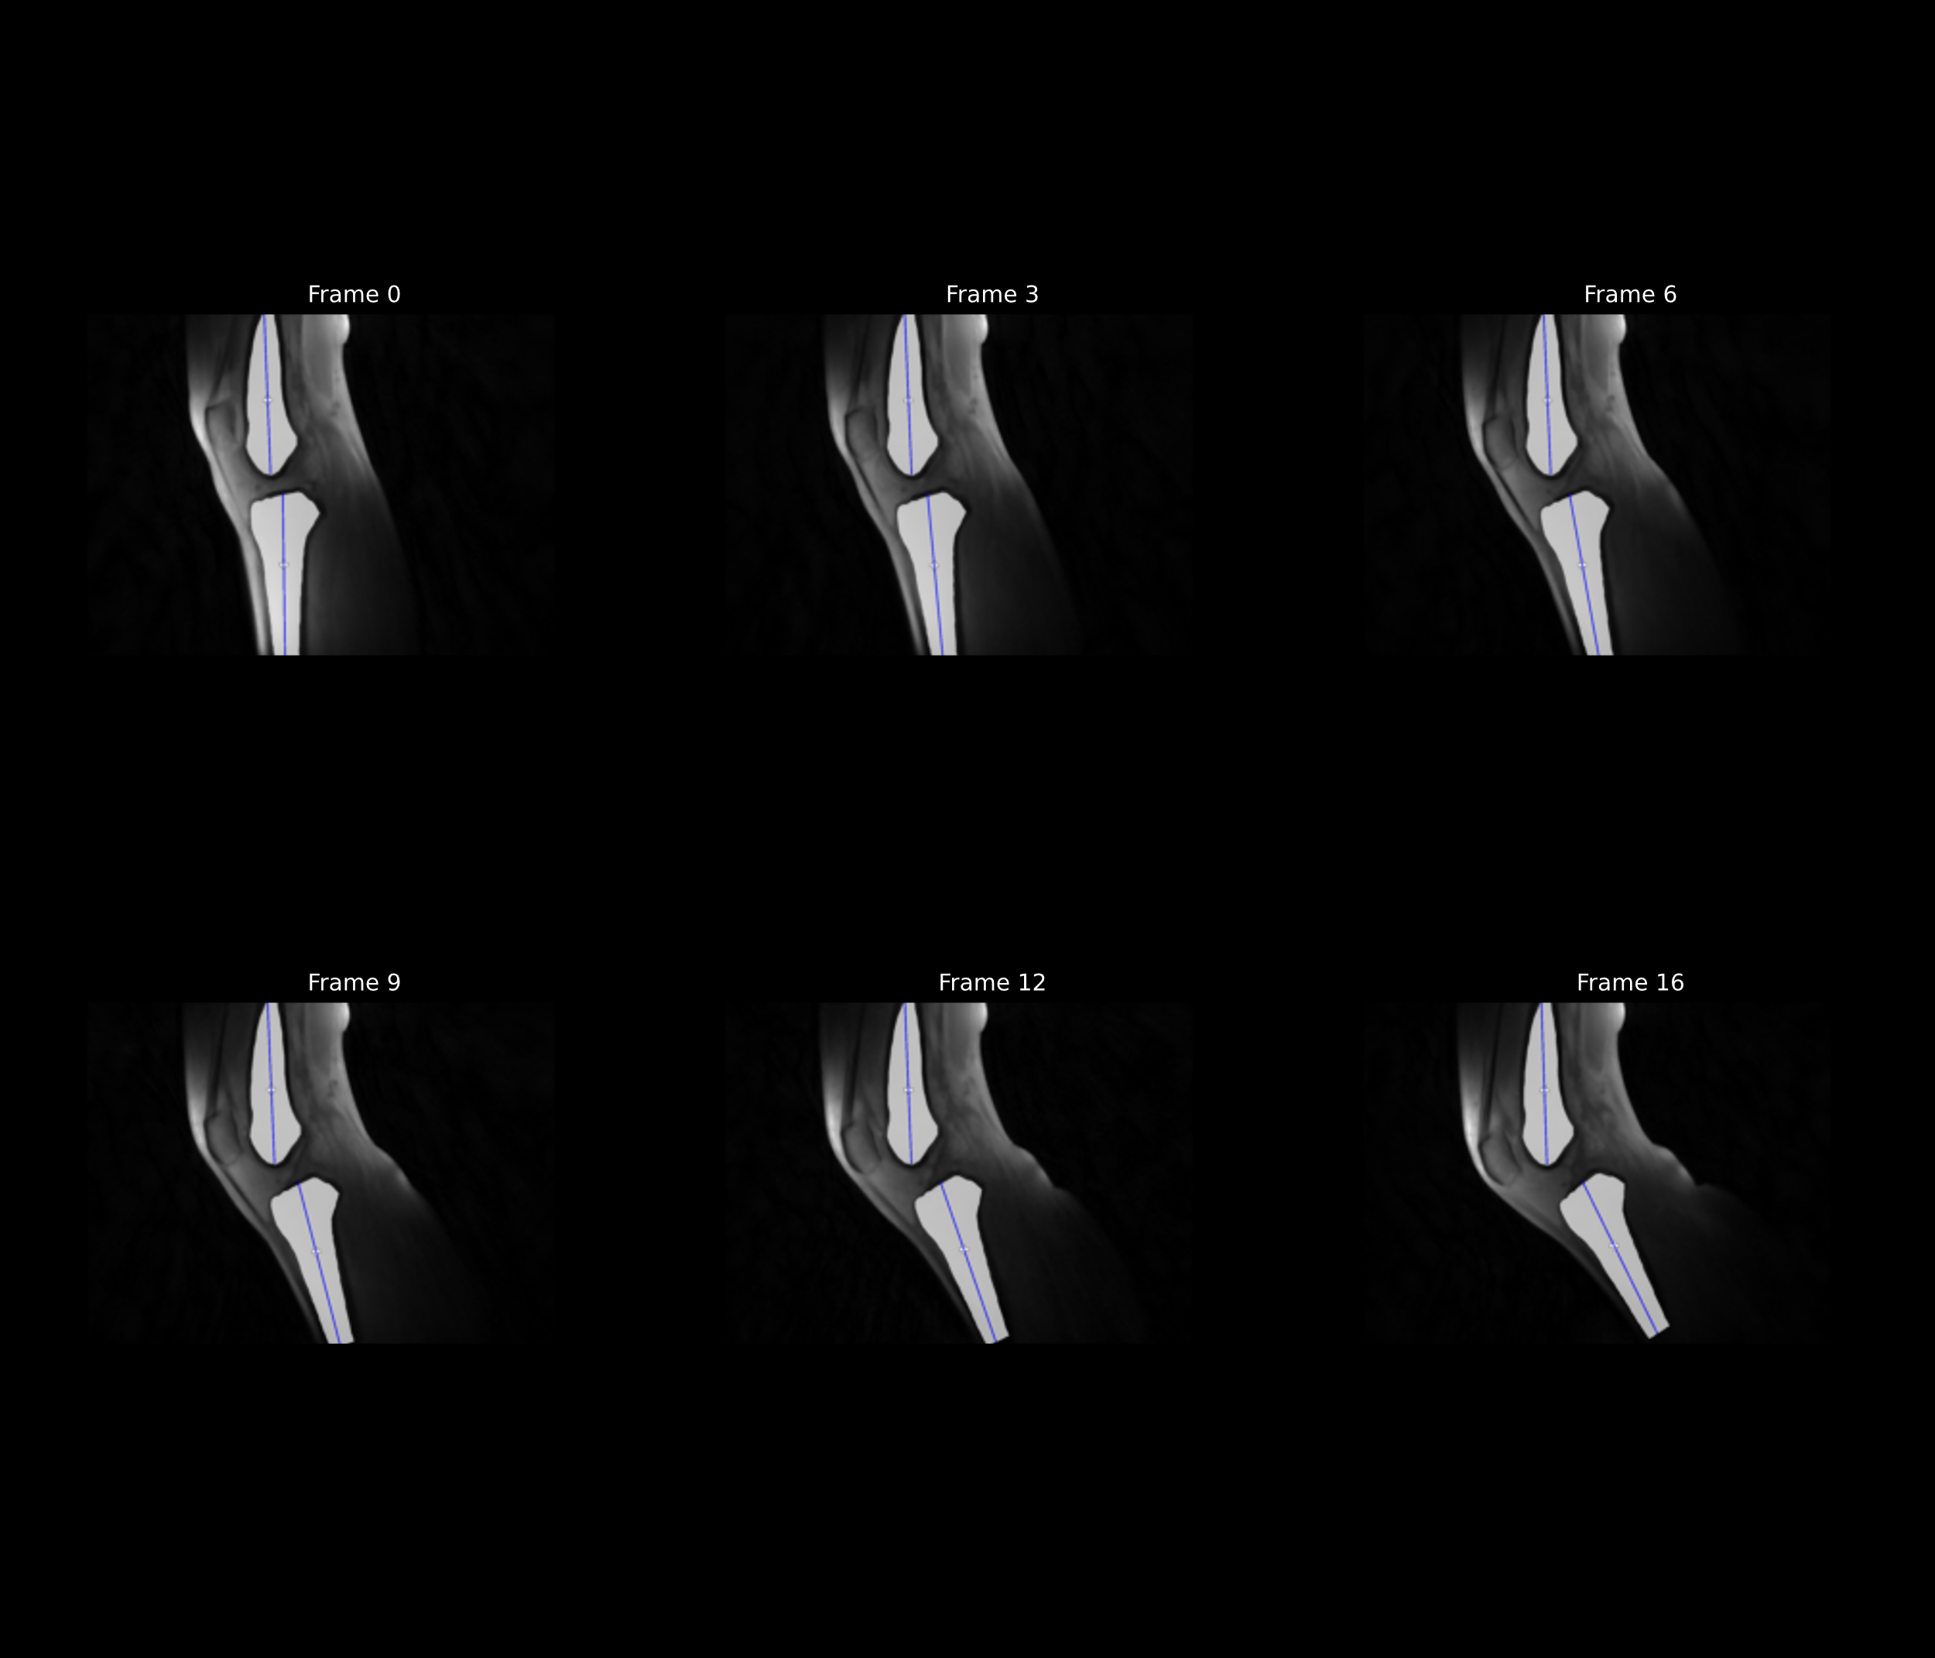
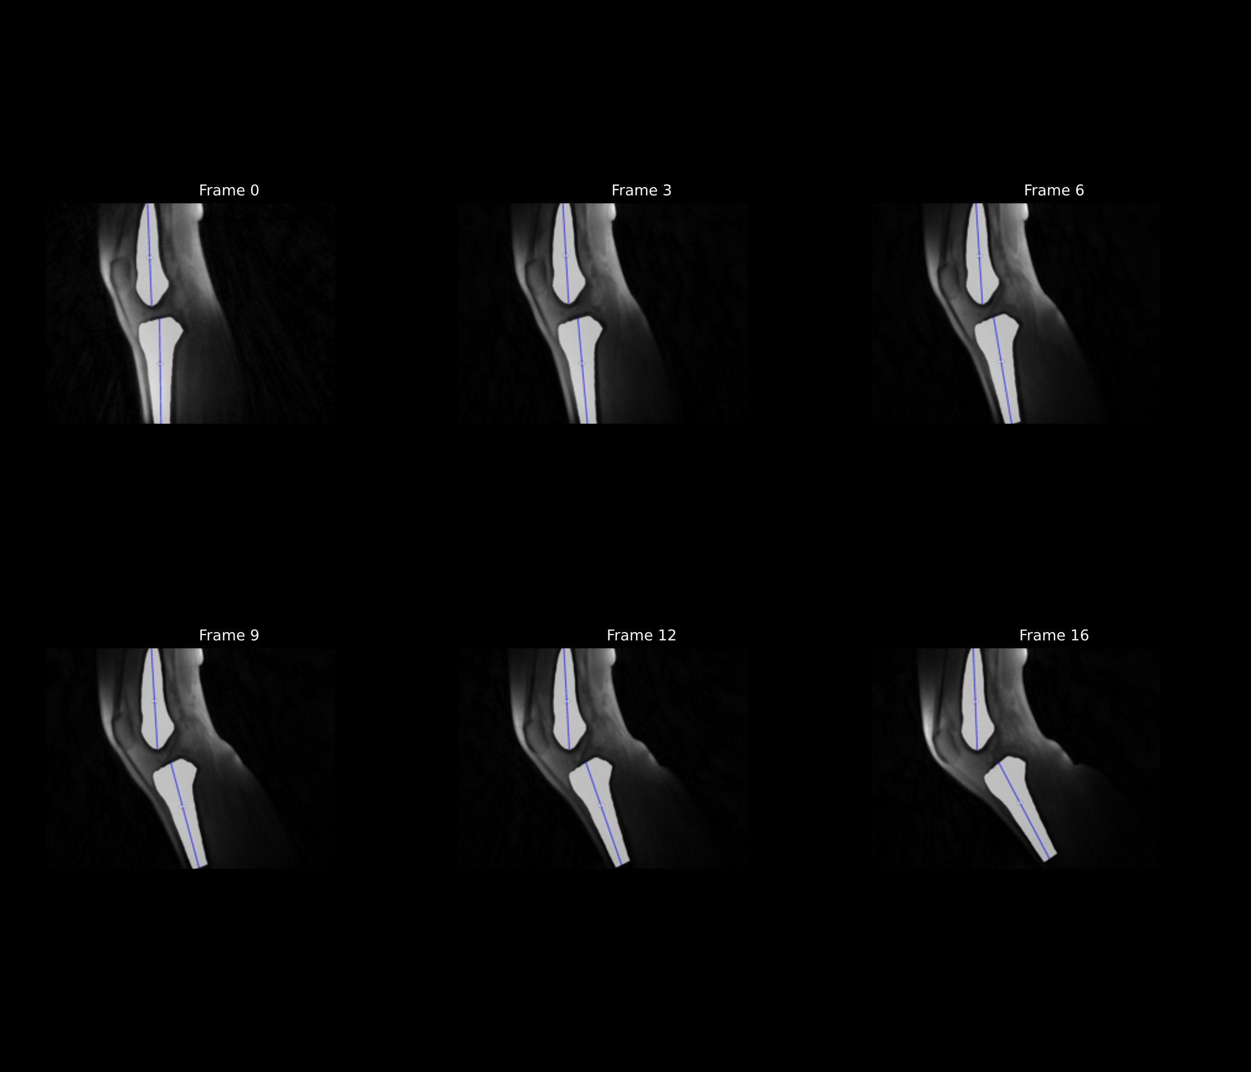
Subject 1
Unloaded
Loaded

Slide 5
Comparision with the paper Mazzoli et al (2017)

