Slide 1
The world of dynamic knee MRI
Different ways in which kinematic parameters are extracted
Jena | 00.00.2024
Aayush Nepal

Slide 2
Meniscal Displacement
List of papers:
Oeveleen , 2024 -> Requires one full lowerlimb scan.
Measured: 3D meniscal position and deformation at 0°, 30°, 60°, 90° flexion
Method: Static 3D MRI scans at each angle + full lowerlimb scan
Used statistical shape models to predict meniscal geometry
Calculated point-to-point distances between flexion angles
Cance , 2024 ->
Measured: Direction and magnitude of discoid lateral meniscus shift
Method: Two static MRI scans - after 'clock' and 'pop' movements
Compared meniscus position between scans to classify instability type
Validated findings with arthroscopic examination

Slide 3
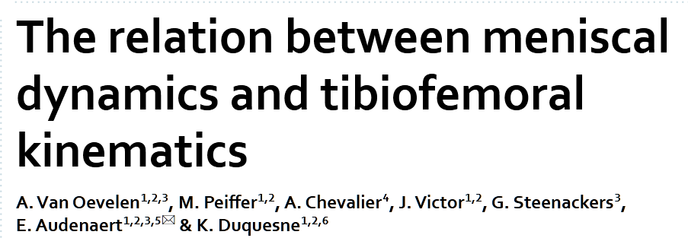
Oeveleen, 2024
- Medial meniscus anterior horn, lateral meniscus anterior horn and lateral meniscus posterior horn displacement at different degrees of knee flexion (0, 30, 60, 90)
Subjects positions in lateral decubitus (lying on their sides) on the MRI table
Foot of the dominant leg pressed against a wooden bar
A weight of 25 kgs attached to the wooden bar to simulate knee joint loading
Scans were taken at four angles.
Knee flexion angle was approximated using a goniometer**
Additional coronal scan taken at 0 degree flexion
Proton density weighted 3D sequence
(0.3571 , 0.3571, 1.5 ) mm
Additional coronal overview scans
(0.7308, 0.7308, 3)
This overview scan needs the full lowerlimb to create full bone models later

Slide 4
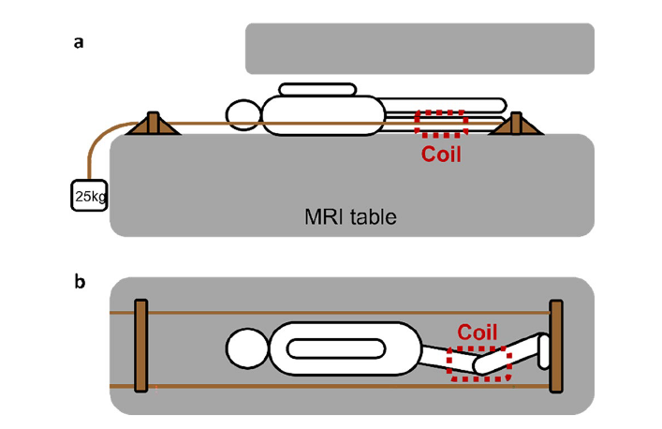
Oeveleen, 2024
Use of Statistical Shape Models
Use the overview scan and SSM .. Fit them to the MRI data to obtain full bone models.
Use the full bone models to analyse the partial scans.

Slide 5
6 DOF knee kinematics
- Conconi, 2023

Slide 6
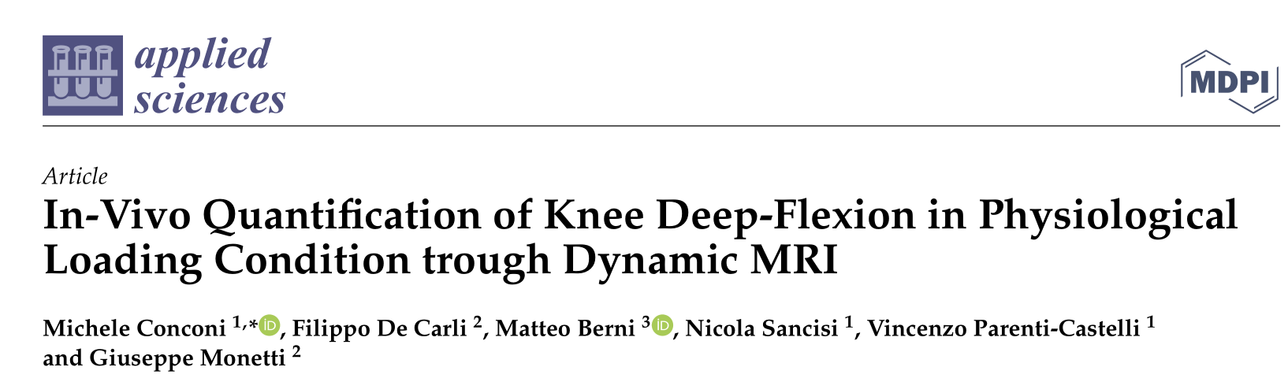
Conconi, 2023
What did they measure?
6 degrees of freedom (DOF) of tibiofemoral kinematics
flexion/extension, abduction/adduction, internal/external rotation, anterior/posterior translation, proximal/distal translation, and medial/lateral translation
The imaging sequence
0.25 T G-Scan, Esaote SpA scanner
Dynamic MRI: 2D hybrid contrast enh
FOV 200 × 200, pixel spacing 0.68/0.68 mm, slice thickness 5 mmancement
2.9 seconds per frame
Two optimal planes were used for scanning
Subject placement and exercise
Weight-bearing, open MRI scanner in vertical position
Custom MR-compatible plastic rig with hydraulic step to guide knee flexion
Volunteers stood with right leg in scanner, left leg on hydraulic step
Lowering the step caused right leg flexion under body weight
Additional support kept shank fixed while allowing unconstrained knee motion
Three exams performed per volunteer, two identical and one with increased starting flexion angle

