Slide 1
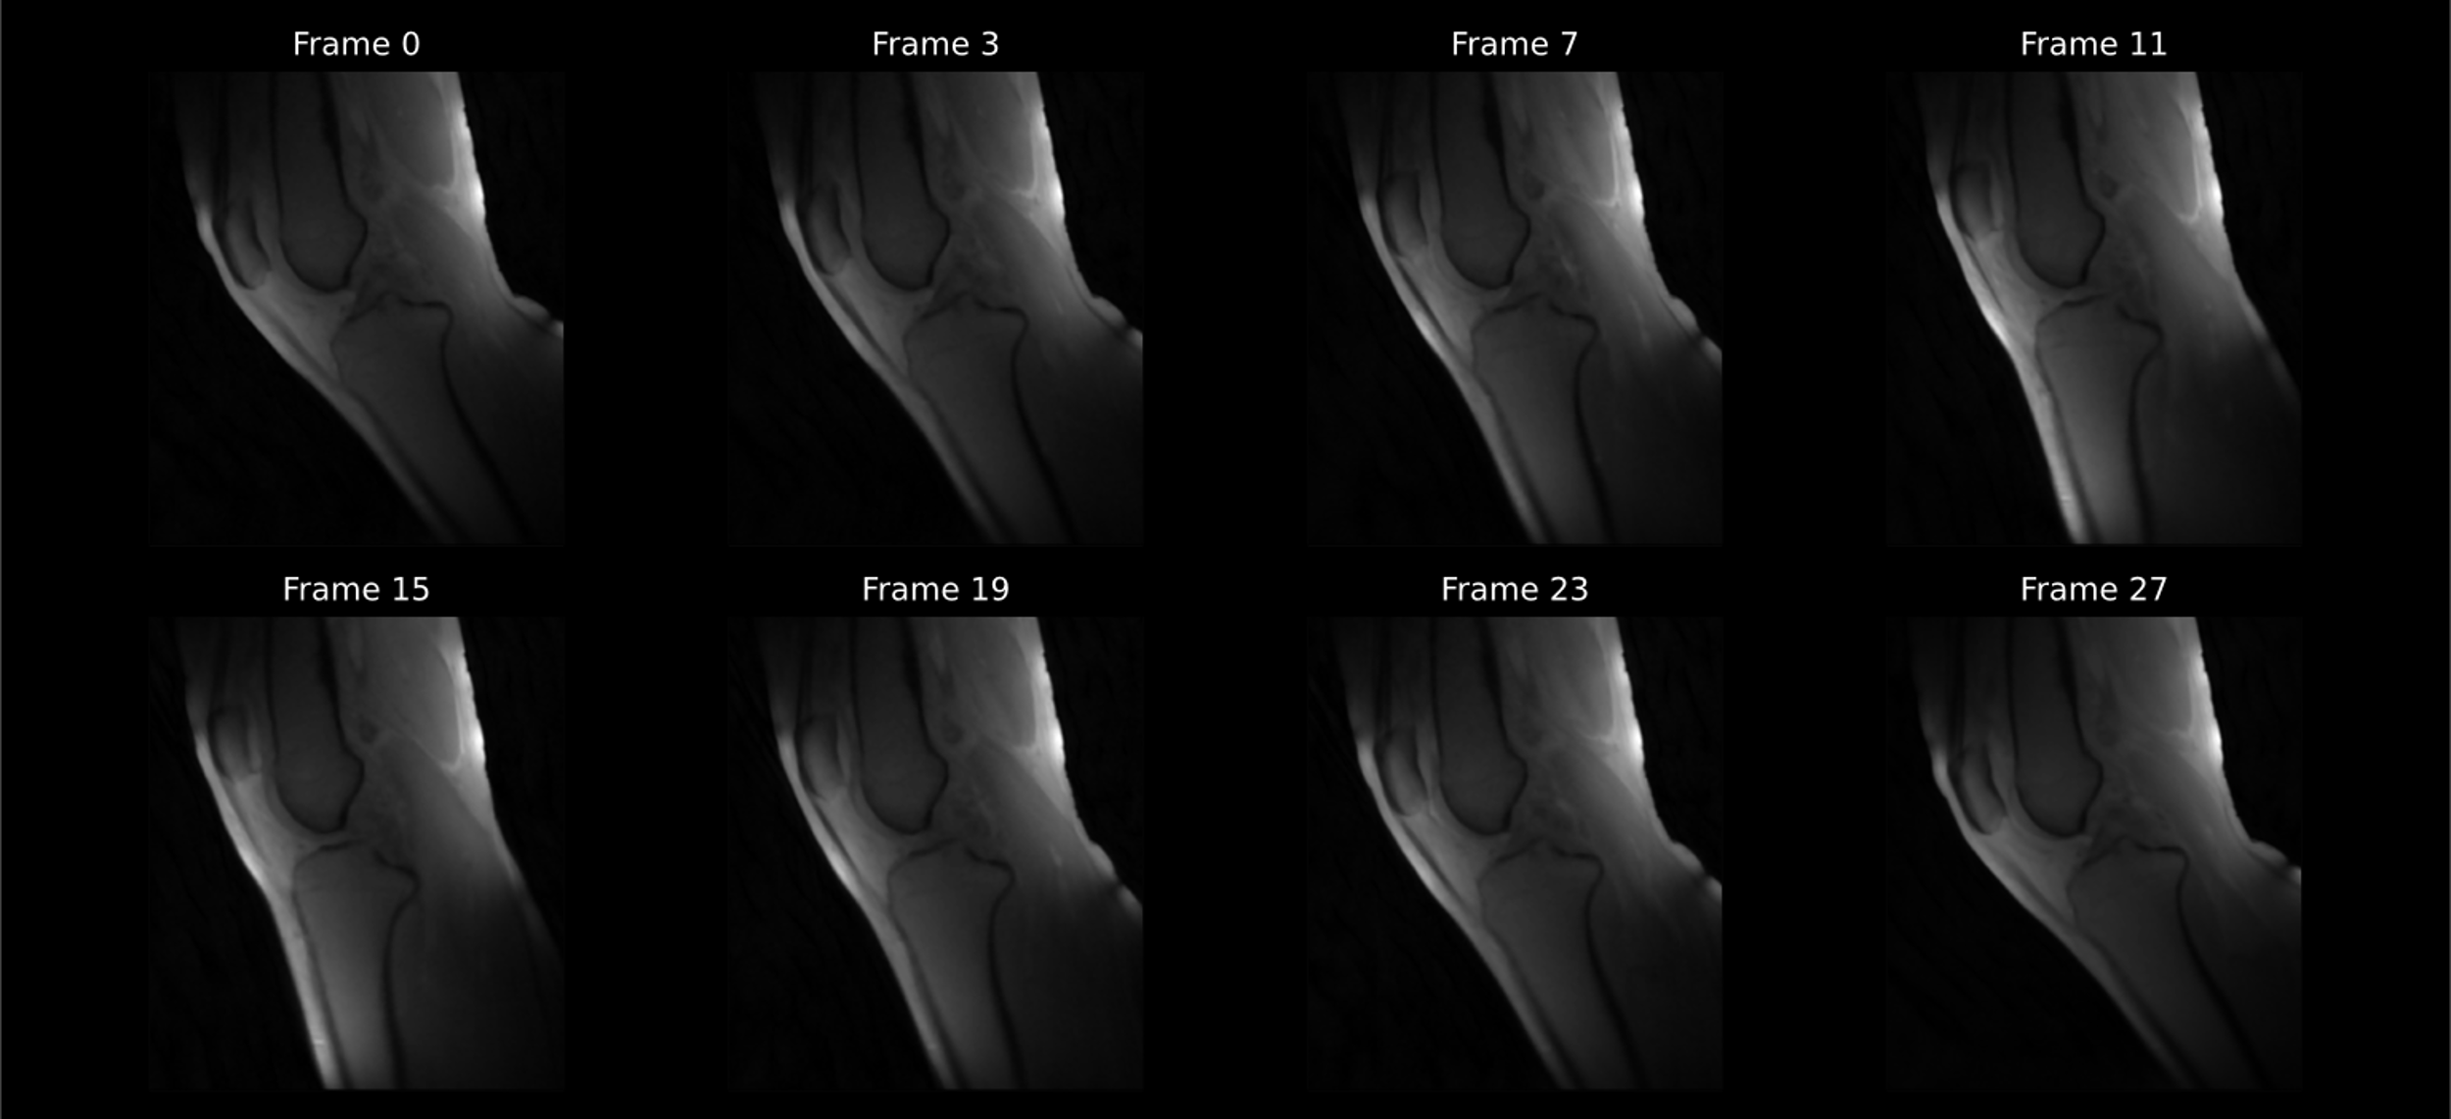
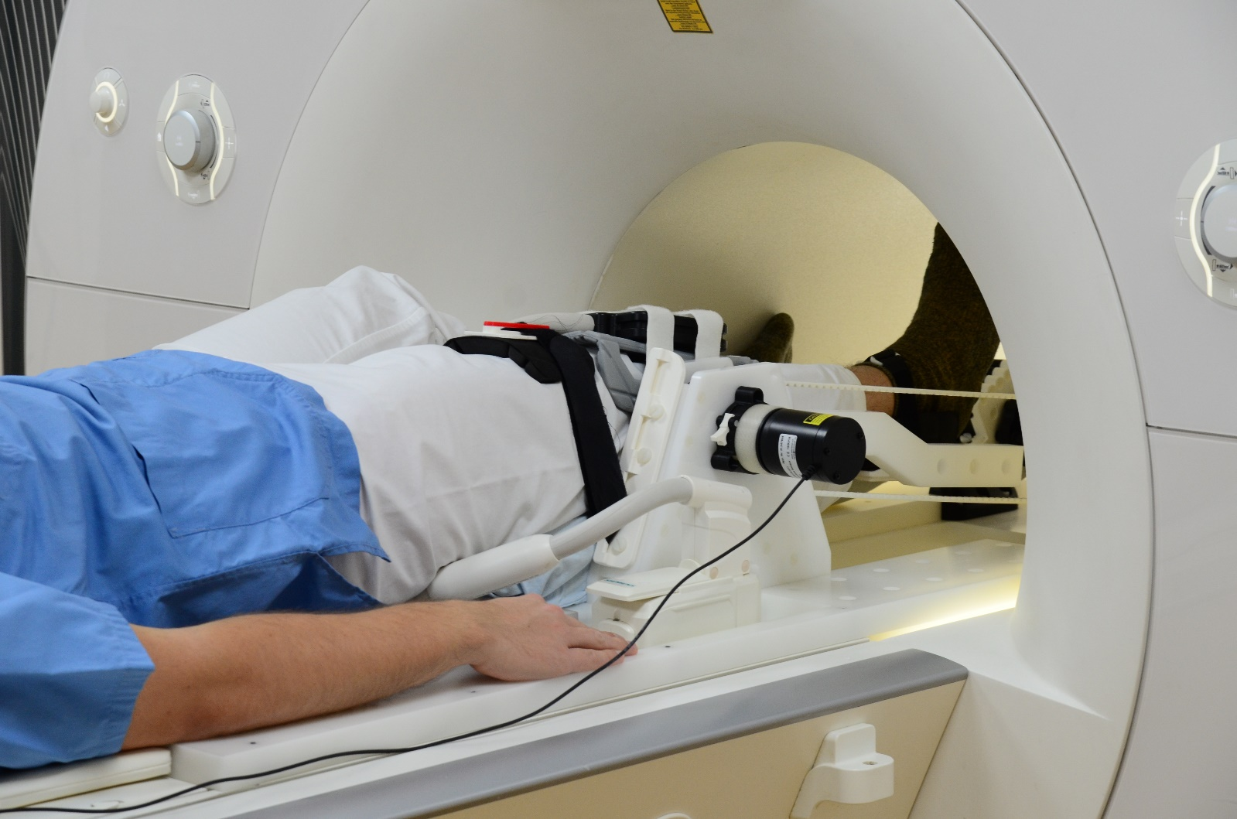
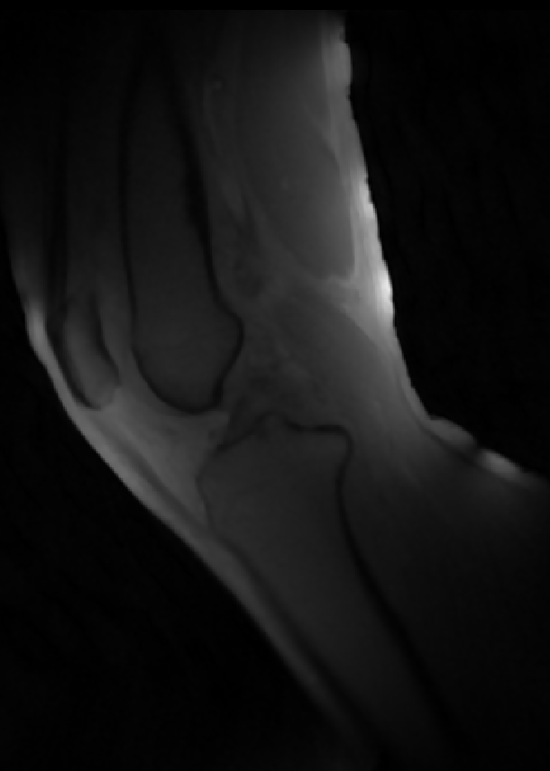
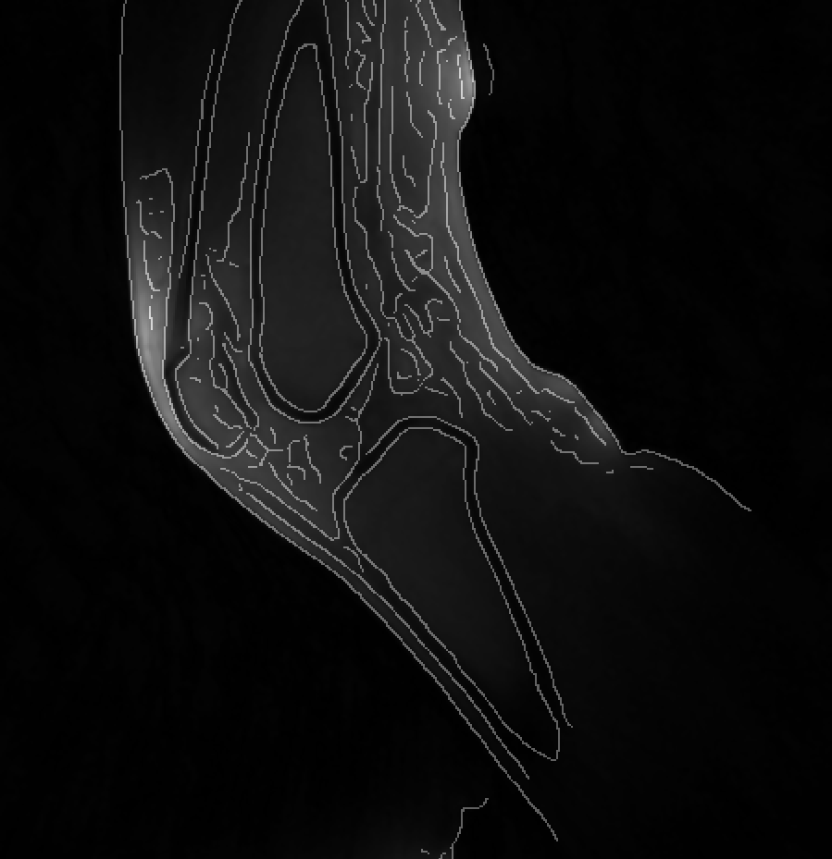
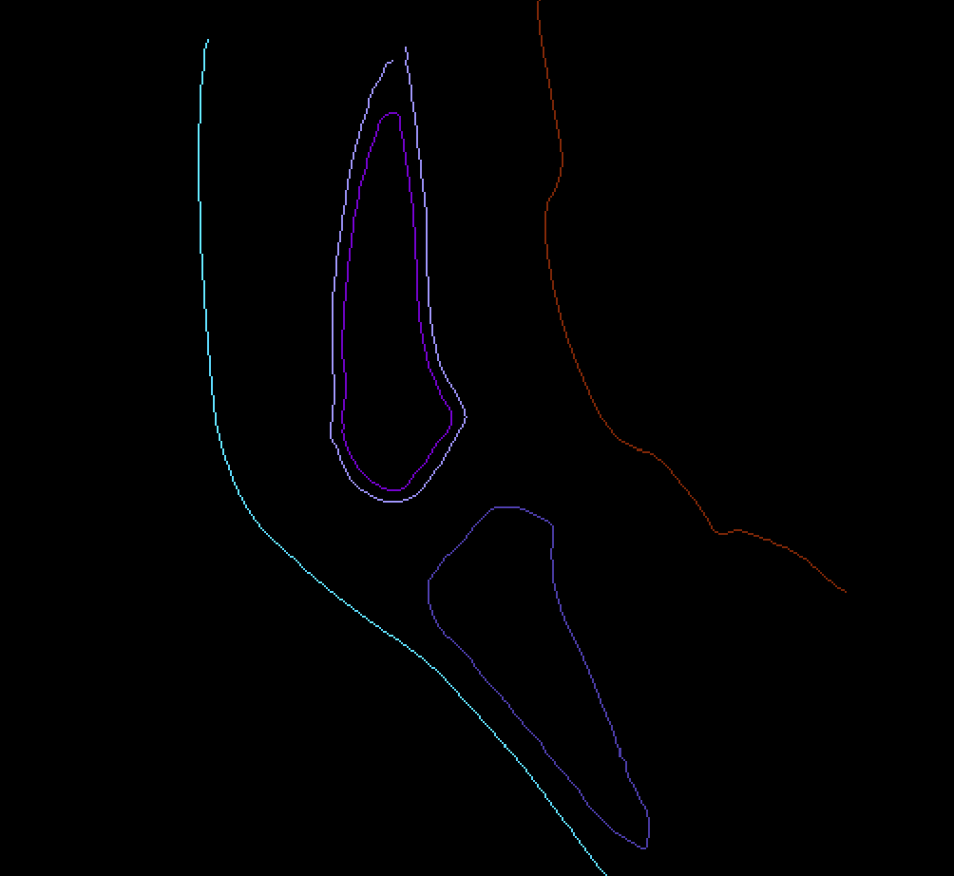
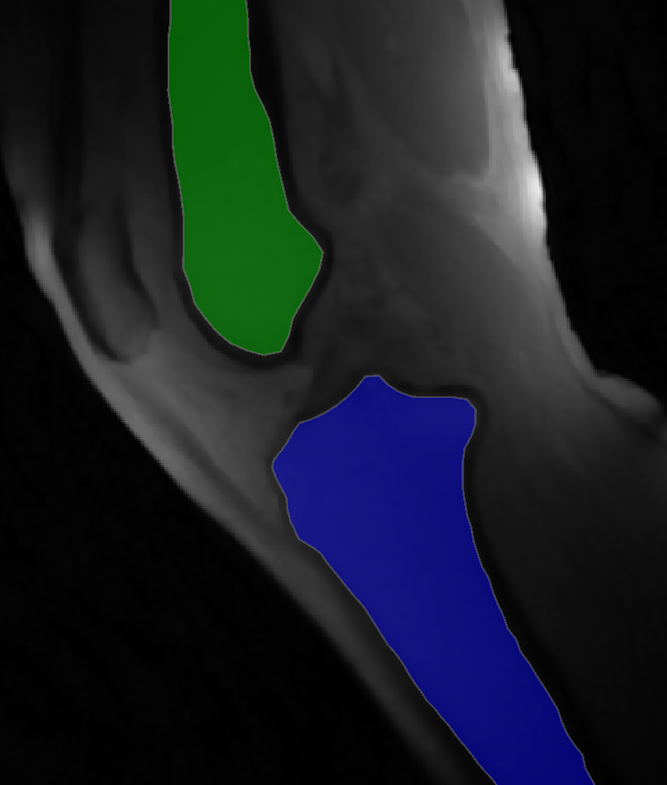
Development of a Semi-Automated Segmentation Pipeline for Dynamic MRI Analysis of Knee Joint Kinematics
Aayush Nepal¹, Nicholas M. Brisson^{2,3}, Georg N. Duda^{2,3},
Jürgen R. Reichenbach¹ and Martin Krämer¹
¹Medical Physics Group, Institute of Diagnostic und Interventional Radiology, Jena University Hospital, Friedrich Schiller University Jena
²Julius Wolff Institute, Berlin Institute of Health at Charité, Universitätsmedizin Berlin
³Berlin Movement Diagnostics (BeMoveD), Center for Musculoskeletal Surgery Charité, Universitätsmedizin Berlin
Synopsis
Accurate segmentation of the tibia and femur from dynamic MRI scans during knee flexion-extension can provide detailed insights into joint kinematics. Developing a semi-automated segmentation pipeline enables a streamlined approach to tibiofemoral kinematic analysis, offering potential advancements in clinical and research applications.
Introduction
This study utilizes a novel MRI-compatible device designed to facilitate controlled, repetitive knee flexion-extension cycles. Equipped with an optical sensor to synchronize motion data, the device enables the precise reconstruction of CINE MRI images that capture the knee during these movements, as illustrated in Fig. 1. Traditional kinematic analyses often rely on manually segmenting
each frame to track the tibia and
femur—processes that are not
only labor-intensive but also
prone to inaccuracies. To
address these challenges,
we developed a semi-automated
segmentation pipeline that
segments the tibia and femur
across the motion cycle with
minimal manual Intervention.
Fig. 1: CINE MRI of Knee Joint During Flexion-Extension Cycle
This figure displays selected frames from one reconstructed dataset of a CINE MRI sequence of the knee undergoing cyclic flexion and extension. The frames capture snapshots of the knee starting in flexion (Frame 0), reaching full extension (Frame 15), and returning to flexion (Frame 27). This dataset serves as a representative example of the image data used in the project, which was collected across multiple subjects.
1
placeholder
2
placeholder
3
placeholder
4
placeholder
Methods
Results and Discussion
References
1. Brisson NM, Krämer M, Reichenbach JR, Duda GN. A Device for Guide Knee Motion and Loading during Dynamic Magnetic Resonance Imaging: A Novel Device. Osteoarthritis and Cartilage 2021, Volume 29, S350 - S351
2. Brisson NM, Krämer M, Krahl LA, Schill A, Duda GN, Reichenbach JR. A novel device for guided knee motion and loading during dynamic magnetic resonance imaging. Z Med Phys 2021, under revision (ZMEDPHYS-D-21-00086)

