Slide 1
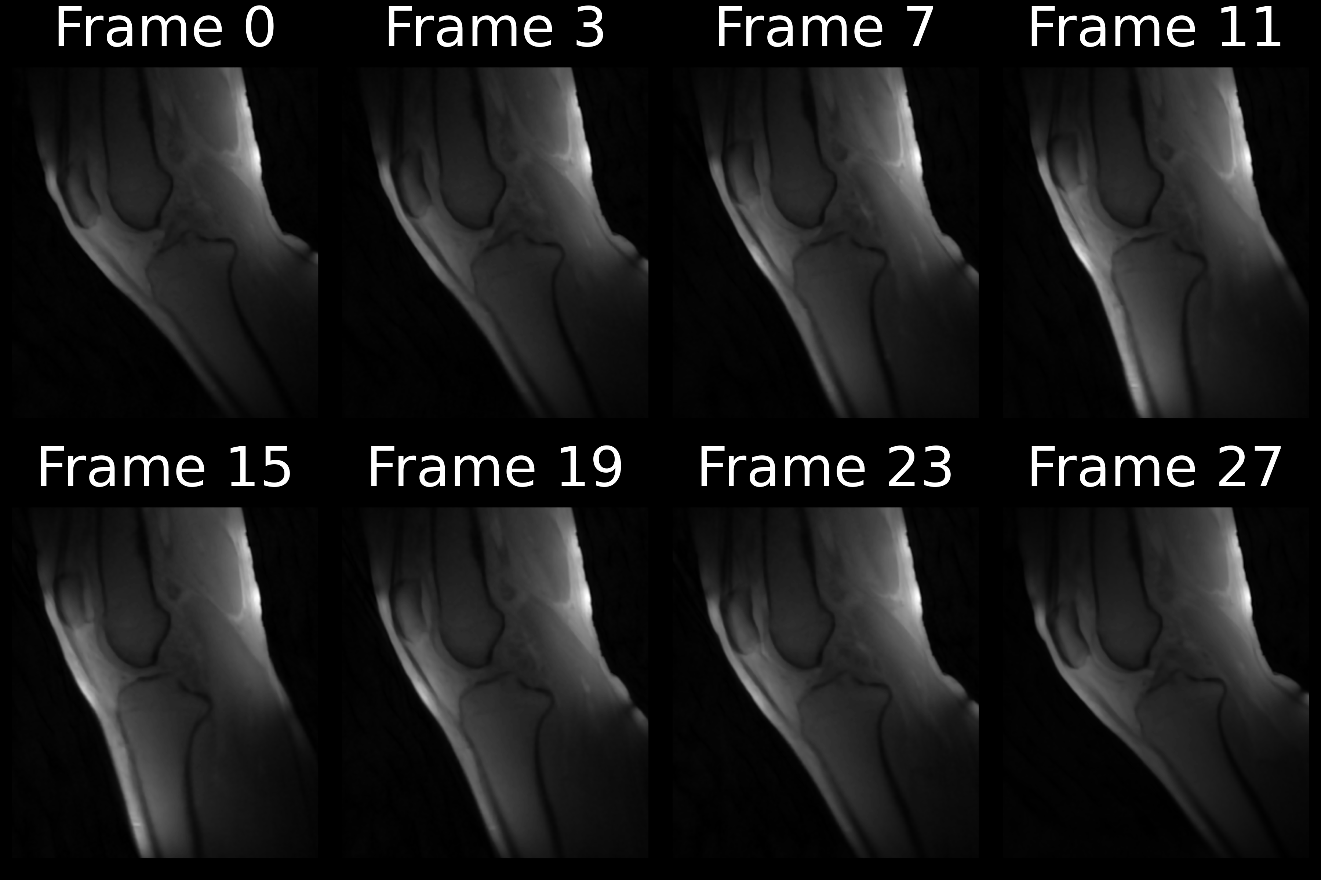
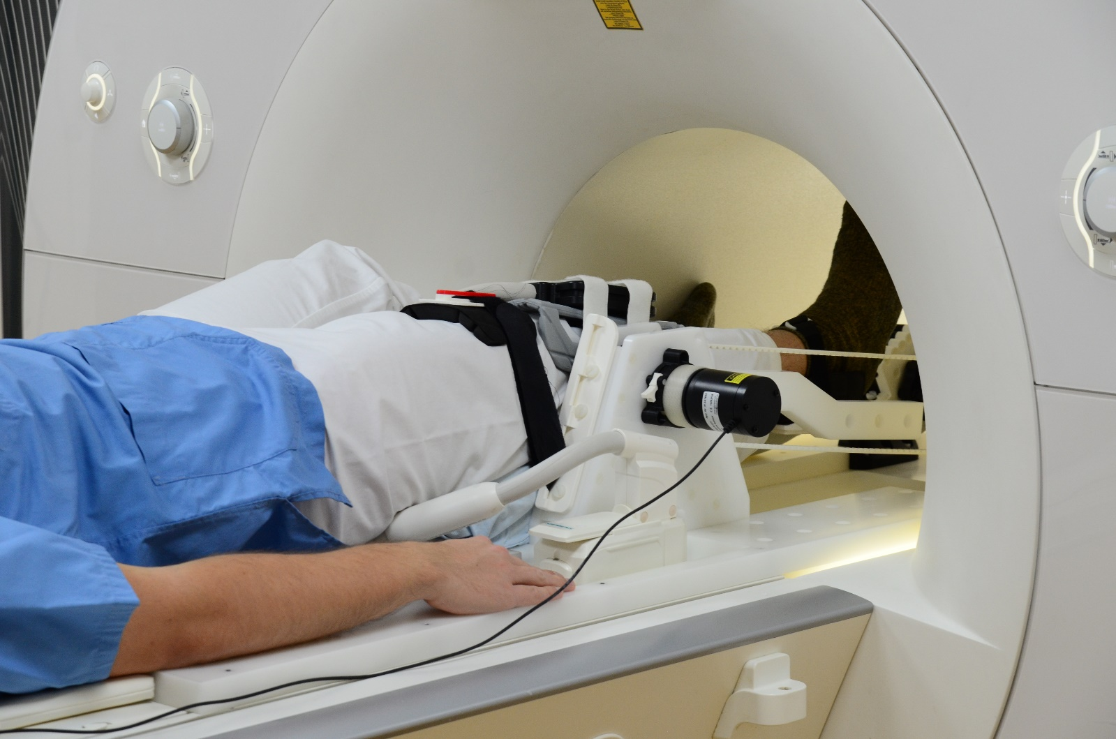
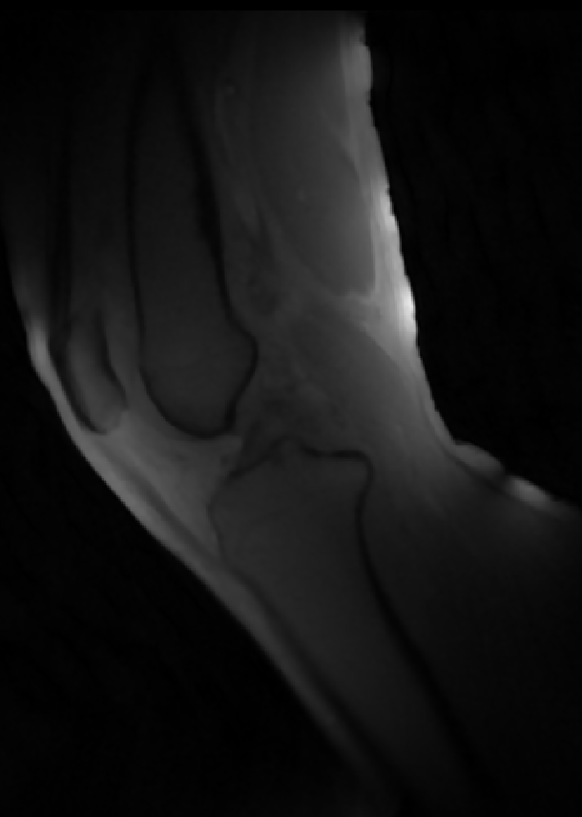
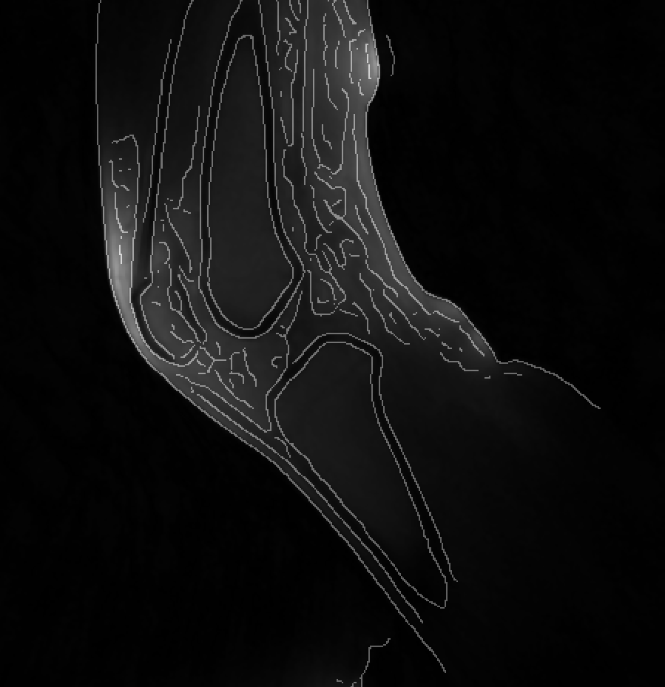
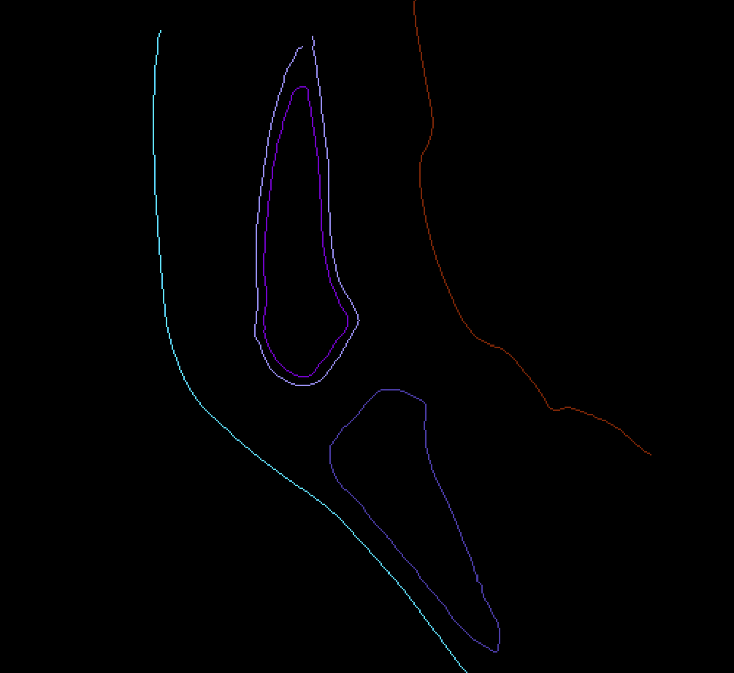
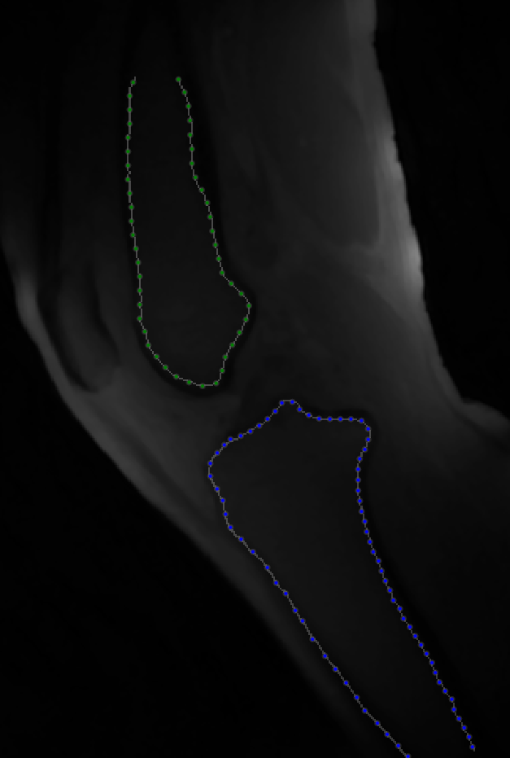
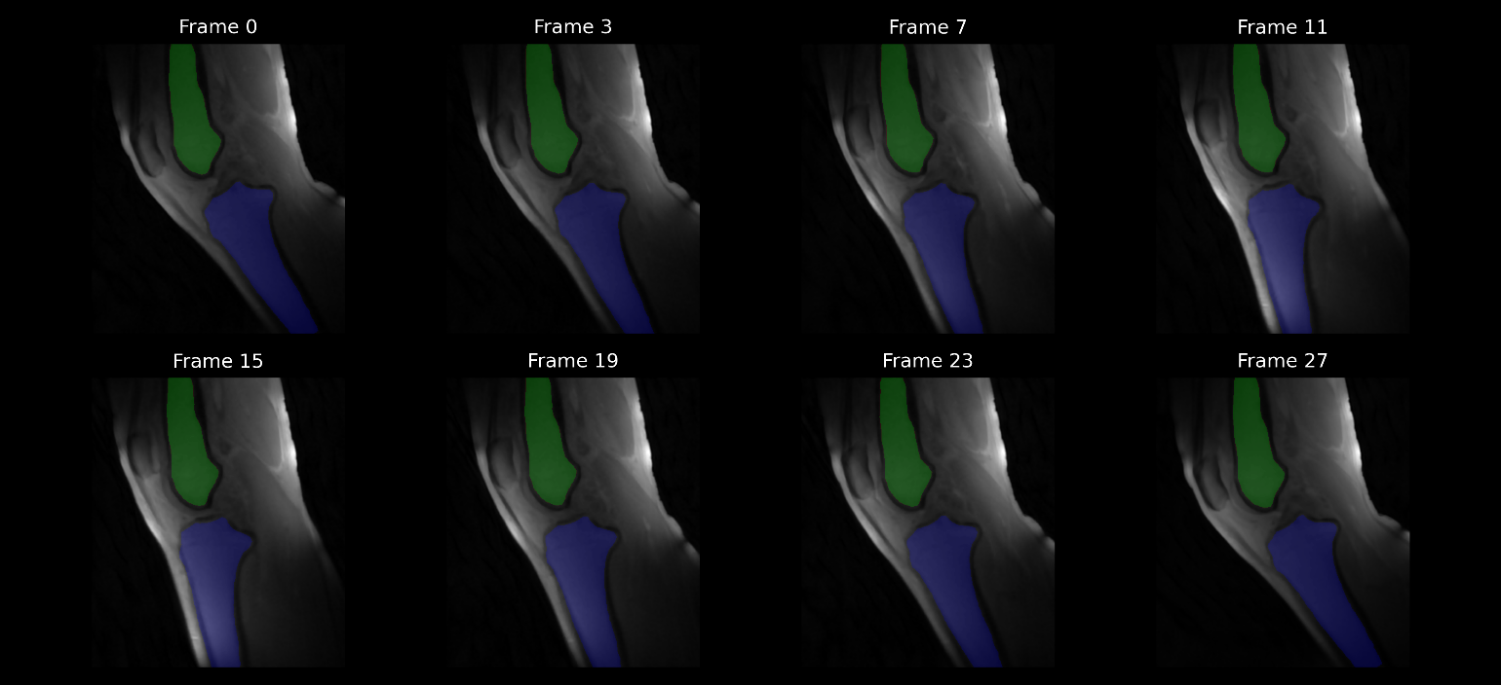
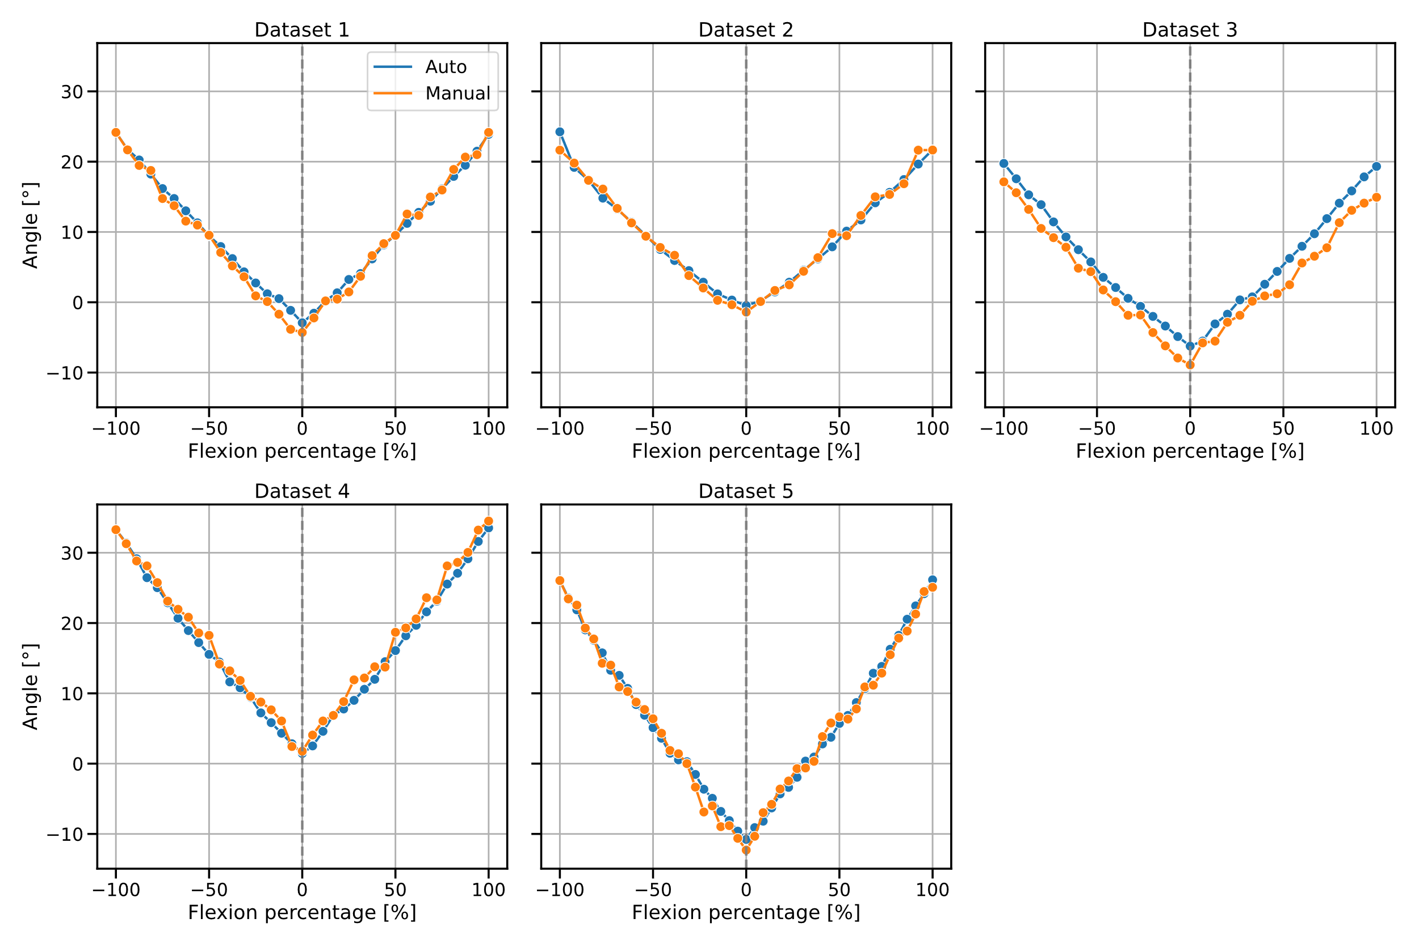
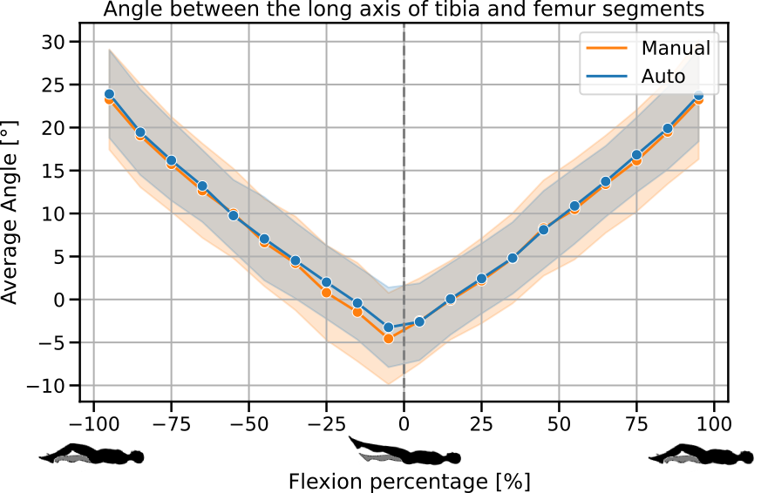
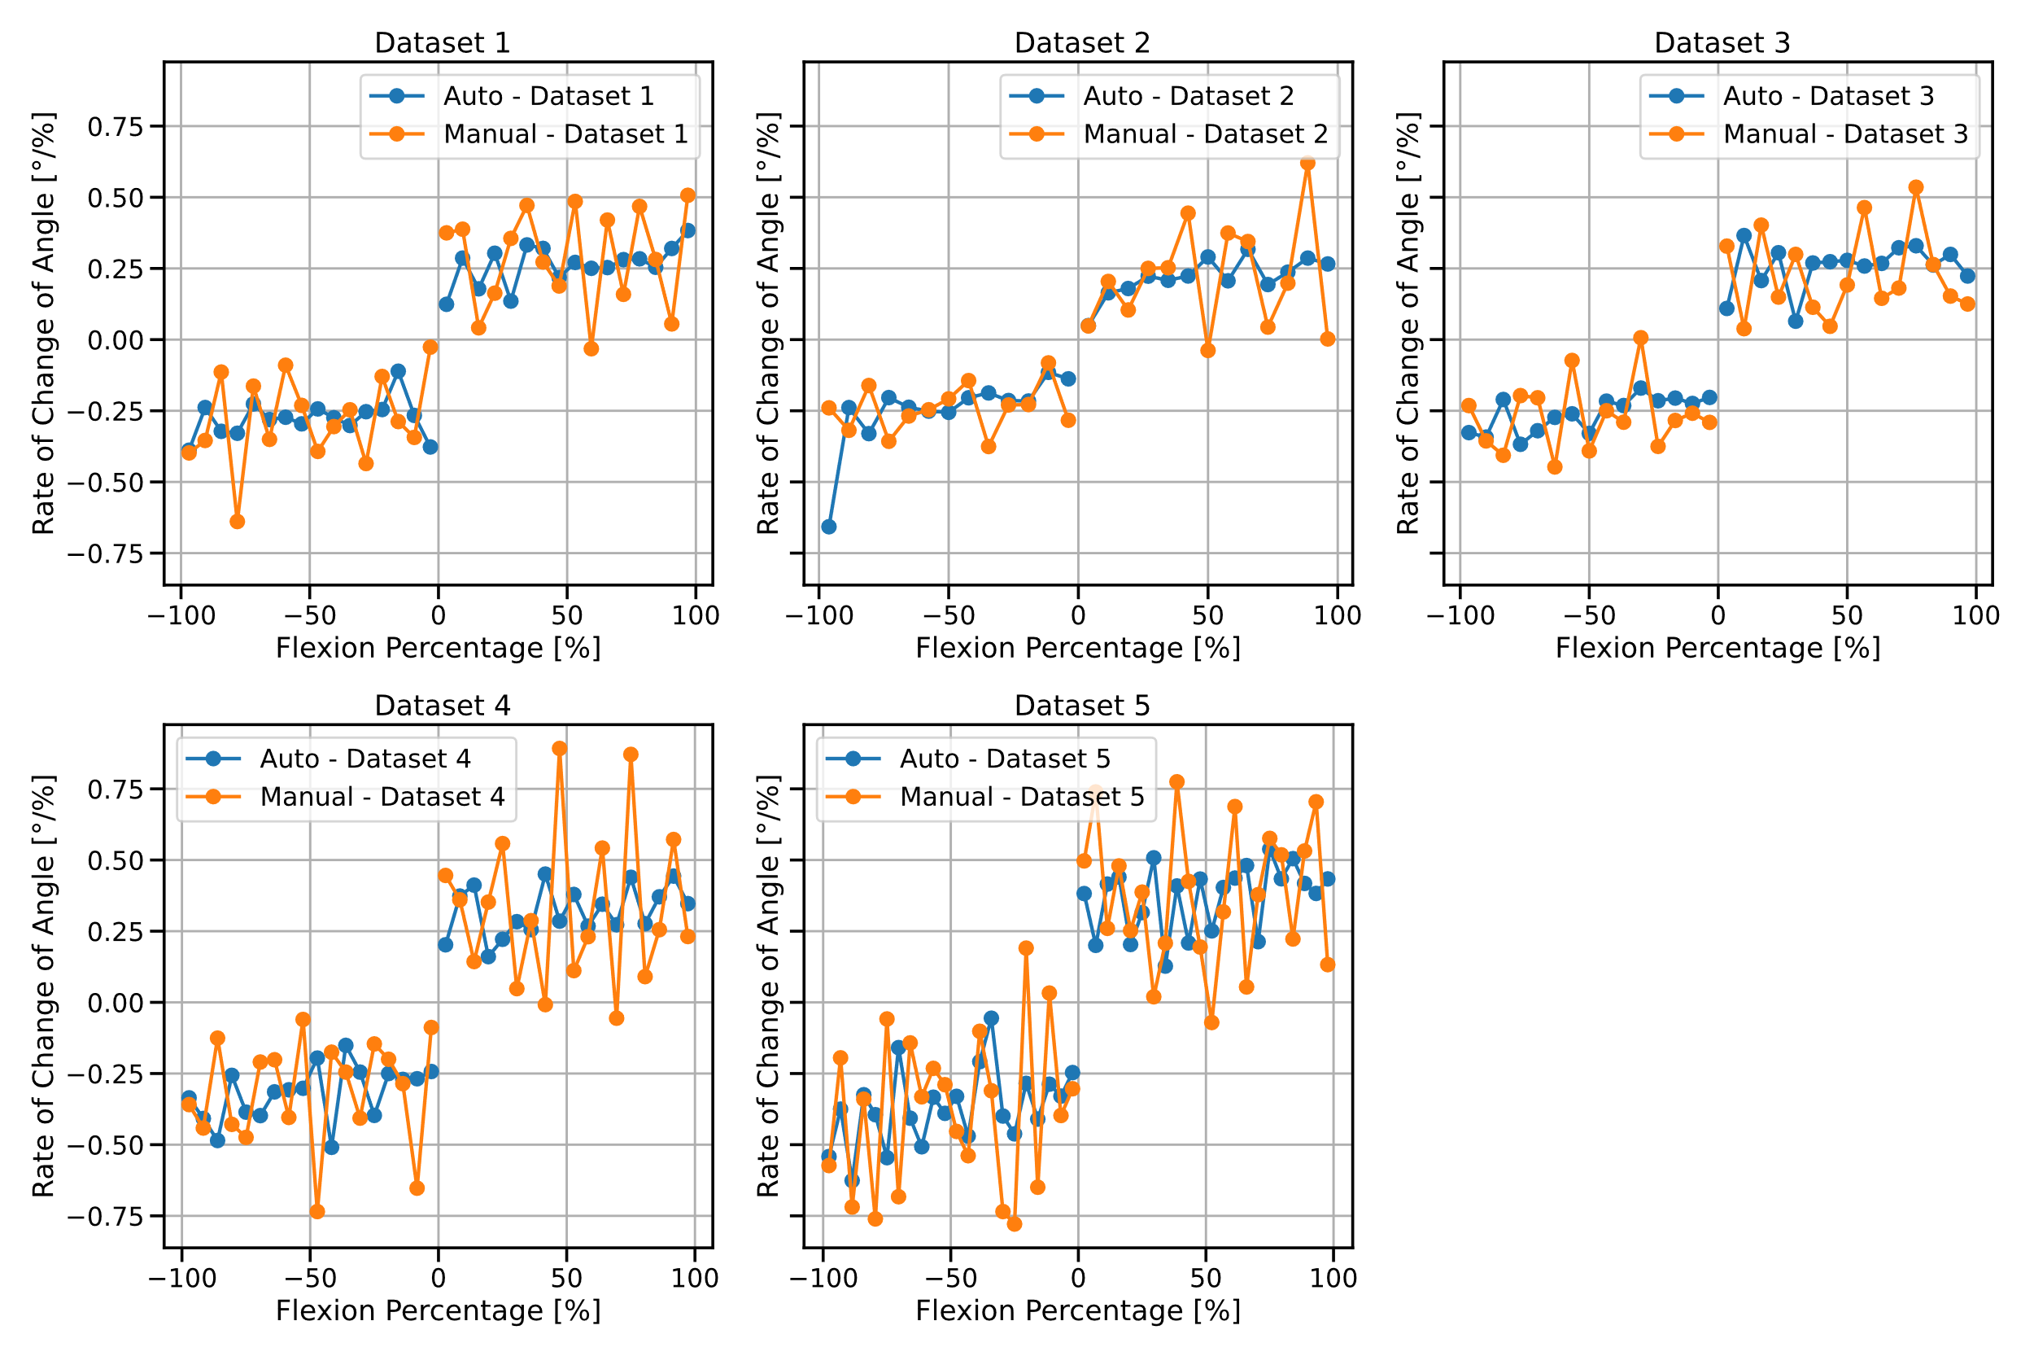
Development of a Semi-Automated Segmentation Pipeline for Dynamic MRI Analysis of Knee Joint Kinematics
Aayush Nepal¹, Nicholas M. Brisson^{2,3}, Georg N. Duda^{2,3},
Jürgen R. Reichenbach¹ and Martin Krämer¹
¹Medical Physics Group, Institute of Diagnostic und Interventional Radiology, Jena University Hospital, Friedrich Schiller University Jena
²Julius Wolff Institute, Berlin Institute of Health at Charité, Universitätsmedizin Berlin
³Berlin Movement Diagnostics (BeMoveD), Center for Musculoskeletal Surgery Charité, Universitätsmedizin Berlin
Synopsis
Accurate segmentation of the tibia and femur from dynamic MRI scans during knee flexion-extension can provide detailed insights into joint kinematics. Developing a semi-automated segmentation pipeline enables a streamlined approach to tibiofemoral kinematic analysis, offering potential advancements in clinical and research applications.
Introduction
This study utilizes a novel MRI-compatible device designed to facilitate controlled, repetitive knee flexion-extension cycles [1,2]. Equipped with an optical sensor to synchronize motion data, the device enables the precise reconstruction of CINE MRI images that capture the knee during these movements, as illustrated in Fig. 1. Traditional kinematic analyses often rely on manually segmenting
each frame to track the tibia
and femur which can be prone
to inaccuracies. To address
these challenges, we developed
a semi-automated segmentation
pipeline that segments the tibia
and femur across the motion
cycle with minimal manual
intervention.
Fig. 1: CINE MRI of Knee Joint During Flexion-Extension Cycle
Selected frames from one reconstructed dataset of a CINE MRI sequence of the knee undergoing cyclic flexion (Frame 0 and 27) and extension (Frame 15). This dataset serves as a representative example of the image data used in the project, which was collected across multiple subjects.
Step I
Step II
Step III
Step IV
Single frame of CINE data
Canny Edge Detection
Connected component labelling
Establishment of reference points
Application of transformation
Methods
Volunteers underwent scans of the left leg as they actively completed repetitive, open chain knee flexion-extension cycles to the beat of a metronome (6 cycles/min), using a special MRI safe device for guided knee motion [1,2]. MRI was captured using a 2D radial golden angle gradient echo FLASH sequence. Cine images were reconstructed, with each frame representing a 2° interval of knee motion using iterative non-Cartesian reconstruction techniques. The semi-automated segmentation process was executed in five main steps: (I) Canny edge detection on the first frame to identify edges of the tibia and femur; (II) connected-component labeling technique to select edges of the interior boundary of the cortical bone; (III) key reference points were established on the binary edge outputs, facilitating frame-to-frame transformations using greedy nearest neighbor sorting and cubic spline interpolation; (IV) transformation of the bone edges from one frame to the next were determined through cost function optimization that minimized the alignment error between subsequent frames. The transformation matrices were then applied to manual segmentations of the tibia and femur segments from the first frame.
Fig. 2 a)
Fig. 2 c)
Fig. 2: Angle measurements between the long axes of the tibia and femur segments across five datasets (a), derivative across time of the obtained angle (b) and average angle between the tibia and femur segments across all five datasets (c). Each subplot compares the "Manual" (orange) and "Auto" (blue) methods, showing the relationship between flexion percentage and angle. The shaded areas in (c) represent the standard deviation, with the manual method showing a higher variance, particularly at the high extension, highlighting the greater consistency and stability of the automatic method.
Results and Discussion
The tibia and femur were segmented twice: once using the semi-automatic pipeline described in the Methods section, and once manually. Using these segmented models, the angle between the tibia and femur was measured and compared across both methods, as shown in Fig. 2. The results clearly indicate that the semi-automatic segmentation outperformed the manual method, taking significantly less time and yielding more stable angle measurements. This is particularly important given the expectation of smooth leg motion. The automatic method better reflects this smooth motion, with fewer fluctuations in angular speed, whereas the manual method introduced greater variability.
Fig. 2 b)
References
1. Brisson NM, Krämer M, Reichenbach JR, Duda GN. A Device for Guide Knee Motion and Loading during Dynamic Magnetic Resonance Imaging: A Novel Device. Osteoarthritis and Cartilage 2021, Volume 29, S350 - S351
2. Brisson NM, Krämer M, Krahl LA, Schill A, Duda GN, Reichenbach JR. A novel device for guided knee motion and loading during dynamic magnetic resonance imaging. Z Med Phys 2021, under revision (ZMEDPHYS-D-21-00086)

