Slide 1

Hey!!
I am Swornim

Slide 2

Pipeline Optimization and Caching

Slide 3

Before Talking about Optimization.
Let’s look at the life cycle of a client requesting resources from a webserver.

Slide 4

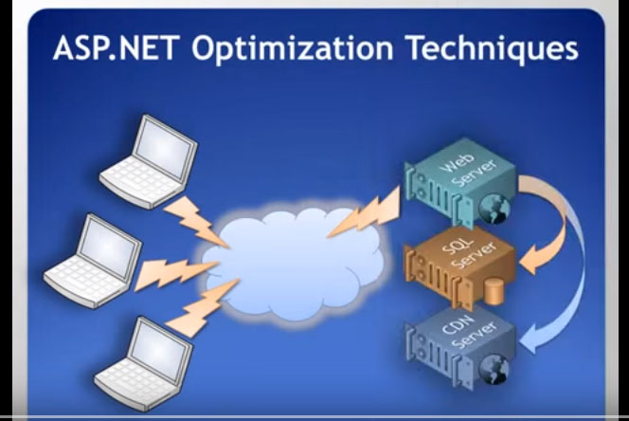

Slide 5

A client requests a page from the webserver.
The server then gathers resources and supplies it to the client.
The page that is sent to the client requires resources from the web server.
If not stored locally the webpage makes round trips to the web server to get resources.

Slide 6

Optimization
To make something work at its best or using something to its best advantage.
In terms of ASP.NET optimization it mans to make the Request/Response time speedy.

Slide 7
Client Side
Script Management
UI Scripting
Ajax
Browser Cache
Cookies
Graphics
Client Side
Scale Up
Scale Out
Configuration
Caching
State Management

Slide 8

How is it done ?
There are several http modules that sit in the request pipeline and intercept every request.
Example: Session State, Forms Authentication, Windows Authentication
They intercept each requests.
They stay in pipeline and execute unnecessary code for each and every request.

Slide 9
Default Modules
<httpModules>
<add name="OutputCache" type="System.Web.Caching.OutputCacheModule" />
<add name="Session" type="System.Web.SessionState.SessionStateModule" />
<add name="WindowsAuthentication" type="System.Web.Security.WindowsAuthenticationModule" />
<add name="FormsAuthentication" type="System.Web.Security.FormsAuthenticationModule" />
<add name="PassportAuthentication" type="System.Web.Security.PassportAuthenticationModule" />
<add name="UrlAuthorization" type="System.Web.Security.UrlAuthorizationModule" />
<add name="FileAuthorization" type="System.Web.Security.FileAuthorizationModule" />
<add name="ErrorHandlerModule" type="System.Web.Mobile.ErrorHandlerModule, System.Web.Mobile, Version=1.0.5000.0, Culture=neutral, PublicKeyToken=b03f5f7f11d50a3a" />
</httpModules>

Slide 10
We can remove these modules by adding <remove> nodes in our sites web.config
<httpModules>
<!--<span class="code-comment"> Remove unnecessary Http Modules for faster pipeline --></span>
<remove name="Session" />
<remove name="WindowsAuthentication" />
<remove name="PassportAuthentication" />
<remove name="AnonymousIdentification" />
<remove name="UrlAuthorization" />
<remove name="FileAuthorization" />
</httpModules>

Slide 11

Which is an easy process of Pipeline Optimization

Slide 12

Any Questions ?
Download: https://goo.gl/t70QVT
View: https://goo.gl/lpFBFY

Slide 13
Credits
Special thanks to
Mr Suneel Chaudhary
Presentation template by SlidesCarnival
www.codeproject.com

