Slide 1
TCSS-554 (IR & Search)
Slides from Jure Leskovec and Prabhakar Raghavan

Slide 2
Outline
Announcements:
Homework 1 due this Thursday
Homework 2 out on Thursday
Link Analysis
Pagerank
Flow Model
Matrix Formulation
Random Surfer Model (Brin-Page, 98)
Topic Specific PageRank

Slide 3
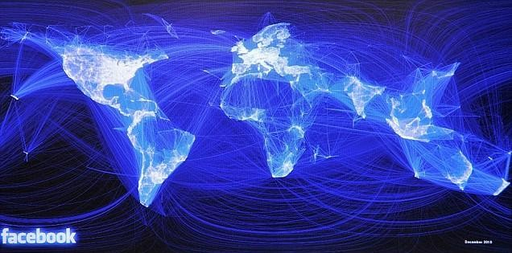
Facebook social graph
4-degrees of separation [Backstrom-Boldi-Rosa-Ugander-Vigna, 2011]

Slide 4
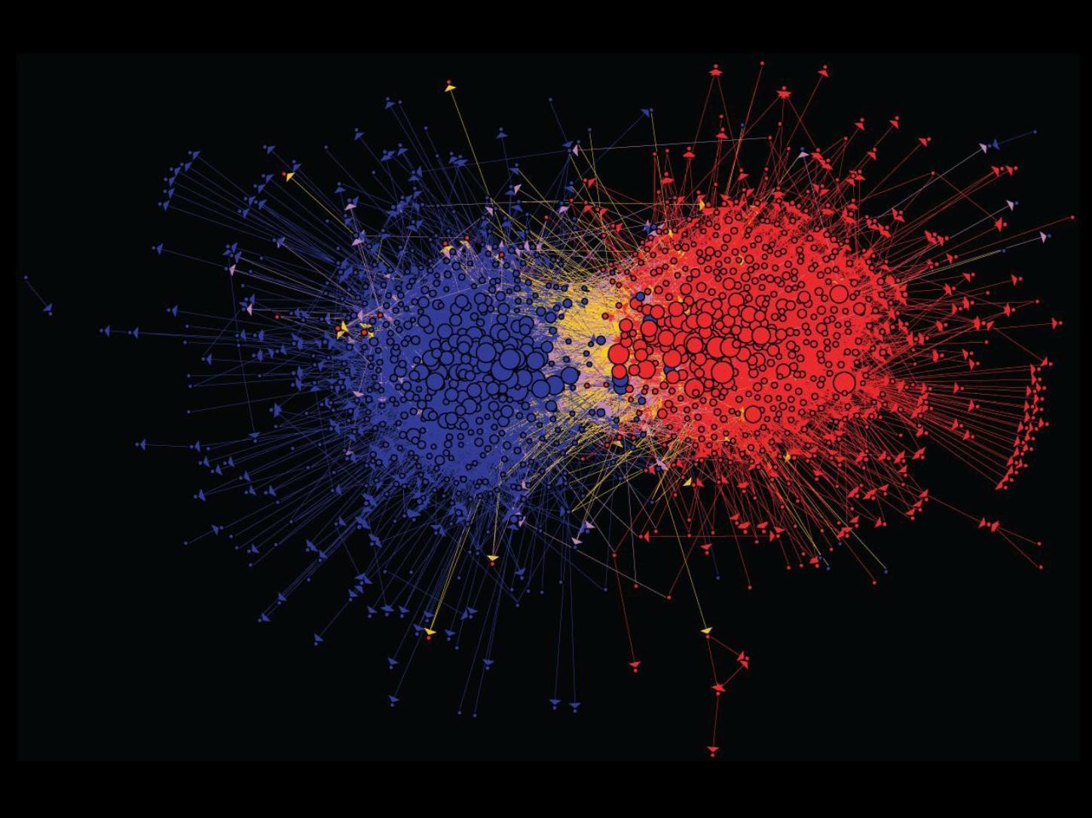
Connections between political blogs
Polarization of the network [Adamic-Glance, 2005]

Slide 5
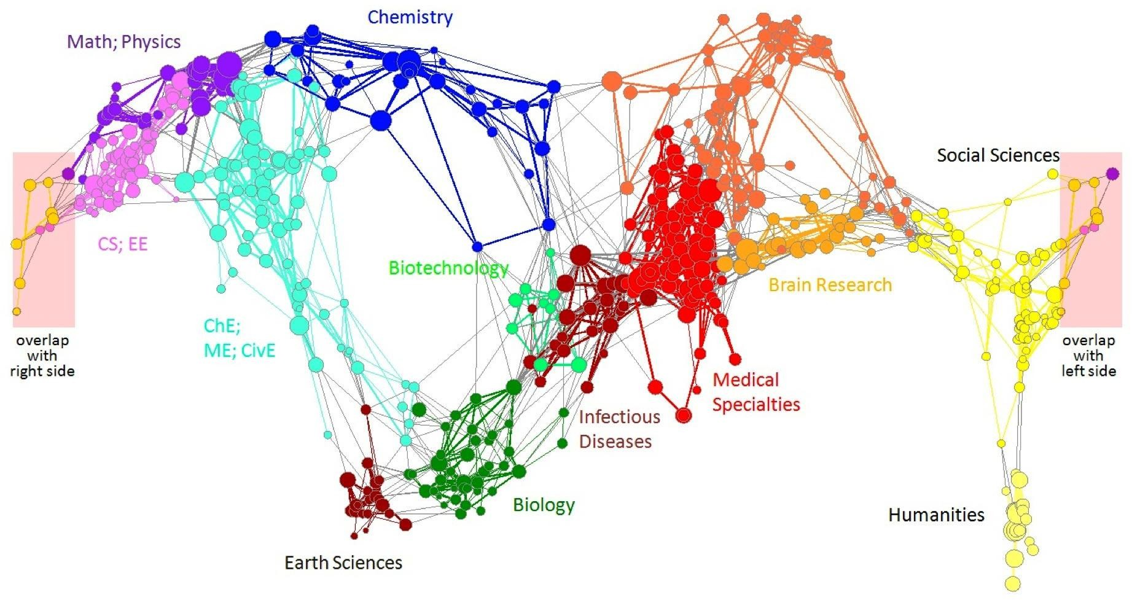
Citation networks and Maps of science
[Börner et al., 2012]

Slide 6






























domain2
domain1
router
domain3
Internet

Slide 7
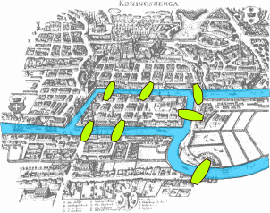
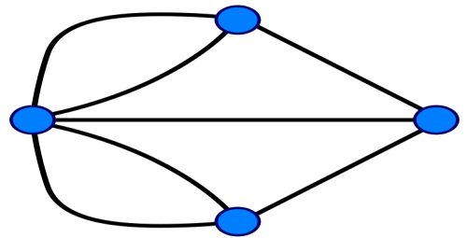
Seven Bridges of Königsberg
[Euler, 1735]
Return to the starting point by traveling each link of the graph once and only once.

Slide 8













Web as a directed graph:
Nodes: Webpages
Edges: Hyperlinks
I teach a class on Networks.
CS224W:
Classes are in the Joy building
Computer Science Department at UW
University
Of Washington

Slide 9
Web as a directed graph:
Nodes: Webpages
Edges: Hyperlinks
I teach a class on Networks.
CS224W:
Classes are in the
Joy building
Computer Science Department at UW
University
Of
Washington

Slide 10
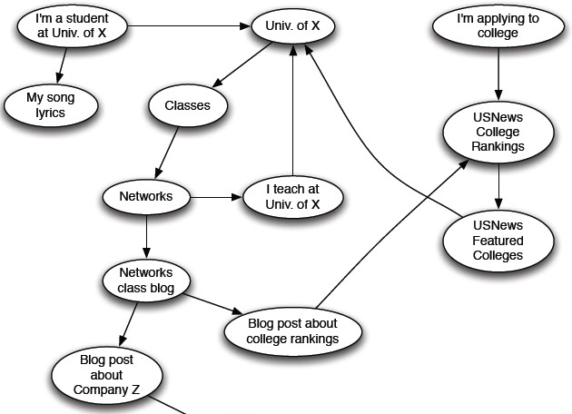

Slide 11


How to organize the Web?
First try: Human curated
Web directories
Yahoo, DMOZ, LookSmart
Second try: Web Search
Information Retrieval investigates:
Find relevant docs in a small and trusted set
Newspaper articles, Patents, etc.
But: Web is huge, full of untrusted documents, random things, web spam, etc.

Slide 12
2 challenges of web search:
(1) Web contains many sources of information Who to “trust”?
Trick: Trustworthy pages may point to each other!
(2) What is the “best” answer to query “newspaper”?
No single right answer
Trick: Pages that actually know about newspapers might all be pointing to many newspapers

Slide 13

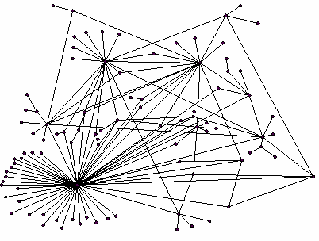

All web pages are not equally “important”
www.joe-schmoe.com vs. www.washington.edu
There is large diversity in the web-graph node connectivity.
Let’s rank the pages by the link structure!

Slide 14

Idea: Links as votes
Page is more important if it has more links
In-coming links? Out-going links?
Think of in-links as votes:
www.washington.edu has 32,470,672 in-links
www.joe-schmoe.com has 1 in-link
Are all in-links are equal?
Links from important pages count more
Recursive question!

Slide 15
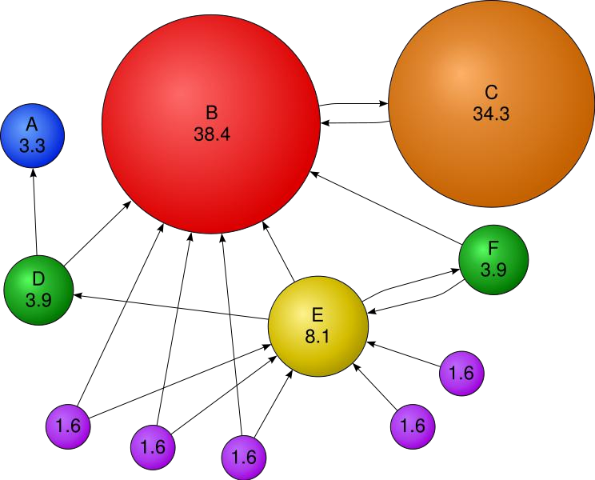

Slide 16






























Each link’s vote is proportional to the
importance of its source page
If page j with importance r_{j} has n out-links, each link gets r_{j} / n votes
Page j’s own importance is the sum of the
votes on its in-links
i
k
r_{k}/4
r_{i}/3
j
r_{j}/3
r /3
r_{j} = r_{i}/3+r_{k}/4
j
r_{j}/3

Slide 17
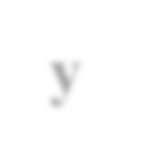

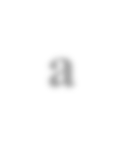

A “vote” from an important page is worth more
A page is important if it is pointed to by other important pages
Define a “rank” r_{j} for page j
The web in 1839
y/2
y
a/2
y/2
r
m
∑
a
m
r =
i
a/2
j
i→ j ^{d}i
“Flow” equations:
r_{y} = r_{y} /2 + r_{a} /2
r_{a} = r_{y} /2 + r_{m} r_{m} = r_{a} /2
𝒅_{𝒊} … out-degree of node 𝒊

Slide 18
Flow equations:
r_{y} = r_{y} /2 + r_{a} /2
r_{a} = r_{y} /2 + r_{m} r_{m} = r_{a} /2
3 equations, 3 unknowns, no constants
No unique solution
All solutions equivalent modulo the scale factor
Additional constraint forces uniqueness:
𝒓_{𝒚} + 𝒓_{𝒂} + 𝒓_{𝒎} = 𝟏
₌ 𝟏
Solution: 𝒓_{𝒚} = ^{𝟐} , 𝒓_{𝒂} = ^{𝟐} , 𝒓_{𝒎}
𝟓 𝟓 𝟓
Gaussian elimination method works for small examples, but we need a better method for large web-size graphs
We need a new formulation!

Slide 19
Stochastic adjacency matrix 𝑴
Let page 𝑖 has 𝑑_{𝑖} out-links
₌ 1
If 𝑖 → 𝑗, then 𝑀
else 𝑀 = 0
𝑗𝑖
𝑑_{𝑖}
𝑗𝑖
𝑴 is a column stochastic matrix
Rank vector 𝒓: vector with an entry per page
𝑟_{𝑖} is the importance score of page 𝑖
_{𝑖} 𝑟_{𝑖} = 1
Columns sum to 1
∑
r
r =
∑
i
j
i→ j ^{d}i
The flow equations can be written
𝒓 = 𝑴 ⋅ 𝒓

Slide 20

∑
i→ j
r
Remember the flow equation:
r =
i
j
d
Flow equation in the matrix form
𝑴 ⋅ 𝒓 = 𝒓
i
Suppose page i links to 3 pages, including j
i
j
r_{j}
.
=
r_{i}
1/3
M
.
r
=
r

Slide 21
The flow equations can be written
𝒓 = 𝑴 ∙ 𝒓
So the rank vector r is an eigenvector of the stochastic web matrix M
In fact, its first or principal eigenvector, with corresponding eigenvalue 1
Largest eigenvalue of M is 1 since M is column stochastic
We know r is unit length and each column of M
sums to one, so 𝑴𝒓 ≤ 𝟏
NOTE: x is an eigenvector with the corresponding eigenvalue λ if:
𝑨𝒙 = 𝝀𝒙
We can now efficiently solve for r! The method is called Power iteration

Slide 22




 | y | a | m
y | ½ | ½ | 0
a | ½ | 0 | 1
m | 0 | ½ | 0
y
a
m
r = M∙r
r_{y} = r_{y} /2 + r_{a} /2 r_{a} = r_{y} /2 + r_{m} r_{m} = r_{a} /2
y a m
½ ½ 0
= ½ 0 1
0 ½ 0
y a m

Slide 23
Given a web graph with n nodes, where the nodes are pages and edges are hyperlinks
Power iteration: a simple iterative scheme
Suppose there are N web pages
_{r} (t )
_{= ∑} i
r_{j}
(t +1)
d_{i}
Initialize: r⁽⁰⁾ = [1/N,….,1/N]^{T}
Iterate: r^{(t+1)} = M ∙ r^{(t)}
Stop when |r^{(t+1)} – r^{(t)}|₁ < ε
i→ j
d_{i} …. out-degree of node i

Slide 24




Power Iteration:
Set 𝑟_{𝑗} = 1/N
 | y | a | m
y | ½ | ½ | 0
a | ½ | 0 | 1
m | 0 | ½ | 0
y
∑
a
𝑟_{𝑖}
𝑖→𝑗 _{𝑑𝑖}
m
1: 𝑟′ =
𝑗
2: 𝑟 = 𝑟′
Goto 1
Example:
r_{y} = r_{y} /2 + r_{a} /2 r_{a} = r_{y} /2 + r_{m} r_{m} = r_{a} /2
r_{y}
r_{a} = r_{m}
1/3
1/3
1/3
1/3
3/6
1/6
5/12
1/3
3/12
9/24
11/24
1/6
6/15
… 6/15 3/15
Iteration 0, 1, 2, …

Slide 25
Power Iteration:
Set 𝑟_{𝑗} = 1/N
 | y | a | m
y | ½ | ½ | 0
a | ½ | 0 | 1
m | 0 | ½ | 0
y
∑
a
𝑟_{𝑖}
𝑖→𝑗 _{𝑑𝑖}
m
1: 𝑟′ =
𝑗
2: 𝑟 = 𝑟′
Goto 1
Example:
r_{y} = r_{y} /2 + r_{a} /2 r_{a} = r_{y} /2 + r_{m} r_{m} = r_{a} /2
r_{y} |  | 1/3 | 1/3 | 5/12 | 9/24 |  | 6/15
r_{a} | = | 1/3 | 3/6 | 1/3 | 11/24 | … | 6/15
r_{m} |  | 1/3 | 1/6 | 3/12 | 1/6 |  | 3/15
Iteration 0, 1, 2, …

Slide 26
Imagine a random web surfer:
At any time 𝑡, surfer is on some page 𝑖
At time 𝑡 + 1, the surfer follows an out-link from 𝑖 uniformly at random
Ends up on some page 𝑗 linked from 𝑖
Process repeats indefinitely
Let:
i₁ i₂ i₃
j
r = ∑
r_{i}
j
d (i)
i→ j
out
𝒑(𝒕) … vector whose 𝑖^{th} coordinate is the prob. that the surfer is at page 𝑖 at time 𝑡
So, 𝒑(𝒕) is a probability distribution over pages

Slide 27
Where is the surfer at time t+1?
Follows a link uniformly at random
𝑝 𝑡 + 1 = 𝑀 ⋅ 𝑝(𝑡)
i₁ i₂ i₃
j
p(t +1) = M ⋅ p(t)
Suppose the random walk reaches a state
𝑝 𝑡 + 1 = 𝑀 ⋅ 𝑝(𝑡) = 𝑝(𝑡)
then 𝒑(𝑡) is stationary distribution of a random walk
Our original rank vector 𝒓 satisfies 𝒓 = 𝑴 ⋅ 𝒓
So, 𝒓 is a stationary distribution for the random walk

Slide 28

Google formulation of PageRank
Image Source: http://kachians.blogspot.com/2015/11/open-culture-google-founder-sergey-brin.html

Slide 29
r
(t )
(t +1)
∑ −
i→ j
r_{j} =
r = Mr
or equivalently
d
Does this converge?
Does it converge to what we want?
Are results reasonable?

Slide 30





_{r} (t )
_{= ∑} i
a
b
r_{j}
(t +1)
d_{i}
i→ j
Example:
r_{a}
1 0 1 0
0 1 0 1
=
r_{b}
Iteration 0, 1, 2, …

Slide 31
_{r} (t )
_{= ∑} i
a
b
r_{j}
(t +1)
d_{i}
i→ j
Example:
r_{a}
1 0 0 0
0 1 0 0
=
r_{b}
Iteration 0, 1, 2, …

Slide 32
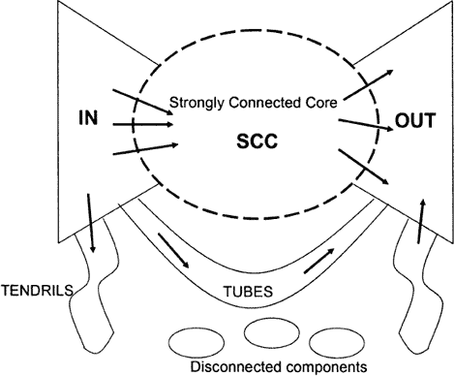

2 problems:
(1) Some pages are
dead ends (have no out-links) Such pages cause importance to “leak out”
(2) Spider traps
(all out-links are within the group)
Eventually spider traps absorb all importance

Slide 33

Power Iteration:
Set 𝑟_{𝑗} = 1
 | y | a | m
y | ½ | ½ | 0
a | ½ | 0 | 0
m | 0 | ½ | 1
y
∑
a
𝑟_{𝑖}
𝑖→𝑗 _{𝑑𝑖}
m
𝑟 =
𝑗
r_{y} = r_{y} /2 + r_{a} /2 r_{a} = r_{y} /2
r_{m} = r_{a} /2 + r_{m}
And iterate
Example:
r_{y} |  | 1/3 | 2/6 | 3/12 | 5/24 |  | 0
r_{a} | = | 1/3 | 1/6 | 2/12 | 3/24 | … | 0
r_{m} |  | 1/3 | 3/6 | 7/12 | 16/24 |  | 1
Iteration 0, 1, 2, …

Slide 34


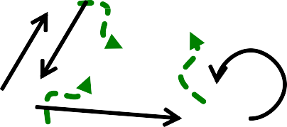




The Google solution for spider traps: At each time step, the random surfer has two options
With prob. β, follow a link at random
With prob. 1-β, jump to some random page
Common values for β are in the range 0.8 to 0.9
Surfer will teleport out of spider trap within a few time steps
y y
a a
m m

Slide 35
Power Iteration:
Set 𝑟_{𝑗} = 1
 | y | a | m
y | ½ | ½ | 0
a | ½ | 0 | 0
m | 0 | ½ | 0
y
∑
a
𝑟_{𝑖}
𝑖→𝑗 _{𝑑𝑖}
m
𝑟 =
𝑗
r_{y} = r_{y} /2 + r_{a} /2 r_{a} = r_{y} /2
r_{m} = r_{a} /2
And iterate
Example:
r_{y} |  | 1/3 | 2/6 | 3/12 | 5/24 |  | 0
r_{a} | = | 1/3 | 1/6 | 2/12 | 3/24 | … | 0
r_{m} |  | 1/3 | 1/6 | 1/12 | 2/24 |  | 0
Iteration 0, 1, 2, …

Slide 36




Teleports: Follow random teleport links with probability 1.0 from dead-ends
Adjust matrix accordingly
y
y
a
m
a
m
 | y | a | m
y | ½ | ½ | 0
a | ½ | 0 | 0
m | 0 | ½ | 0
 | y | a | m
y | ½ | ½ | ⅓
a | ½ | 0 | ⅓
m | 0 | ½ | ⅓

Slide 37
_{r}(t +1) _{= Mr}(t )
Markov chains
Set of states X
Transition matrix P where P_{ij} = P(X_{t}=i | X_{t-1}=j)
π specifying the stationary probability of being at each state x ∈ X
Goal is to find π such that π = P π

Slide 38
Theory of Markov chains
Fact: For any start vector, the power method applied to a Markov transition matrix P will converge to a unique positive stationary vector as long as P is stochastic, irreducible and aperiodic.

Slide 39




Stochastic: Every column sums to 1
A possible solution: Add green links
1
T
a_{i}…=1 if node i has out deg 0, =0 else
e…vector of all 1s
A = M + a (
e)
n
y
 | y | a | m
y | ½ | ½ | 1/3
a | ½ | 0 | 1/3
m | 0 | ½ | 1/3
r = r /2 + r /2 + r /3
y y a
m
r_{a} = r_{y} /2+ r_{m} /3 r_{m} = r_{a} /2 + r_{m} /3
a
m

Slide 40

A chain is periodic if there exists k > 1 such that the interval between two visits to some state s is always a multiple of k.
A possible solution: Add green links
y
a
m

Slide 41
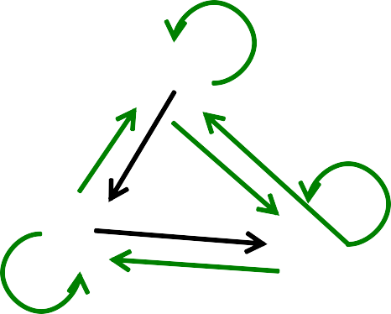
From any state, there is a non-zero probability of going from any one state to any another
A possible solution: Add green links
y
a
m

Slide 42

Google’s solution that does it all:
Makes M stochastic, aperiodic, irreducible
At each step, random surfer has two options:
With probability β, follow a link at random
With probability 1-β, jump to some random page
PageRank equation [Brin-Page, 98]
𝑟_{𝑖} 1
d_{i} … out-degree
of node i
$$Σ$$
𝑟 = 𝛽
+ (1 − 𝛽)
𝑗
𝑑_{𝑖} 𝑛
𝑖→𝑗
This formulation assumes that 𝑴 has no dead ends. We can either preprocess matrix 𝑴 to remove all dead ends or explicitly follow random teleport links with probability 1.0 from dead-ends.

Slide 43


PageRank equation [Brin-Page, 98]
$$Σ$$
𝑟
1
𝑛
𝑟 = 𝛽
𝑖
+ (1 − 𝛽)
𝑗
𝑑_{𝑖}
The Google Matrix A:
𝐴 = 𝛽 𝑀 + (1 − 𝛽)
𝑖→ 𝑗
1
e…vector of all 1s
𝒆 ⋅ 𝒆
𝑇
𝑛
A is stochastic, aperiodic and irreducible, so
_{𝒓}(𝒕+𝟏) _{= 𝑨 ⋅ 𝒓}(𝒕)
What is β ?
In practice β =0.8,0.9 (make 5 steps and jump)

Slide 44


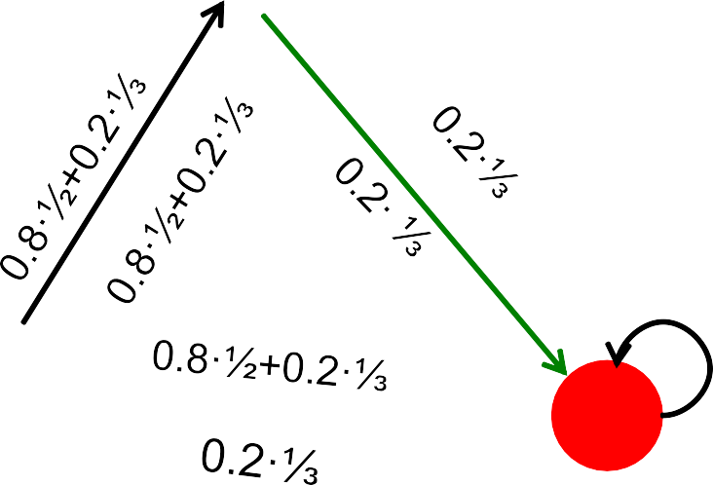




1/n·1·1^{T}
M
0.8·½+0.2·⅓
y
1/2 1/2 0
1/2 0 0
1
1/3 1/3 1/3
1/3 1/3 1/3
1/3 1/3 1/3
0.8
+ 0.2
0 1/2
y | 7/15 | 7/15 | 1/15
a | 7/15 | 1/15 | 1/15
m | 1/15 | 7/15 | 13/15
0.8+0.2·⅓
a
m
A
y
a = m
1/3 | 0.33 | 0.24 | 0.26 |  | 7/33
1/3 | 0.20 | 0.20 | 0.18 | . . . | 5/33
1/3 | 0.46 | 0.52 | 0.56 |  | 21/33

Slide 45
Topic Specific PageRank
Personalization

Slide 46
Can we measure popularity/importance based on topic?
Goal: Measure web pages
not just according to popularity
Relevant (close) they are to a topic (health, sports, arts, etc)
Application:
Personalized search
Solution: Bias the random walk
When the surfer “jumps”, picks a page from specific set S
S contains all documents relevant to the topic

Slide 47
Ranking methods you should know by now
Ranking
Vector Space
Probabilistic
Boolean
Frequency
Tf-IDF
Scaling (Tf) - IDF)
Language Models
LSI
Link Based
Pagerank

Slide 48
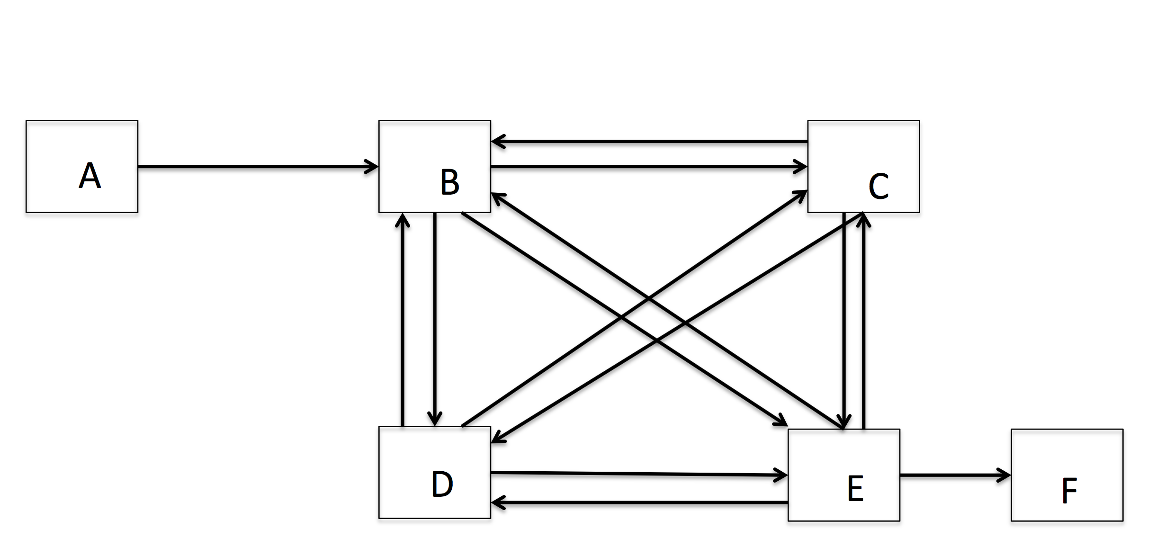
Homework 2

Slide 49
Recap
Link Analysis
PageRank
Flow Model
Matrix Formulation
Random Surfer Model (Brin-Page, 98)
Topic Specific PageRank
Next Class:
Evaluation

