Slide 1
Popular Music Analysis
And Prediction
HOME
TABLE OF CONTENTS
PLAYLIST
01
Motivation & Objective
02
Datasets
03
Analysis
04
Prediction
THANKS!
ECE 143 - Group 15
Notes:
Hello, welcome to the project presentation for Group 15. Our Project is called Popular Music Analysis and Prediction

Slide 2
Table of contents
01
Motivation & Objective
02
Datasets
03
Analysis & Visualization
04
Prediction
Notes:
Our presentation is divided into 4 parts. They are motivation and objective, Datasets, Analysis with Visualization, and Prediction.

Slide 3
Motivation & Objective
Exploratory Analysis
Prediction
Analyze multiple datasets to understand worldwide popular music features.
Utilize existing datasets and predict if music can show up on top rank list
Notes:
We first want to conduct multiple analysis on the ranking datasets to find interesting insights.
Then, with those insights, we use machine learning model to predict whether if a song can achieve high popularity.

Slide 4
Datasets
HOME
TABLE OF CONTENTS
PLAYLIST
01
Motivation & Objective
02
Datasets
03
Analysis & Visualization
04
Prediction
THANKS!
Worldwide Music Rank
Metadata For Songs
Notes:
For datasets, We have Worldwide music rank, and MetaData for songs.

Slide 5
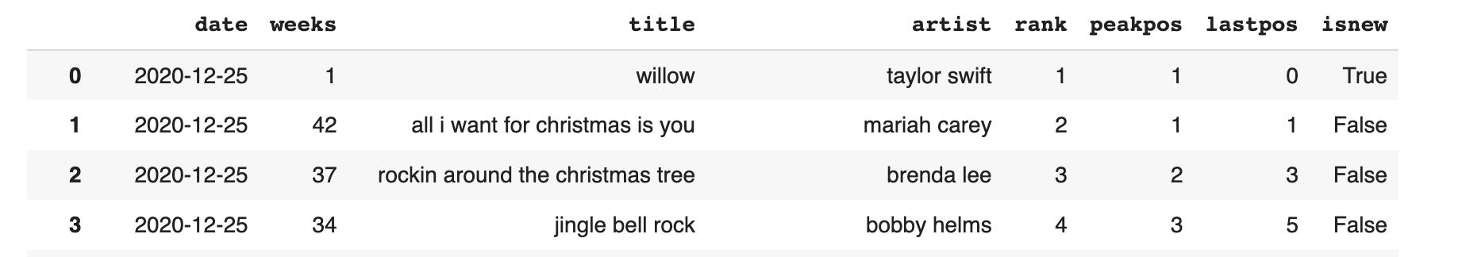
Worldwide Music Rank
Content:
Location:
United States
France
United Kingdom
Notes:
For the music rank, it contains information like song titles and artists.
To make more comprehensive analysis, we used a total of three datasets for different countries.

Slide 6
Music Metadata
Acousticness
Duration
Danceability
Liveness
Energy
Loudness
Valence
Instrumentalness
Notes:
The metadate sets includes some characteristic information for the music such as energy and duration.

Slide 7
Music Metadata
Spotify Audio Data
Million Song Data
Notes:
For these information, we took the union of Spotify Audio data and Million Song dataset that we got from there official API

Slide 8
Analysis & Visualization
HOME
TABLE OF CONTENTS
PLAYLIST
01
Motivation & Objective
02
Datasets
03
Analysis & Visualization
04
Prediction
THANKS!
Key Feature Analysis
Cross Country Analysis
Notes:
We then move onto the Analysis and visualization part, including individual country’s Key feature Analysis and Cross country analysis.

Slide 9
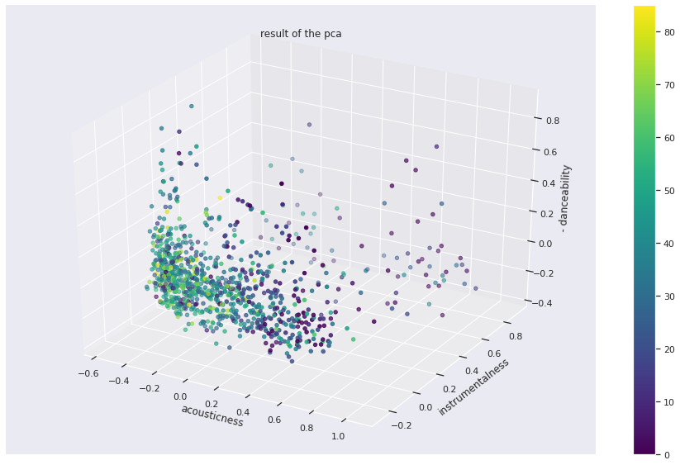
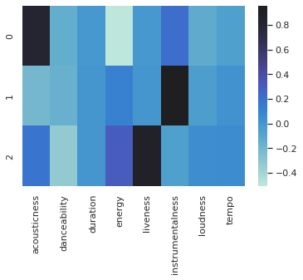
US Data: Principal Components Analysis (PCA)
Notes:
We first put focus on US data where we utilize Principal Components Analysis.
PCA can help to project high dimensional data point onto the lower dimensional space, while preserving as much of the data’s information as possible.
Doing so, we observed 3 main axes. (click)
On the left hand correlation map, where darker the color means stronger the relationship.
(click) under the rightmost column, we notice a strong color contrast between energy feature and accousticness feature. It means that these two feature are inversely related.
(click) Move on to the middle column. There are no distinct color contrast, hence there are no dependency on the instrumentalness feature. As you can see on the right hand diagram, the data points are pretty scattered in this direction.
(click)The third column shows negative correlation between liveness and Danceability rate

Slide 10
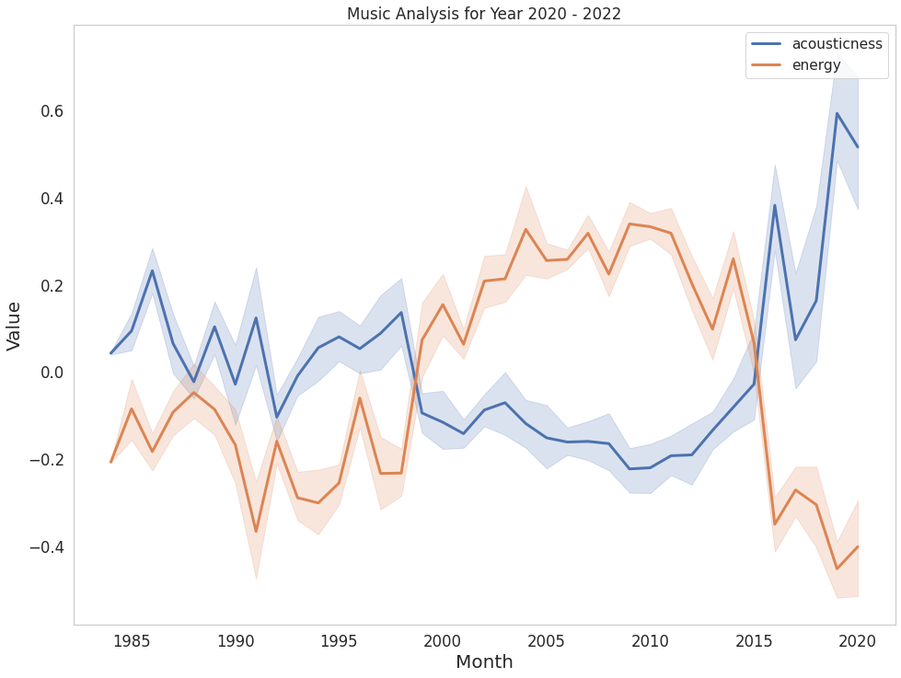
US Data: Features Analysis
Intuitively, Acouticness and Energy rate have inverse relationship, which is also proved in the billboard dataset.
Notes:
Among those three components, we further dig into the the relationship between Accousicness and energy by plotting out their actual value changes over the years.
As we can see on the diagram, their changing tend show an inverse relationship.
This also matches with our intuition, since a high acoustic music might be less intense on the energy.

Slide 11
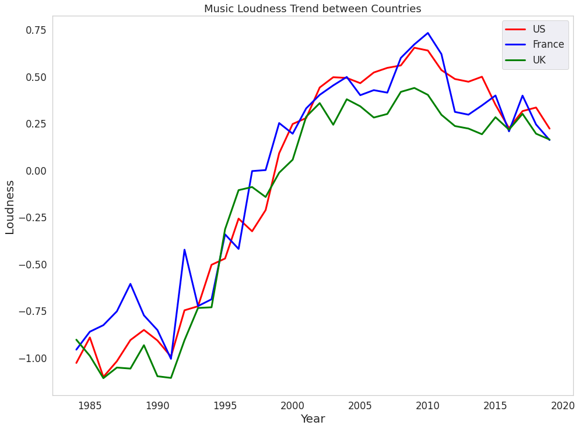
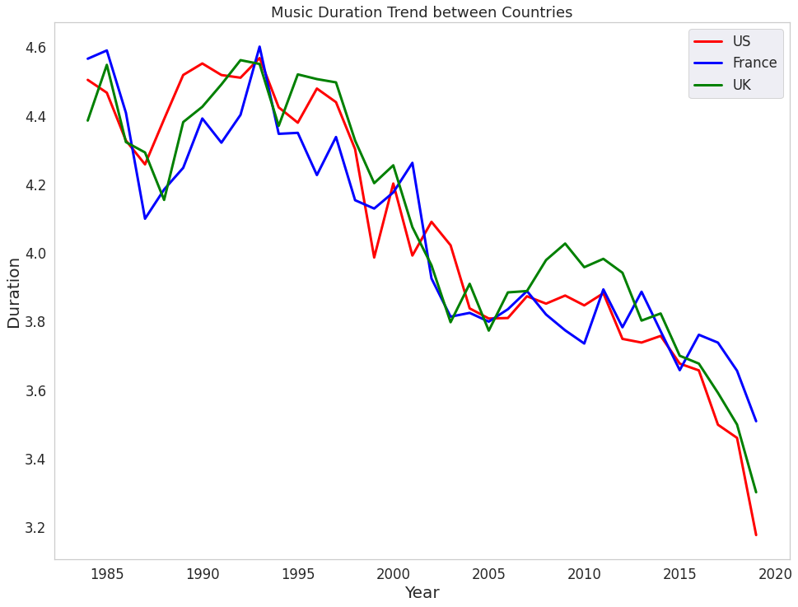
Cross Country Music Trend: Similar Change
Increasing Trend：Loudness
Decreasing Trend：Duration
Notes:
Now we move on to cross country analysis, where we notice some similar trends between three countries.
Such as the decibel of three countries popular songs are gradually increasing over the years.
Whereas the duration are decreasing as time goes by.

Slide 12
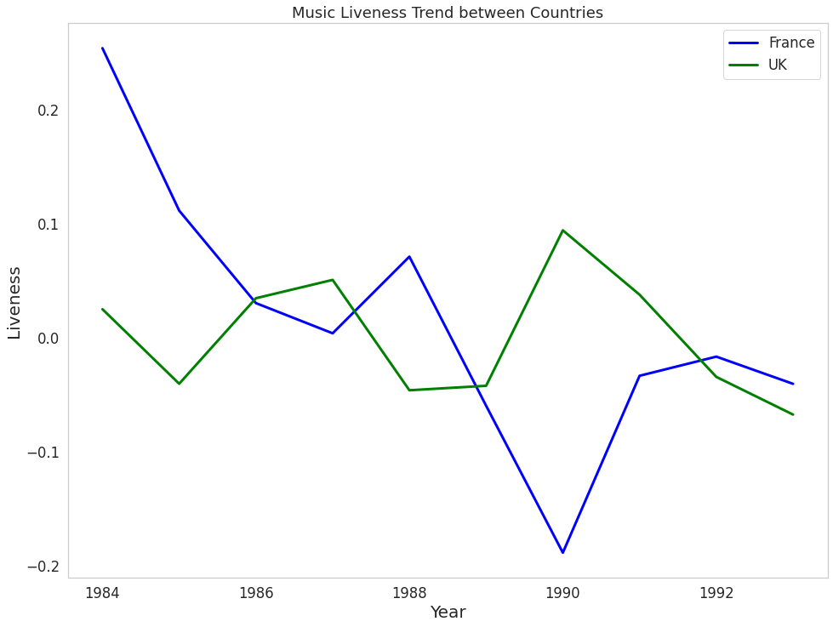
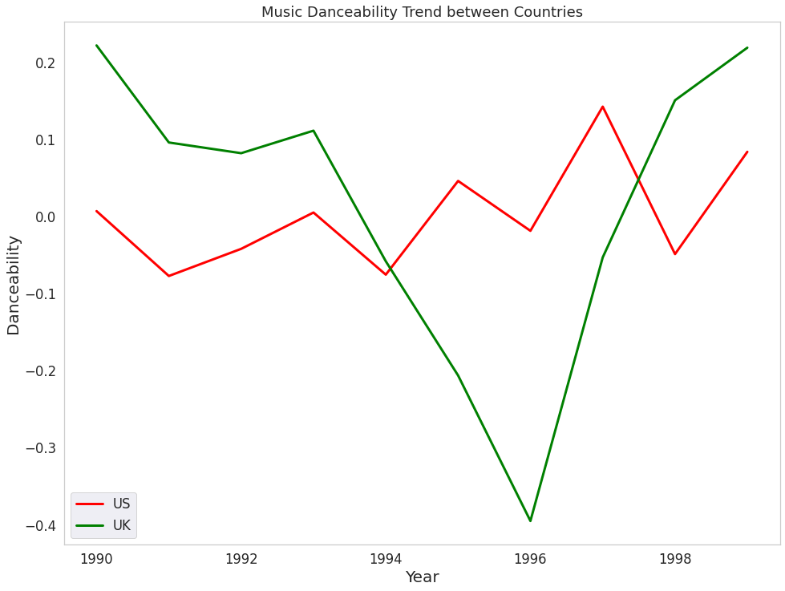
Cross Country Music Trend: Inverse Change
Liveness
Danceability
Notes:
In contrast, we notice some inverse trends.
(Click) In late 20th century when the liveness of French music drops, music with high liveness rate is rather popular in UK.
(Click) Further, US and UK also have a inverse relationship on danceability rate around 1995 - 1998

Slide 13
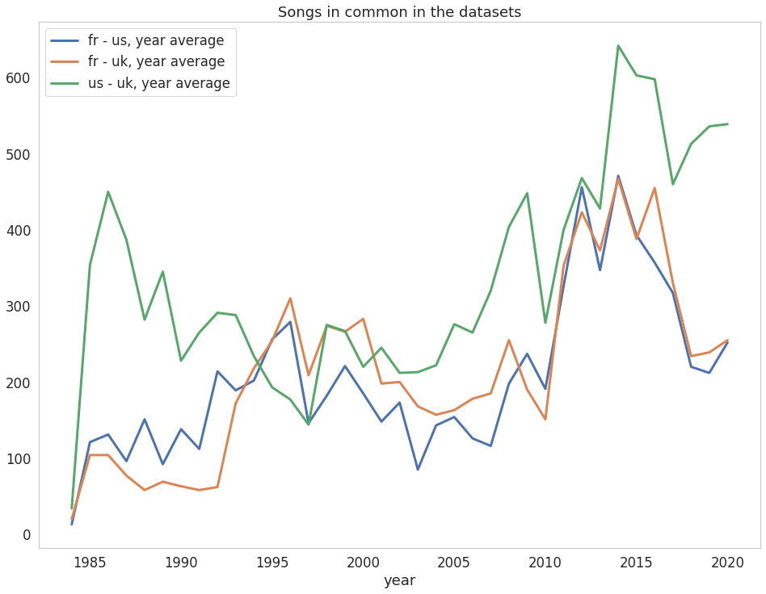
Cross Country Analysis: Common Songs
Notes:
With table joins, we also plot out a diagram making pairwise comparison on number of common songs between countries.
As an example, on 1985, (Click)
The green curve is above the other two because US and UK shares the highest count of common songs among three pairs.

Slide 14
Cross Country Analysis: Common Songs
US - UK curve is above the other two, confirming the theory of a "language barrier"
Notes:
Before the 90s, US and UK curve is above the other two, reflecting the theory of a "language barrier", meaning that songs can be shared more easily between countries that use the same language.

Slide 15
Cross Country Analysis: Common Songs
Cross country curves shows high correlation after 2010s
Notes:
At the beginning of 21st century, as social media develop, we see three lines move in a very similar way with less distance between. Suggesting a popular song can be shared in a world wide range easier than before.

Slide 16
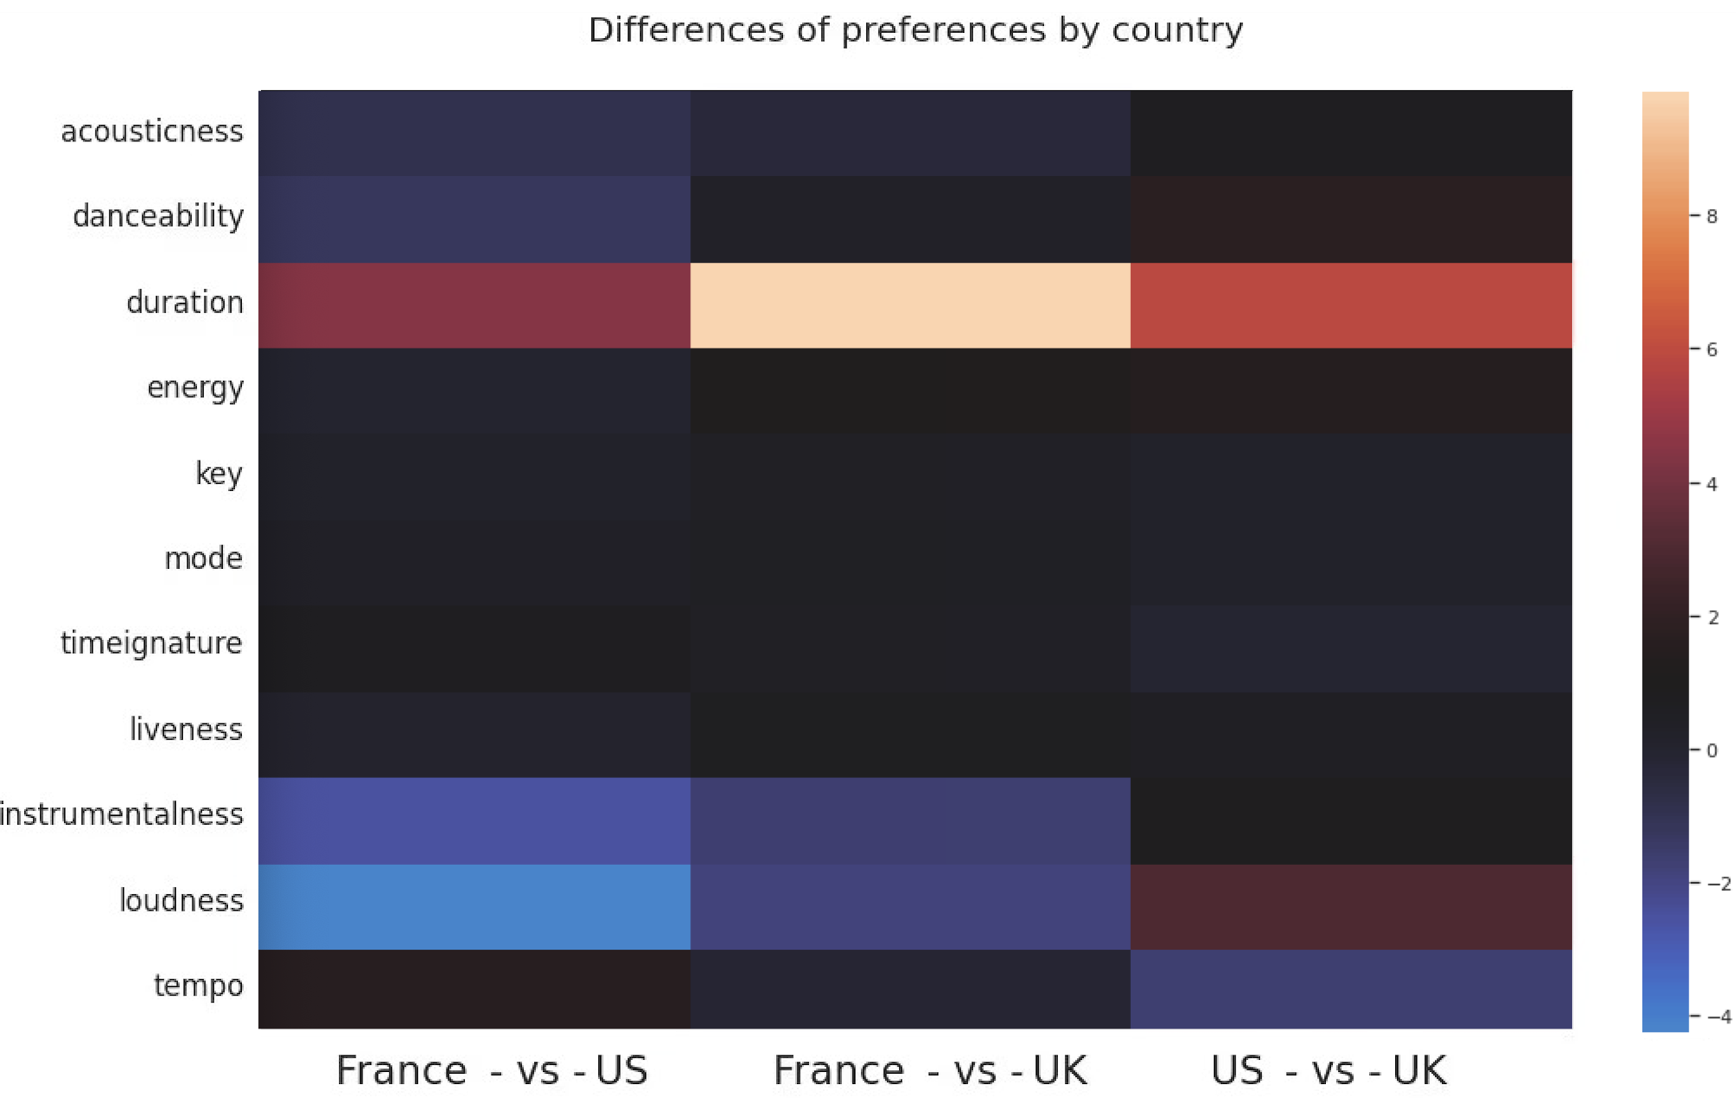
Cross Country Analysis: Preference Difference
No Preference:
Liveness
Danceability
……
Notes:
Using the Linear disctimation Analysis, we were able to separates two classes out of the 12 features from metadata.
Where in the diagram on the left hand side, the lighter the colors means larger the preference difference between two countries.
As a result, we rule out a group of features that three countries show no preference with, such as liveness and danceability.

Slide 17
Cross Country Analysis: Preference Difference
No Preference:
Liveness
Danceability
……
Distinct Preference:
Loudness: US < UK < FR
Duration: UK < FR < US
Notes:
However, on the loudness, France shows strong preference for louder music then UK and US.
Additionally, US prefer longer music than other countries.

Slide 18
Prediction
HOME
TABLE OF CONTENTS
PLAYLIST
01
Motivation & Objective
02
Datasets
03
Analysis & Visualization
04
Prediction
THANKS!
Feature Correlation
Model Selection
Notes:
With these findings, we starts our prediction task,
given a random number of music, we want to predict how many of them can show up on popular list.
This process includes feature correlation and model selection.

Slide 19
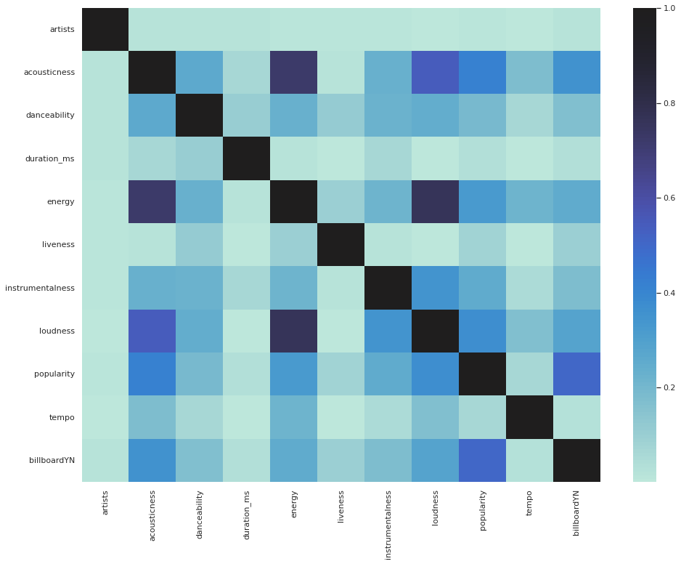
Feature Correlation
Duration VS Others
Notes:
Using the US data as example, in the correlation heatmap, where darker the color means stronger the relationship (Click)
we notice that the duration and tempo of a song seems to have no correlation with the other parameters. Hence they are dropped out from prediction.

Slide 20
Feature Correlation
Duration VS Others
Loudness VS Energy
Notes:
On the contrary, loudness and energy are heavily correlated.

Slide 21
Feature Correlation
Duration VS Others
Loudness VS Energy
Billboard
VS
Popularity/Acousticness
Notes:
Here, BillboardYN contains boolean value 0 and 1 to denote whether if the music can show up on billboard or not. （click）
This key column seems to have positive correlation with accousticness rates and popularity on Spotify platform.

Slide 22
Model Selection
Classification -> Logistic Regression
# of Songs
Not On List
# of Songs On List
No
Yes
Notes:
For model selection, since our task is to output a classification result. We therefore chose logistic regression model.

Slide 23
Prediction Result
UK
US
France
Prediction
Accuracy
78%
80%
89%
Y | 72% | 77% | 80%
N | 28% | 23% | 20%
Ground
Truth
Notes:
After prediction, we ends up with 78% accuracy for UK’s data, 80% percent for US data and 89% for France data, comparing with the ground truth percentage below.

Slide 24
Prediction Result
US
80%
8.0% on Spotify Popularity
0.82% on Acousticness
Notes:
We further calculate the performance loss after removing individual features.
For US data, removing Spotify popularity feature leads to largest loss of 8%, then is the accoustiness with point 8 two percent loss.
Such importance is also indicated on the correlation map as we have shown before

Slide 25
Conclusion
In US data, we found that Energy and Acousticness are inversely related.
Distinct preference between countries’ music taste
Predictive analysis on music’s popularity
Notes:
In conclusion,
based on US Data analysis, we found that energy rate and acousticness are inversely related.
In cross country analysis, there are distinct music preference. Such as France prefer loader music and US prefer shorter songs.
Last but not least, our prediction model generate relatively accurate result, which can help others to understand the reason behind song’s popularity.

Slide 26
Future Work
Expand Cultural Diversity
Make Prediction on Specific Rank
Notes:
In the future we should consider include countries with different culture background. Doing so might allow us to find other exciting trends.
Second, In the future, with more advanced models, we can also try to predict song’s specific rank number.

Slide 27
Thanks!
HOME
TABLE OF CONTENTS
PLAYLIST
01
Motivation & Objective
02
Datasets
03
Analysis & Visualization
04
Prediction
Do you have any questions?
THANKS!
Notes:
This concludes our presentation. Thanks for your time and let us know if you have any questions

