Slide 1
Software Architecture for Distributed Systems
Goals:
understand various architectural styles for distributed systems
review design patterns applicable to construction of distributed systems

Slide 2
Software Architecture
Why is architecture important?
in a well-designed system (and not all are), architecture decisions are the first ones made, influencing
what the key elements of the system will be
how the functional requirements will be partitioned among those elements
what the inter-element communication paths will be, influencing how (or even whether) the non-functional requirements will be achieved

Slide 3
Software Architecture
Software architecture defined:
elements + interactions + patterns of composition + constraints (Shaw and Garlan)
constraints are the nonfunctional requirements, also known as quality attributes
performance
reliability, availability
scalability
security
and all of the transparency goals discussed previously

Slide 4
Software Architecture
Software architecture should
reduce change propagation: if one part of the system is changed, other parts should be minimally affected
be built with well-defined modules
partitioning, again
have well-defined interfaces
no side effects

Slide 5
Client-Server Architecture
Client-server is the classic distributed system architecture
server listens for requests
client interacts with user, sends requests to server, receives responses back
asymmetric design: typically, multiple clients, one server
but: multiple servers are possible for load balancing/performance

Slide 6
Client-Server Architecture
Both client and server should separate the communication element from the rest
client deals with user’s requests, calls client-side proxy with request
proxy is in charge of packaging data, knowing where and how to send the request, receiving and unpacking the answer
server and server-side proxy operate similarly

Slide 7
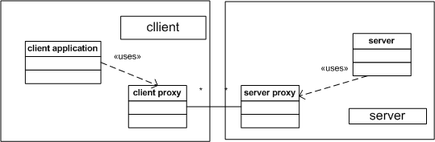
Client-Server Architecture
Typical client-server structure

Slide 8
Client-Server Architecture
How the communication actually is implemented is independent of the client-server style
explicit message passing via, for example, TCP/IP
some other messaging method, like a message queuing system
remote procedure call
remote method invocation
As noted above, these details are encapsulated in the proxies

Slide 9
Broker Architecture
In client-server, it is assumed that the client knows where the server is located
may be hard-coded, or
a runtime parameter, or ...
A broker architecture adds a middle component that:
provides look-up services for multiple clients
allows servers to register services
may, or may not, mediate communication between client and server (e.g., a filter)

Slide 10
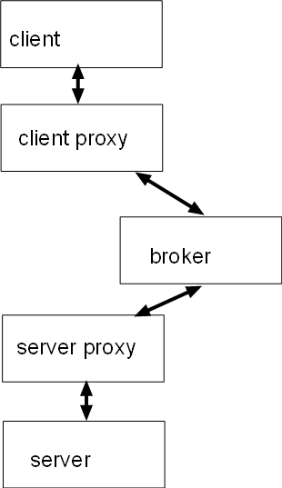
Broker Architecture
Broker structure

Slide 11
Broker Architecture
Brokers add a layer of communication overhead
but that can be leveraged, e.g., to filter communication
proxy can add security (e.g. logging) or some other secondary service
Services must conform to an interface
can then provide multiple instances of the same service and choose, for example, by location or load

Slide 12
Publish-Subscribe Architecture
Publishers place event notices on a common bus
where “bus” may be implemented in several ways
Subscribers register their interest in types of events
event notices are delivered to subscribers
no direct connection between publishers and subscribers

Slide 13
Publish-Subscribe Architecture
Pub-sub structure
publishers can be subscribers and vice versa
publisher
subscriber
messages
event bus
publisher
subscriber

Slide 14
Publish-Subscribe Architecture
As in a broker, an intermediary manages the connections: event service module
space decoupling: publishers and subscribers have no knowledge of each other
time decoupling: event processing may not happen immediately after event publishing
synchronization decoupling: publishers don’t block, and subscribers are notified asynchronously

Slide 15
Publish-Subscribe Architecture
Publish-subscribe concerns
specification of events and interest: who answers a publish event?
exact-match
regular-expression based matching
queuing of events versus dropping unhandled events
event priorities
causality and temporal ordering of events

Slide 16
Peer-to-Peer Architecture
Every client is also a server
spreads the load among all participants (ideally)
how does a peer find data and/or services among other peers?
centralized directory server
distributed directory servers
no directory: flood the network with a request

Slide 17
Peer-to-Peer Architecture, cont.
How are peers connected?
unstructured: new peer (as a client) gets a connection to the node (server) it originally asked
new connections are added dynamically as a result of queries/responses, without thought to overall topology
structured: overlay some logical connections over top of the unstructured layout
some useful topology is created by the overlay
still uses underlying network for actual communication

Slide 18
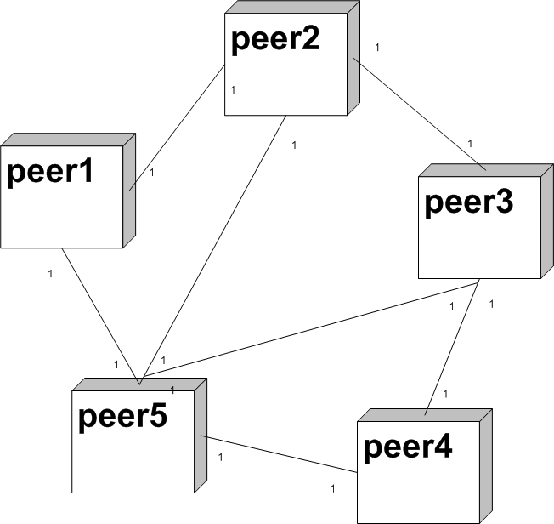
Peer-to-Peer Architecture, cont.
peer-to-peer unstructured

Slide 19
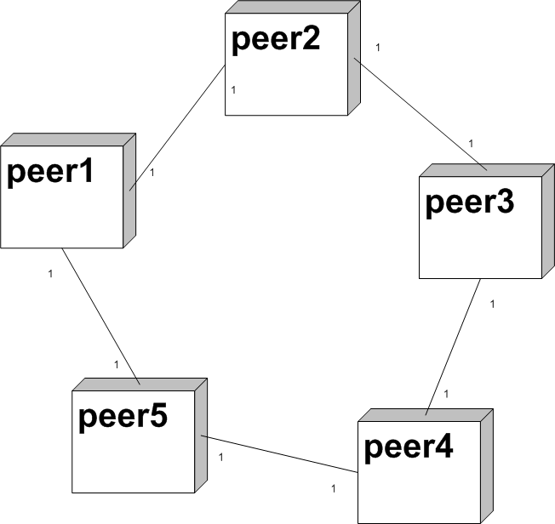
Peer-to-Peer Architecture, cont.
peer-to-peer structured (ring)

Slide 20
Peer-to-Peer Architecture, cont.
Overlay network
this is a logical network built on top of an existing network (e.g. the Internet)
the logical connections take some different form for some good reason
multicast tree: instead of using IP multicast, create a logical tree of nodes plus a signaling protocol
ring: connect each machine to predecessor and successor nodes (with cheater chords, too); distributed hash tables map keys to machines
supernodes: head node connects to other head nodes; responsible for a set of regular nodes; Skype setup

Slide 21
Layered Architecture
Layering comes in two styles
vertical structure for a particular component or application: same machine
distribution of components across machines: tiered architecture
both use the same basic ideas
insulation of layers from each other
independent structures within layers
explicit interfaces
(usually) one-way communication: down only

Slide 22
Layered Architecture, cont.
Lower layer should not know anything about the layer above it
upper layer uses lower one as a service
upper layer only knows the interface; internal details should be hidden
Within a layer, some other partitioning is possible (or none: collection of cooperating objects)

Slide 23
Layered Architecture, cont.
Layering choices
upper layers are higher levels of abstraction; lower layers are more implementation oriented => e.g. OSI communication model, or layered operating systems
presentation/application logic/persistent storage (ordered by rate of likely change)
policy/method or implementation

Slide 24
Layered Architecture, cont.
Distributed version of layering
recall the client-server architecture: which parts of an application belong on the client, which parts belong on the server?
layering is independent of the distributed architecture
C&C style versus module style
should other layers be involved?
three tier business application model: user interface, business rules, storage
each layer can be on a different machine

Slide 25
MVC Architecture, cont.
User interfaces are more likely to change faster than the data model
presentation of data may take several forms, even simultaneously
input or change of data relies of specific UI widgets
data model is often set at analysis time, with few, if any, changes

Slide 26
MVC Architecture, cont.
MVC separates the architecture into three parts: model (data), view (output), controller (input)
Views and, optionally, the controllers register themselves with the model
Model receives input from the controllers, then ...
... sends update notices to the views, which ...
... request new data from the model to be displayed

Slide 27
Pipe and Filter Architecture
Data stream processing can often be broken into multiple, discrete stages: filters
Connections between filters are communication methods: pipes
Conceptually, a filter reads a data item from its input pipe, processes it, and writes it to its output pipe
In practice, the filters may read batches of data, and the pipes may or may not queue individual data items

Slide 28
Pipe and Filter Architecture, cont.
In practice, filters may be:
functions if small
components if large
Likewise, pipes may be:
function calls with parameters
interprocess communication methods, e.g. UNIX pipes
message passing, for distributed filters

Slide 29
Repository Architecture
In pipe-and-filter, data is explicitly moved from/to pipes. A more general method is to decouple the filters from their pipes by using a central, shared storage area: a repository
components know which data they are interested in
changes in data (state changes) can trigger other components – like MVC – or not
if trigger: blackboard, where processes poll
if not: repository

Slide 30
SOA Architecture
Service Oriented Architecture
original motivation: legacy applications (including databases) needed some service connection to new applications => reuse
discovery, composition, and invocation are enabled by the SOA infrastructure

Slide 31
SOA Architecture, cont.
Technologies used to bind consumers and services
Web Services: HTTP, SOAP, WSDL
message-oriented middleware: IBM Websphere MQ
Infrastructure should enable:
Quality of Service (QoS) requirements
service discovery
data transformation

Slide 32
SOA Architecture, cont.
application
portal
SOA infrastructure
security discovery
transformation
service1
service2
service3
ERP
legacy code
new code

